Slide 1
Resource Sharing Frontiers
Massachusetts Library System
ALA 2015 – San Francisco

Slide 2
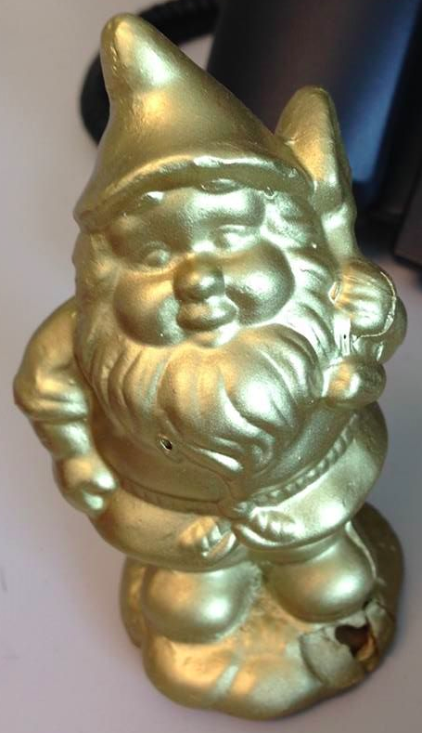
Massachusetts Library System
About Us
Stronger Together
State-funded
Nonprofit organization
1600+ member libraries
Multi-type

Slide 3
Resource Sharing Programs
Commonwealth eBook Collections
MassCat
Mediated ILL
Statewide Databases
Statewide eBook program
Small, multi-type library network
ILL processing center
400+
70+
500+
Delivery
Statewide courier service
500+
1600+

Slide 4
Two Big Initiatives
Commonwealth eBook Collections
Interstate Delivery

Slide 5
Collections
Partners
Library Networks
Participating Libraries

Slide 6
FY 2016 Goals
User Experience
Library Training and Engagement
Building Program Value
Publisher Connections
More than content
Product enhancements
eBook discovery
More training – face to face and virtual
Comicon
Strategic meetings
School Library Curriculum
SELF-e

Slide 7
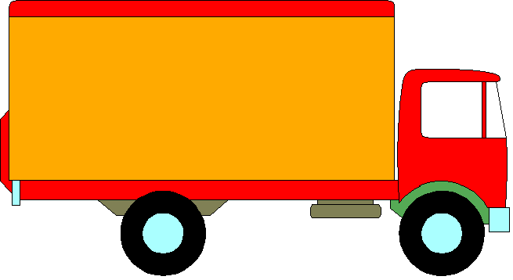
Partners: Optima Shipping ~ Automated Resource Sharing Networks

Slide 8
In the works…
Regional Resource Sharing Symposium, February 2015
NEXT: Interstate Pilot, 2016
NIBBLES: CT, ME, NY, RI

