Slide 1
California State University Libraries of the Future Taskforce Update Print Archive Network Forum/ALA MW
January 25, 2013

Slide 2
LOFT (Libraries of the Future Taskforce)
Chancellor’s Office Initiative
Prompted by Education Advisory Board report
LOFT membership includes
Provosts
CIOs
Chancellor’s Office staff
Faculty in several disciplines
University Librarians
Print Management is one of three components

Slide 3
CSU = An Excellent Laboratory
Scale
LA basin libraries pilot (6)
Entire CSU system (23)
Geography
Central funding
Administrative mandate
A track record of collaboration

Slide 4
SCS Role
Provide tools & services: data management, analysis & interpretation
Develop and propose scenarios based on group’s preferences
Facilitate discussions and decisions
Quantify the yield and trade-offs associated with various strategies
Help the non-librarians in LOFT understand the library’s context

Slide 5
Project Scope: LA Basin Libraries
Primary focus: Circulating print monographs
Reference books
Juvenile books
Out of Scope
eBooks (may be discussed further)
Government Documents
Non-print
Maps, Scores
Journals
Special Collections

Slide 6
Assembling the data (July 1-31)
Bib, item & circulation data
Individual calls on scoping, data mapping and technical issues with all 6 libraries
4-5 people from each library on the calls
Excellent responsiveness, sharing of expertise
Innovative Interfaces (system vendor) very helpful in adjusting data export profiles
1-2 days’ effort per library

Slide 7
CSU Data Set
Library | Bib Records Received | Filtered Bib Records
Dominguez Hills | 384,752 | 380,584
Fullerton | 695,567 | 683,025
Long Beach | 627,417 | 614,951
Los Angeles | 681,923 | 659,375
Northridge | 790,736 | 758,984
Pomona | 485,025 | 478,402
Total | 3,665,420 | 3,575,321

Slide 8
Preparing the libraries’ data
Bibliographic, item, circulation, and holdings data extracted, transformed, loaded (ETL process)
Eliminate duplicate bib records
Normalize call numbers
Eliminate trailing spaces in control numbers
Validate OCLC numbers
Match bib records on OCLC number (with title-string check)
LCCN/title-string lookups for records lacking OCLC#
Identify and accommodate unusual implementations of MARC (local call # typically in 090 --- one pilot library stores some in 099, etc., etc.)
Filter out-of scope bib records (eBooks, maps, scores, DVDs, Gov Docs)

Slide 9
Categories of bib records filtered out
Government documents
Record type not ‘a’ (non-language materials)
Bib level not equal to ‘m’ (non-monographic materials)
Non-print resources (videos, sound recordings, eBooks)
Unable to obtain an OCLC number
Bib title or author mismatch with OCLC record
Multiple OCLC numbers in the local record

Slide 10
Shared Circulation History?
Library | Circ Data from | Number of Years | Earliest Last Charge Date
Dominguez Hills | 2002 | 10 years | 2001-05-12
Fullerton | 1988 | 24 years | 2000-01-03
Long Beach | 1993 | 19 years | 2000-01-04
Los Angeles | 1993 | 19 years | 2000-01-03
Northridge | 1980 | 32 years | 2000-01-03
Pomona | 1990 | 22 years | 2000-01-03

Slide 11
WorldCat™ Holdings
SCS licensed access to WorldCat API
WorldCat™ holdings
US, State Holdings
Peer Holdings LA Basin
Peer Holding: other CSU
Peer Holdings UC
SkyRiver

Slide 12
CSU: LA Basin Libraries Database
Bib, circ & item data from each library, normalized & supplemented with WorldCat holdings in specified categories
Data from individual libraries combined into group ‘roll-up’
Held in SCS postgresql database in AWS cloud
SCS queries against the group database using the PG Admin client
Output: Group Collection Summary & lists

Slide 13
Group collection summary: first iteration delivered 9/18/12

Slide 14
By “titles” we can mean two different things
1. Title Set
Dominguez Fullerton Long Beach Los Angeles Northridge Pomona
2. Title Holding
Notes:
California in the New Millennium: The Changing Social and Political Landscape,
Publication Year 2000 (Paperback version 2002)
This Title is held by all 23 CSU Libraries – we have details on the 6 in the Pilot Group

Slide 15
Each “Title-Holding” has different characteristics
Dominguez Hills
Fullerton Long Beach Los Angeles Northridge Pomona
Total Circulations
0 circs 19 circs 16 circs 12 circs 13 circs 8 circs
Last Circulation Date
-none- 11/30/11 12/16/08 5/30/07 4/27/07 3/11/08
Date added to Collection
6/27/02 4/23/02 9/21/01 5/03/00 11/11/02 8/11/00

Slide 16
Pilot Group Holdings and Avg Total Charges by LC

Slide 17
Holdings Within Group by Publication Year

Slide 18
Please Note
The following slides outline only the facets of the data that were explored.
Specific results will be released after additional vetting & discussion among the participants
Graphs are based on sample data & intended only to demonstrate concepts, not to reflect CSU’s specific activity.

Slide 19
Circulation Counts
 | CSU Library Title-Holding Counts | All Libraries | Percent
1 | All Title Holdings - Filtered | 3,575,321 | 100%
2 | Total Charges = 0 (all available circ data)
3 | Total Charges = 1 to 3 (all available circ data)
4 | Total Charges = 4 to 9 (all available circ data)
5 | Total Charges = 10+ (all available circ data)
6 | Last charge after 2010
7 | Last charge after 2007
8 | Last charge after 2005

Slide 20
WorldCat™ Counts
 | CSU Library Title-Holding Counts | All Libraries | Percent
1 | All Title Holdings - Filtered | 3,575,321 | 100%
9 | 0-9 Holdings in USA
10 | 10-19 Holdings in USA
11 | 20-49 Holdings in USA
12 | 50-99 Holdings in USA
13 | 100-199 Holdings In USA
14 | 200+ Holdings in USA
15 | 0-9 Holdings in California
16 | 10-49 Holdings in California
17 | 50+ Holdings in California

Slide 21
Overlap within LA Basin Group
 | CSU Library Title-Holding Counts | All Libraries | Percent
1 | All Title Holdings - Filtered | 3,575,321 | 100%
18 | Title-holdings present in 1 library
19 | Title-holdings present in 2 libraries
20 | Titles-holdings present in > 2 libraries
21 | Title-holdings present in 3 libraries
22 | Title-holdings present in 4 libraries
23 | Title-holdings present in 5 libraries
24 | Title-holdings present in 6 libraries

Slide 22
Overlap with other CSU Libraries
 | CSU Library Title-Holding Counts | All Libraries | Percent
1 | All Title Holdings - Filtered | 3,575,321 | 100%
25 | WorldCat holdings set in 1-5 more libraries
26 | WorldCat Holdings set in 6-10 more libraries
27 | WorldCat Holdings set in 11-17 more libraries
* | WorldCat Holdings set in all 23 CSU libraries

Slide 23
Date Related Counts
 | CSU Library Title-Holding Counts | All Libraries | Percent
1 | All Title Holdings - Filtered | 3,575,321 | 100%
30 | Publication Year before 2005
31 | Publication Year before 2000
32 | Publication Year before 1990
33 | Last Item Add-Date before 2005

Slide 24
Hathi Trust and CHOICE Matches
 | CSU Library Title-Holding Counts | All Libraries | Percent
1 | All Title Holdings - Filtered | 3,575,321 | 100%
34 | Hathi Trust Public Domain Match
35 | Hathi Trust In-Copyright Match
36 | Reviewed in CHOICE

Slide 25
Sample Scenarios: Calculating the opportunity

Slide 26
Uniquely Held Titles

Slide 28
Titles Published and Acquired before 2000 Shared Withdrawal Scenarios
 | 0 Circulations | 1 or fewer circulations | 3 or fewer circulations
Keep 1 Title-holding
Keep 2 Title-holdings
Keep 3 Title-holdings

Slide 29
Discussion and next steps

Slide 30
Design of Broader Project?
Space goals? Required yield?
Desired service levels (delivery time)
Single CSU Collection? Three Regions?
Archive copies vs. Service copies
CSU ‘unique’ titles: how to handle
Retention commitments?
Preservation commitments (in what context?)
Role/relationship with UC system? Regional partners?

Slide 31
Defining Criteria for Shared Print
How will decisions be made?
Allocation of retention commitments & withdrawal opportunities: on what basis?
How many title holdings should be retained in the system? In each region?
Is it appropriate for some titles to be discarded from the CSU system?
Legal aspects? MOU needed?

Slide 33
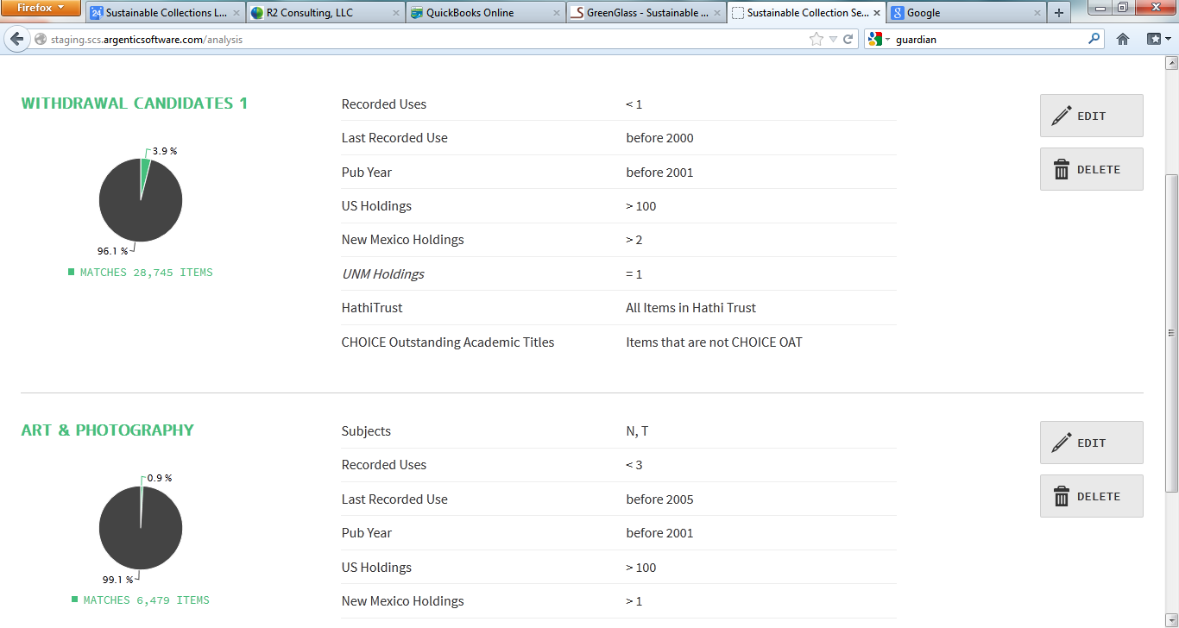

Slide 34
Conclusions
Data and scenario modeling improve decision-making
Use of third-party services expands capacity and speeds up the process
Tools and services still evolving

Slide 35
Contact Info
http://sustainablecollections.com
rick@sustainablecollections.com
Twitter: @SCSinsight; @ricklugg

