Slide 1
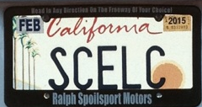
SCELC and Shared Print A New California Adventure
Print Archive Network Forum
ALA Midwinter
Philadelphia, PA
January 24, 2014
Rick Burke
Executive Director, SCELC

Slide 2
What Is SCELC
The Statewide California Electronic Library Consortium
We have 110 mostly small and medium-sized private academic and nonprofit research member libraries throughout the state, plus one in Nevada and six in Texas
Aggregate Member FTE is 278,714
Aggregate Member Materials Budget: $75.7 million
Members collectively licensed >$31 million in e-resources in FY13

Slide 3
Why Shared Print
SCELC was already a participant in the WEST program
Our strategic plan calls for the consortium to develop shared print programs to:
Preserve copies
Identify unique copies, prevalent copies
Develop processes to share books among member libraries

Slide 4
Feasibility Study
Feasibility study exploration authorized by SCELC Board in June 2013
Bob Kieft and the SCELC Resource Sharing Committee drafted proposal for the study
SCELC hired Lizanne Payne as its Shared Print Consultant to assist with the expansion of the study
This included the creation of shared print survey whose results were just gathered this past week

Slide 5
Goals of the SCELC Study
Understand SCELC members’ readiness to participate in a shared print agreement
Study composition and use of SCELC member print collections
Look at potential partnerships with other systems
Develop proposals for addressing the long-term sustainability of the program
Understand user behaviors with respect to print and electronic books
Analyze costs of performing condition surveys for circulating materials

Slide 6
Challenges for SCELC
SCELC at its heart is an opt-in e-resource licensing consortium
We are a diverse group of very different types of libraries
We are not a system
Thus, it is a difficult cultural change to obtain library buy-in for a large scale shared print program for SCELC

Slide 7
The SCELC Shared Print Survey
The survey was designed to gather information about
Library identification and demographics
Library print collection size and plans
Consortium and shared print planning
Shared print goals
The survey will also share the final version of the shared print study
The survey was also shared with and circulated among the UC and Cal State (CSU) campuses

Slide 8
Preliminary Survey Results
Summary of responses
56 SCELC members
15 CSU libraries
7 University of California libraries plus the California Digital Library and two Regional Library Facilities, for a total of ten UC responses
1 non-affiliated library, Stanford University

Slide 9
Goals Surveyed
Importance of SCELC shared print program
Collaboration with UC
Collaboration with CSU
Reclaim Space or Preserve the Scholarly Record
Focus on Rarely-held or Widely-held Monographs

Slide 10
Goals Surveyed (2)
Importance of prospective collection development
Willingness to hold collections
Factors that would play the biggest role in willingness to participate

Slide 11
Next Steps
Perform initial comparative collection analysis
Identify optimal tools for collection analysis
Develop a framework for a shared print program, including policies, business models, services and governance
Explore with potential partners the establishment of corollary studies

Slide 12
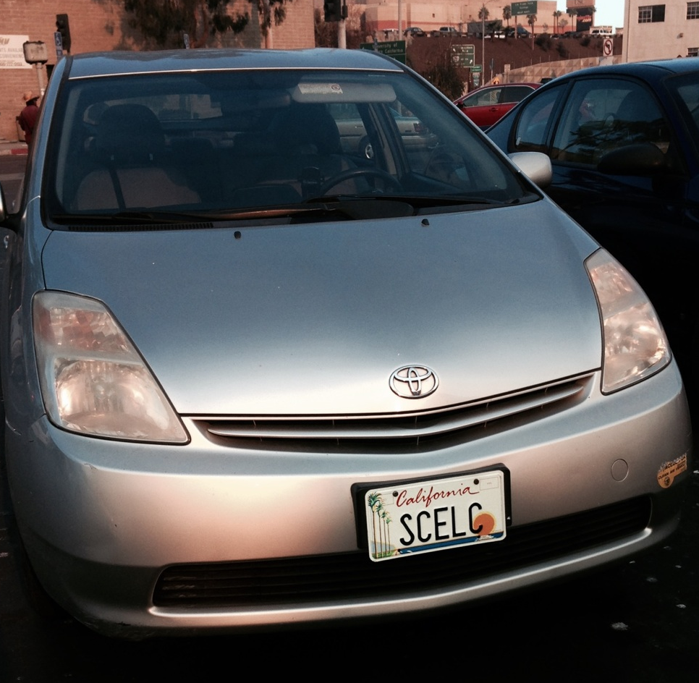
For Further Information
Rick Burke
rburke@scelc.org
Bob Kieft
kieft@oxy.edu

