Slide 1
JRNL: Journal Retention and Needs Listing
Judith C. Russell
Print Archiving Network (PAN) Meeting
Seattle, January 25, 2013

Slide 2
Background
The Association of Southeastern Research Libraries (ASERL) is creating a distributed print journal archive through its cooperative journal retention program (http://www.aserl.org/programs/j-retain/)
Purpose is to optimize collection management across the consortium
Retention agreement is in effect through December 31, 2035
To date 24 of the 40 ASERL libraries are retaining 3,089 unique titles through this program

Slide 3
Background, continued
Policies/options documented in brief (2 page) agreement (http://tinyurl.com/d2hx8vp)
Journals are retained by participating libraries
No central funding or central storage
No requirement for holding in off-site storage or without circulation
Participation can be discontinued with 24 months written notice
Multiple libraries may retain the same title
Simple letter of commitment (http://tinyurl.com/bzlv3ad)

Slide 4
Background, continued
Recent Development: ASERL and the Washington Research Library Consortium (WRLC) Agreement
Synchronized archiving policies for bound journals
Overlap/uniqueness analysis underway
ASERL = 3,800 titles held in multiple locations with varying conditions of storage and use
WRLC = 5,000 titles held at central facility in Maryland
WRLC & ASERL libraries can make long-term collection decisions based on the combined archive holdings

Slide 5
Background, continued
The State University System (SUS) of Florida is building a shared collection called FLARE: FLorida Academic Repository
Offsite storage in Gainesville managed by UF
Shared policy development and funding
http://csul.net/node/774
Journals retained in the FLARE collection are also being contributed to the ASERL distributed print journal archive

Slide 6
JRNL Tool
To avoid duplicative entry into databases for the two archiving programs, UF offered to develop software that would serve both ASERL and FLARE:
JRNL: Journal Retention and Needs Listing
Purpose is to track archived titles and identify missing volumes to facilitate filling gaps
It is open source software, available for modification and use by others

Slide 7
JRNL Tool, continued
Record ISSN, title, holdings and circumstances of storage and use for archived journals
Identify missing volumes (gaps)
Support journal weeding projects
Upload list of titles to be weeded
Receive report of titles already in storage with circumstances/conditions of use (circulation status, etc.)
Receive report of missing volumes to fill gaps

Slide 8
JRNL Tool, continued
Current Status: Live Pilot
1,153 Titles
150 Titles with complete holding records
179 Active gap records from 58 unique titles
Projected Release: February or March 2013
Survey of ASERL and FLARE participants in February to confirm/adjust terminology
Summit in Atlanta February 12th to refine software before release and identify requirements for future releases

Slide 10
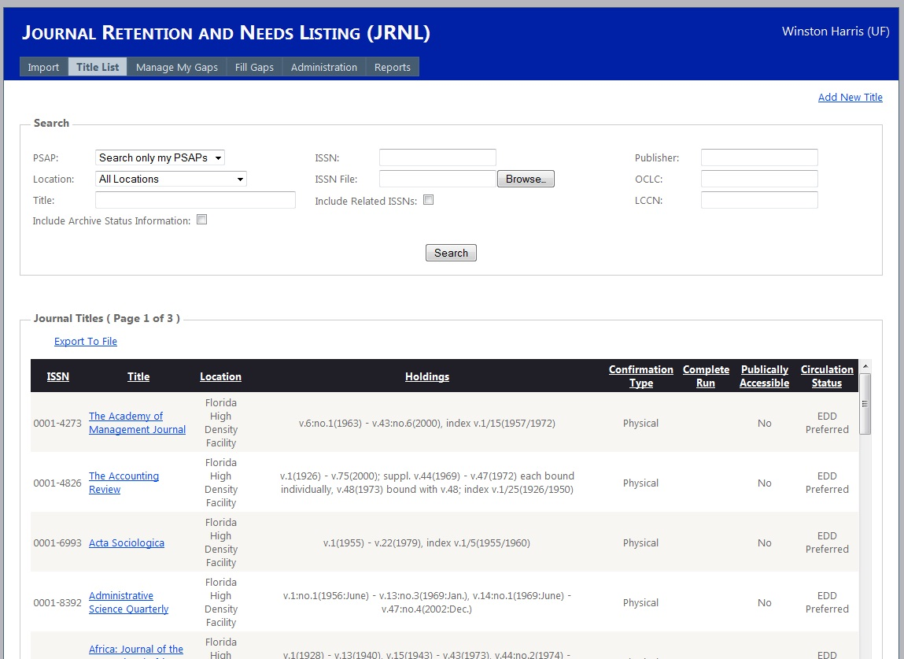

Slide 12
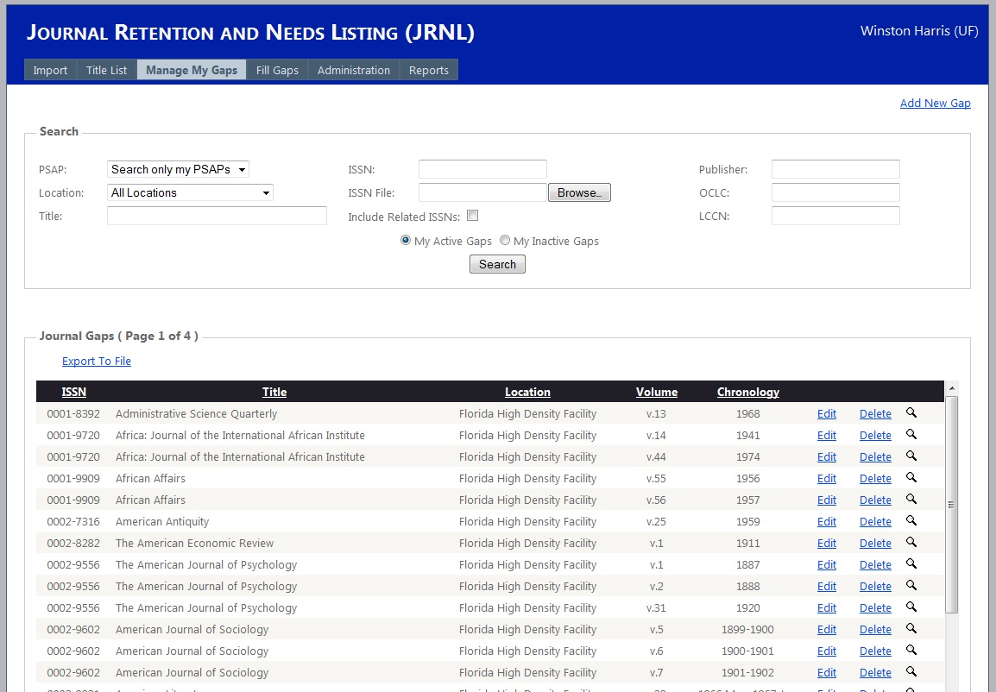

Slide 13
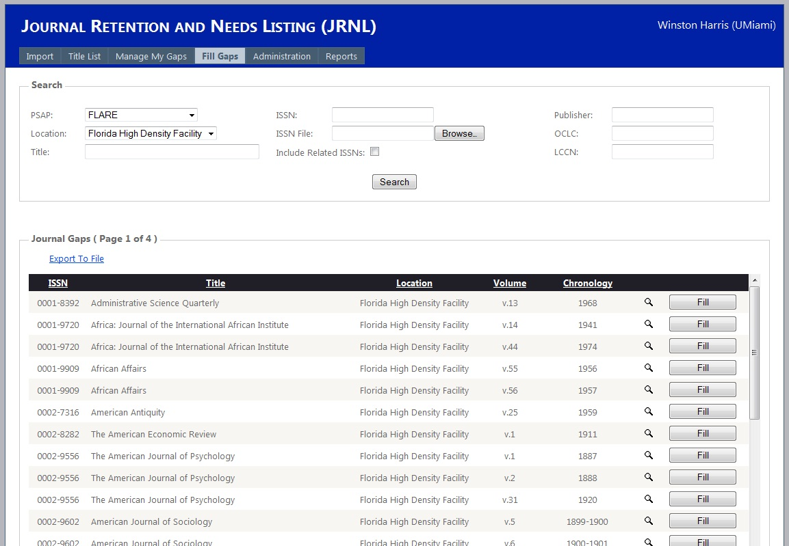

Slide 14
Additional Information:
Judy Russell, University of Florida jcrussell@ufl.edu; 352-273-2505
John Burger, ASERL Executive Director jburger@ASERL.org; (919) 681-2531
Website: http://aserl.org/

