Slide 1
VIVA - Collaborating to Build:
2015 ALA Midwinter
Print Archive Network Forum
Using Collection Analysis to Inform Consortial Collection Development
Genya O’Gara, Director of Collections
Libraries & Educational Technologies

Slide 2
What is the Virtual Library of Virginia (VIVA)?
VIVA
72 academic libraries - including doctorals, four years, two years, and specialized institutions.
Central funding provided by the Commonwealth of Virginia, additional cost-sharing by members.
Grounded in the coordinated collection development of online resources and an extensive resource sharing program.

Slide 3
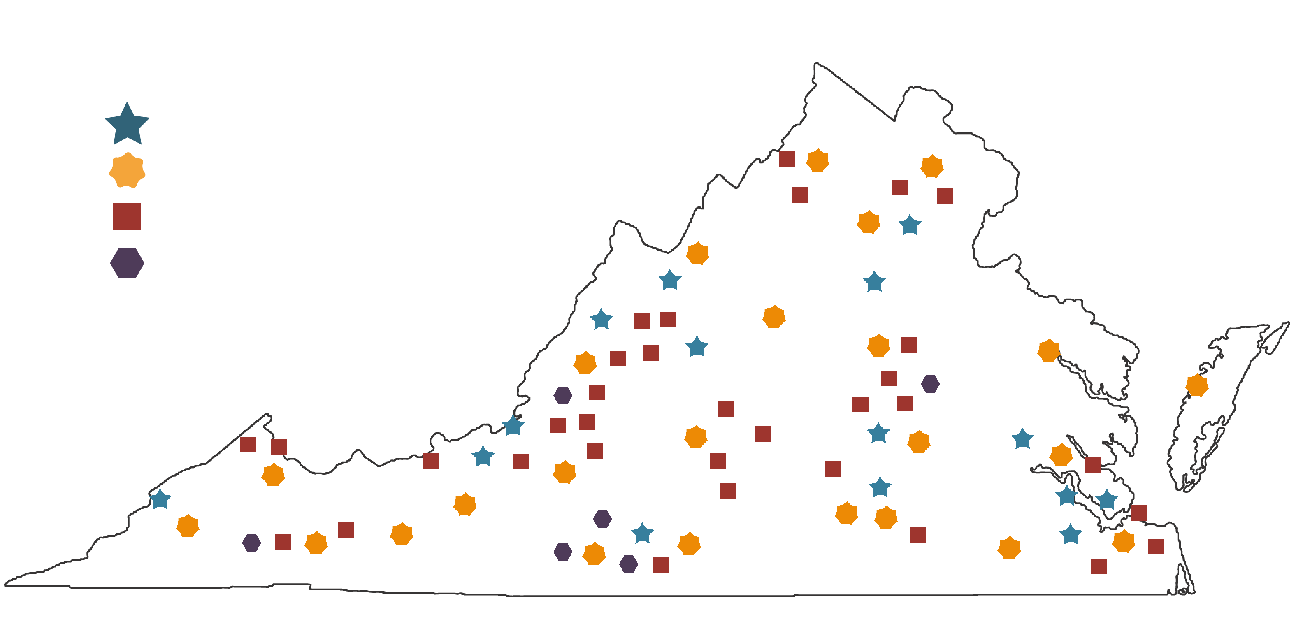
V
VIVA
www.vivalib.org

Slide 4
Background
BACKGROUND
Virtual Library of Virginia
VIVA Steering Committee
Collections Committee
Monographic Collection Analysis Task Force

Slide 5
Task Force Makeup
BACKGROUND
12 participants
Notes:
.

Slide 6
Task Force Approach
BACKGROUND
Sustainable Collection Services (SCS) selected to analyze data
Previous work with VIVA members
Experience with consortial level analysis
6 million records

Slide 7
Project Goals:
BACKGROUND
Pilot a coordinated, consortial approach to collection assessment
Use data and analysis to inform future, collaborative collection development
Identify scarcely-held titles in need of protection
Discuss approaches to reducing consortial title duplication & local space savings through weeding

Slide 8
A Different Approach
BACKGROUND
Not just about weeding and preservation!
Primary interest was to inform collection development!
Use the analysis to figure out the “where’s” and “how’s”

Slide 9
DATA
Included in the Analysis
All circulating print monographs
English language only
Main library (no law libraries,
medical libraries, etc.)
LC classification only
6 million records

Slide 10
ANALYSIS
Initial Analysis
Examine widely held and highly and recently circulated titles
Examine shelf life to inform e-book acquisition models
Examine use patterns of print holdings of publishers acquired by the consortium in e-format
Identify parameters and approach for scarcely-held titles.
Look for local disciplinary strengths to inform future collaborative collection development.

Slide 11
Looking for Intersections
ANALYSIS
Highly circulated titles
Widely held titles
Identified Top
Publishers

Slide 12
Widely held – highly circulated
ANALYSIS
Proquest Title Matching: space savings, access for distance learners, ILL savings
Historical number of publisher titles held by year: inform future e-purchasing options
Examine circulation patterns of “top” publishers: overall and by discipline

Slide 13
ANALYSIS
Holdings and Usage for Top Publishers

Slide 14
Examining Shelf Life
ANALYSIS
Looked at average number of years between publication year and last charge date
Informs lease vs. purchase of ebooks
DDA program could support trigger-to-purchase level decisions by discipline
Notes:
.

Slide 15
Looking for Local Strengths
What does the subject distribution of the whole collection look like distributed across the pilot libraries?
What do our uniquely held titles tell us
about our collections?

Slide 16
Results – Subject Distribution
Classes where the percent distribution of total collections is widely (more evenly) shared
B – Philosophy, Psychology, Religion
C – Auxiliary Sciences of History (General)
D – World History (except American History)
E – American History
F – Local History of US & British,
Dutch, French, & Latin America
G – Geography, Anthropology,
Recreation
H – Social Sciences
J – Political Science
L – Education
M – Music
N – Fine Arts
U – Military Science

Slide 17
Results – Subject Distribution
Classes where the distribution of total collections is not as widely (less evenly) shared
A – General Works
P – Language and Literature
Q – Science
R – Medicine
S – Agriculture
T – Technology
V – Naval Science
Z – Bibliography, Library Science

Slide 18
Distribution is Key!
Pilot libraries had wide distribution of subject areas across the state!
Distribution of collection depth (uniqueness) was the second piece of the puzzle.

Slide 19
Results – Local Strengths
Wide ranging examples of institutions with high percentages of unique titles by LC class!
If unique titles are an indicator of collection depth, this was great news for consortial collection development.

Slide 20
Results – Local Strengths

Slide 21
Why does this matter?
Consortial confidence in building on existing subject strengths
Potential for formal collection development on behalf of other institutions
Imagine what we could do….

Slide 22
DATA DRIVEN ROADMAP
4. Establish a voluntary recommended threshold for new print monograph purchases
3. A Memorandum of Understanding for the cooperative retention of widely-held monographs, allowing for safe deduplication within the consortium
2. Focus VIVA e-book acquisitions on publishers with widely and highly and recently used print titles
1. A Memorandum of Understanding to protect over 72,000 unique and rare titles that had been found in the main stacks of the participating libraries

Slide 23
Challenges
STRENGTHS & CHALLENGES
Different reasons for participation
No shared ILS/Discovery Layer
No history of thinking as a “collective collection”
Staffing
Budgets
Data can only be used for so long

Slide 24
Strengths
STRENGTHS & CHALLENGES
Culture of trust
Simple and flexible MOUs
Low barrier entry
Distributed “repositories”
Voluntary threshold
Clear resource savings

Slide 25
Results
RESULTS
Analysis supported a vision for a shared collection
Clearly defined, implementable initiatives
Cultural shift – beginning to think of VIVA as one collection (with many local personalities)
Data-driven identified areas for consortial collection development
Clear strategy for where/how to build collaboratively

Slide 26
THE END
Thank you!
-Genya O’Gara on behalf of the VIVA Monographic Collections Analysis Task Force

