Slide 1
EAST ILL Stats
Access Working Group Results
PAN Short January 27, 2023
Notes:
I was asked to speak today about a project that EAST’s Access Working group did last year to look at Resource Sharing Statistics through a Shared Print lens.
=====================
https://eastlibraries.org/retention-access/access/2019-ill-stats

Slide 2
2021-2022 Access Working Group
Stats Subgroup
Does retention change the ILL pattern?
Do retained items circulate more than non-retained titles?
How many requests could have been fulfilled by a digital surrogate?
Would seeing the percentage of retained items lent via ILL, both to East members,
and outside of EAST be useful?
Is speed of delivery, or turnaround time, important? Not just “can we access,” but “can we access quickly”?
Notes:
We had a list of questions to investigate, thought mostly focused on “does retention change the ILL Pattern” and “how many requests could have been fufilled by a digital surrogate”.
================================================================================
One of the major themes from the 2020 program assessment completed by EAST was a focus on improving and expanding access to EAST retained content, both as returnable print materials via inter-library loan and via digitization of the content. A new Working Group (WG) on Access was created, a subgroup of which looked at Resource Sharing statistics for retained materials. We started out with this set of questions, not knowing of they would be answerable, but were interesting to us.
Does retention change the ILL pattern?
Do retained items circulate more than non-retained titles?
Does circulation increase the risk of loss or damage to retained titles?
How many requests could have been fulfilled by a digital surrogate?
Would seeing the percentage of retained items lent via ILL, both to EAST members, and outside of EAST be useful?
and
Is speed of delivery, or turnaround time, important? Not just “can we access,” but “can we access quickly”?

Slide 3
Sources of Data - 2019
OCLC GAC data
RapidR (returnables)
OCLC API for determining retention status
HathiTrust and Internet Archives APIs to determine digital surrogates
Notes:
Of course the big question was how to get useable data. We were able to get transaction level data from the OCLC EAST GAC, and the RapidReturnables pod, and while we know a lot of lending takes place outside of these systems, for example in union catalogs or local borrowing systems, we felt it at least gave us someplace to start.
We did discuss other ways of gathering stats, which I’ll talk about on our future projects slide.
We used the OCLC API for determining retention status, as all EAST retentions are registered in OCLC, and the HathiTrust and Internet Archives APIs to see if digital surrogates existed in those services, and if they were open access.
We looked at data for the calendar year of 2019 as being a fairly “normal” year for lending.
========================================
Of course the big question was how to get useable data. While EAST does have an OCLC statistical group, we know that a lot of ILL takes place outside of OCLC, e.g. in Rapid and RapidR, or in local borrowing networks or via union catalogs. So while we knew our data would be far from complete, we wanted to at least start somewhere, and were able to get OCLC stats and Rapid POD stats. We looked at the calendar year of 2019 as being a fairly “normal” year for lending.
We also needed to know what titles that were lent were also retained titles. For this we needed an OCLC number for each transaction that we could use with the OCLC API to determine retention status, as all EAST retentions are registered in OCLC. This was somewhat problematic with the Rapid POD data, but they were able, after some work on their end, to get us OCLC numbers for over 80% of the transactions.
We also used these OCLC numbers to query the HathiTrust and Internet Archives APIs to see if digital surrogates existed in those services, and if they were open access.
And we discussed other ways of gathering stats, which I’ll talk about on our future projects slide. But for now we were dealing only with OCLC and Rapid data.

Slide 4
Fields in Our Summary Data Sheet
Lending Name
Lending Institution Symbol
RapidR
Gac Loan
Rapid Loan
GAC Copy
Rapid Copy (Article or Book Chapter)
Total Returnable Loans
Total Copies
Total ALL ILL
Shared Print?
Lent to EAST Library
% ILLs that are Shared Print
Shared Print AND Retained by Lending Institution
Shared Print AND Retained by Lending Institution AND Lent to an EAST Library
Shared Print AND Retained by Lending Institution AND Lent to an EAST Library - % of total loans
Percent of circulating monographs retained
Percent of circulating monographs ILLed
Estimated Collection Size when joining EAST
# Registered LHRs in OCLC
Unique Lent
% of Loans that were Shared Print titles that are retained by only 1
Of interest but not explored:
Retained & Unfilled
OCLC EAST holdings
Notes:
Here’s the list of fields we put in a summary sheet of the data - including who lent the material, who borrowed it, was it a returnable, was it a retained title, and if so, was the institution who retained it also the institution who lent it (surprisingly we found many retained titles were actually lent by non retaining institutions. This is probably an artifact of having focused part of our retention model on widely held titles.) And we looked to see if the retained titles were lent to an EAST institution, and the publication year of returnable material (i.e. books).
We also looked at ILL transactions compared to the size of the circulating collection, for which we used the collection size
reported by the library when they joined EAST. And we looked at if a title was available in HT or IA, and if it was openly available.
We were also interested in, but did not look at, unfilled requests to see if there were retained titles that were requested but NOT available (perhaps out on loan to someone else). There was also a question of the number of EAST holdings of titles that were ILLed, but this was not data we had nor explored.
Initially our data did not have year of publication of returnables, but we later decided that was important to know, and we were able to get that information.

Slide 5
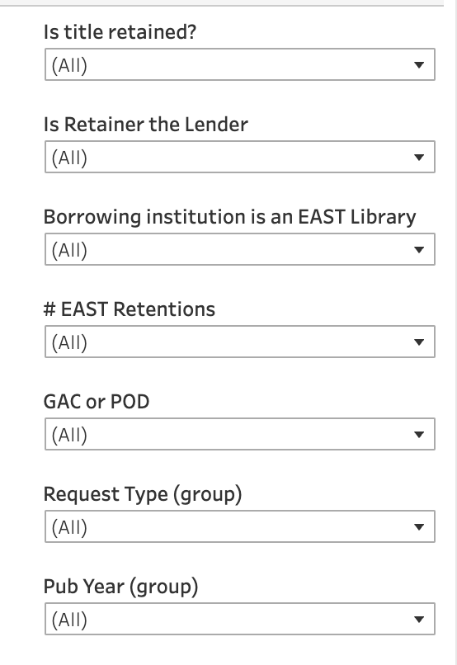
Data pulled into Tableau to query and visualize
Notes:
We compiled and cleaned the data a bit and put it into a large spreadsheet format, we pulled it into Tableau for exploration and visualization.
You can see our facets here - is the title retained, and how many retentions does it have in EAST? Was the lender also the library who holds the retention? Was the borrowing institution also an EAST library? Was the loan a book (returnable) or a scan of an article or chapter, and what was the publication year of the material lent.

Slide 6
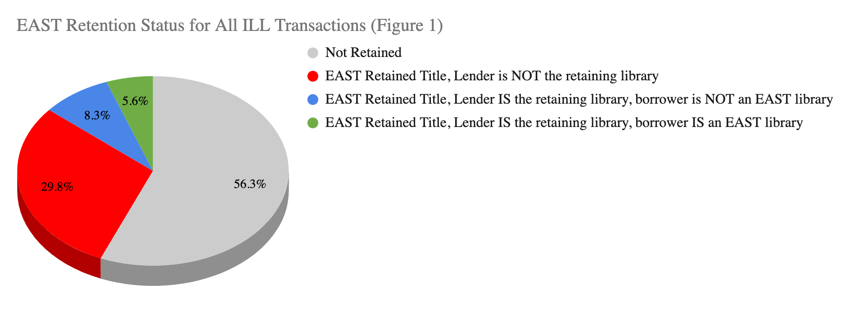
Results: All (GAC/POD Loans/Scans): 229,000 transactions
Notes:
Here’s what we found:
In general, EAST member libraries retain between 15-30% of their circulating print monograph collections for EAST.
In this data set, approximately 1% (ranging from .2%-1.6%) of the circulating print collection was lent via Rapid or OCLC.
Of these transactions, almost 44% were on titles that have an EAST retention commitment (the red, blue and green slices of this pie chart), though they were not necessarily loaned by the retaining library.
When looking at titles that were lent by the retaining libraries, that number drops to 13.9% (the blue and green slices), and when further limiting to loans where the title was lent to an EAST member, it drops to 5.6% of all ILL transactions (the green slice).
We took from this that retained copies do get loaned, but not excessively so.
(Charts: https://docs.google.com/spreadsheets/d/1sY7JqNh2Nz0CAdJ_LMCmXR6uQx76rmvy/edit#gid=1147007239)

Slide 7
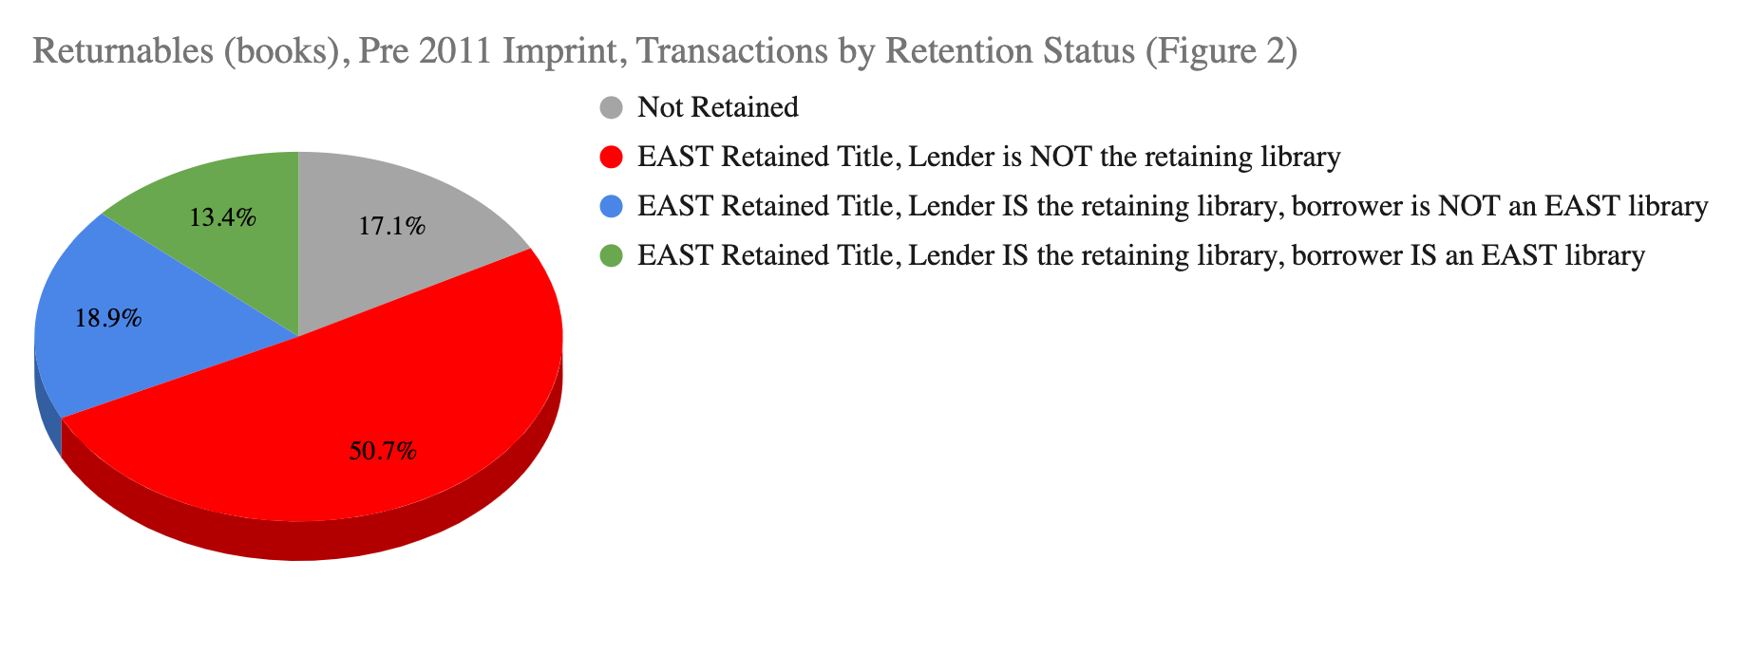
Pre 2011 Returnables Only
Notes:
We then decided to look just at the corpus of data that pertains to EAST retentions - which is pre 2011 print monographs. So this is looking at just that subset of the ILL transactions.
About one third of all transactions were on pre 2011 imprints. When looking only at this subset, the percentage of transactions that were on retained titles increased to 83%, with 13.4% being lent by the retainer to another EAST institution (again the green slice here)
This made us feel good that we were retaining materials that are used and useful.

Slide 8
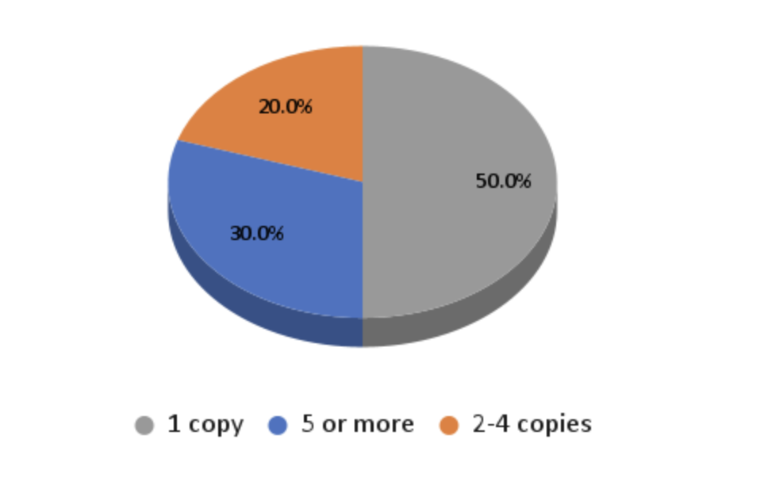
Number of EAST Retentions on Loaned Material
Notes:
Also of interest was investigating the total number of EAST retention commitments on retentions which were lent. Approximately 30% of retained titles that were lent had 5 or more copies committed across EAST, while almost half had only one retention commitment, with the remaining 20% having 2-4 copies retained across the EAST member libraries. This does, in fact, reflect the distribution of retained titles across the EAST collective collection, so no surprises there.
Pub year data is in 2019 GAC and POD for Tableau.xlsx

Slide 9
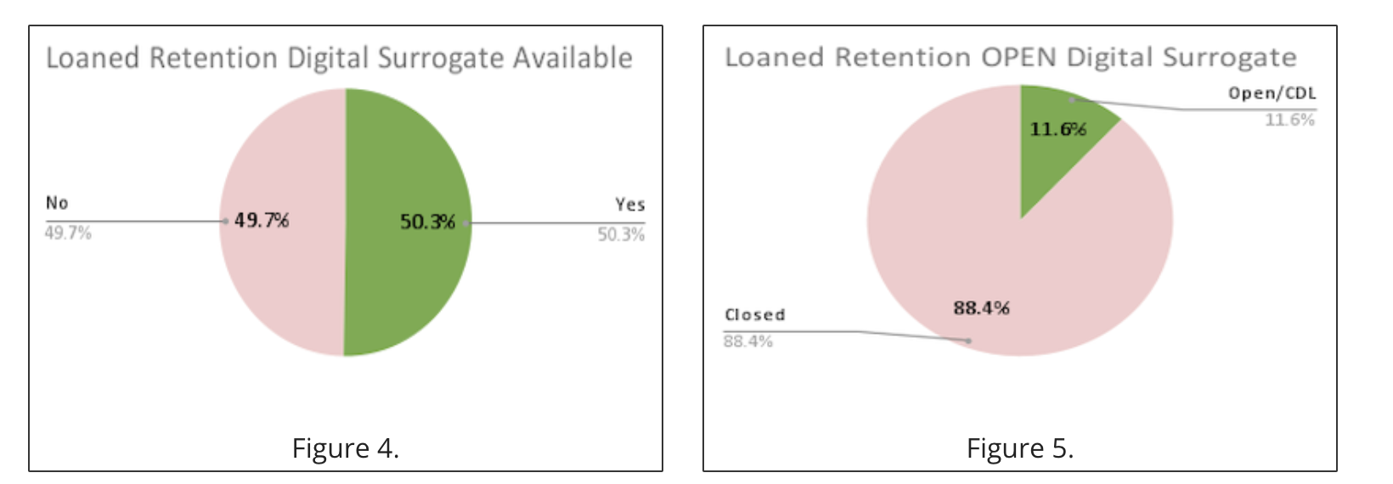
Digital Surrogates
Notes:
And finally we looked at the the existence of a digital surrogate in HathiTrust or Internet Archive for retained titles that were lent (regardless of the retainer or borrower). Approximately half of the transactions were found to have a digital surrogate though only 11% of retained titles that were loaned were open access or available for controlled digital lending. (so better on the preservation side, not so great on the access side.)
Of particular note, approximately one quarter of the lent retention transactions were for titles that lacked a digital surrogate and were retained by only 1 EAST member. These may be candidates for further investigation for digitization.

Slide 10
Conclusions
~44% of all the ILL transactions analyzed had a retention commitment
> 6% were lent by the EAST retaining library
50% had only ONE EAST retention commitment
~ 70% of the retained titles lent were returnables
25% had only 1 retention and lacked a digital surrogate.
https://bit.ly/EASTILLStats
Notes:
Here are some of our conclusions - the full report is available on the EAST website, which a shortcut at bit dot ly slash EAST ILL Stats:
Most interesting to us, it turned out, was not any spike in ILL for retained materials, but the realization that a quarter of retained titles that were lent had only 1 retention and lacked a digital surrogate. We feel these merit more investigation either for further retention or digitization.
============================================
Titles with an EAST retention commitment account for almost 44% of all the ILL transactions analyzed, although the majority were neither lent by the retaining library nor borrowed by another EAST member library.
Fewer than 6% of the total number of ILL transactions analyzed were lent by the EAST retaining library although this increases to over 13% for titles published prior to 2011, the cutoff for the original EAST retention model.
Almost half of the retained titles that were lent had only ONE EAST retention commitment. With further analysis, we may find this to be an area of focus to retain additional copies.
While almost 70% of the retained titles lent were returnables, lent as books, a not insignificant 30%+ were retained titles lent digitally as articles, books chapters, or digital copies.
one quarter of the retained titles which were lent lack a digital surrogate and have only a single copy committed to retention for EAST, these may be good candidates for digitization both to expand access and to further EAST’s preservation goals.

Slide 11
What questions should the
ILL analysis help us answer?
Does retention change the ILL pattern?
We didn’t see that happening, merits continued research
Do retained items circulate more than non-retained titles?
We didn’t look at circulation, though widely circed were a focus of retention
How many requests could have been fulfilled by a digital surrogate?
Almost half, if CDL allowed
Would seeing the % of retained items lent via ILL, both to EAST members, and outside of EAST be useful?
Yes!
Is speed of delivery, or turnaround time, important? Not just “can we access,” but “can we access quickly”?
Turnaround time was not something we explored, but as EAST grows it is an area of interest
Notes:
We didn’t look at circulation but anecdotally some members of the working group noted that retained titles do circ frequently - again perhaps related to retaining higher circed materials.

Slide 12
Future projects and exploration
Explore 2022 Data
Digitization of Held By One and No Digital Surrogate
Explore Other Sources of Data:
Local Systems data e.g. Alma stats
Illiad IDS customers - can get retention information into data
Local circulation (do retained titles circulate locally more?)
Notes:
Areas for future projects and exploration are:
Repeating this work on the 2022 ILL data set and see if the trends we saw in 2019 hold.
Exploring more about the ‘retained by 1 and no digital surrogate’ titles
And, probably most importantly, exploring ways to more easily get at this type of data. There has been discussion in the Alma community of how these stats might be generated, and OCLC is also aware that having retention status in ILL reports is desirable.
We also learned from our working group that ILLiad IDS customers can request a logic rule that searches the ILS for retention notes and brings it into ILLiad, which can then be used in reports.
We also may consider looking at circulation information to determine if retained titles circulate more frequently. A very anecdotal survey indicated that is true, though EAST did focus on highly circed materials, so perhaps that makes sense.

Slide 13
Join us on this quest
https://eastlibraries.org/retention-access/access/2019-ill-stats
Let us know if you are doing any similar work
samato@blc.org
Notes:
And with that I invite you to join us on this quest. Again here’s the link to our 2019 results on the EAST website. If you are doing any similar work or have other ideas we’d love to hear from you. You can drop me a note at samato@blc.org

