Slide 1
Online Guide to U.S. Map Resources:
Prospective MAGIRT Shared Print Archive Project
Carol McAuliffe w Map and Imagery Library w University of Florida
Print Archive Network Forum w June 24, 2016

Slide 2
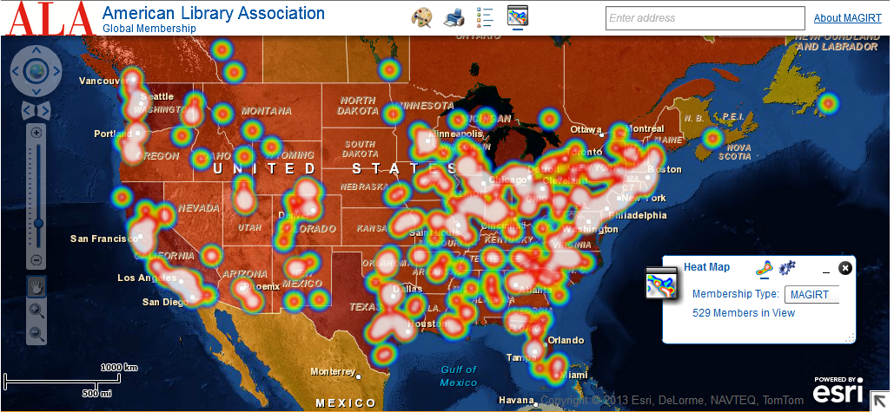
MAGIRT Membership Map
http://arcweb.forest.usf.edu/flex/ALA/
Historical USGS 7.5-minute topo quads downloaded from the National Map
The Map and Geospatial Information Round Table
Notes:
2

Slide 3
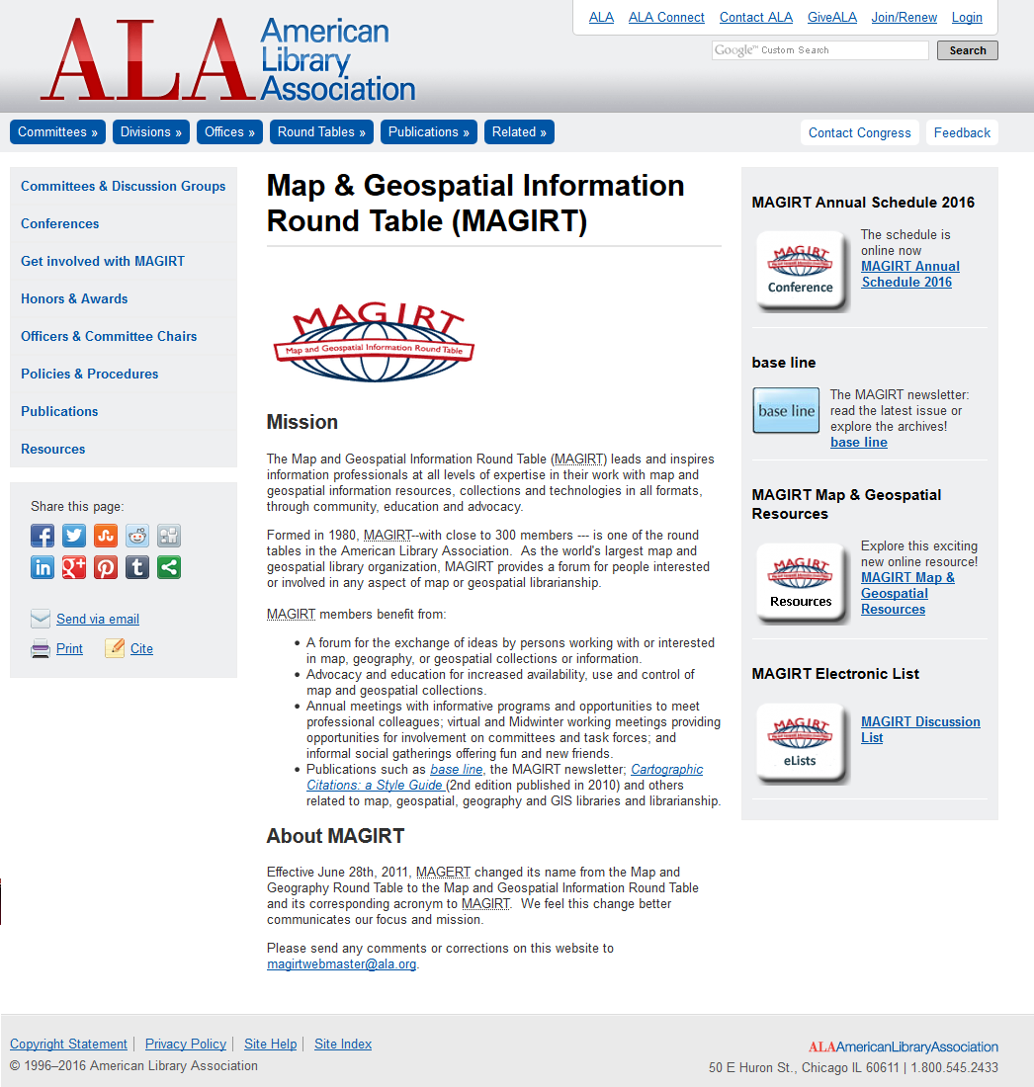
MAGIRT
Map & Geospatial Information Round Table (MAGIRT)
World’s largest map and geospatial library organization
Approximately 300 members representing a variety of institutions
http://www.ala.org/magirt/
Historical USGS 7.5-minute topo quads downloaded from the National Map
The Map and Geospatial Information Round Table
Notes:
3

Slide 4
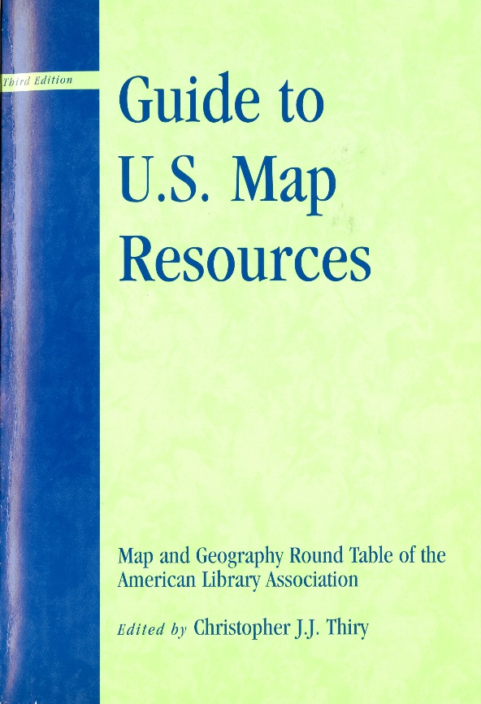
Guide to U.S. Map Resources
First and second edition (editor: David Cobb) published in 1986 and 1990, respectively
Third edition (editor: Christopher Thiry) published in 2006
In October 2014, the MAGIRT Publications Committee formed taskforce to investigate an online edition
Historical USGS 7.5-minute topo quads downloaded from the National Map
The Map and Geospatial Information Round Table
Notes:
4

Slide 5
Guide to U.S. Map Resources
Online crowd-sourced directory
Searchable map interface
Searchable subject and geographic specialties
Links to digital collections
Information on print holdings for collaborative collection management
Focus needed
Historical USGS 7.5-minute topo quads downloaded from the National Map
The Map and Geospatial Information Round Table
Notes:
5

Slide 6
Federal Information Preservation Network (FIPNet)
“a strategy for a collaborative network of information professionals working in various partner roles to ensure access to the national collection of Government information for future generations.”
~ http://www.fdlp.gov/project-list/federal-information-preservation-network
Collaborative Preservation
Actively Seeking Partner Libraries
Ensure Long-Term Access to Government Information
Historical USGS 7.5-minute topo quads downloaded from the National Map
The Map and Geospatial Information Round Table
Notes:
6

Slide 7
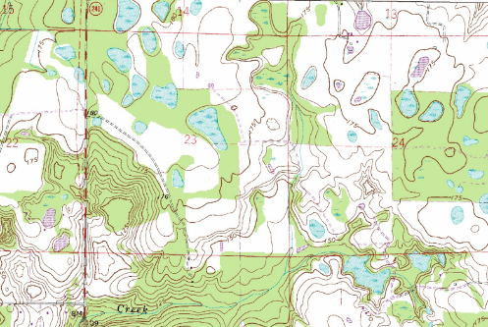
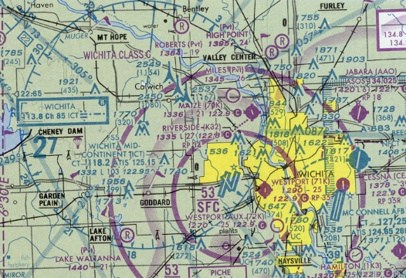
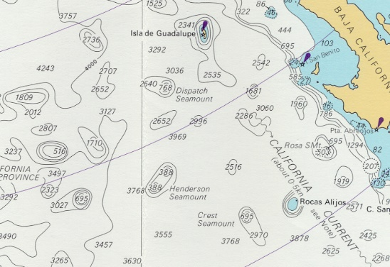
Guide to U.S. Map Resources
Through partnership with GPO and FDLP, determined that print government documents would be initial focus.
Inventory print cartographic resources (GPO, USGS topographic maps, NOAA nautical charts, etc.)
Track retention and deselection policies of these cartographic resources
Include all members of the Federal Depository Library Program with map collections
Identify potential FIPNet partner libraries
Historical USGS 7.5-minute topo quads downloaded from the National Map
The Map and Geospatial Information Round Table
Notes:
7

Slide 8
Shared Print Archive Project
Potential to create a preservation network of institutions with print collections of cartographic government documents
Determine areas of specialization and areas of overlap
Disseminate “best practice” information for print archives
By establishing shared print collaborations, we ensure a stable print archive
Historical USGS 7.5-minute topo quads downloaded from the National Map
The Map and Geospatial Information Round Table
Notes:
8

Slide 9
Path to Success
Survey libraries to determine print cartographic holdings and retention/deselection policies
Create database and map for Online Guide to U.S. Map Resources
Provide training so that libraries can update information through the online portal
Establish sustainable plan for maintaining and expanding the Guide
Historical USGS 7.5-minute topo quads downloaded from the National Map
The Map and Geospatial Information Round Table
Notes:
9

Slide 10
Questions? Comments?
Carol McAuliffe, Map Librarian
Head of the Map and Imagery Library
Special and Area Studies Collections
George A. Smathers Libraries
University of Florida
carolmc@uflib.ufl.edu
(352) 273-2828
MAGIRT Map Collection Management Discussion Group
Saturday, June 4, 3:00 – 4:00 pm
Orange County Convention Center S33OH
Historical USGS 7.5-minute topo quads downloaded from the National Map
The Map and Geospatial Information Round Table
Notes:
10

