Slide 1
PAN Forum – Friday, January 8, 2016
Group Features in GreenGlass:
Supporting Shared-Print Projects focused on Monographs
Ruth Fischer
Senior Product Manager, Sustainable Collection Services/OCLC
Notes:
OCLC is developing support for collection management - at a level ‘ABOVE THE INSTITUTION’. We’re trying to provide analytics that can supplement the expertise of librarians and faculty – and that make shared-print workflows less labor-intensive. Today I get to show what we’ve got going with regard to print monographs.

Slide 2
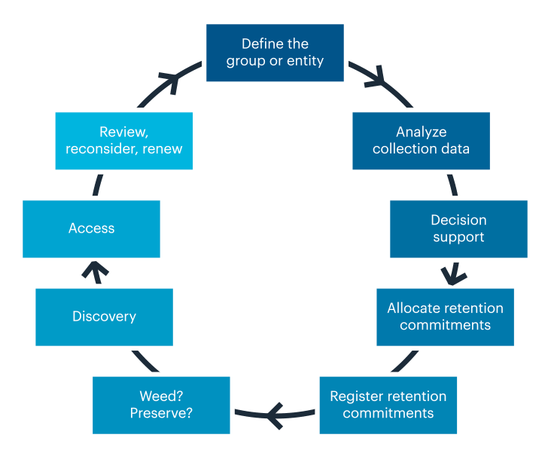
Shared Print Workflow
Notes:
This circle-chart provides an overview of the shared-print workflow as we currently understand it – again focusing on monographs. Starting at 12 noon, a group must come together and agree to collaborate. At 1 o’clock quite a bit of heavy lifting is needed in terms of data collection, synchronization and analysis. Only then, can decisions be made about the components of a shared-print agreement. After that, retention commitments can be allocated to participant libraries - and then actions taken to protect and register them. Finally at seven o’clock – member libraries can safely weed surplus copies.
[Click] GreenGlass is an OCLC web application – that offers a substantial number of shared-print features for monographs. Functionality is now in place - to support the first six steps in this shared-print workflow.

Slide 3
Shared Print: Retention First!
Establish a safety net: ensure that all titles are secure
Group-wide agreement on retention models
Group-wide commitment to retention rules & duration
Secure scarcely-held titles within the group
Secure sufficient holdings of each titles to satisfy likely user demand
Share responsibility for retention proportionately
Deselection only after retention commitments established
Notes:
I want to emphasize that all of our tools and services for group projects - prioritize RETENTION. Creating the safety net always comes first.

Slide 4
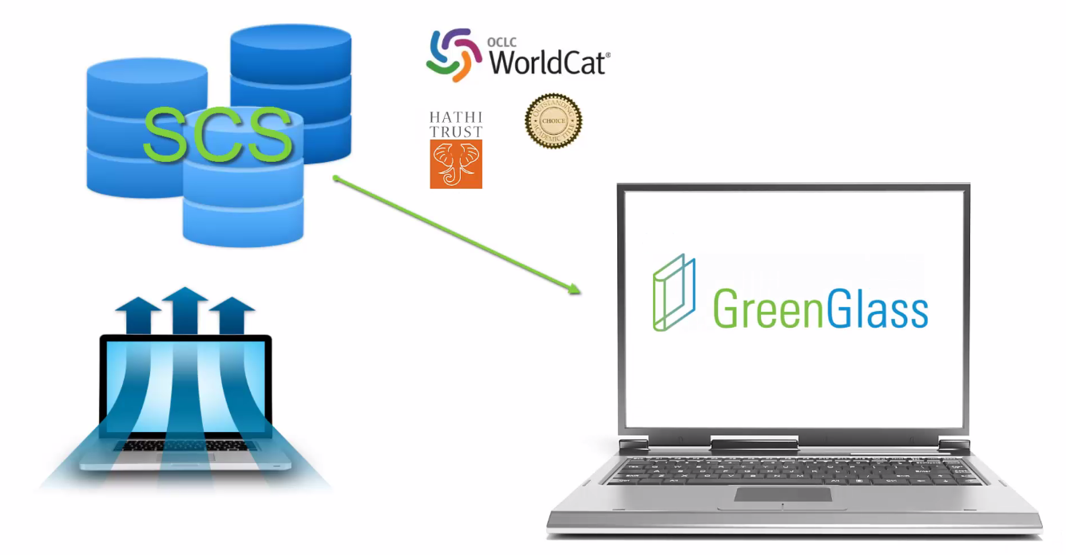
Library’s bib, item and transaction data for PRINT MONOGRAPHS
Notes:
And I want to mention that we start with bibliographic, item and transaction data, extracted directly from each library’s ILS --- not from WorldCat. We cleanse, filter and normalize it – and then match it against holdings in WorldCat and in HathiTrust. This enhanced data is then loaded to GreenGlass.

Slide 5
Group features in GreenGlass complement
original GreenGlass features designed for individual libraries.
For information about individual library features, watch our video tutorials:
http://www.oclc.org/sustainable-collections/resources.en.html#tutorials
Notes:
GROUP members get all of the GreenGlass individual library features for collection analysis and list generation. Group features that we’re talking about today are in ADDITION.

Slide 6
GreenGlass Group Functionality
GreenGlass Group functionality employs data visualizations and modeling tools to enable groups of libraries to:
understand their shared collection in terms of overlap, subject dispersion, and usage.
experiment with various retention scenarios, and estimate the impact on each participant library.
commit to specific retention agreements, with confidence in the outcome.
Notes:
For most groups seeking to share responsibility for their print monographs collections, the biggest problems stem from the fact that very few people have done this before - and basic concepts are not familiar. Therefore, we’ve designed GreenGlass to help participants learn about important characteristics of the shared collection and to have enough information to engage in strategic conversations about how to move forward. GreenGlass provides data visualization and a data modeling tools to achieve these goals.

Slide 7
Group collection visualizations
in greenglass
Notes:
(Breath.)

Slide 8
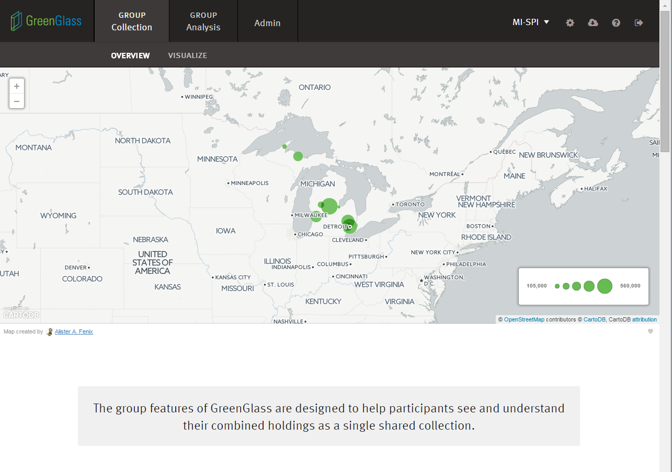
Notes:
Group visualizations in GreenGlass transform huge amounts of disparate collections data - into interactive displays – designed to help users understand the nature of the shared collection --- AND their own library’s position in it.
All of the screen shots we will see today show MI-SPI collection data. MI-SPI is a group of 8 libraries in Michigan (as you can see) – for whom we have recently loaded their shared collection data into GreenGlass. Thank you MI-SPI! For allowing us to show off your data!

Slide 9
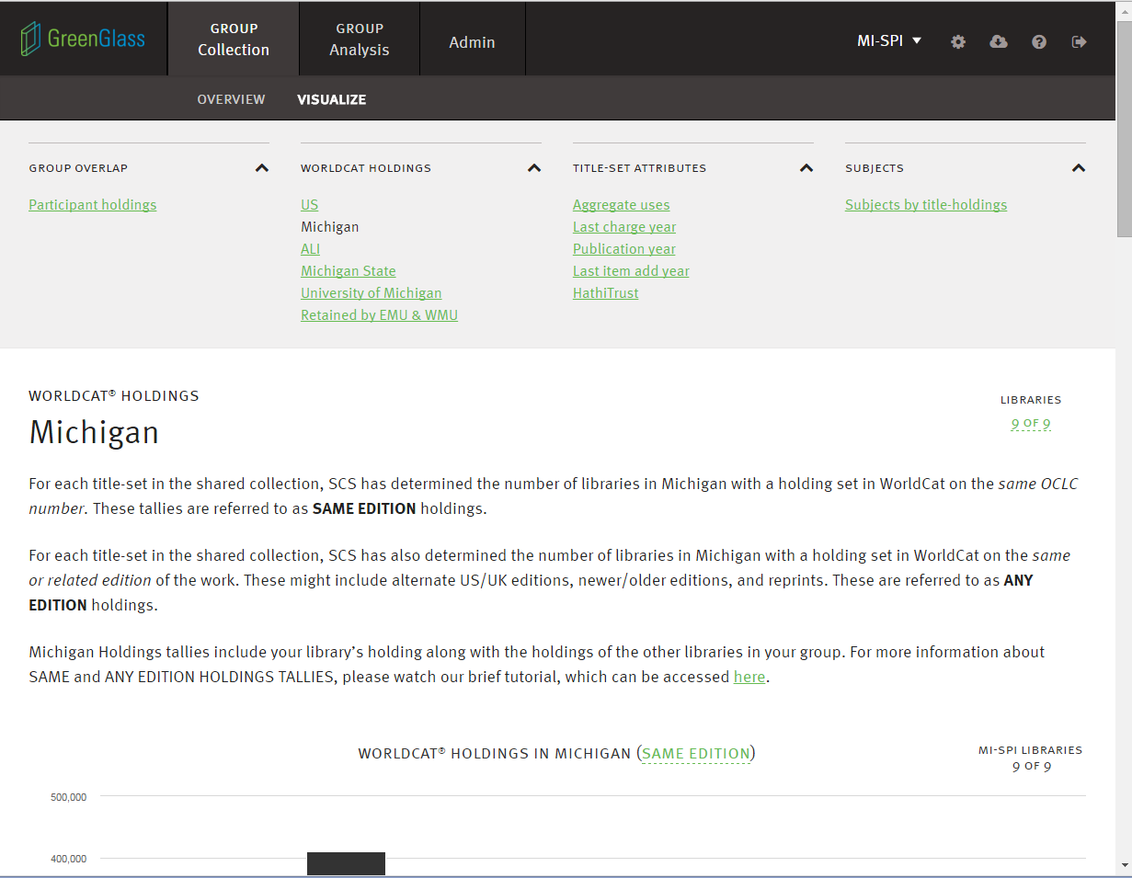
Notes:
The green hyperlinks that you see here represent the most critical collection attributes. [CLICK] Each has a dedicated page in GreenGlass - with interactive charts and explanatory text.
Again, the effort we’ve put into these explanatory pages is meant to help group participants gain a really solid understanding. For example – The extent to which titles are widely or scarcely held, cannot be understood with a single metric. Overlap within the group is one perspective, which we address in depth. But the extent of holdings in the country, the state, and in external comparator groups can be essential to good decision-making. Each of these kinds of overlap, is addressed separately in GreenGlass.

Slide 10
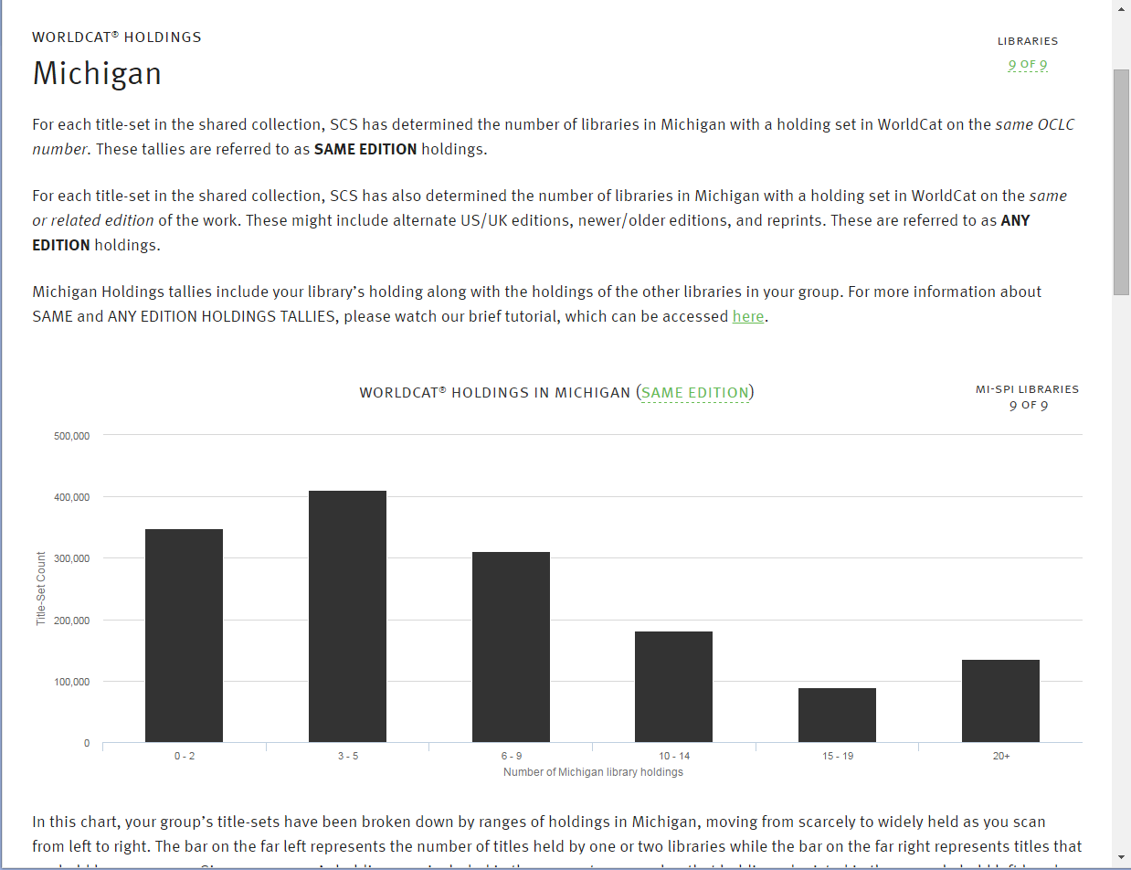
SAME EDITION OVERLAP TALLIES IN THE STATE
Notes:
And we go further. With regard to holdings overlap, it’s important for participant libraries to understand the relationship between SAME …. [CLICK]

Slide 11
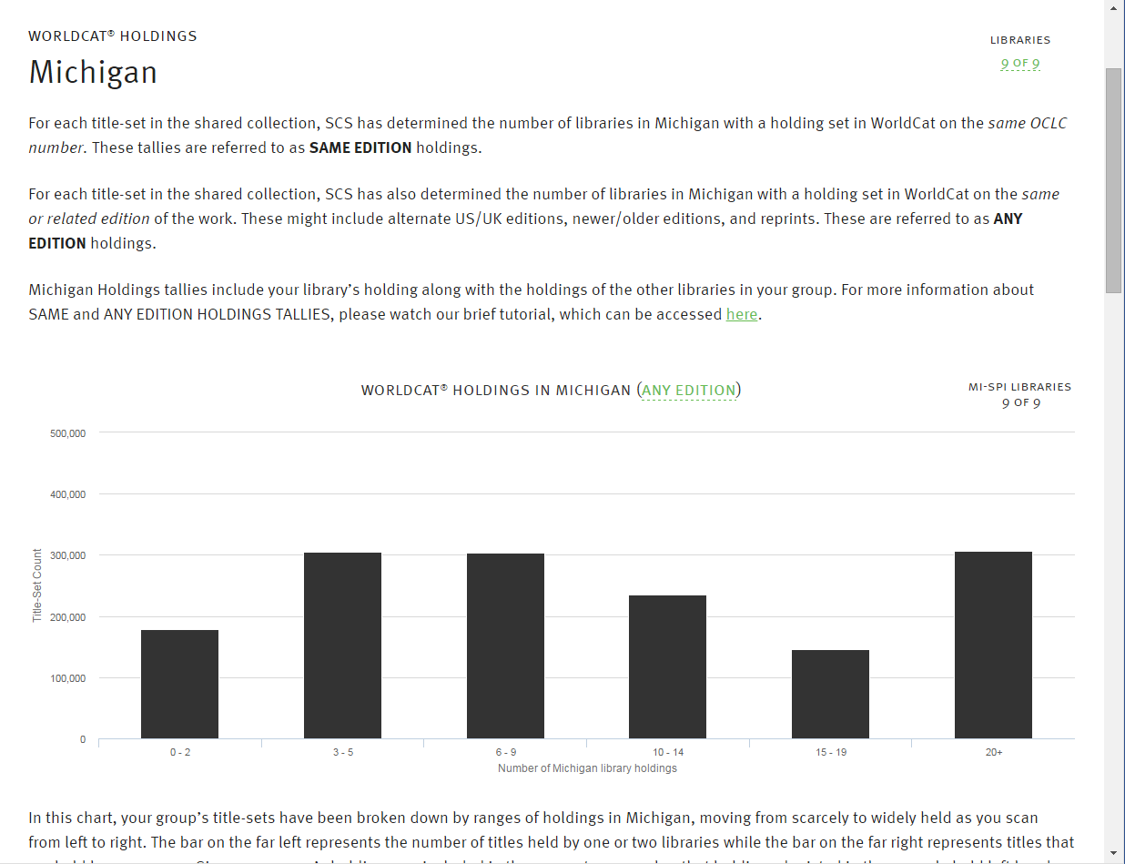
ANY EDITION OVERLAP TALLIES IN THE STATE
Notes:
… and ANY edition tallies --- so we’ve created an interactive tool that lets users explore this relationship.

Slide 12
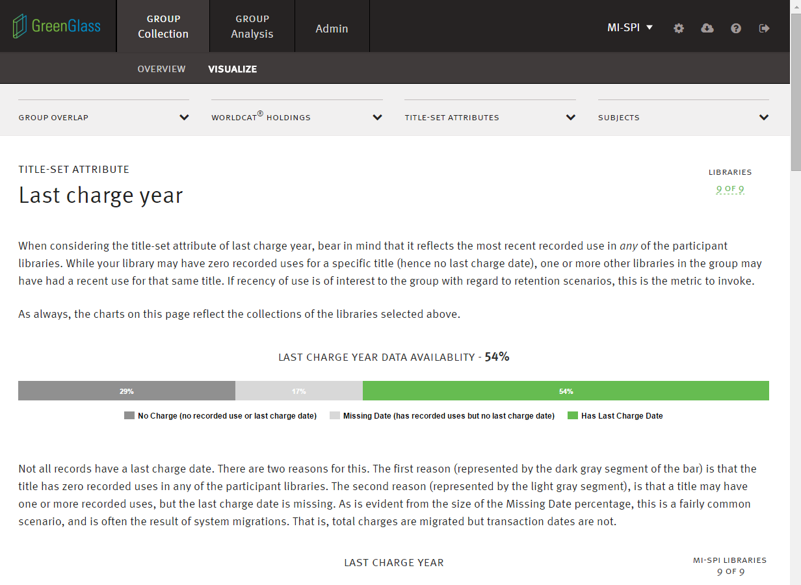
Notes:
It’s also important for group members to understand (for example) the number of recorded uses for each title, but also whether or not specific titles are of current interest to users. This page helps users understand the way in which GreenGlass measures recency of use, and the extent of relevant data available. As we scroll down the page on this topic, we see several views of usage data, for the group collection as a whole … like this

Slide 13
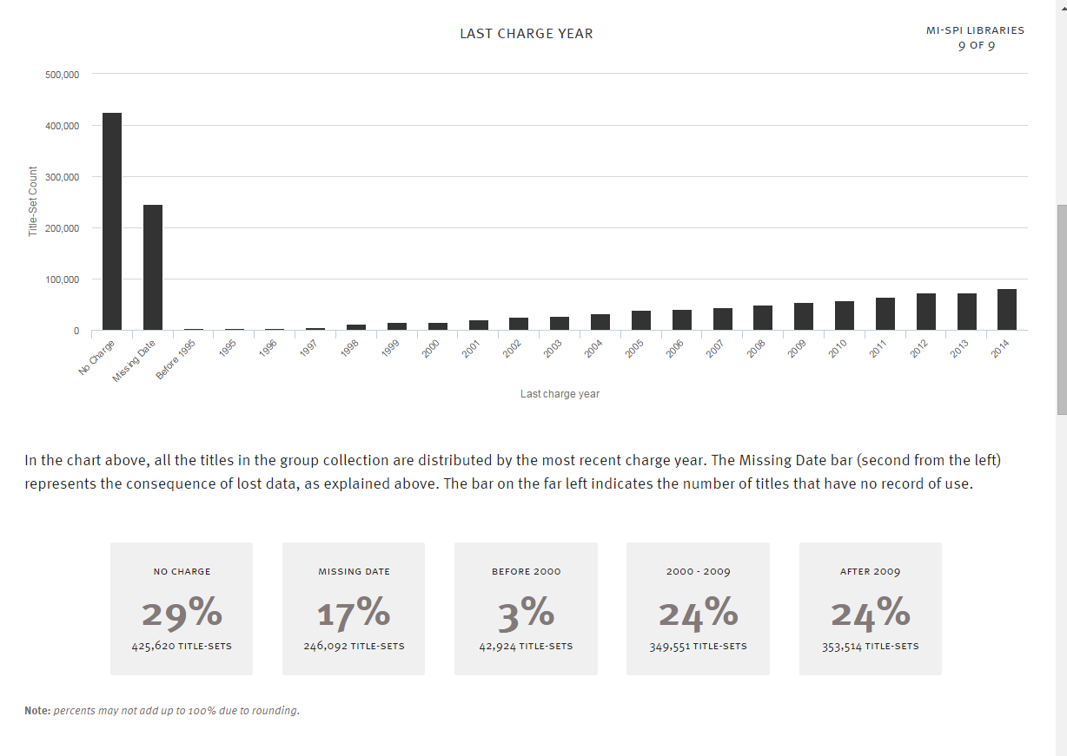
LAST CHARGE YEAR
Notes:
.. and this …

Slide 14
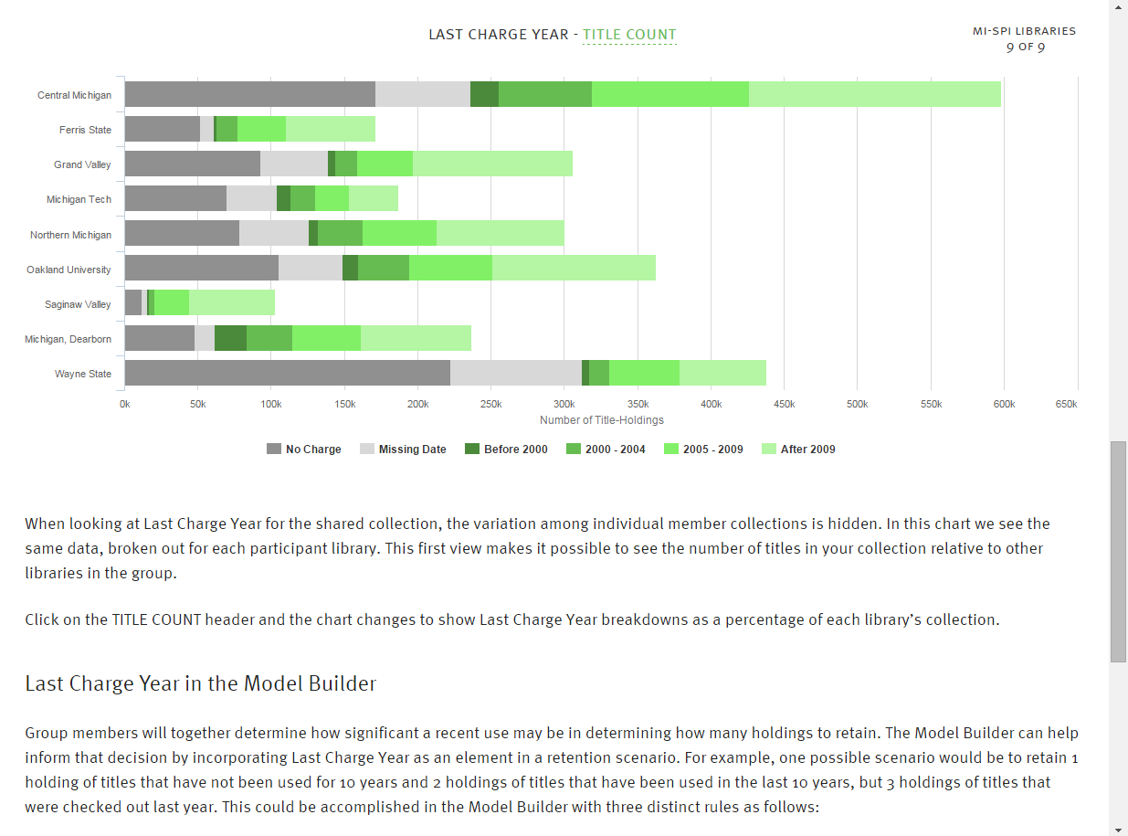
LAST CHARGE YEAR BY TITLE COUNT
Notes:
… AND for each participant library. This graph shows circulation time frames for each library – by title count, and also by …

Slide 15
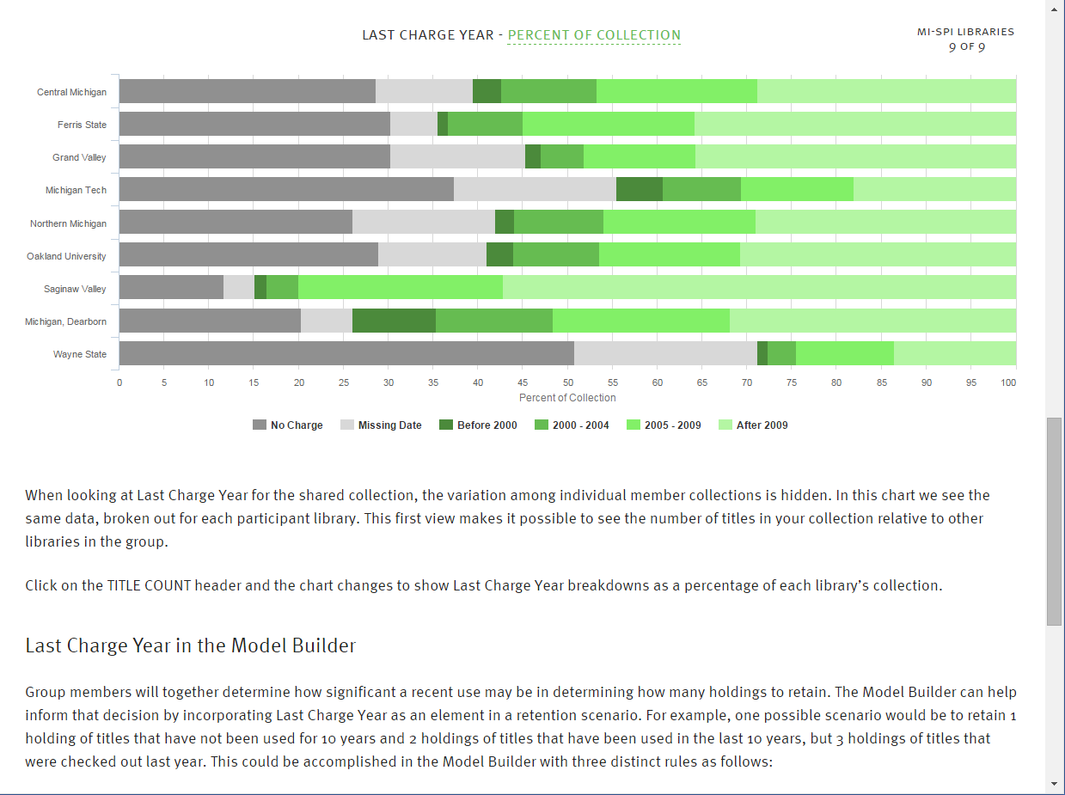
LAST CHARGE YEAR BY PERCENT OF COLLECTION
Notes:
… percent of collection.
Once users understand each collection attribute they will be ready to use the GreenGlass Model Builder.

Slide 16
Retention modeling
in greenglass
Notes:
The Model Builder is the part of the application where users can experiment with various group retention scenarios, invoking the attributes you’ve just seen - and setting thresholds – singly or in combination.

Slide 17
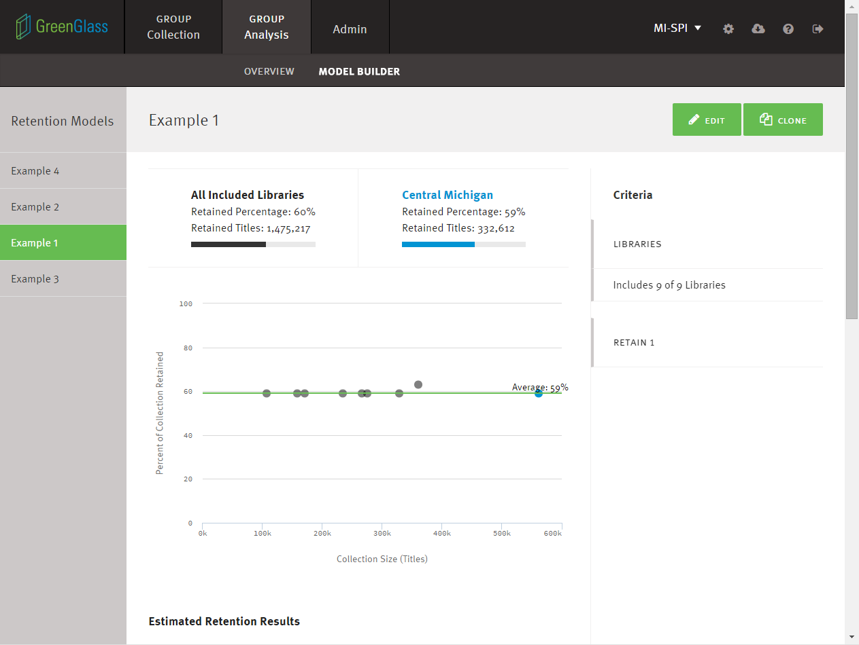
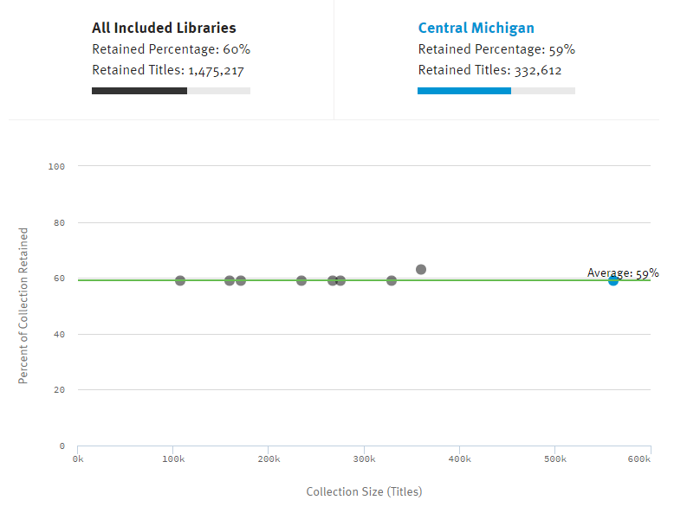
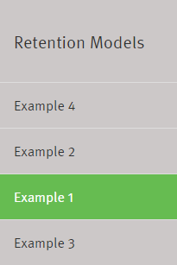
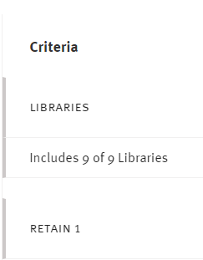
Notes:
Remember that GreenGlass Group Models are always retention focused.
You can watch a tutorial to see how to build them, so for today – I’m just going to show you some results. Navigational tabs on the left display the names of my saved models [CLICK]. Criteria for each model appear on the right. [CLICK] The scatterplot in the center of the screen [CLICK] displays the results of the model.
Each dot represents one of the libraries in the group. The x (or horizontal) axis represents library size, and the y (or vertical) axis represents the percentage of each collection that will be retained. As you add rules and conditions to your own models, you can watch the dots shift.
This is probably the simplest of all models wherein the group will retain 1 copy of all titles currently owned by the group. For MI-SPI, this would require that the group retain 59% of the shared collection, and each library would be required to retain approximately the same percentage of their own collection.

Slide 18
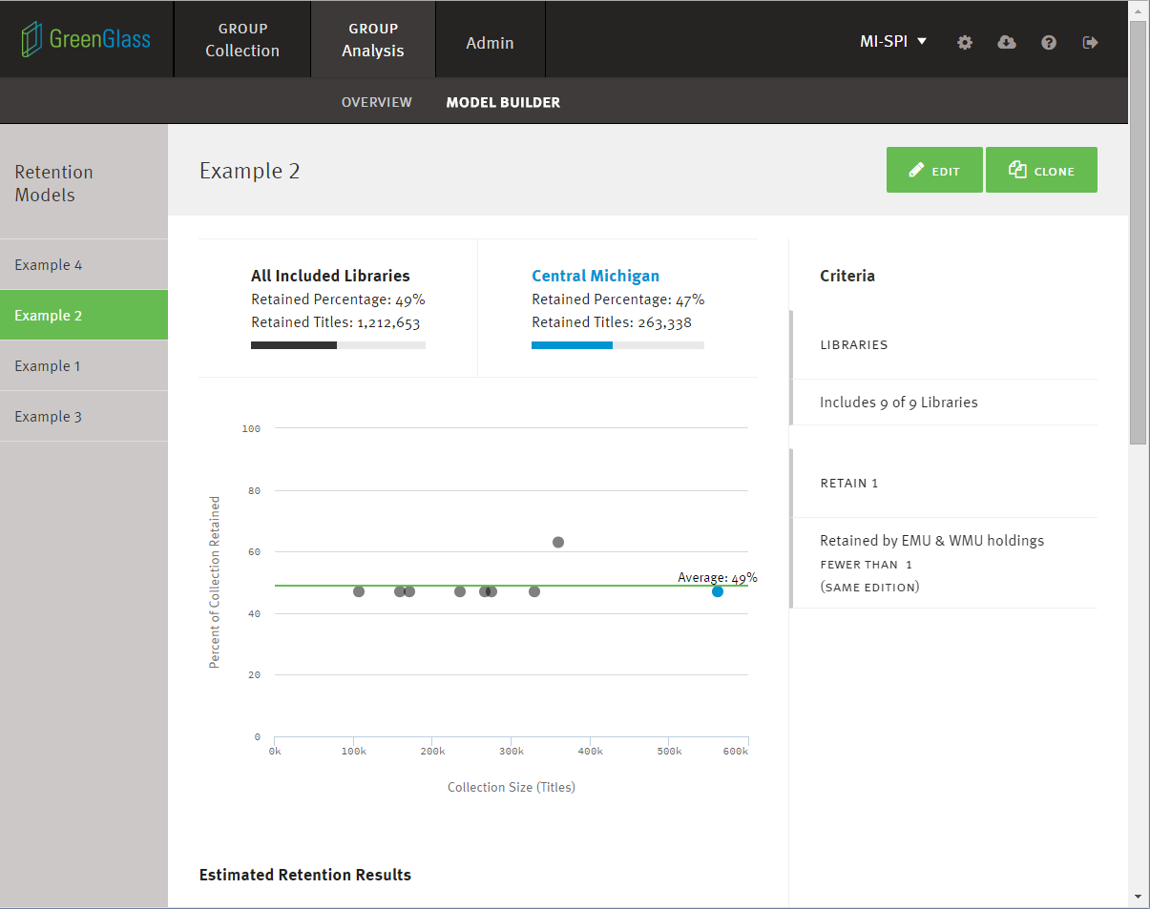
Notes:
In this model, I have simply added a condition – whereby the group will retain 1 copy of everything owned - but ONLY IF neither Eastern Michigan NOR Western Michigan has already retained it. For MI-SPI, this drops the overall retention estimate from 59 to 49 percent.

Slide 19
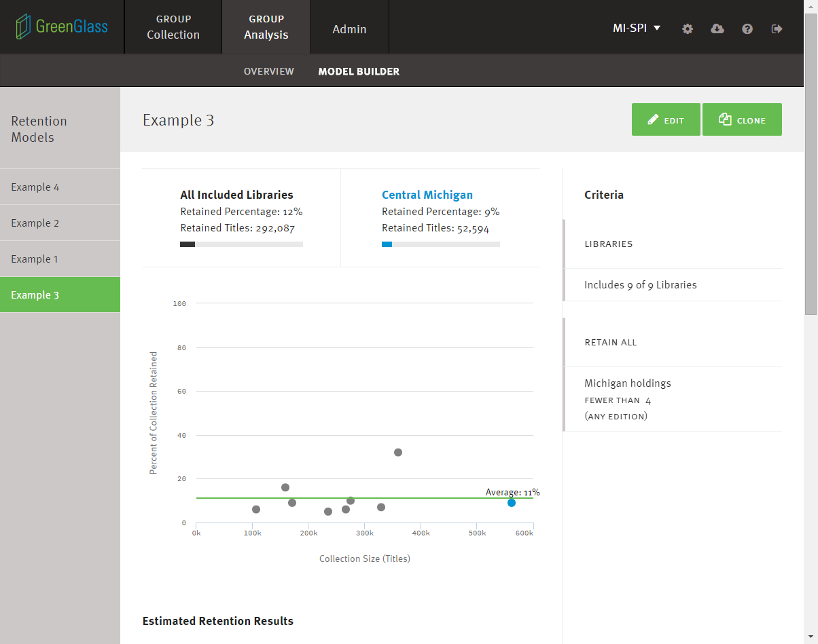
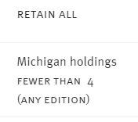
Notes:
MI-SPI would expect to retain 11% of the shared collection if they decided to retain ALL holdings for titles held by fewer than four libraries in the state.

Slide 20
Notes:
You can see that this is model has multiple rules and conditions. There’s no limit on the number of rules or on the number of models that a user can build.

Slide 21
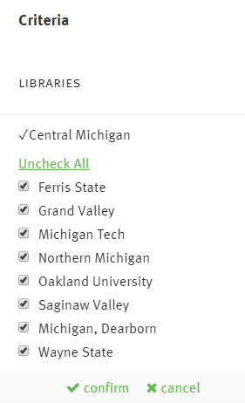
Notes:
For any given model the user can choose to include some or ALL of the participant libraries. We see this as a critical feature for projects with a LOT of members spread across a large geographic region.

Slide 22
Retention Allocations and Beyond
Retention commitments are allocated to participant libraries
Retention commitments are flagged/integrated into GreenGlass so users can generate lists
Participant libraries secure their retained items and set retention holdings in WorldCat
Participant libraries use GreenGlass to weed surplus copies according to local needs and circumstances
Notes:
Once the group has come to consensus about a retention model …. subsequent steps in the process go something like this.

Slide 23
Thank you!
Ruth Fischer
Sustainable Collection Services/OCLC
fischerr@oclc.org
Notes:
Thanks for listening! Is there time for a question or two?

