Slide 1
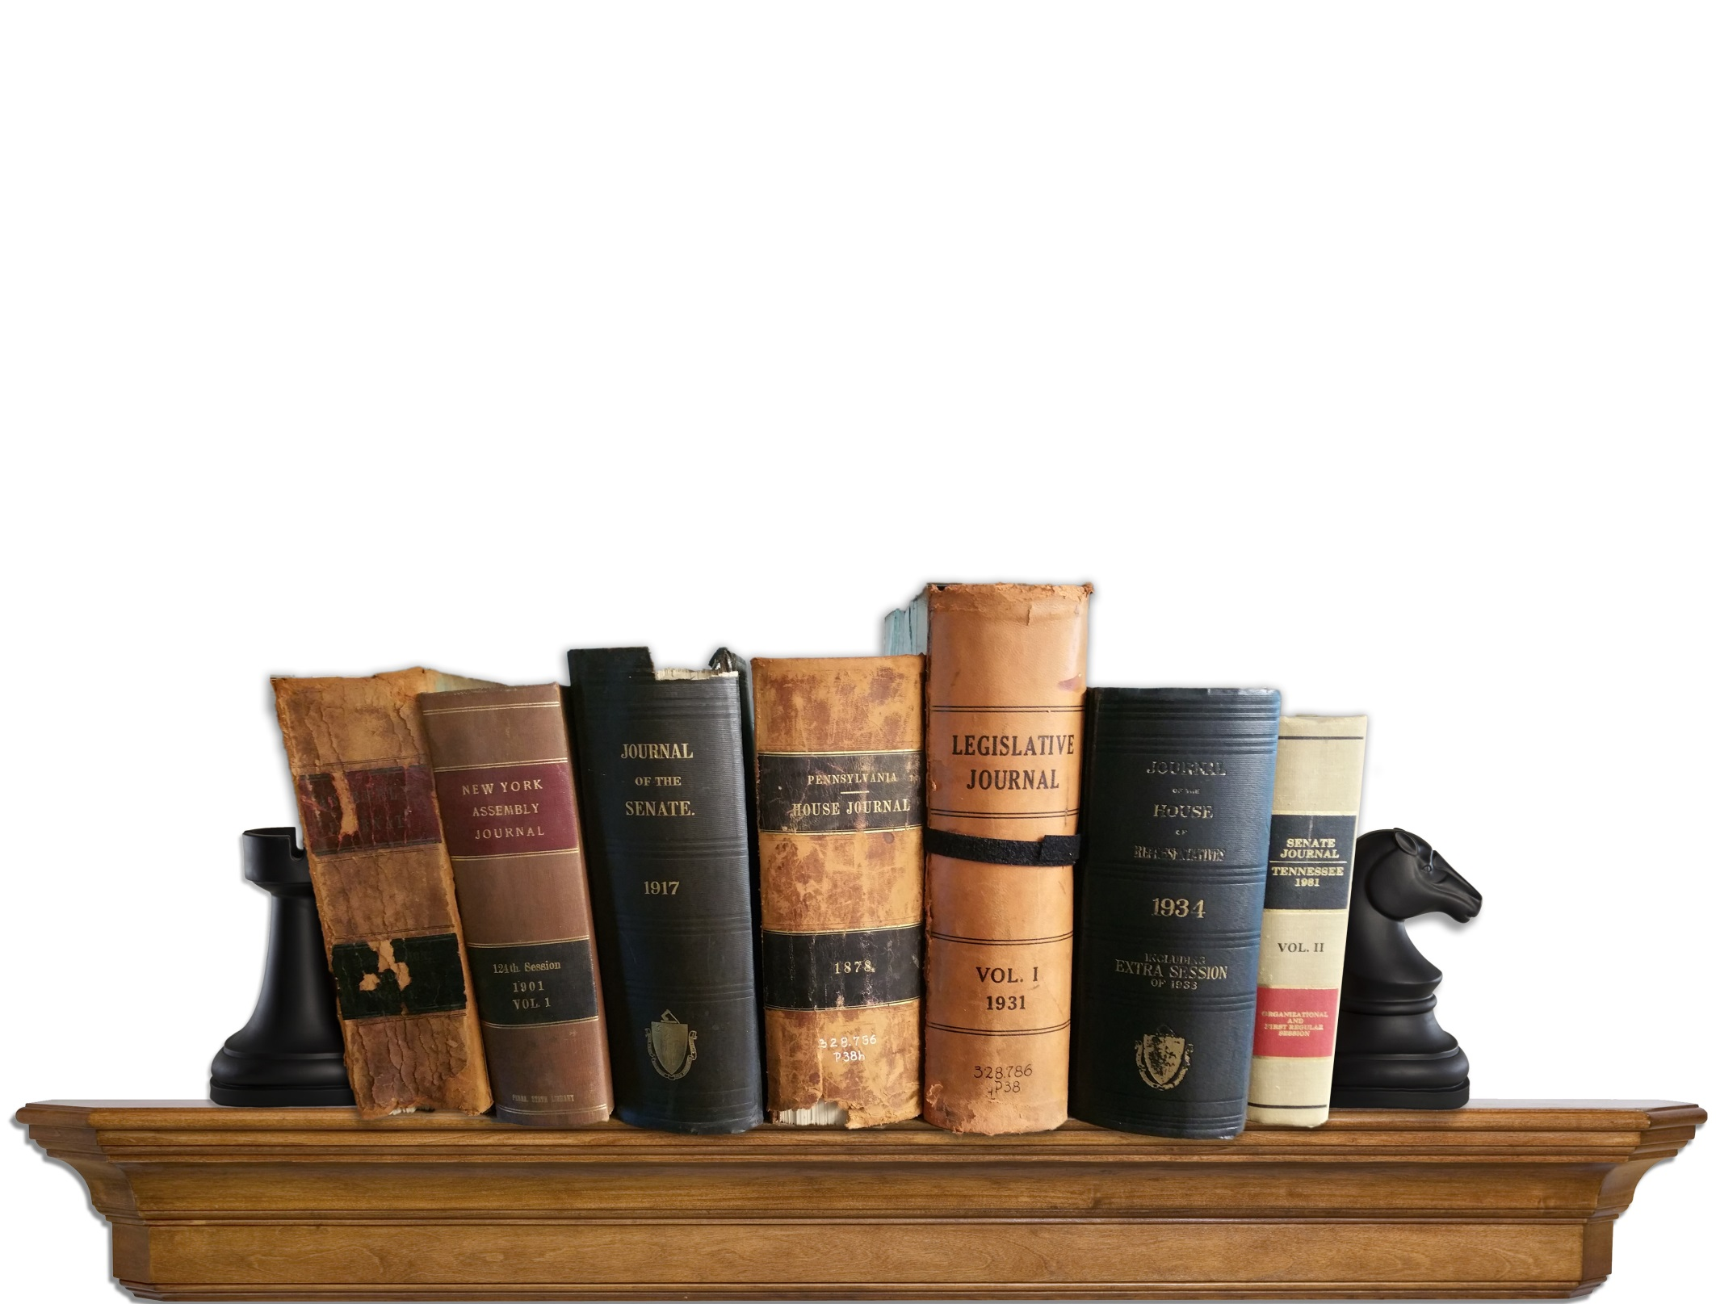
US States Legislative Journals via LLMC Digital
A Collaboration between CRL and LLMC
Presentation at PAN ALA Annual 2016, Orlando, FL
Kathleen Richman, LLMC Executive Director

Slide 2
LLMC – Overview and LLMC Digital
LLMC (Law Library Microform Consortium) is a 501(c )3 nonprofit
Self-governing (Board of Directors elected by member libraries)
509+ universities and law libraries from around the world (see list of ‘Participating Members’ hyperlink on main menu at www.llmc.com )
Mission: “Preserving global legal and governance-related materials and making this valuable content accessible and searchable”
Started in 1976-2002 by converting 105,000 volumes into microform (which are being digitized for online access)
Beginning 2002 launched the LLMC-Digital online service, digitizing over 105,000 volumes and growing (download spreadsheet at www.llmc.com at ‘Online Services’ tab and select ‘Digital Title List’)
Multiple-format Preservation
Original paper blocks of scanned books are archivally wrapped and preserved in ideal dark-archive salt mines 650 ft. below ground
Digital Images stored in 3 secure locations

Slide 3
Strategic Alliance with Center for Research Libraries (CRL)
Started May 2010
Benefits include:
All CRL Member Institutions have full access to LLMC Digital
CRL’s law-related print holdings are digitized, catalogued, and preserved
Cooperative content initiatives such as Haiti, Foreign Official Gazettes, Africa, et al are prioritized by Joint Global Resources Steering Committee
Support for Print Archive Repository (information registered in PAPR)

Slide 4
LLMC Digital Collections Digitized in Collaboration with CRL 2010-16
As a result of the CRL collaboration, LLMC digitized a total of 18,874 volumes* as of 3/31/2016.
*13,887,409 images

Slide 5
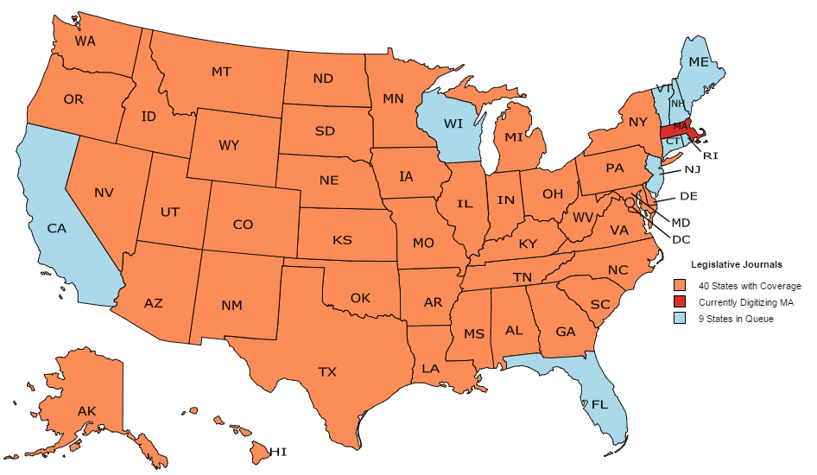
U.S. Legislative Journals Project in Collaboration with CRL
LLMC & CRL collaborative initiative to digitize U.S Legislative Journals. This content is currently available in 40 different States. 10 more States are in the queue.

Slide 6
Top Ten States by Volume Count
Total (as of 5/31/16): 11,203 volumes of CRL’s State Legislative Journals on LLMC-Digital

Slide 7
CRL Members Usage of LLMC-Digital
Overall CRL Members Usage Trends 2011-15.

Slide 8
Top LLMC-Digital Collections Searched in 2015
*Top Ten countries searched within this collection by order: Ghana, Dominican Republic, Haiti, India, Myanmar, Philippines, Cuba, South Africa, Germany, South Korea
**Top Ten Searched in “Special Focus Collections” by order: Anglo-American Legal Treatises, Canon Law, Military Law, British Empire, Yale Blackstone, Comparative Law, Legal Philosophy, Native American, Anglo-American Case Reporters/Encyclopedias, Legal Bibliography

Slide 9
Top Ten States Searched in LLMC-Digital “U.S. States and Territories” Collection in 2015

Slide 10
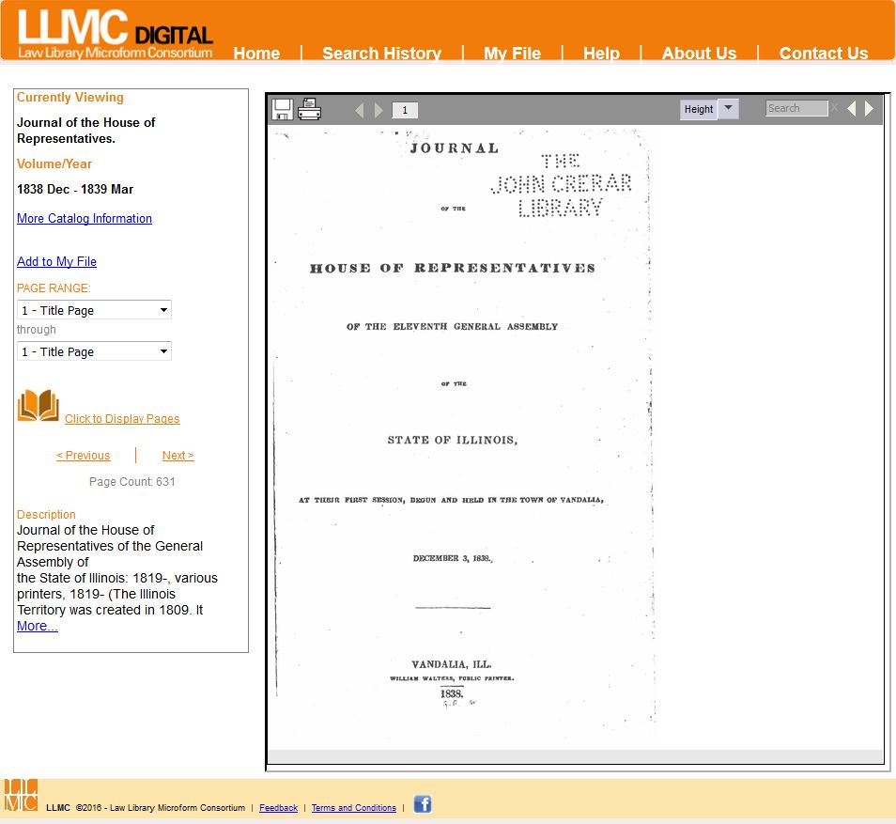

Slide 11
Preservation
LLMC’s Dark Side – Salt Mines in Kansas
Contracted with Underground Vaults & Storage
Wrapped in a 400 ft thick rock salt cocoon, located 650 ft below earth’s surface, accessible only by vertical freight elevator
“Fort Knox” security measures like biometric scans, video cameras, redundant authorizations, steel vault doors, blind passwords, anonymous storage, restricted personnel access, infrared monitors…
Guaranteed access to 000’s cubic feet of storage
Jan 2015 LLMC exceeded 10,000 cubic ft; equivalent of 200,000+ volumes
Expenses
Fixed costs $20,000/year
Variable costs
$1.65 per cubic ft based on 700 cubic ft/year; ingest & retrieval charges
Business Model – Integral to LLMC Mission
Part of our general operations budget (primarily subscription revenue)
Operation and Quality Controls
Shipment boxes standardized
10x11.15 inch double walled box
As of June 2016, 9,600 boxes at salt mines
Location Control Reports
PAPR Database (supported by CRL) is available at no charge and includes archive records for all LLMC Digital content preserved in salt mines

Slide 12
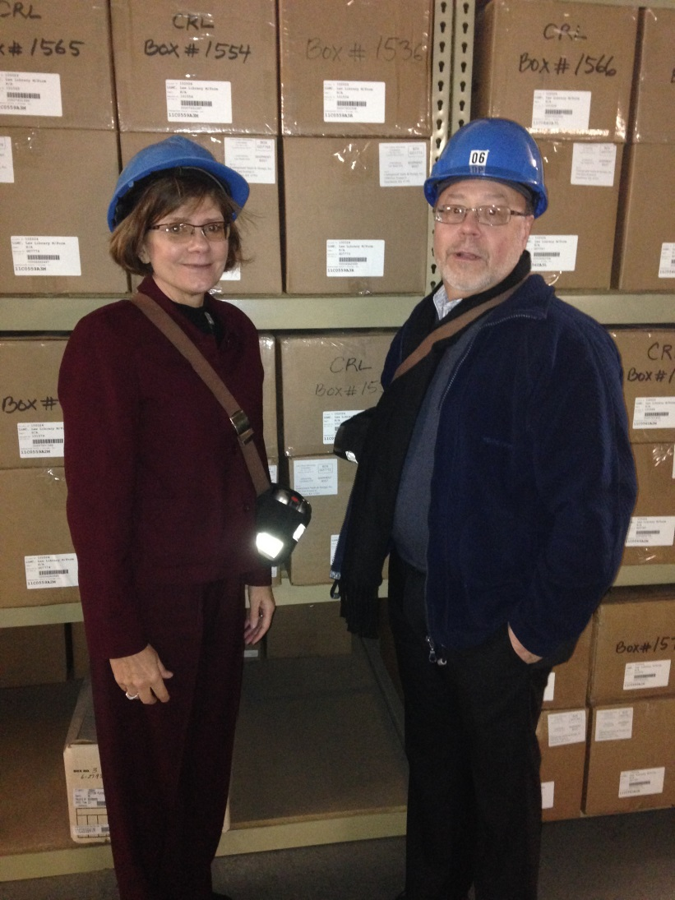
Salt Mine Preservation of Legislative Journals
Legislative Journals by Volume Count Preserved in the Salt Mines

Slide 15
“It takes a village..”
Iowa Legislative Services Agency (Glen Dickinson, Director) provides current updates to the Legislative Journals as well as updating Revised Codes; also contributed to Attorney General Reports/Opinions and other titles
Maine Law and Legislative Reference Library (John Barden, Director) contributed the Legislative Record in both paper and digital format; also helped fill session law gaps
University of Hawaii’s Law Library as well as Hamilton Library have contributed fill-ins for the Legislative Journals and session laws.
Washington State Law Library donated numerous volumes to fill session law collections across many states; also donated many revised statutes and codes from various states
Additional information regarding ‘Gap Filling’:
Wisconsin State Law Library filled in the Wisconsin Attorney Generals Opinions. Since they rely on LLMC Digital for digital access, they were able to lend us hard-to-find volumes (due to an incomplete donation years prior); also donated newer volumes to extend the range that is covered. These relationships typically develop and allow LLMC to then reach out in the future for more gap-filling or other collaboration.
LLMC may also have to fill in at the individual paper level. We actively track any pages that are missing from our volumes. LLMC inserts an “NYA” (not yet available) page when one is missing, while behind the scenes we are tracking down volumes to fill in those missing pages. The pages could be missing for various reasons: physically missing from book, misprint, page too damaged to scan, binding mistakes and printing mistakes to name a few.

