Slide 1
Jan, 2024
Stewarding the Monographic Collective Collection: Charting the Present
Devon Smith – OCLC
Alison Wohlers – Partnership for Shared Book Collections
Notes:
Devon –
Hello all, I’m Devon Smith with OCLC’s Membership and Research division. I’m happy to present today on the work my team and I have been working on. They are Gibi George, Rachael Juskuv, Kirk Hess, and Heather Carter.
Hello everyone, my name Alison Wohlers – presenting today as a representative of the Partnership Shared Print Corpus Task Force (part of the Research & Network Level Standing Committee https://sharedprint.org/about/working-groups/research-and-network-level/), which also includes Peg Seiden, Susan Stearns, Ian Bogus, Nika Worth, and previously Sara Amato.

Slide 2
Origin Story
The Partnership for Shared Book Collections serves 17 shared print monograph programs including 388 libraries
That service includes scaled research to support:
evidence-based decision-making and best practices for shared print and collective collection management;
cost-effective retention and access to shared print monograph collections;
preservation and long-term accessibility of print resources; and
expanding the collective of shared print programs and the value they provide.
Notes:
Alison – 30 seconds
The origin story for this collaborative research starts with the Partnership for Shared Book Collections, which is a federation of 17 shared print monograph programs, which together include 388 individual libraries in the U.S. and Canada. Our mission is to ensure the long-term preservation of, access to, and integrity of monographic print resources. One of the ways they we work to achieve our mission is by undertaking or partnering on scaled research.
https://sharedprint.org/about/research-agenda/
https://sharedprint.org/wp-content/uploads/2020/06/Partnership_Info_Packet-12-2-2019.pdf

Slide 3
Tier 1 priority research for the Partnership
Research questions...
What is the corpus of content we are looking to protect/preserve as part of Partnership programs (monographs)?
What is not being adequately retained (or potentially over retained)?
To answer these questions, we needed to be able to look at the broad landscape of both retained and unretained print book collections.
Notes:
Alison - 1 min
One of our top research priorities is to answer the questions on this slide.
What is the corpus of content we are looking to protect/preserve as part of Partnership programs?
What is not being adequately retained (or potentially over retained)?
Part of the power we have at a network level like the Partnership is the opportunity to look across individual efforts and provide information back to our community about
where we have a lot of coverage in terms of protecting the monographic print record
where we might have too much redundance
and where we have gaps
Building that understanding can then lead us to "how" questions – such as "how can we deploy resources strategically to ensure effective coverage of the monographic print corpus"
To answer these questions, we needed to be able to look at the broad landscape of both retained and unretained print book collections and that's where this research partnership with OCLC and the vast data sets in WorldCat of both registered shared print commitments and holdings data has been so very important.
https://sharedprint.org/about/research-agenda/

Slide 4
OCLC Analysis Approach
Analysis of current registered monograph print retentions in the US and Canada
Refine by state/province and shared print program
Further refine by subject, language, decade of publication, place of publication, retention expiration date, scarcity
Compare the landscape of print retentions against all monographic bib holdings
Notes:
~1 min

Slide 5
What we'll share today
Share initial findings on the landscape of current registered retention commitments of monographs
Gaps in data and participation
Data anomalies
Frame the next steps for the analysis
Comparing registered retention commitments against unretained holdings
Anticipated timeline and deliverables
Notes:
Alison – 1 min
Hand off to Devon to give a preview of the analysis.

Slide 6
AnalysiS - Preview

Slide 7
Data Overview
Who is represented in the analysis?
Institutions that have registered their commitments in OCLC’s Shared Print Registry
What is the state of the data?
34 million registered monographic retention commitments
99% updated in last 5 years
Normal errors that need normal cleaning
What challenges does the state of data present?
Multiple overlapping commitments complicate the analysis
One item committed to multiple programs
Multiple commitments for the same manifestation
Unregistered data limits the extent of the analysis
Notes:
Only institutions that have registered their commitments in the OCLC Shared Print Registry are considered in this analysis.
Overall, the state of the data is good and fit for analysis. There are, of course, errors and inconsistences but they are not atypical.
There are some challenges, though, that are worth mentioning.
Multiple overlapping commitments are a challenge to report without exploding visuals and charts.
Most important though is the unregistered commitments
This data is of unknown size.
Having all the data would make the report more valuable to the shared print community.

Slide 8
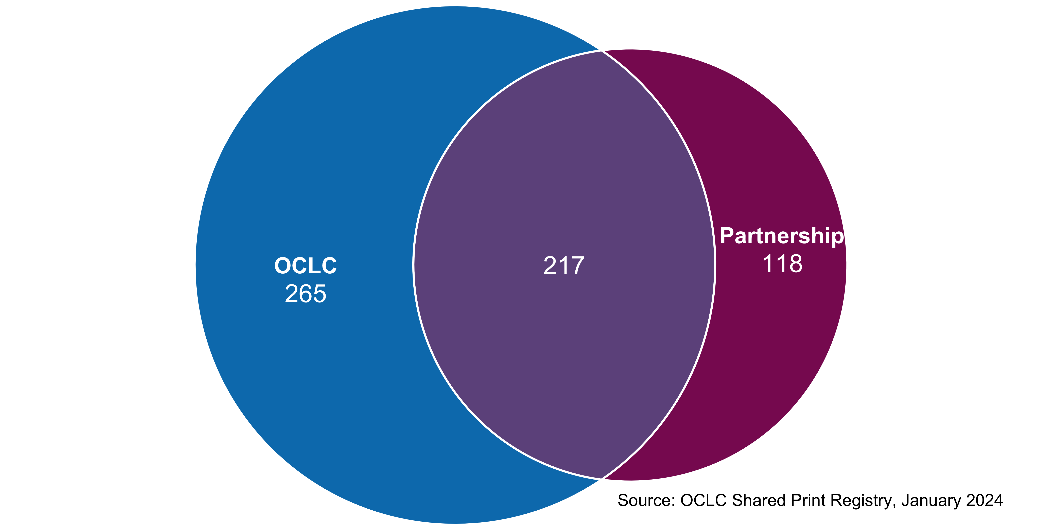
OCLC
482
Partnership
335
Institutions with
monographic
retention
commitments
Participating
institutions
Notes:
This is an overview of the coverage of OCLC’s data vis-à-vis The Partnership’s participating libraries. It should be noted that not every participating library is at this point making retention commitments, so they would not be in our dataset. But you can see that we have a large set of data beyond The Partnership.

Slide 9
Notes:
As mentioned before, there are 34 million registered monographic retention commitments in the US and Canada.

Slide 10
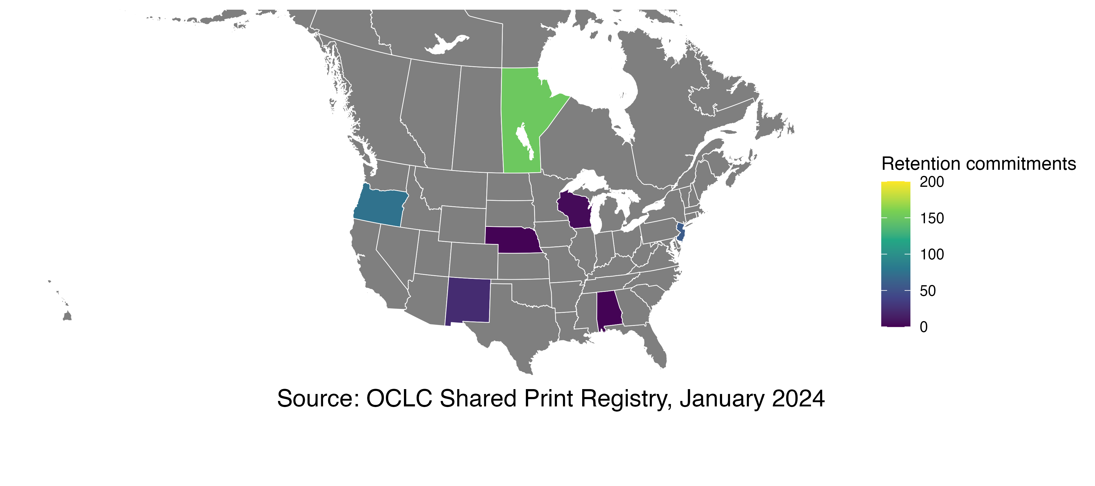
Total registered monograph commitments per state
Notes:
This is a map of registered monographic retention commitments - by state – where the number of commitments is under 200. In the next few slides we’ll see more states added so that we can see more clearly the relative scale.

Slide 11
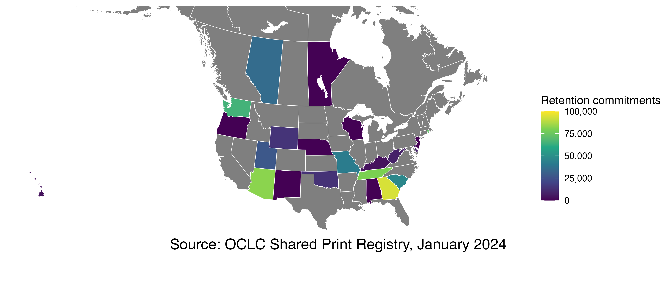
Total registered monograph commitments per state
Notes:
This is states with fewer than 100 thousand retention commitments. The states in the original slide all appear to be the same color now.

Slide 12
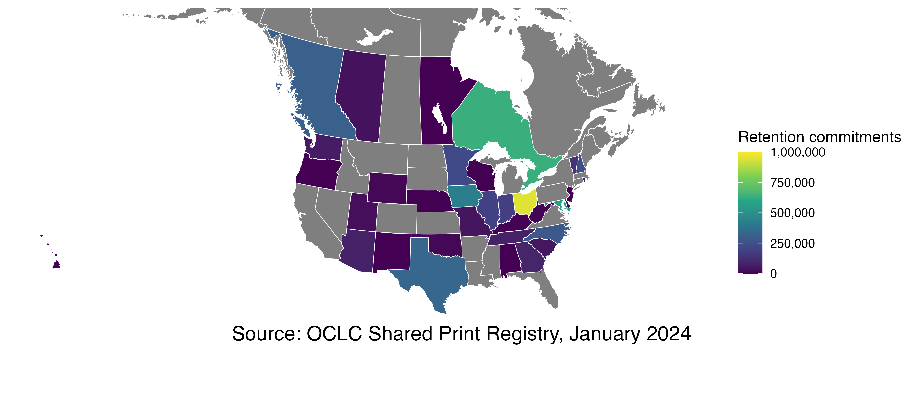
Total registered monograph commitments per state
Notes:
And this is states with fewer than a million registered commitments.

Slide 13
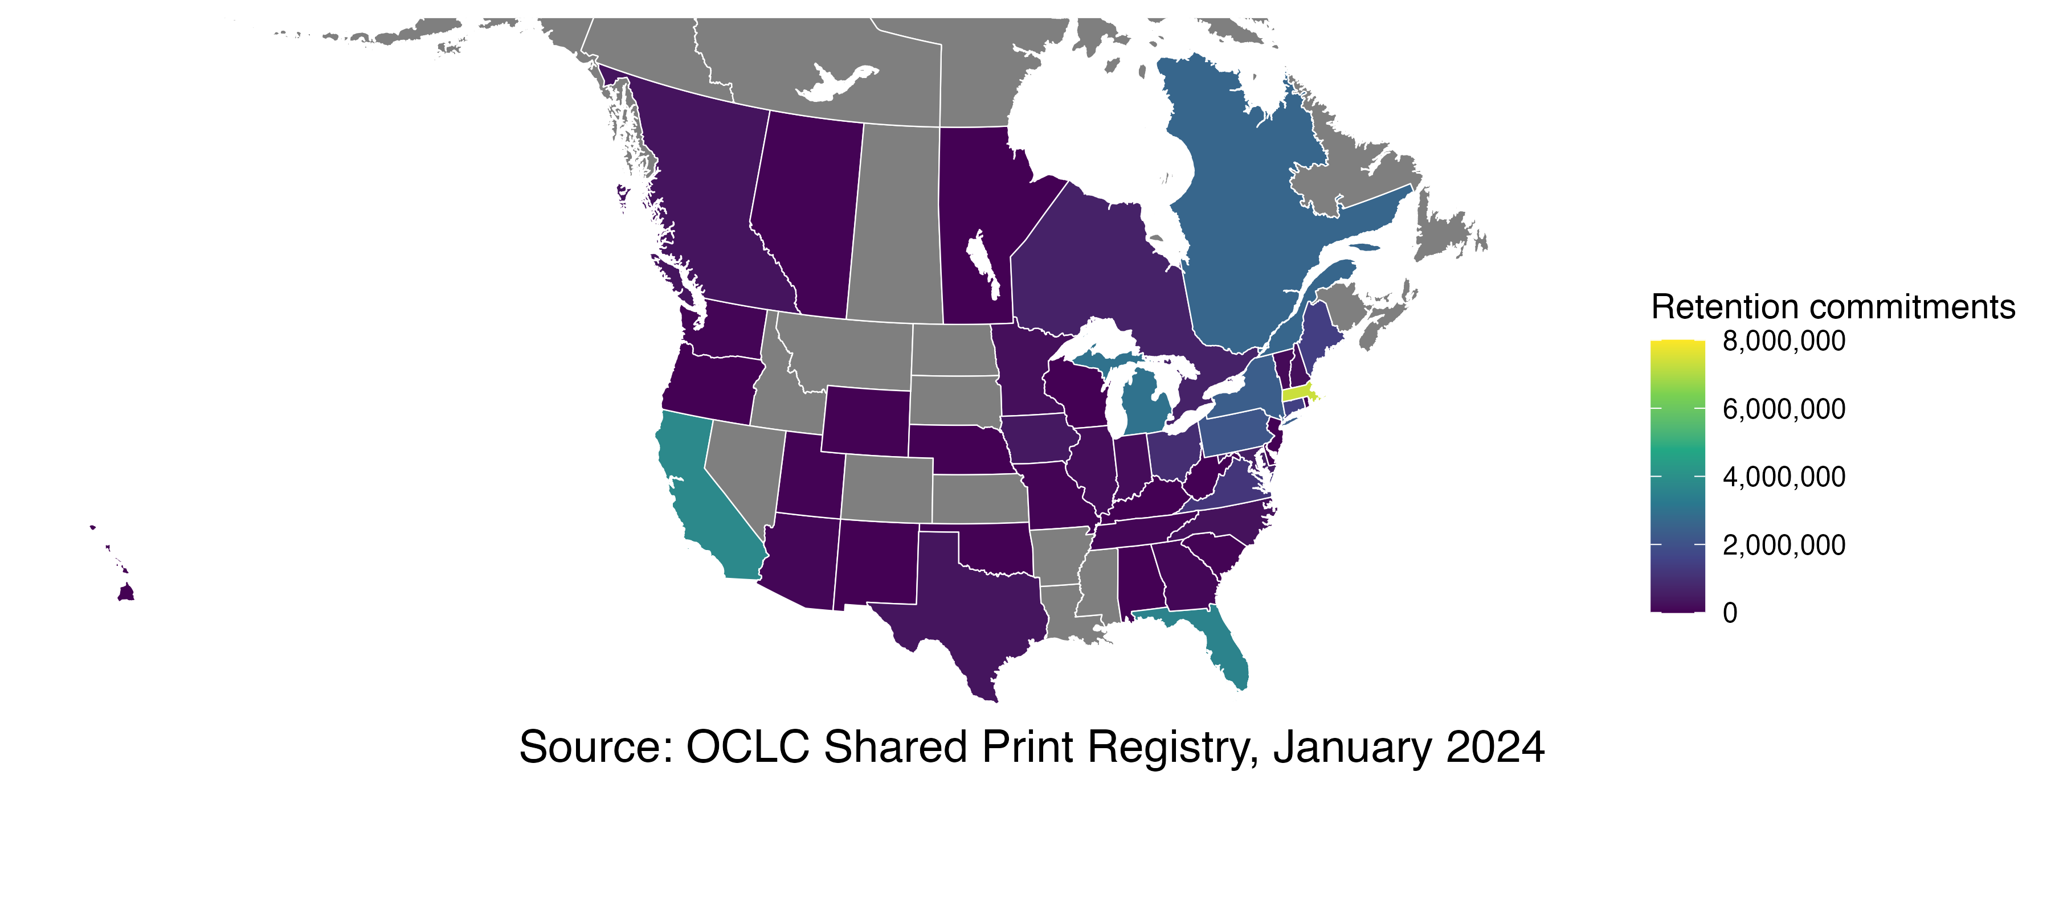
Total registered monograph commitments per state
Notes:
And this is the full map with all the states with registered monographic retention commitments.

Slide 14
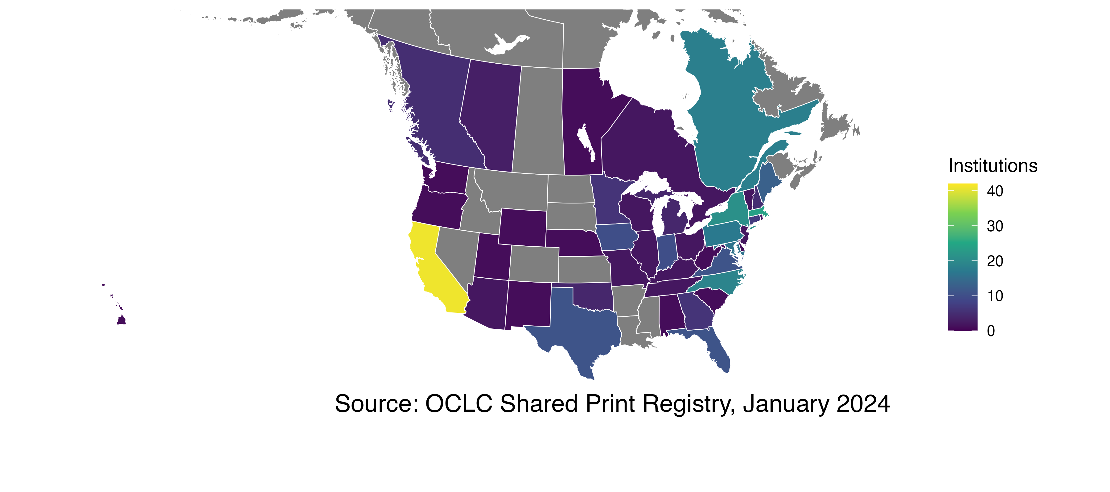
Institutions per state with registered monograph commitments
Notes:
Instead of commitments per state, this chart shows the number of institutions in each state.

Slide 15
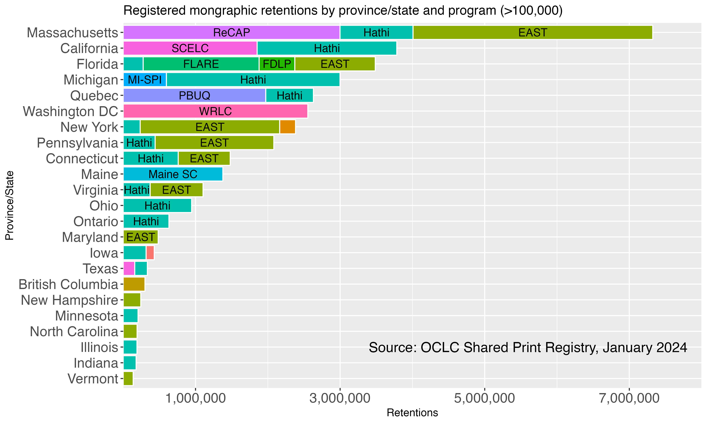
Notes:
Here, we see the number of registered commitments by state, broken down by the program in which the commitments are made. This chart only shows a program when there are at least 100 thousand commitments in that state for that program. There are several that have other retentions that aren’t visible here – eg, Maryland has 75 thousand commitments in HathiTrust that don’t show here.

Slide 16
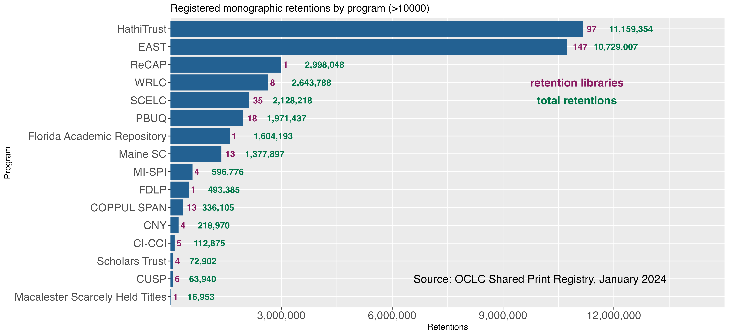
Notes:
This chart shows the number of registered monographic retention commitments in each program, when greater than 10 thousand and also the number of institutions that have registered those commitments.

Slide 17
Timeline
Started data engineering July 2023
Started analyzing September 2023
Targeting analysis completion February 2024
Will produce a public report, mid 2024
Including a website with datasets
Regular updates of analysis as registration grows

Slide 18
Q&A?
Join us at the PAN Watercooler!

Slide 19
Thank you
Alison Wohlers – Partnership for Shared Book Collections
Devon Smith – OCLC

