Slide 1
Capturing the Visuals of Shared Print
PAN Meeting - ALA Annual
June 21, 2019
Heather Weltin
HathiTrust Shared Print Program Officer
Notes:
Recently several of us active in a variety of shared print programs chatted about how we could capture and share shared print visuals in order to help inform ourselves, our programs, and beyond.
As the discussion progressed, we realized there might be value in a discussion with others which brings me here today.
The goal of these few minutes is to facilitate a discussion here regarding this and what the community thinks about this idea.
I plan to walk through some visuals you may have seen already, along with a few you probably haven’t.
As we walk through these visuals, please keep in mind the discussion we are about to have.
The goal of this open discussion is to hear from you all about value of visuals in telling your story, use cases, audience.
Now on to the visuals.

Slide 2
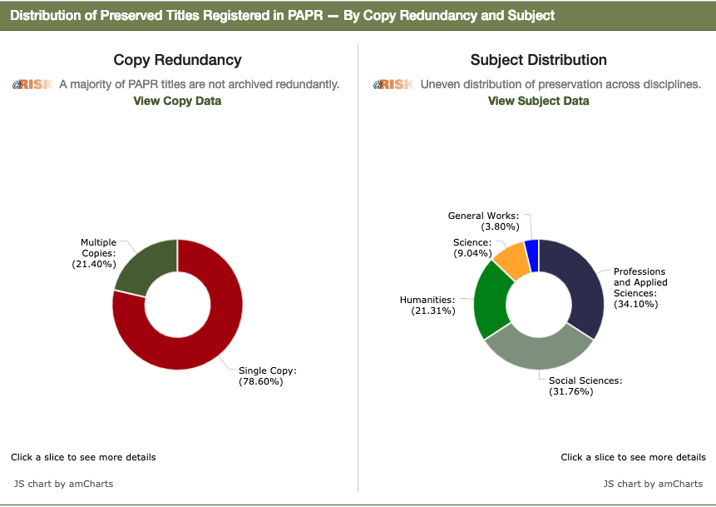
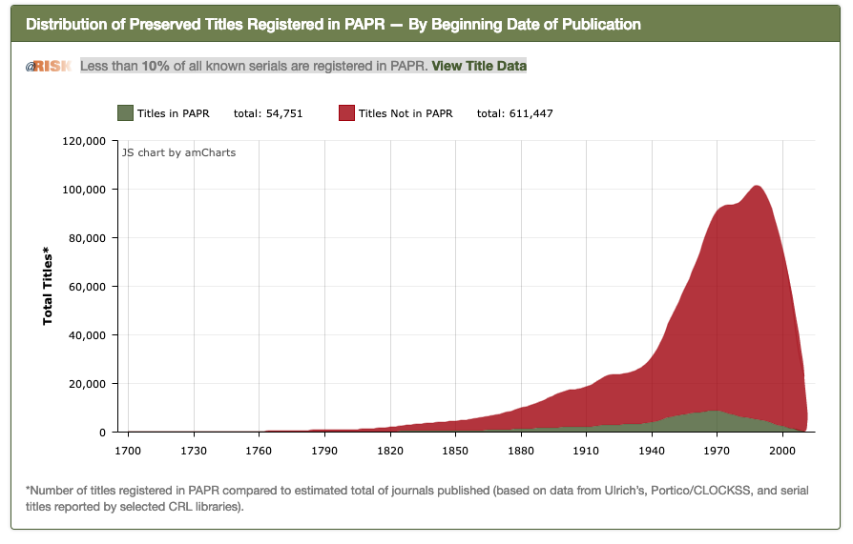
Print Archives Preservation Registry (PAPR)
Notes:
PAPR provides several types of statistics.
The ones on the screen now are visuals related to the programs, which are located on the PAPR dashboard.
The first shows the distribution of Preserved titles registered in PAPR by starting date of publication
The other shows distribution of preserved titles by copy redundancy and subject.
For each of these visuals, you can select different areas for more detailed information.

Slide 3
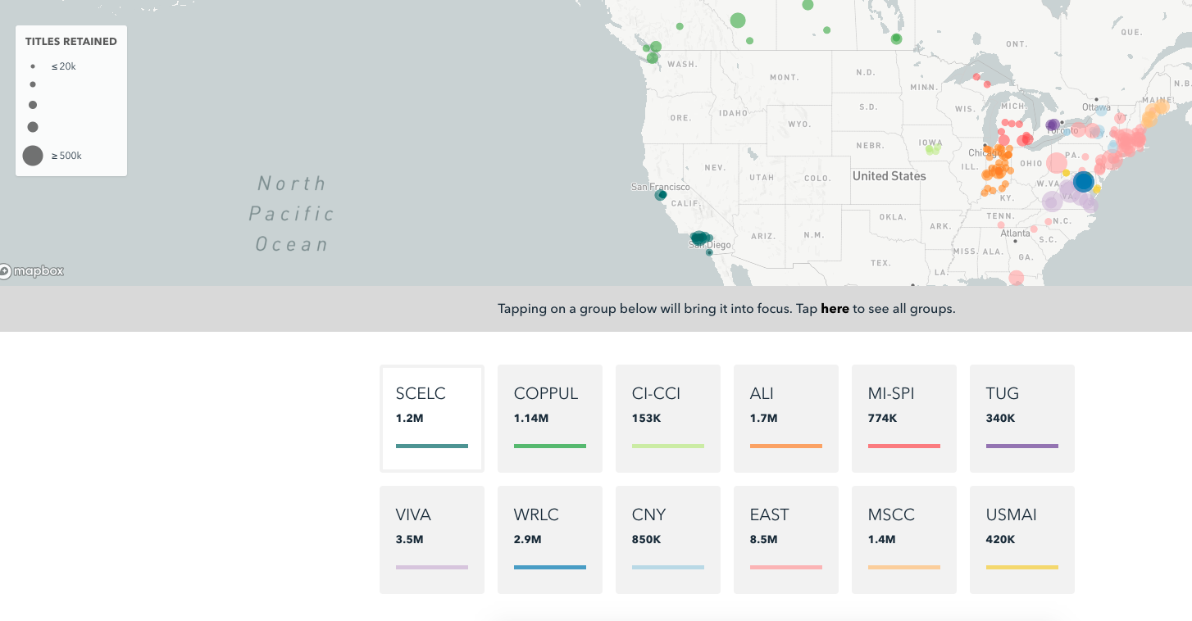
OCLC Sustainable Collection Services (SCS)
Notes:
This is a SCS and OCLC visual that shows shared print monograph retentions in north america. Well, those who have data with SCS.
If you aren’t familiar with this visual, the page includes narrative, data, and visuals to tell the story.
You can also drill down on each program for more information.

Slide 4
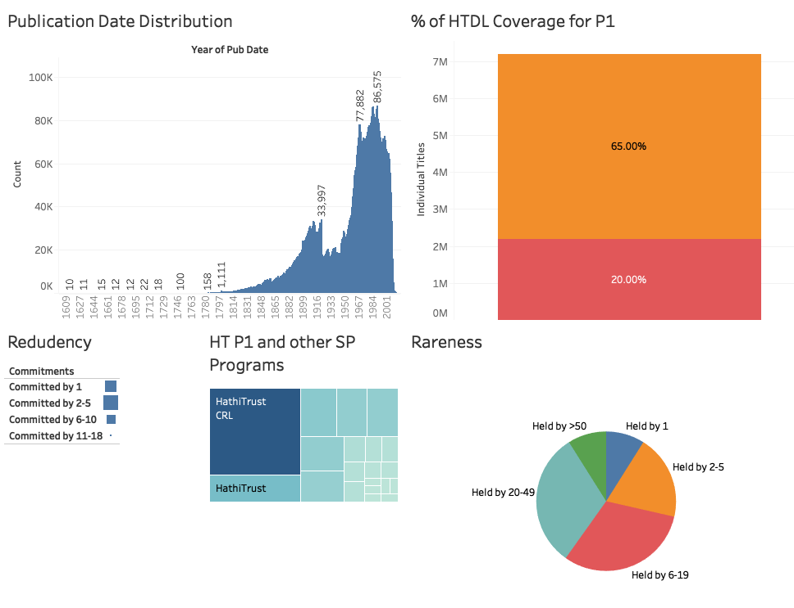
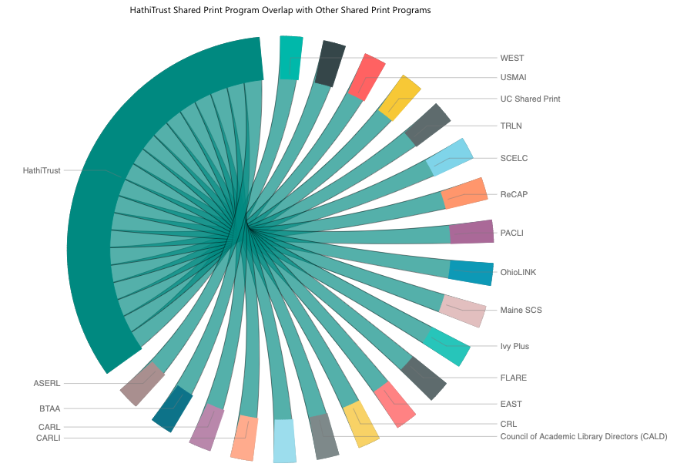
HathiTrust Shared Print Program
Notes:
These images are examples HathiTrust uses internally in order to help analyse the program and tell our internal story.
There is a lot on this screen, but they include
visuals related to % of coverage
publication data distribution
The sunburst chart shows HathiTrust’s connection with other shared print programs (many of you in the room today).
While they may not be publicly viewed now, that will most likely change.

Slide 5
Open Discussion
Value?
Use Cases?
Audience?
Data Needed?
Notes:
Now that you have seen some data, let’s turn to the discussion.
Before we identify which group might become the warehouse for national data or start pulling data together, we would like to hear from you all regarding the topics on the screen.
What value would we see in having this information available across programs?
What use cases could you see for this data?
What would the projected audience be?
What type of data would be valuable at a national level?
All ideas and suggestions are welcomed.
I will try to take notes, and have asked a few colleagues in the audience to do the same too.
So, who wants to start?

Slide 6
Additional Thoughts . . .
Heather Weltin
weltin@hathitrust.org
Notes:
Thank you for taking the time to discuss this with us.
Again, we are still discussing this with multiple people, so you have time to share additional thoughts, interest, etc.
Feel free to reach out to me at anytime.

