Slide 1
Enhancing the Shared Print Infrastructure
Amy Wood
Head of Technical Services
Center for Research Libraries
awood@crl.edu

Slide 2
Notes:
"This project provides an opportunity to make WorldCat, core infrastructure of the library world, a more serviceable tool for academic and independent research libraries in addressing the challenges of collections stewardship today," said Bernard Reilly, President, CRL.

Slide 3
Essential Building Blocks of Shared Print Network

Slide 4
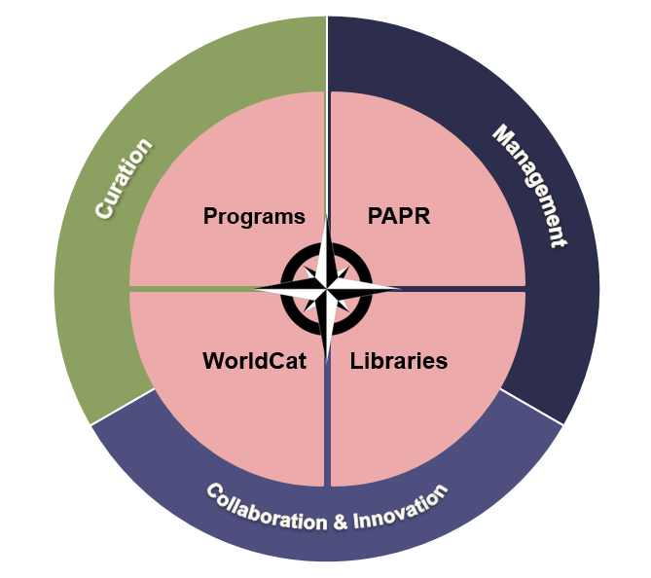
Essential Building Blocks of Shared Print Network

Slide 5
PAPR & WorldCat Synchronization
PAPR to WorldCat
Participate in PAPR
Library and CRL sign agreement listing terms of the synchronization service
Program Manager will remain the main contact
Updates immediately following PAPR updates
WorldCat to PAPR
CRL will create Collection Manager Query Collections to push alerts for new and updated shared print holdings in WorldCat.
Alerts will trigger process to pull records for loading into PAPR
All records will be checked against current PAPR holdings to prevent data loss or data problems.

Slide 6
PAPR Enhancements
Exposed publication history
Added format to improve aggregation of microfilm and electronic holdings with print holdings
Extended ability to add electronic holdings beyond Portico and CLOCKSS
Created ability to export data in format needed for batch loading
Extended ability to custom export data from PAPR to sync data with other databases
Improved statistical visualization
Identified key data issues to resolve to better support future data analysis

Slide 7
Project Web Page
A vital element of this effort has been & will continue to be feedback from all interested parties.
url: https://www.crl.edu/infrastructure-shared-print-collections
Contents
Shared Print Advisory Board Members
List of meetings held with the advisory board
List of meeting held with the Shared Print Community
Other relevant meeting notes and information about the project

Slide 8
Next Steps
Adding shared print disclosures in PAPR to WorldCat.
Keeping communication open.
Building a strong system of data sharing.

Slide 9
Contacts and Information
Amy Wood awood@crl.edu
PAPR http://papr.crl.edu/
Project page
https://www.crl.edu/infrastructure-shared-print-collections

