Slide 1
PRINT ARCHIVE NETWORK FORUM
GEPA, the Catalan Shared Print Collaboration &
Upcoming EPICO Conference in September 2024
Santi Balagué i Linares
GEPA Facility Manager
19th January 2024

Slide 2
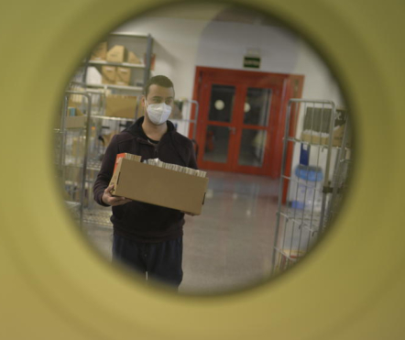
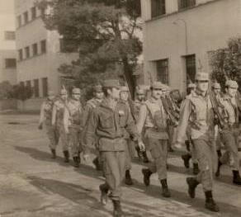
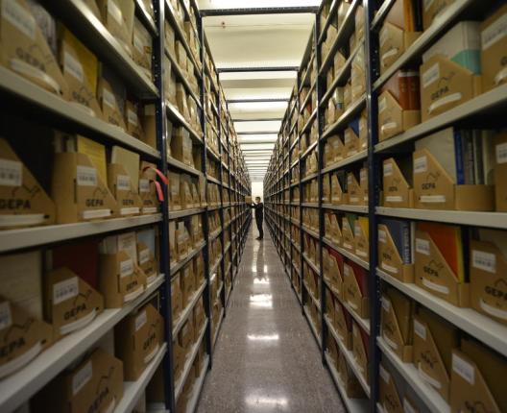
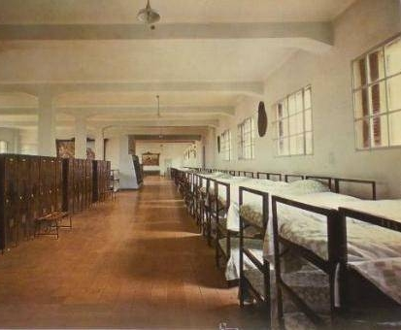
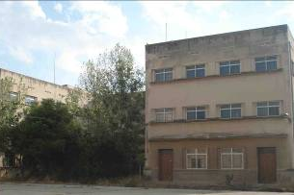
GEPA Cooperative Repository
CSUC, Consortium of Academic Services of Catalonia.
From a military barracks to a document depository.
The name GEPA is reminiscent of the dromedary hump used to store fat and water. In this case, however, documents that can be used in the future are stored.
GEPA promotes the release of room in university libraries so that it can be spent for new uses.
A maximum capacity for more than 23 km of shelves, so we can have up to 40 km of documents by compact shelving (Harvard model).
By the end of 2023, it has reached almost 100% capacity.
Planning to turn the dromedary into a camel: GEPA2, the 2nd hump, by remodelling another military barracks.

Slide 3
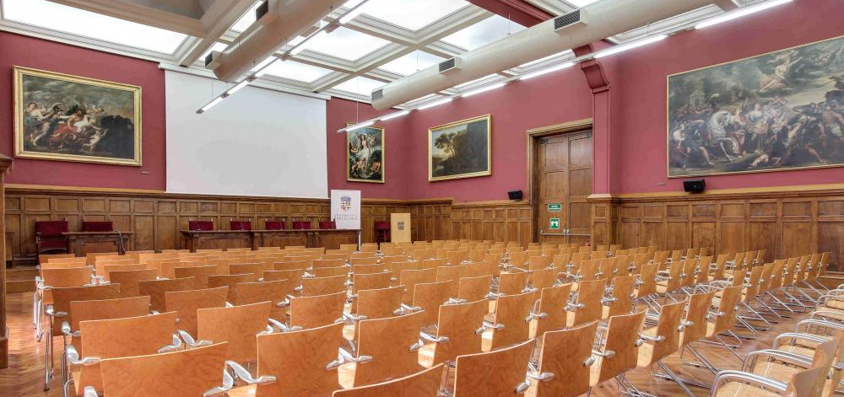
EPICo Conference September 2024
Welcome to the 2nd EPICo Conference in Barcelona, Spain.
Dates: 25-27 September 2024
Venue: Historic Building of the University of Barcelona. Aula Magna.
Hosted by: Universitat de Barcelona.
Co-organized by: Consortium of Academic Services of Catalonia.
Theme: “Importance of Print in a Digital World”
https://www.ub.edu/kuopio2024/

Slide 4
EPICo Conference September 2024
2nd EPICo Conference = 8th Kuopio Conference
A series of successful events originated in Kuopio, Finland, in 1999.
As in previous years, it will focus on themes in collaborative approaches to physical library storage.
Wide-ranging and engaging programme with perspectives not just from across Europe, but around the world (America, Australia, Middle East), bringing together library staff, partners, publishers, exhibitors and special guests .
Session themes will include: sustainability, architecture, business continuity planning, or approaches to access.
Registration will open this spring.

Slide 5
EPICo Conference September 2024
We can’t wait to see you at
EPICo/Kuopio Conference
in Barcelona!

