Slide 1
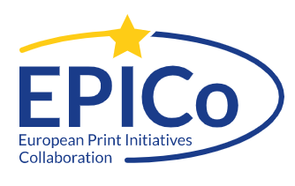
EPICo Then and Now
Andy Appleyard, British Library (andy.appleyard@bl.uk) Santi Balagué, GEPA (santi.balague@csuc.cat) Wolfgang Mayer, Shared Archiving Austria (wolf.mayer@univie.ac.at)
PAN Midwinter, January 2024

Slide 2
EPICo was born November 2015 in Vienna when representatives of seven European archiving initiatives met to discuss future collaboration.
Original intention was to have a focus on sustainable retaining scientific literature (AND meeting expectations of optimization of space use) as opposed to items of cultural heritage.

Slide 3
THEN (2015): 7 projects - 7 countries Limited to shared print initiatives (”complementary” to National Libraries) Max. 2 physical meetings per year One overall group Publicity limited to talks and publications
NOW (2024):
17 projects - 13 countries
Broader approach; National Libraries members as a matter of course
1-2 physical, numerous virtual meetings per year
Implementation of Special Interest Groups (e.g. Metadata)
PLUS website, biennial conference, transcontinental idea exchange

Slide 4
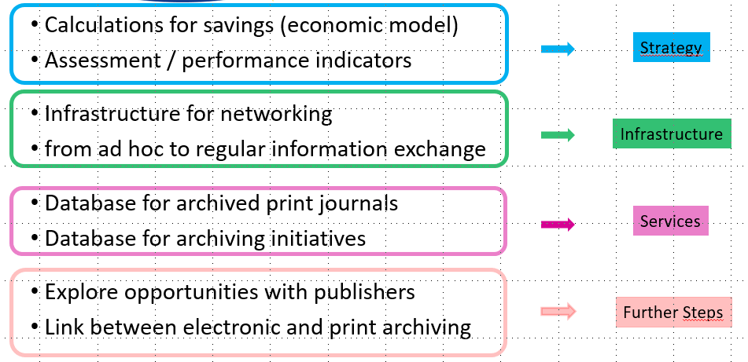
THEN (2015): Initial Plans

Slide 5
NOW (2024): Realization / Modifications
best practice exchange
Metadata activities
via website
via Conference

Slide 6
NOW (2024): Focal Point Conference
In 2018 EPICo decided to assume responsibility of the Kuopio Conference.
Sep 2022 (postponement due to Covid): 7th Kuopio (retrospectively 1st EPICo) Conference in Vienna, Austria (Programme; all presentations archived and OA available): 2 ½ days, 106 participants from 18 countries; 28 presentations Sep 25-27, 2024 2nd EPICo (=8th Kuopio) Conference in Barcelona, Spain

