Slide 1
PRINT ARCHIVE NETWORK (PAN) FORUM The British Library New Storage Facility
19th January 2024
Andy Appleyard
Director of Operations, North

Slide 2
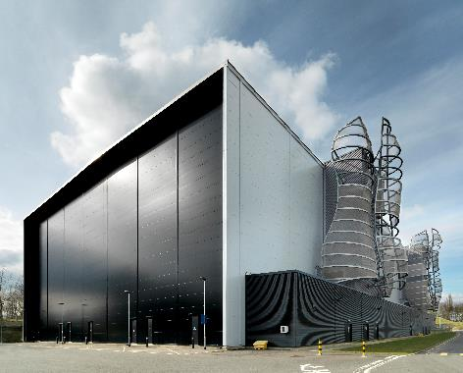
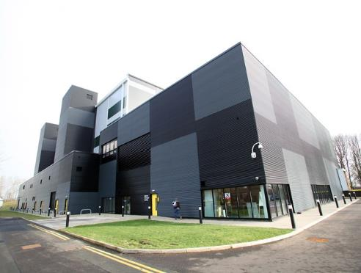
New Generation Storage and Preservation
High density, low oxygen, automated and lightweight construction
2010
2015
Additional Storage Building (ASB) 262 linear km of shelf space – approx. 7m items.
National Newspaper Building (NNB) 33 km of newspapers (60m issues / 750m pages).

Slide 3
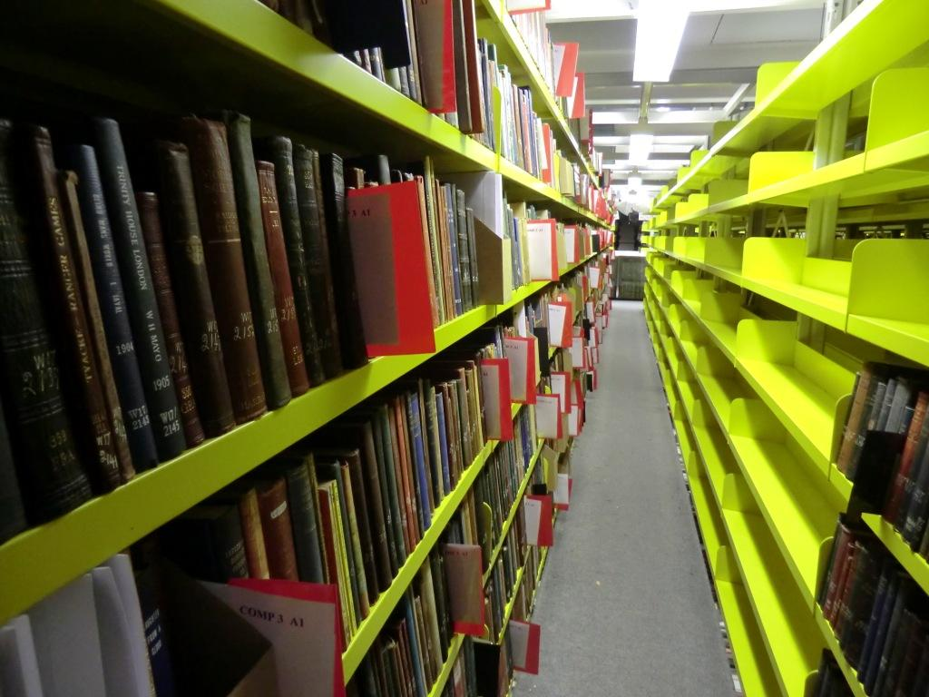
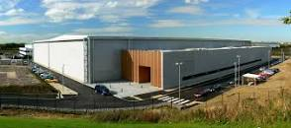
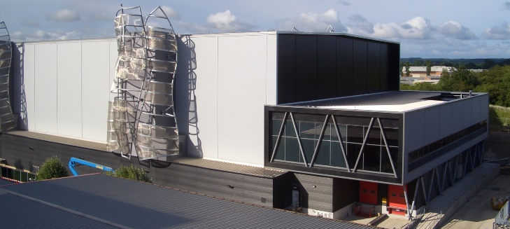
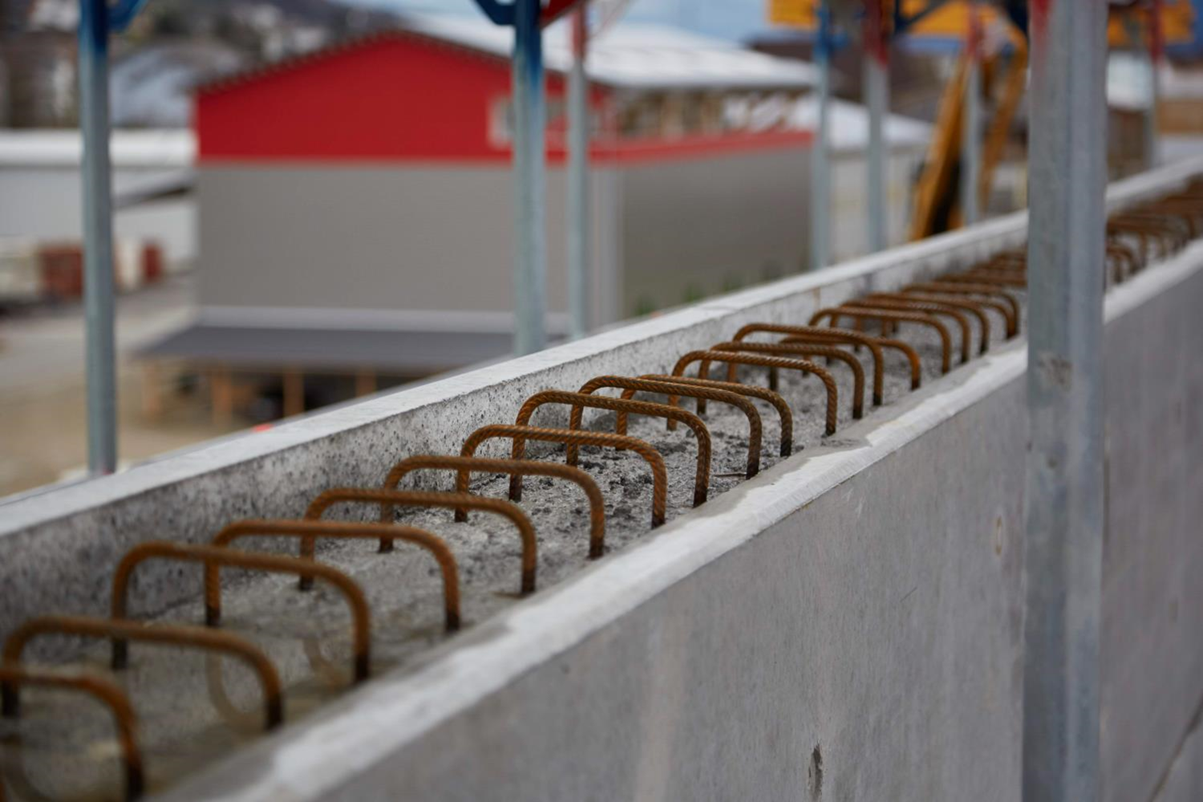
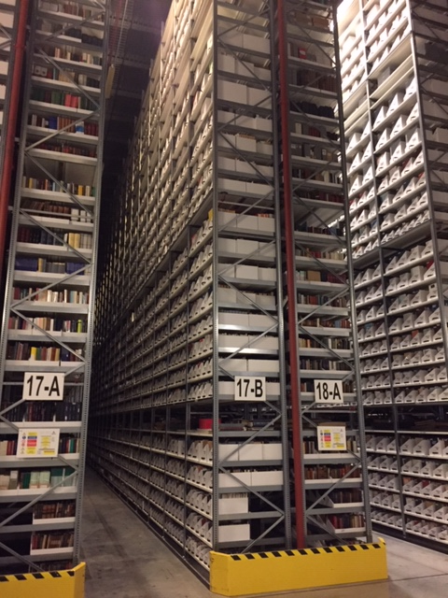
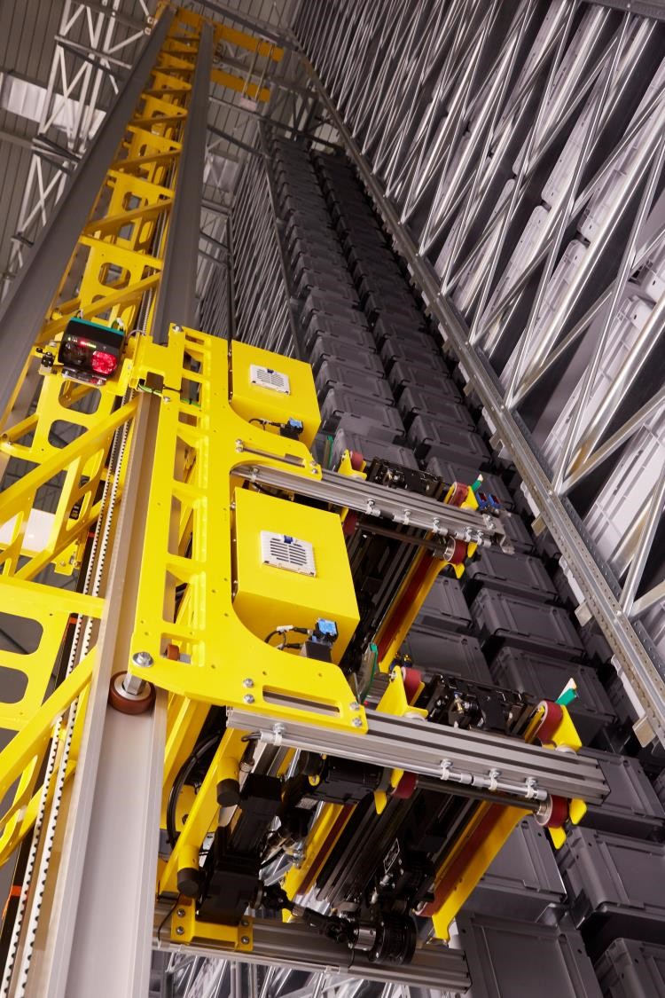
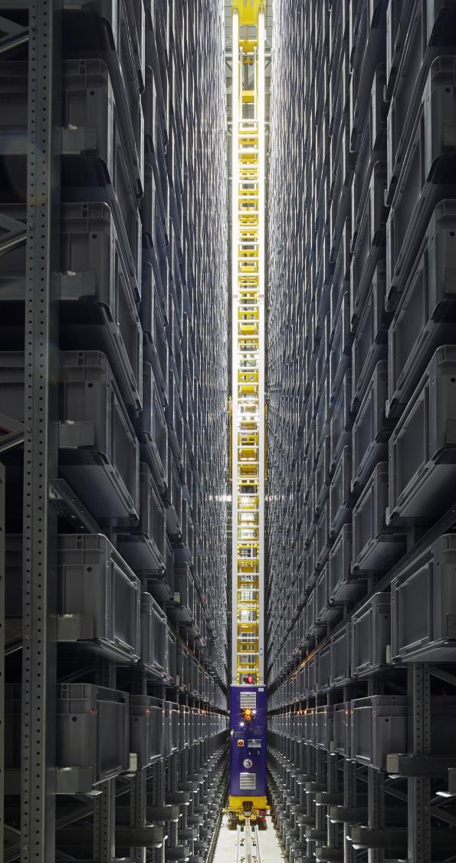
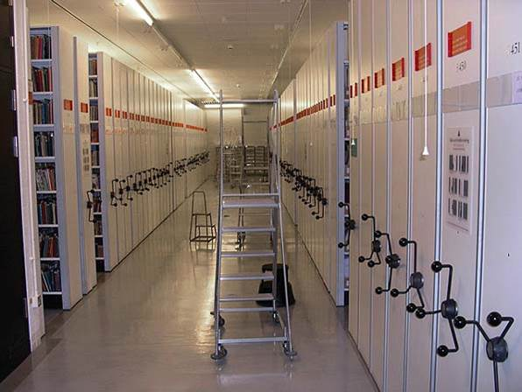
Different Print Storage Methods
Open Shelf
Harvard (Oxford) Model
The British Library Model
The Buron Model
Roller Shelving

Slide 4
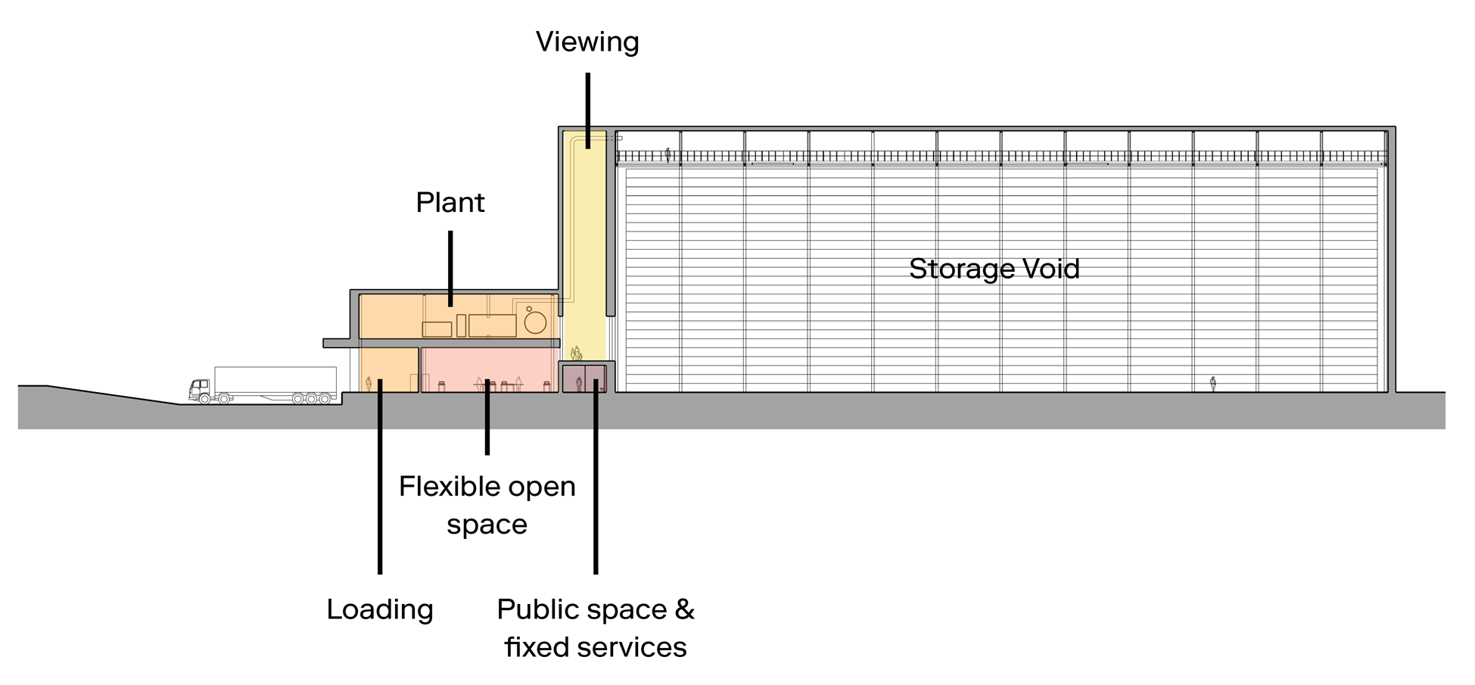
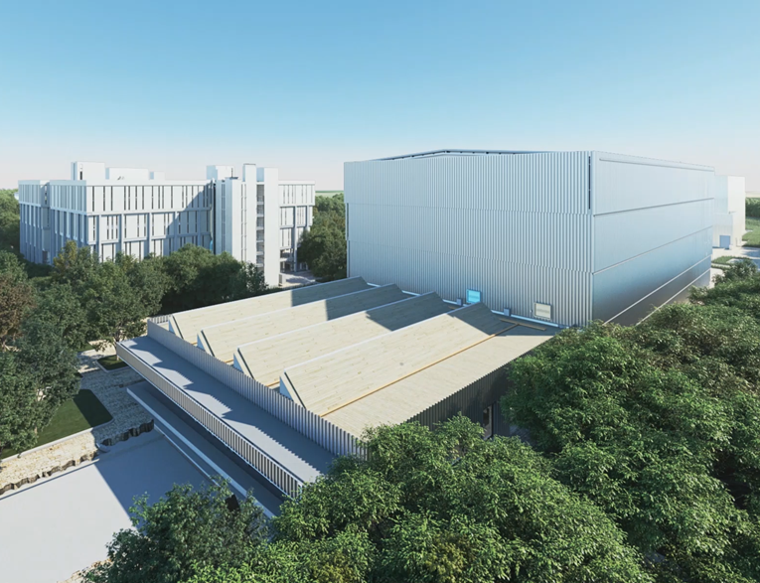
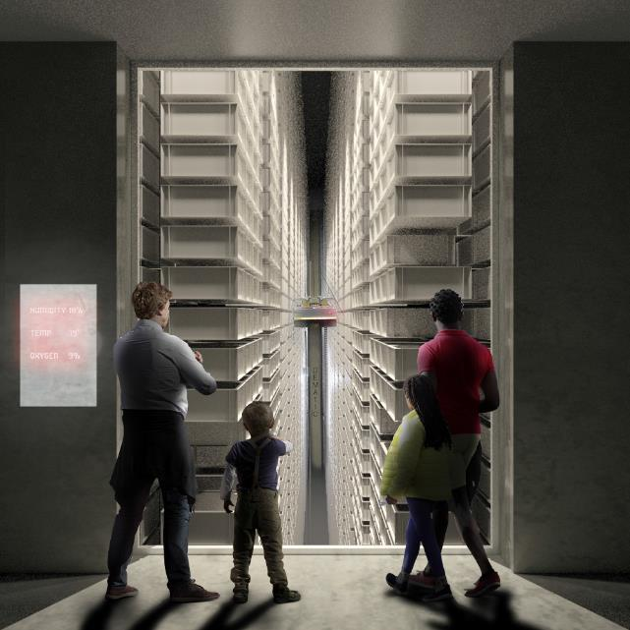
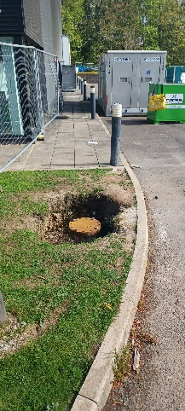
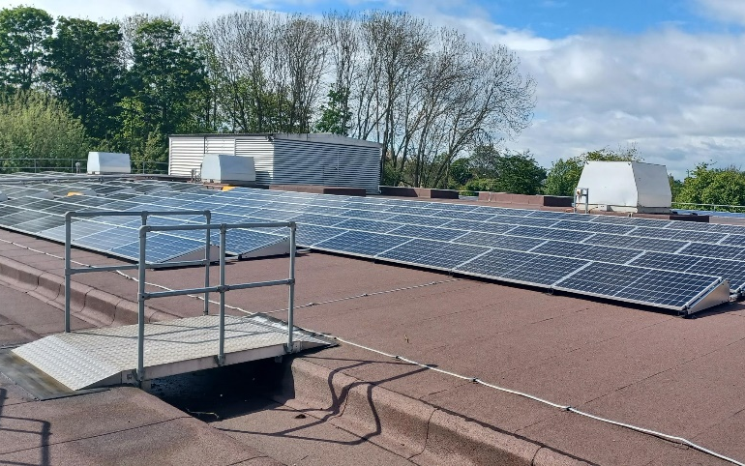
A new (sustainable) high density storage repository
225 linear km storage
Lightweight construction
Passivhaus (air tight)
Viewing gallery
Solar panels and GSHP
Notes:
Appearance
All key aesthetic design elements retained
Aluminium veil to storage vault
Cross-laminate timber Logistic Hub construction
Roof lights to Logistic Hub for natural light
Purpose-built viewing gallery
Standards
Exacting standards for building performance specified:
PassivHaus - An international standard and certification process for low-carbon buildings and design; includes a thorough quality management process during construction
BREEAM - An international sustainability assessment method for master planning projects, infrastructure and buildings
BS EN 16893 - An international specification for the location, construction and modification of buildings intended for the storage or use of heritage collections

Slide 5
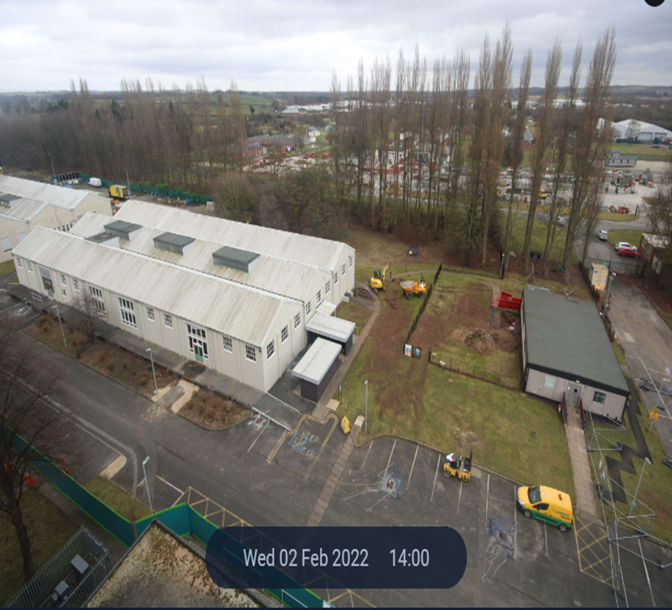
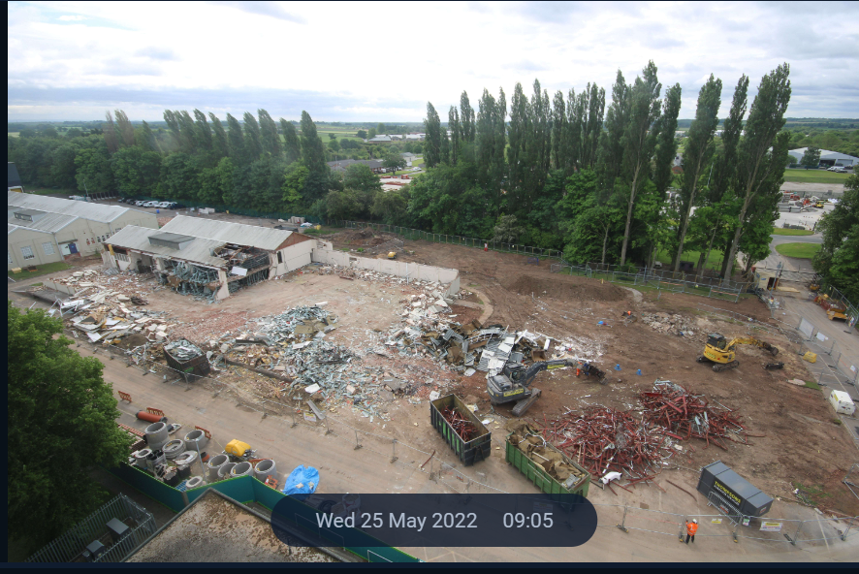
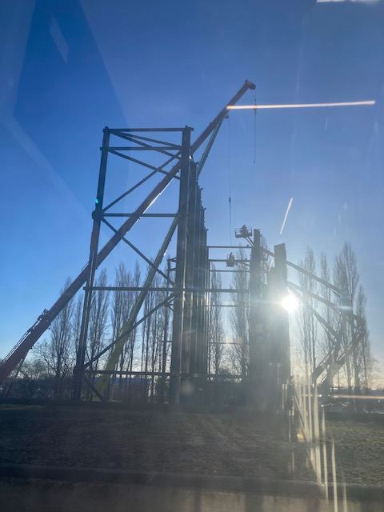
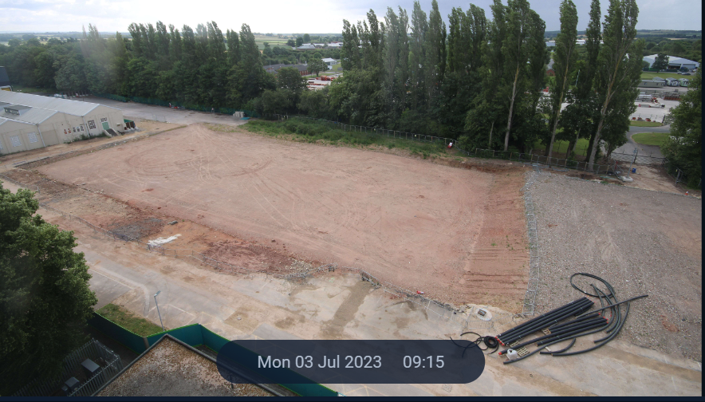
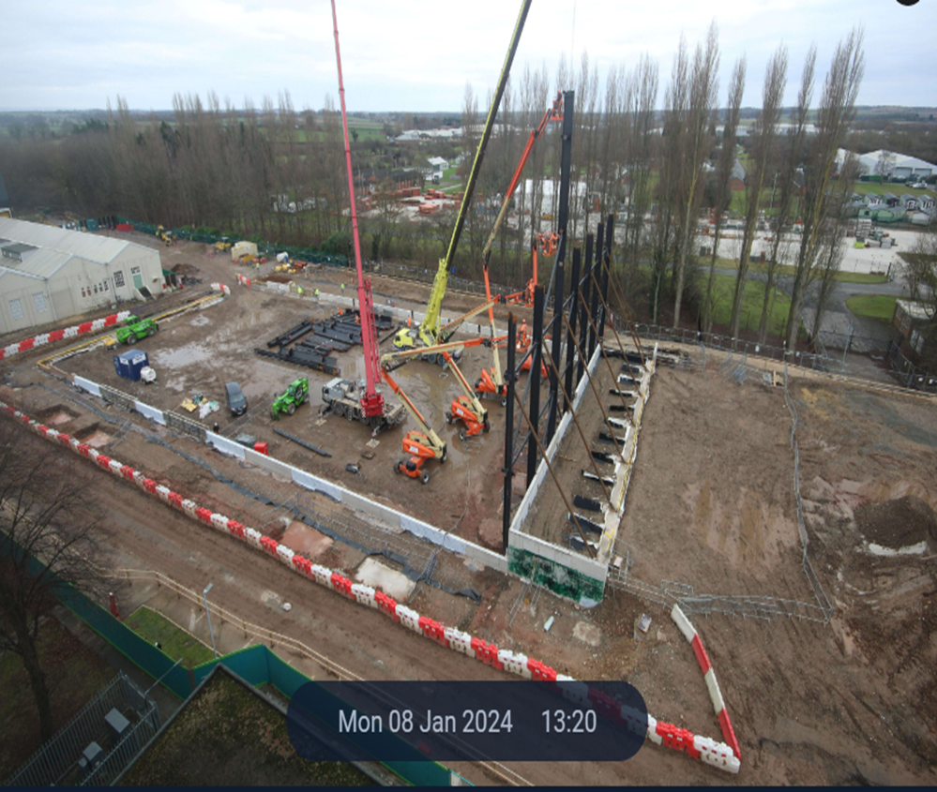
Planned completion 2026
Feb 2022
May 2022
July 2023
Jan 2024

