Slide 1
BTAA Shared Print Collection
UPDATE: PAN Midwinter 2024
Karla Strieb, she/her
Visiting Program Officer for Shared Collections

Slide 2
aspiration for a tremendous vision:
the BIG Collection
THROUGH COLLECTIVE ACTION
unite the collections into one collection - shared - fully networked
increase findability and usability of the total pool of content across the Big Ten
deepen our interdependence optimize for the whole before individual interests
continually improve value at scale for our community
increase resilience for an uncertain future for our universities
Maurice York, maurice.york@btaa.org | www.btaa.org/library

Slide 3
the KNOWLEDGE COMMONS
for the Big Ten will be
FINDABLE &
DURABLE &
USABLE
TRUSTWORTHY
access to the total
from past generations to future scholars
pool of knowledge
OPEN & JUST
INCLUSIVE &
public knowledge
COLLABORATIVE
for the public good
vested in the community
Maurice York, maurice.york@btaa.org | www.btaa.org/library

Slide 4
A Shared Print Collection: Distributed and Collectively Stewarded

Slide 5
Added value through an at-scale shared collection
Members can strategically invest in their collections in the context of the shared collection
The shared collection has greater persistence and
benefit for users than the collective collection
Users gain access to enhanced experiences
through the shared collection
The framework allows for coordinating effort and gaining
mutual benefit in the context of the shared collection

Slide 6
Community development
Fulfillment
Analytics
Agreements
Joint Stewardship
Designated for the shared collection
Building the Shared Collection (print)

Slide 7
Implementation of the AnalysisTool
What it is
BIG metadata pool of all records from all members – almost 100 million records (reflecting the collective collection)
Overlay of tools, reporting (including record export), and visualizations for bibliographic analysis and comparative holdings
Monthly indexing, giving up-to-date, continuous analytic capabilities

Slide 8
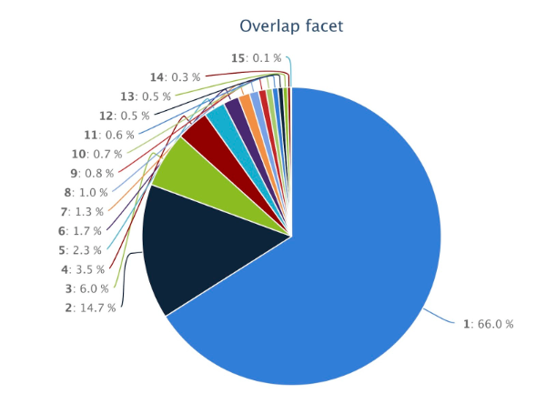
Monographs: Overlap Distribution
66%
Held by one member
.1%
Held by all

Slide 9
Some early learning
A shared collection of print material - distributed, collectively stewarded, and locally managed - requires shifting our thinking, collectively and locally.
A shared collection is a different goal from a shared print program.
The work of developing a shared collection requires and inspires dialog that joins a range of perspectives, knowledge, and commitments
Seeing the collective collection provides a focus for re-envisioning how the local and the collective form a new relationship
The community can and must create new ways to work together that align collective and local work

Slide 10
BTAA Shared Print: Up next
Building the distributed shared collection of print materials

