Slide 1
Validation & (Artifactual) Value: A Condition Survey Experiment
Mike Garabedian Collections Management Librarian Wardman Library • Whittier College
Notes:
(1) GOOD MORNING!

Slide 2
Ask a Question (1)
Notes:
(2) I’m here today to discuss a condition survey for the purpose of condition validation that I undertook as a member of the SCELC Shared Print working group during a research sabbatical in the summer of 2014. The genesis of this survey (and my involvement with the working group itself) was a question I posed on a SCELC listserv during early discussions about a potential shared print agreement.

Slide 3
Ask a Question (1)
[I]f in going forward, just one or two … copies [of a given edition] are going to be part of our shared print repositories, won’t we want to make certain that the copies we retain ... are the most complete documents we can find?—Me, in an e-mail message to mscelc@lists.scelc.org, October 8, 2012
Notes:
(3) Basically my question was whether anyone was interested in paying attention to the condition and completeness of our shared print copies, and whether we planned to use condition as a criterion for deselection.

Slide 4
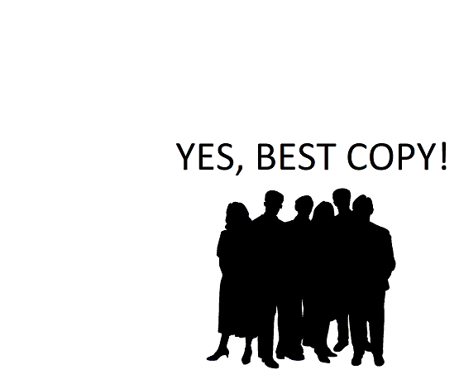
Ask a Question (1)
[I]f in going forward, just one or two … copies [of a given edition] are going to be part of our shared print repositories, won’t we want to make certain that the copies we retain ... are the most complete documents we can find?—Me, in an e-mail message to mscelc@lists.scelc.org, October 8, 2012
Notes:
(4) In response, more than a few member librarians said that in thinking about a consortium-level shared print agreement they favored a policy whereby “best copies” would be identified and retained for sharing, but they also identified more than a few obstacles to considering book conditions for the purposes of retention and de-selection. Karen Schneider, formerly of Holy Names University, zeroed in on one of the main impediments, writing “I agree with ‘best copy’ [but] am thinking that we have at best very limited tools for this (versus online bookselling where noting condition of copies is routine).”

Slide 5
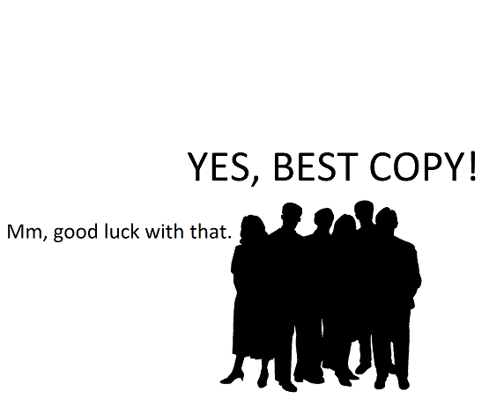
Ask a Question (1)
[I]f in going forward, just one or two … copies [of a given edition] are going to be part of our shared print repositories, won’t we want to make certain that the copies we retain ... are the most complete documents we can find?—Me, in an e-mail message to mscelc@lists.scelc.org, October 8, 2012
Notes:
(5) Meanwhile, consultant Lizanne Payne expressed others’ legitimate concern that developing tools to assess and record condition beyond a simple kind of yes/no validation, and then deploying such tools, would likely be too time-consuming, and too costly an undertaking, for the purposes of shared print.

Slide 6
Ask a Question (2)
Notes:
(6) At the same time I was thinking about how we might use condition as a measure by which to identify copies to share, I became eligible for a summer research sabbatical that would allow me to test on a small scale the feasibility of the kind of condition analysis I was proposing, and so I asked a new question:

Slide 7
Ask a Question (2)
Is it possible to design a condition survey instrument to gather reasonably detailed information about the completeness of and damage to mutually-held book copies that is also simple to deploy and cost-effective?

Slide 8
Ask a Question (2)
Is it possible to design a condition survey instrument to gather reasonably detailed information about the completeness of and damage to mutually-held book copies that is also simple to deploy and cost-effective?

Slide 9
Ask a Question (2)
GOALS

Slide 10
Ask a Question (2)
GOALS
/ • Define the physical attributes of condition validation • Develop a survey instrument based on these attributes • Develop policies/procedures to assess condition • Undertake a trial version of a condition survey using mutually held copies at select SCELC member libraries
Notes:
(10) In short, my project was to define the physical attributes condition validation would include, but also to undertake the more difficult tasks of developing the procedures by which condition would be assessed and recorded and then actually to put these procedures into practice by assessing the condition of mutually-held copies at several SCELC member libraries.

Slide 11
A note about ‘Condition’
Notes:
(11) Before I continue, Moderator Bob Kieft said I could take 30 seconds out of my 8-minute presentation to mount my soap box and explain what I mean by “condition.”

Slide 12
A note about ‘Condition’
Notes:
(12-14) For the purposes of shared print certainly it is imperative to identify damaged books or books with missing pages, for example (13), or to exclude from consideration book-copies whose poor conditions might mean a copy would have to be conserved before it could be used again (14). For this reason existing shared print networks have developed basic validation criteria to identify and reject copies in really bad shape, and indeed, this is in general what practitioners who work in circulating collections think of when then think about a book’s condition.

Slide 13
A note about ‘Condition’
MISSING PAGES
Notes:
(12-14) For the purposes of shared print certainly it is imperative to identify damaged books or books with missing pages, for example (13), or to exclude from consideration book-copies whose poor conditions might mean a copy would have to be conserved before it could be used again (14). For this reason existing shared print networks have developed basic validation criteria to identify and reject copies in really bad shape, and indeed, this is in general what practitioners who work in circulating collections think of when then think about a book’s condition.

Slide 14
A note about ‘Condition’
MISSING PAGES
HINGES BROKEN
Notes:
(12-14) For the purposes of shared print certainly it is imperative to identify damaged books or books with missing pages, for example (13), or to exclude from consideration book-copies whose poor conditions might mean a copy would have to be conserved before it could be used again (14). For this reason existing shared print networks have developed basic validation criteria to identify and reject copies in really bad shape, and indeed, this is in general what practitioners who work in circulating collections think of when then think about a book’s condition.

Slide 15
A note about ‘Condition’
Notes:
(15) However, as we begin to think about the exigencies of shared print, I am arguing that it’s as important to ensure the copies we select for sharing are the most artifactually complete copies we can identify. In this sense “best copy” would mean a copy of that mutually held title whose physical form is closest to the book in its original state.

Slide 16
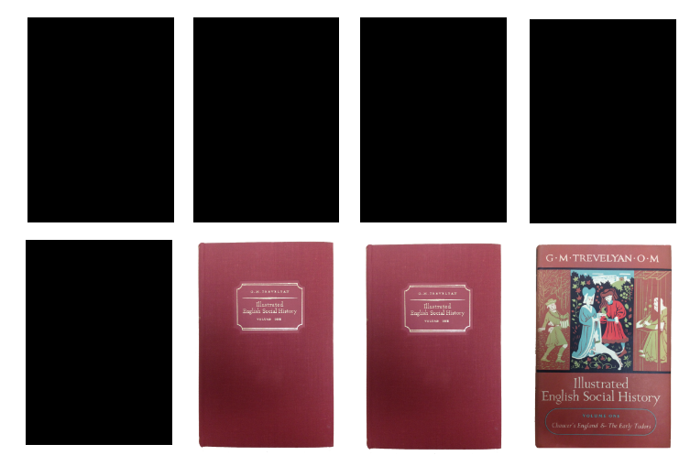
A note about ‘Condition’
Notes:
(16) So for example, given eight copies of a mutually held book where five copies have been rebound in library buckram, two are still in the publisher’s original binding, and one is yet in its original dust-jacket, the “best copy” – the most artifactually valuable copy – would be the jacketed copy.

Slide 17
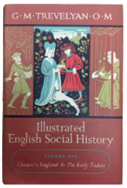
A note about ‘Condition’
Notes:
(16) So for example, given eight copies of a mutually held book where five copies have been rebound in library buckram, two are still in the publisher’s original binding, and one is yet in its original dust-jacket, the “best copy” – the most artifactually valuable copy – would be the jacketed copy. (17)

Slide 18
A note about ‘Condition’
Notes:
(18) In a grouping of eight copies of a mutually held title comprising seven copies re-bound in buckram, and one yet in its original jacket …

Slide 19
A note about ‘Condition’
Notes:
(19) Clearly the jacketed copy would be the most artifactually “complete” copy, and depending on what one thinks its important in a given information object, we might consider it the copy worth retaining -- even if another, less artifactually complete copy is in better physical shape (20)

Slide 20
A note about ‘Condition’

Slide 21
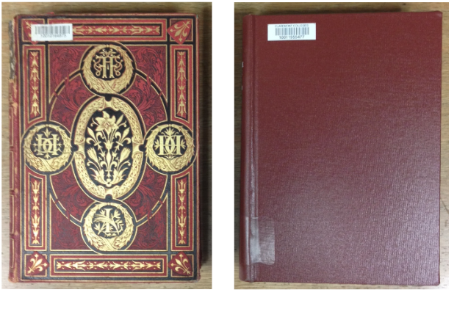
A note about ‘Condition’
Special Collections
General Collections
Notes:
(21) Librarians who work in general collections are of course not used to thinking about books in this way. Traditionally, the physical or artifactual value of books is something to which our colleagues in special collections give attention and prioritize. Former University of Pennsylvania Curator of Research Services Daniel Traister has written, “the root of the sense of the difference between general and special collections” has to do with preservation versus access: Whereas in circulating collections access and the intellectual content of books is emphasized, in special collections preservation and artifactual value take precedence.

Slide 22
A note about ‘Condition’
Special Collections
General Collections
Artifactual Value
Intellectual Content
Preservation > Access
Access > Preservation
Notes:
(22) And indeed, to the extent we “do” preservation in general collections, it is not to preserve the objects in which information is embedded but simply to ensure these objects last longer, even if this means destroying parts of the originals (e.g., rebinding books in buckram boards), or using surrogates in their place. In the preservation/access binary practitioners like Traister have posited, then, general collections librarians come down firmly on the side of access: For us a book’s intellectual content trumps its format or artifactual value, which is why there’s such a thing as library bindings in the first place, and which explains why Whittier College has a set of Dodsley’s Old Plays which looks like this:

Slide 23
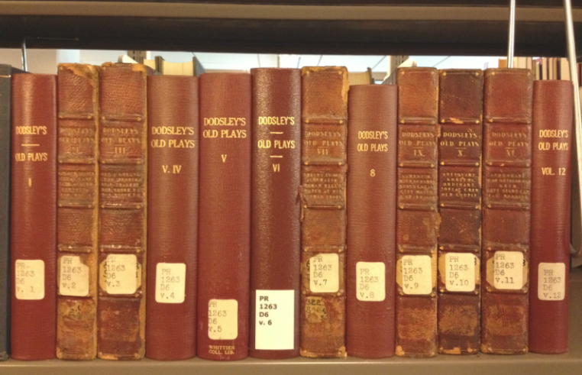
A note about ‘Condition’

Slide 24
A note about ‘Condition’
!!!

Slide 25
Full Disclosure
Notes:
(25) So some full disclosure: My project is informed by the idea that, in planning for shared print, it is best to adopt an artifact-focused view of preservation allied more closely with special, not general collections. For if one of the goals of shared print is to allow participating libraries to deaccession duplicate copies in order to free up space, then in a real sense we are creating scarcity where none existed before. In other words, whether shared copies will exist in a storage facility or not, in essence a shared print network will constitute a kind of new, special collection whose originals will have to be all things to future consortium member library researchers, including researchers interested in books as artifacts. Thus, it behooves us to identify, if we can, the most artifactually valuable of our mutually-held copies.

Slide 26
Full Disclosure
!!!

Slide 27
The Survey Instrument
• Though existing works for validating print journals were somewhat helpful, print journals are not print monographs ... • Existing, well-known condition surveys designed to extrapolate conditions of collections from a survey group (e.g., Yale, University of Illinois, and Syracuse in the late 1980s; and more recent surveys at the Universities of Kansas and Southern Mississippi) were far too complex, and therefore far too long • My validation criteria and survey instrument are 'stripped down versions' of these more complex surveys
Notes:
(27) In developing the survey instrument for my project I wanted the instrument to gather information about completeness of and damage to mutually-held book-copies in several consortial collections, but also about key artifactual elements of these items. I sought above all to keep my apparatus complex enough to capture significant artifactual, paratextual information, but simple enough for work study students to deploy, and short enough to make analysis efficient and cost-effective. To help shape my questions I looked to some of the well-known published condition surveys undertaken in circulating collections at Yale, the University of Illinois, and Syracuse in the mid- and late-1980s; more recent surveys from the Universities of Kansas and Southern Mississippi; and a condition survey apparatus employed by the preservation unit at the University of California at Los Angeles. In part because my goals of hypothetical deselection of mutually held copies for shared print were different than the goals in these surveys (i.e., extrapolating conditions about entire collections, and prioritizing volumes in a single collection for preservation) without exception the survey instruments in these studies comprised far too many questions. However, the responses in the published studies informed my ultimate apparatus, which represents a kind of stripped down version of these more complex surveys.

Slide 28
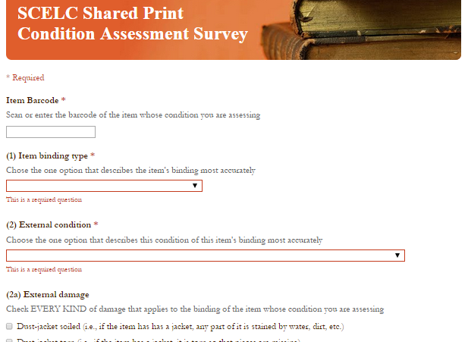
The Survey Instrument
* tinyurl.com/conditionsurvey *
Notes:
(28) I don’t have time here to go through the survey, but you can check it out yourself at tinyurl.com/conditionsurvey. The survey instrument I created is composed of five primary entries. Upon scanning an item’s barcode the respondent is presented with three forced-response dropdown questions, two of which are followed by optional specifiers. Dropdown menus include nominal values describing the type of binding the item has, as well as 4-item Likert scales describing external and internal condition with options ranging from “very good” to “poor.” The respondent is then asked whether to retain or discard the item, and a space for optional notes or comments concludes the instrument. Thirty-seven scripted responses to the five primary and four optional specifier entries would make data collection more efficient and data analysis easier, and also allow the respondent to make more explicit, objective claims about somewhat subjective Likert scale options. This all sounds complex, but if you look at the survey you’ll see that it’s quite simple. Given concerns about the time (and cost) needed to undertake item-level condition analysis, it bears noting that leveraging Google Forms to design a survey instrument that fed directly into a web-based database, in addition to using barcodes as unique identifiers, made the process of data collection and analysis far easier and more efficient. Google Forms allowed for a simple, clean, and instructive data form. Scanning barcodes rather than inputting this information manually -- or inputting another kind of unique identifiers like call number, title, author, or imprint information -- saved inputting time. It also allowed me, post-survey, to draw out information about book-copies from existing ILS item records and to manipulate this data for the purposes of comparing mutually held titles.

Slide 29
The Sampling Method
Azusa Pacific University
​ FTE: 8,803; Volumes: ​250,000
BIOLA University
​ FTE: ​ 5,709​; Volumes: ​300,000​
Claremont Colleges
​ FTE: ​6,747; Volumes: ​ 1,000,000​
University of LaVerne
​ FTE: ​7,388; Volumes: 230,000​
Loyola Marymount University
​ FTE: ​8,307; Volumes: ​ ​582,800​
Mt. St. Mary's College
​ FTE: ​2,100; ​ Volumes: ​ ​130,000​
Pepperdine University
​ FTE: ​5,978; ​Volumes: ​ ​394,200​
Whittier College
​ FTE: ​1,855; Volumes: ​ ​300,300
Notes:
(29) Before the survey could begin, a sampling method needed to be developed. I had significant help from USC Associate Dean for Collections John McDonald and SCELC Program Manager Jason Price. From an existing dataset of OCLC numbers of holdings at SCELC member libraries, McDonald derived a convenience sample of nearly 42,000 titles at my institution, Whittier College, that were published before 2010 and also held at two or more other SCELC libraries. Next, Price, McDonald, and I met at the SCELC offices to consider the institutions closest to my own with collections large enough to give us statistically significant results: Azusa Pacific University, BIOLA University, the Claremont Colleges, Loyola Marymount University, Mount Saint Mary’s College, Pepperdine University, and the University of La Verne.

Slide 30
The Sampling Method
Notes:
(30) It was determined that to generate statistically significant results, a final sample of approximately 4,000 items was necessary; and because the eight institutions hold these titles to varying degrees, items were sorted into categories based on the number of libraries in which they appear (3, 4, 5, 6, 7, 8). I needed to examine titles from each category in equal amounts, requiring the sample to include approximately 667 items per category. This evenly distributed final sample was achieved by sorting the existing sample of available titles at the selected institutions by imprint date followed by call number, and then selecting every nth title in each category, where n was determined by dividing the total number of titles in each category by the number needed to result in the examination of 667 items. The sample was distributed like so.

Slide 31
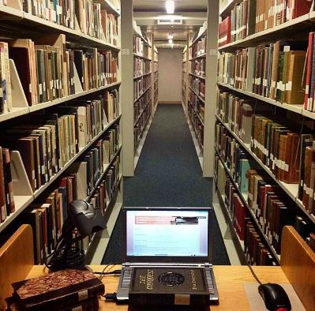
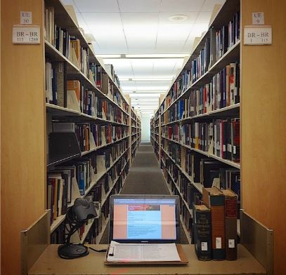
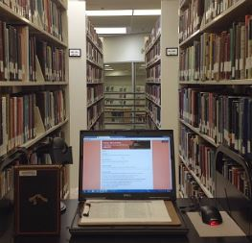
The Sampling Method
Notes:
(31) Following a first survey conducted at my institution in late May, I visited the remaining seven SCELC libraries between July 14 and July 27, a period at most places when books are not as likely to circulate. Prior to arriving at the libraries I contacted directors and staff to explain my project and arrange my visit, noting that for my purposes I would require a library cart for my laptop and scanner and the wireless password in order to access my Google Form, Worldcat, and local catalogs. With the exception of one institution -- Loyola Marymount University, whose student workers pulled and shared titles prior to my arrival -- at each library I set my laptop and scanner on a borrowed cart, then proceeded to locate each item in the stacks, scan its barcode, examine the book and record the data in my form, then re-shelved the book before moving on to the next title.
Following data collection, from the survey results spreadsheets I isolated the barcodes for the items I scanned at each institution. I then emailed these barcodes back to staff at each of the eight survey institutions, where systems librarians used review files to associate the correct author, title, and OCLC number with the barcodes, as well as the circulation data for these items, and then exported this information into a text file which they sent back to me. Next, I pasted this information into the survey results spreadsheets from Google Forms, color coded the data for each institution, and finally aggregated all the survey results in one spreadsheet. Arranging the data by OCLC number resulted in groupings of mutually held copies.

Slide 32
Results
• 3,429 books examined total* • Imprint dates from 1905 to 2012 • Two days at six libraries; one day at two libraries • Average time to find and examine books = ~ 120 seconds, or ~30 books per hour**
Notes:
(32) The majority of book-copies I was not able to verify (i.e., locate in the stacks) were checked out to patrons or, as in the case of Azusa Pacific University, in the midst of a relocation. Though it’s not as high as the Iowa results most were in the high 90s. Two additional hings to note: The total is now 3,737, and the average time at LMU – where staff and students pulled books for me, then consolidated these books -- was 49 seconds per. Here are three takeways I think worth taking away:

Slide 33
Results
Notes:
(33) First, I discovered that the vast majority of the copies I examined are in what we might call “good shape.” In other words, only 2% of all books I examined had external conditions I regarded as poor, and only 1% of all books I examined had poor internal conditions. In short, I determined that 98% of all the books I examined reasonably could be candidates for use in a shared print repository. This was somewhat surprising, especially after reviewing condition survey literature from several decades ago which led me to believe that a far greater number of books would be damaged or brittle.

Slide 34
Results
Notes:
(34) Second -- and perhaps unsurprisingly -- though not a strong one, there is a correlation between the frequency a copy circulates and the extent to which it is damaged.

Slide 35
Results
Notes:
(35) Third, and I think more importantly, when I plotted total copies against those copies that had what I designated “paratextual value” (i.e., original dust-jackets, original paperback binding, or facsimile paperback binding), then grouped by “total copies,” a clear trend emerged: Overall, 31% of the copies in the groupings have paratextual value, which possibly indicates that if a title exists in less than 3 copies, any deselection has the potential to remove artifactually valuable copies from the shared print collective.

Slide 36
Concluding Thoughts
SO WHAT?

Slide 37
Concluding Thoughts
SO WHAT?
Yeah!

Slide 38
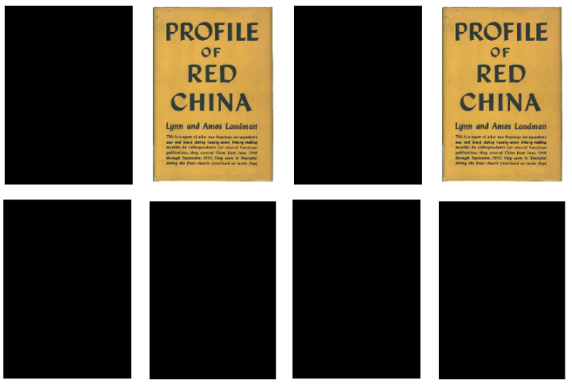
Concluding Thoughts
From a condition perspective where access to information is paramount, the majority of books examined were good enough to retain. BUT data also indicated that just 1/3 of books in each copy grouping had paratextual value, i.e., random deselection is likely to result in the loss of artifactually significant copies.
Notes:
(38) Well, the so what is this: For the purposes of a shared print agreement, from a condition perspective rooted in the culture of general collections where access to information is paramount, the overwhelming majority of the books examined for this project were good enough to retain. However, data also indicated that just one-third of the books in each copy grouping had paratextual value in the form of elements like original dust-jackets or publisher’s paperback bindings. This finding is significant from a more artifact-centered position that seeks to retain mutually-held copies that have the most artifactual value, as it indicates not only that the majority of books in the study did not have paratextual elements, but also that random deselection is likely to result in the loss of artifactually significant copies.

Slide 39
Concluding Thoughts
DISCARD
DISCARD
DISCARD
DISCARD
DISCARD
KEEP
DISCARD
DISCARD
From a condition perspective where access to information is paramount, the majority of books examined were good enough to retain. BUT data also indicated that just 1/3 of books in each copy grouping had paratextual value, i.e., random deselection is likely to result in the loss of artifactually significant copies.

Slide 40
Validation & (Artifactual) Value: A Condition Survey Experiment
Mike Garabedian Collections Management Librarian Wardman Library • Whittier College mgarabedian@whittier.edu

