Slide 1
WEST Program Assessments Past and Present
Western Regional Storage Trust
Update to the Print Archive Network
ALA Annual 2019
Alison Wohlers, WEST Program Manager

Slide 2
Where this is going…
What is WEST?
Past Program Assessments
2019 Program Assessment
Lessons Learned (so far…)

Slide 3
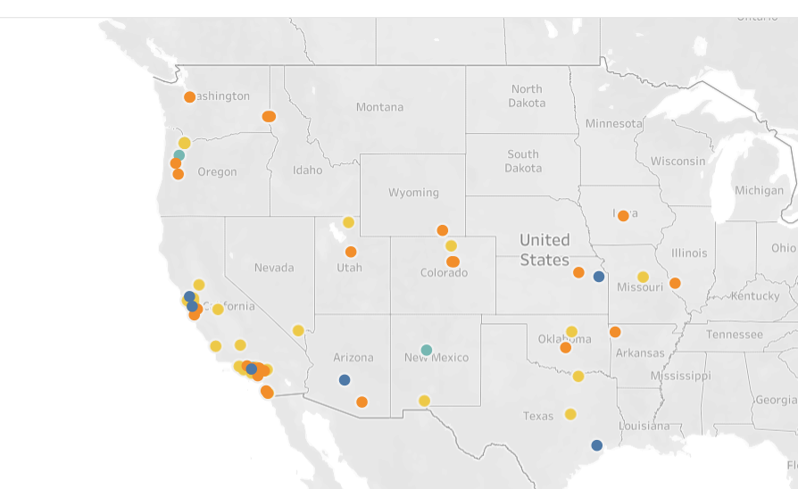
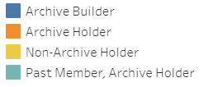
What is WEST?
A shared retrospective journal repository program among research libraries in the Western Region of the United States
Who we are
Administrative Host: California Digital Library
Governed by:
Executive Committee
Operations and Collections Council
Member program in the Rosemont Shared Print Alliance
66+ libraries across 16 states

Slide 4
How we do it (…since 2011)
What we do
Preserve the print scholarly record through distributed retention commitments and active consolidation of some commitments
Provide access to retained materials
Create opportunities to reallocate library space
Analyze our collective serial holdings using WEST’s custom-built decision support tool, AGUA, to identity titles for retention
Target our effort and resources based on risk for loss of content:
Higher risk titles are physically validated and consolidated in optimal storage environments
Lower risk titles are retained in-place as they are
Explicitly record and disclose the retention in the local metadata for the titles
Provide tools for local decision-making and comparison against WEST-retained titles
~28,000 unique titles across over 40 institutions

Slide 5
Past Program Assessments
(supported by Phase 2 grant funding)
2014 Program Assessment
Member Survey
Disclosure Audit
2014 Strategic Planning
Collection model and analysis adjustments
Business model adjustments to reach sustainability
2016 Program Assessment
Member Survey
Disclosure Audit
Evaluation of Member Fees
Potential new services

Slide 6
2019 Program Assessment – What are we doing?
Member Survey
Focus Groups
Analysis Projects
Instruments
Deselection
What’s left to archive
Membership fee structure
Not looking at disclosure rates this time around…

Slide 7
2019 Program Assessment – What are we looking at?
Broad themes
Value of WEST
Member satisfaction
Areas for change and new services
Understanding change over time (by comparison with previous assessment results) – the “why” of WEST, importance of WEST’s primary objectives, deselection trends, importance of specific services/reports

Slide 8
Lessons Learned (so far!)
Assessment takes…
A detailed, but flexible plan
A village!
Iteration
Time

Slide 9
A village, a plan, and lots of iteration
WEST
Members
WEST Executive Committee
WEST Operations and Collections Council
WEST Project Team
California Digital Library User Experience Team
Notes:
First: visual of Screenshot in an example template with themes, objectives, → questions -→ into focus group / survey / analysis project

Slide 10
A village, a plan, and lots of iteration
Notes:
First: visual of Screenshot in an example template with themes, objectives, → questions -→ into focus group / survey / analysis project

Slide 11
A village, a plan, and lots of iteration
Start here.
Review past assessments, brainstorm themes, objectives, ideas
Compile assessment plan
Seek input and iterate on assessment plan
Turn assessment plan into instruments
Seek review, input, testing; iterate on instruments
Deploy instruments
Analyze results; discuss
Present results; hear feedback; move into strategic planning..

Slide 12
..oh yah, and Time Projecting 10 months, including subsequent strategic planning
January – June: planning
June – July: survey
August: focus groups & analysis
September: report writing
October – November: present results & strategic planning
And here we are – cautiously feeling on-schedule!

Slide 13
Thank you!
Alison Wohlers
WEST Program Manager
alison.wohlers@ucop.edu
Want to learn more about WEST? Come to our
Member Meeting!
Sunday, June 23 from 1-2:30pm ET at the
Renaissance Hotel, Room 16

Slide 14
Links for more information
General WEST info: http://www.cdlib.org/west
2014 Assessment Report
2014 Strategic Planning Report
2016 Assessment Report

