Slide 1
HathiTrust Shared Print Update for PAN
Heather Weltin
Content and Data Management Lead & Program Officer for Shared Print, HathiTrust
January 21, 2022

Slide 2
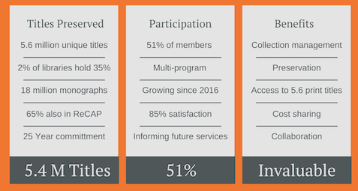
HathiTrust Shared Print Program
The primary goals of the HathiTrust Shared Print Program are to ensure preservation of print and digital collections by linking the two, to reduce overall costs of collection management for HathiTrust members, and to catalyze national/continental collective management of collections.

Slide 3
Assessment
Quotes from discussions
“Greatest value is the belief, commitment and action to a collective collection. The idea is that what's mine is yours even if ownership is elsewhere.”
“Shared print is a vital component in developing a national approach to managing print collections”
“We are stronger and better when working together in most things, especially in preserving resources in the future.”

Slide 4
HathiTrust Shared Print’s Unique Non-Circulating Collection
Focus on unique single-part monographs held in the HathiTrust Digital Library that are non-circulating or in-library use, in special collections, or a retention library is willing to make them non-circulating
Unique materials are those that are held by 1-2 members
Incremental phase:
Phase 3, Part 1 - would secure commitments on unique public domain items with retention libraries
Phase 3, Part 2 - would secure commitments on unique public domain items with current non-retention libraries
Phase 3, Part 3 - would secure commitments on unique and in-copyright items

Slide 5
Phase 3

Slide 6
Questions?
Heather Weltin
Content and Data Management Lead
& Program Officer for Shared Print
weltin@hathitrust.org

