Slide 1
Update on the Merger of The Partnership for Shared Book Collections and the Rosemont Alliance PAN Midwinter 2024

Slide 2
Anthony (Tony) Fonseca
Elms College - Chicopee, MA
Director, Alumnae Library
EAST Board of Directors & Partnership Operations Committee
fonsecaa@elms.edu
413-265-2281
Update Website:
https://sharedprint.org/shared-print-merger/
Courtesy of Anna Striker
California Digital Library
Systemwide Library Planning Senior Analyst

Slide 3
A Little Background
Since 2016, the Rosemont Shared Print Alliance has been coordinating the shared print needs related to serials and journals held by its 174 member libraries. Since 2019, the Partnership for Shared Book Collections has been addressing the shared print monograph or book needs of its 17 member shared print programs, which represent 388 libraries. Although each focuses on different material formats, both organizations have a significant overlap in interests, issues, challenges, and opportunities, as well as in leadership, and membership.

Slide 4
A Little Background
An investigative task force was created and charged with determining the concerns, challenges, and opportunities that would emerge with the merger of the two organizations. It presented its recommendations at the January 27, 2023 PAN Midwinter and produced a report in March 2023, which was ratified by both the Rosemont and Partnership Executive Committees. A summit was held to clarify the purpose of the merged organization and to determine next steps toward merger, which included forming a Merger Implementation Task Force and hiring a consultant to facilitate developing business and governance models.

Slide 5
Task Force: Investigating the Merger
John Burger, Association of Southeastern Research Libraries (ASERL)
Michael Levine-Clark, University of Denver (WEST)
Daniel Dollar, Yale University (HathiTrust)
Matthew Revitt, University of Maine (MSCC)
Susan Stearns, Eastern Academic Scholars’ Trust (EAST)
Scott Warren, Syracuse University (EAST)
Alison Wohlers, University of California Libraries (WEST)
Amy Wood, Center for Research Libraries (CRL)

Slide 6
The Merger Implementation Task Force (MITF)
A Task Force was formed to guide the implementation of the merger. It is made up of equal representation from the Executive and Operations Committees of both the Partnership and Rosemont. The MITF was charged with identifying and working with a consultant to refine the organizational statement of purpose and to define, develop, and document a new business model.

Slide 7
Merger Implementation Task Force
Gwen Bird, Simon Fraser University (Partnership EC)
John Burger, Association of Southeastern Research Libraries (Rosemont OC)
Stephen Connaghan, The Catholic University of America (Rosemont EC)
Tony Fonseca, Elms College (Partnership OC)
Aaron Krebeck, Washington Research Library Consortium (Rosemont OC)
Peggy Seiden, Swarthmore College, Retired (Partnership EC)
Anna Striker, California Digital Library (Partnership OC)
Scott Warren, Syracuse University (Rosemont EC)

Slide 8
Identifying a Consultant
The MITF created an RFP after determining what knowledge, skills, and level of experience would be necessary in a consultant/expert. The MITF created a three-member subcommittee to conduct interviews and reference checks and then make a recommendation. The MITF received three proposals, and using a rubric created by the subcommittee and honed by the full committee membership, identified the Big Questions Collaborative (Sarah Cohen) as consultant. Cohen was hired by CRL (which is funding the consultancy) in December 2023.

Slide 9
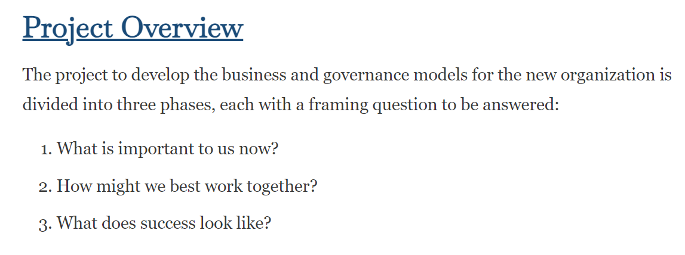
BQC and MITF Meeting

Slide 10
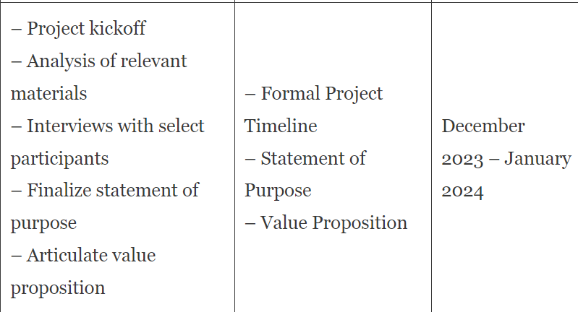
Phase 1: What Is Important to Us Now

Slide 11
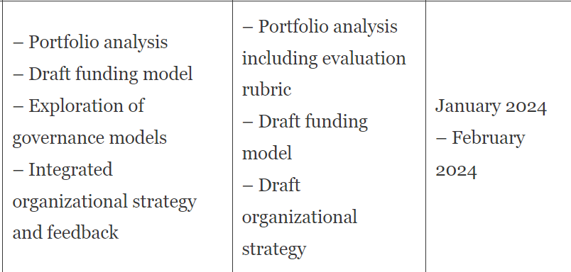
Phase 2: How Might We Best Work Together?

Slide 12
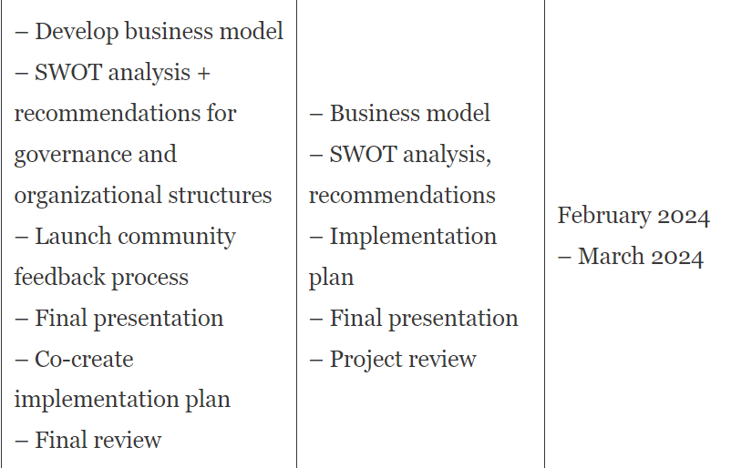
Phase 3: What Does Success Look Like?

Slide 13
Next Meeting with BQC
Monday, January 26

Slide 14
Thank you! Questions?
Anthony (Tony) Fonseca
Elms College
Chicopee, MA
Director, Alumnae Library
fonsecaa@elms.edu
413-265-2281

