Slide 1
MOU as Place: Overlapping realm(s) and intention(s) in shared print
PAN Forum, 22 June 2018, ALA New Orleans
Jeff Kosokoff, Assistant University Librarian for Collection Strategy, Duke University, @JeffKosokoff

Slide 4
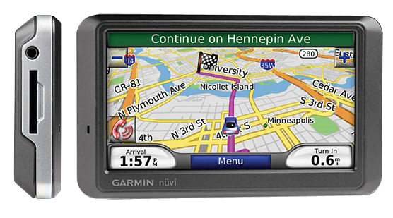

Slide 6
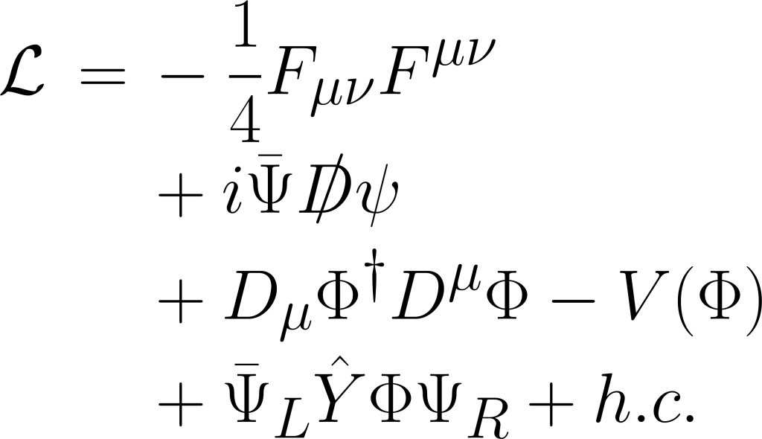
The Standard Model

Slide 7
Monograph Retention “Standard Model”
Analyze, Allocate, Commit
MOU
Hire OCLC or CARL

Slide 8
HathiTrust “Volunteer” Model
Holdings file overlaps
MOU
Choose locally
Commit
Previous commit
overlaps
Notes:
Both of these major models are project-based. Appropriate for getting our legacy collections retained. But can we avoid having to play catchup again in the future?

Slide 9
Maturing Models?
Notes:
The dominant standard models assume group action, extensive analysis, and work best when large numbers of materials are committed all at once. But might we break that down a little and consider other ways this can proceed? Are there other workflows to leverage here? Does it make sense to commit any titles one-at-a-time? Could one institution make commitments whenever it wants. That is, what if we think about an MOU as a place to put commitments?

Slide 11
Analytics
Start here?
Scale
Retrospective
MOU as Project
Opportunity
Synergy
Touch-it-once
More current?
MOU as Place
Analytics vs. Opportunity

Slide 12
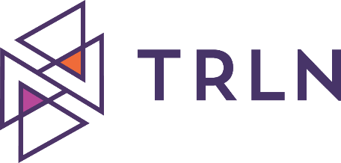
MOU as Project?
Place
“All four member institutions are expected to execute the MOU even if there is no immediate intention to participate.”
Notes:
If we consider the MOU as a place to put our commitments, then within the rules of an MOU, libraries could commit eligible items at any time, perhaps with minimal or no consultation. Sub-groups within a given MOU could do a project alone…. We can leverage workflows, touch things fewer times, and grow the formally retained collective collection at multiple scales…

Slide 13
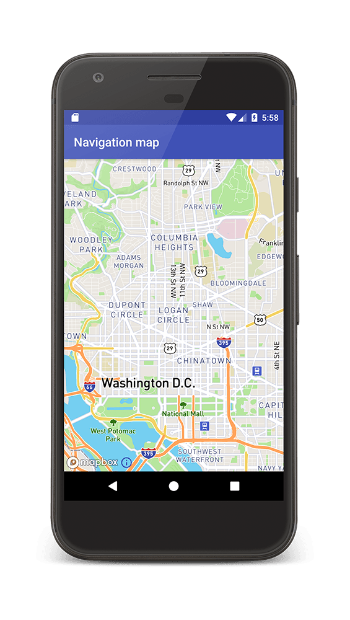
Notes:
Subtle evolution….
Are we ready for new models inn retention?

Slide 14
Overlapping Realms, Leveraging Across Workflows
Shared Collection Development
Replication of commitments elsewhere
During receipt of locally specialized materials
[YOUR IDEA HERE!]
Relocation and weeding projects
Digitization
Notes:
What are some existing processes that could catch items for retention?
Relocation and weeding projects. Might we check the items under consideration and retain based on local criteria?
Some libraries actively collect materials of high local interest that are not widely collected. E.g., Area Studies…
Shared collection development. E.g., Ivy Plus Libraries have established programs to collectively collect Brazilian monographs, American Composers, Art and Architecture materials, with a commitment to retain…
Replication of commitments elsewhere. This is already happening with EAST and the ReCAP partners in the context of HT
Digitization. When you digitize un/under retained things, consider retaining in that workflow?
YOUR IDEA HERE. And what else?...

Slide 15
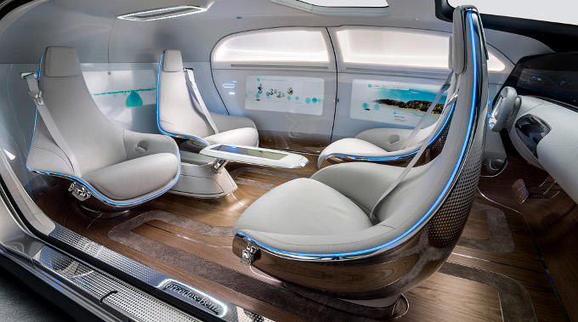
Transforming or Maturing?

Slide 16
Thanks!
@JeffKosokoff
jeff.kosokoff@duke.edu

