Slide 1
The Center for Research Libraries
Collections and Services Overview
June 11, 2014

Slide 2
CRL Presenters
James Simon
Director, International Resources
Kevin Wilks
Head of Access Services
Virginia Kerr
Digital Program Manager
Gwen Ihnat
Communications Specialist

Slide 3
CRL Global Resources
More than 200 academic and independent research libraries as voting members
United States
Canada
Hong Kong

Slide 4
CRL Global Resources
More than 200 academic and independent research libraries as voting members
Supporting advanced research and teaching in the humanities, sciences, and social sciences

Slide 5
CRL Global Resources
More than 200 academic and independent research libraries as voting members
Ensuring the availability of primary sources through preservation and acquisition

Slide 6
CRL Global Resources
More than 200 academic and independent research libraries as voting members
A shared collection of 5 million books, journals, archives, documents, and newspapers

Slide 7
CRL Global Resources
More than 200 academic and independent research libraries as voting members
Communities of interest identifying and sharing information about critical and at-risk source materials

Slide 8
Agenda
Collection Overview
Collection Partnerships
Discovering CRL Resources
How to Borrow
  ILL policies & practices
Digital Services
Electronic Resource Licensing
Purchase Programs
Outreach Services
  Reference Consultations
Optimizing your CRL Membership
Questions & Answers

Slide 9
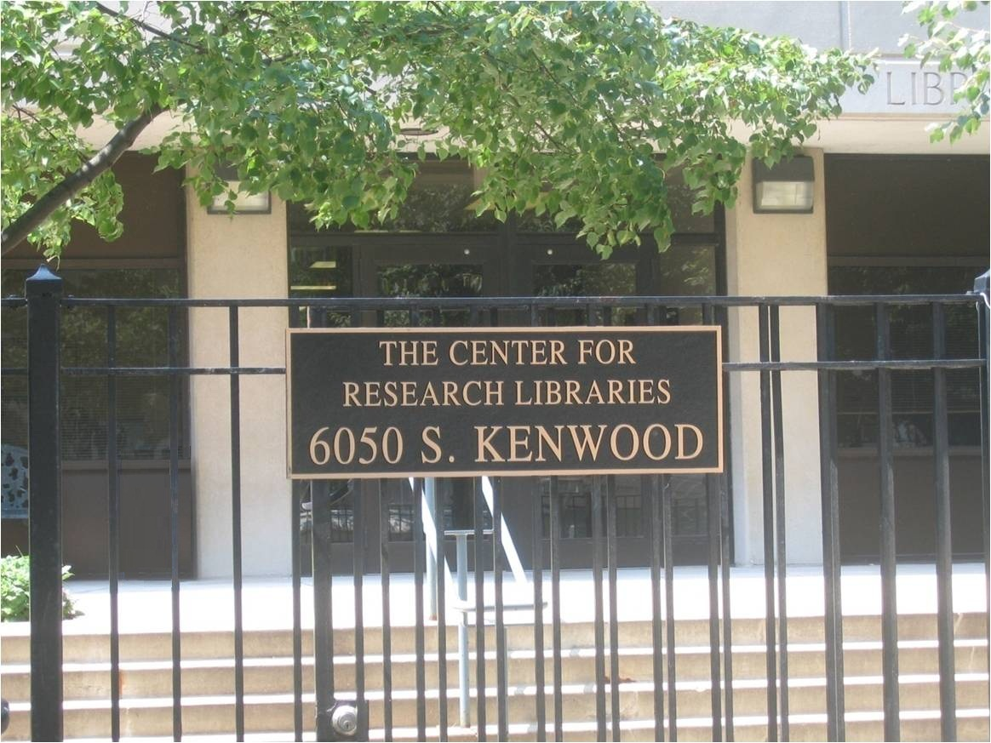

Slide 10
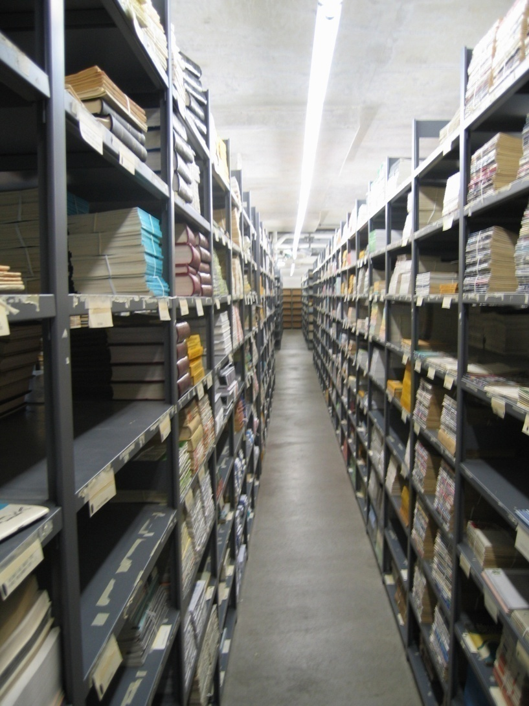
2nd Floor Stacks

Slide 11
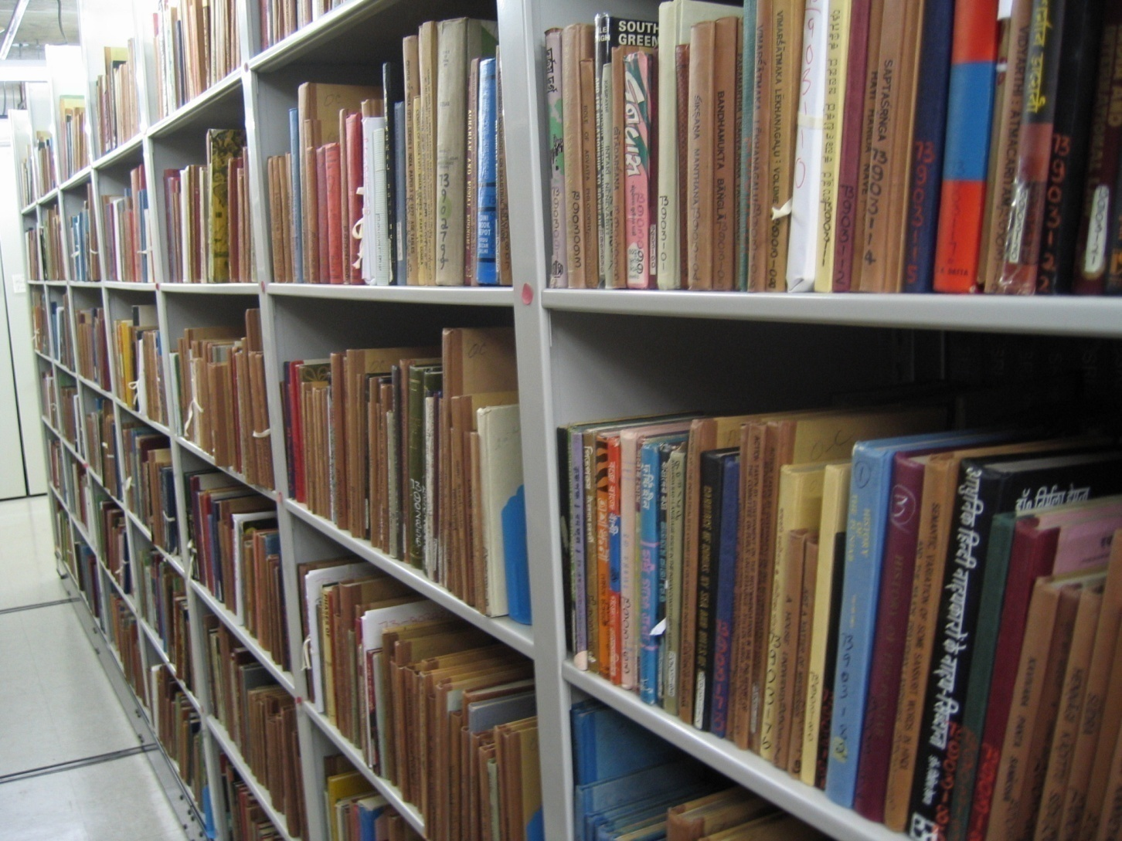
4th Floor Compact Shelving

Slide 12
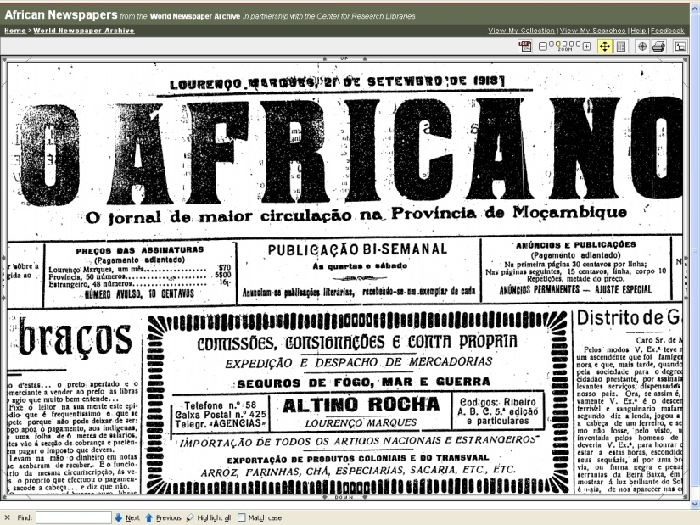
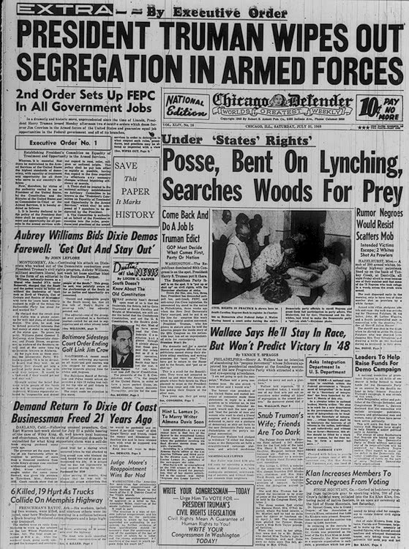
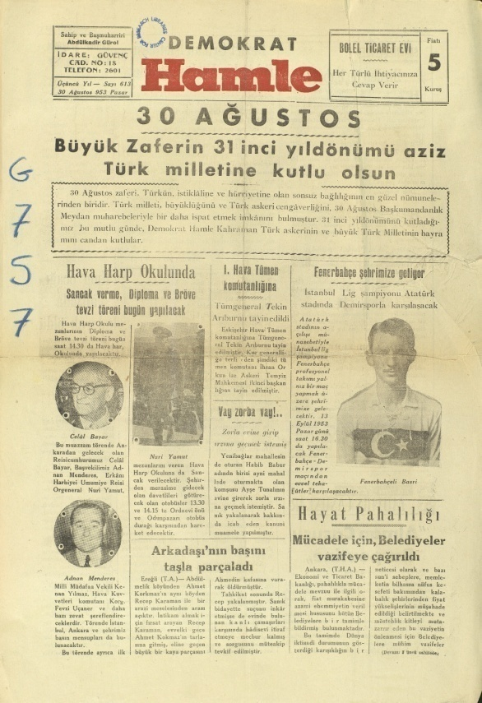

Newspapers

Slide 13
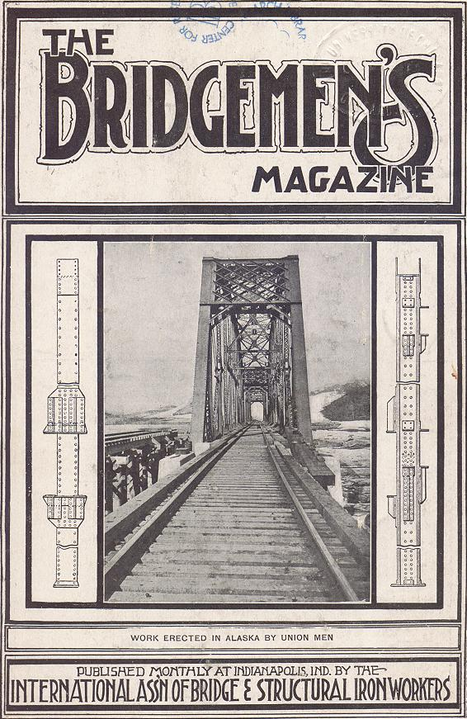
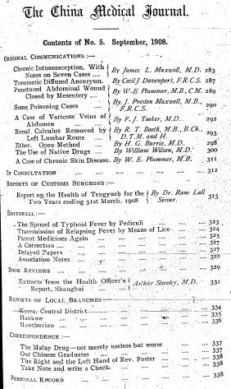
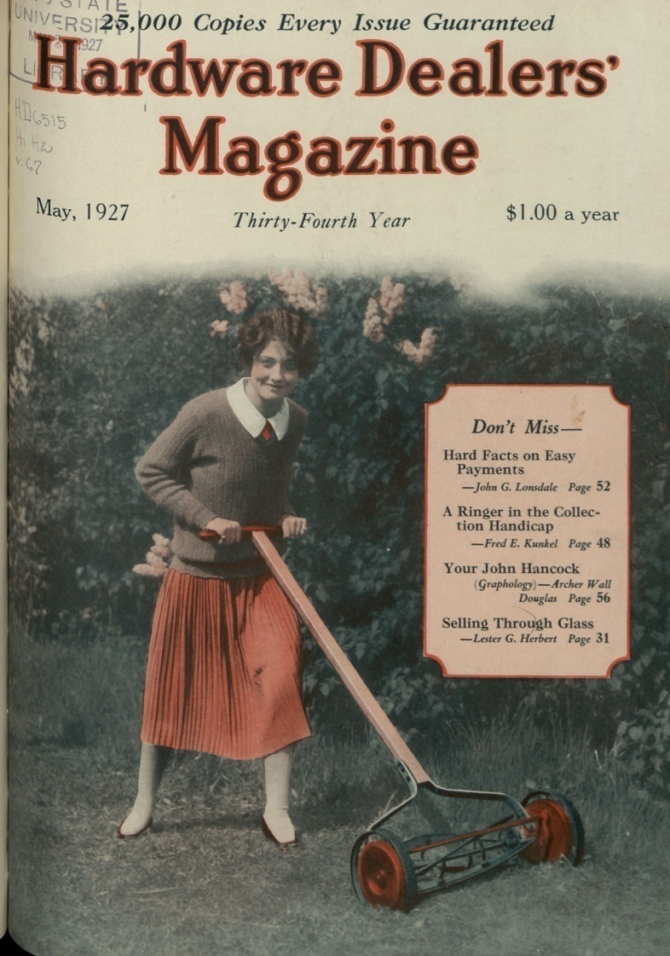
Journals

Slide 14
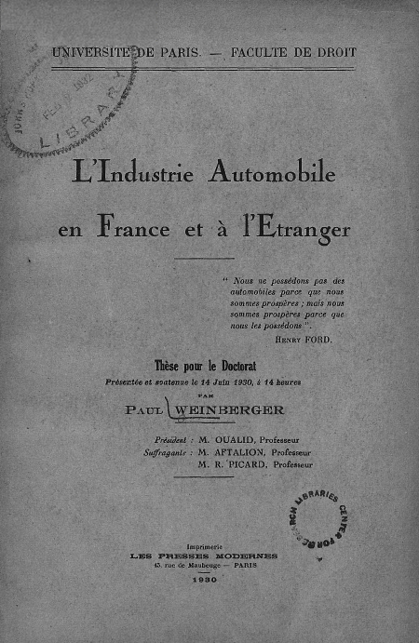
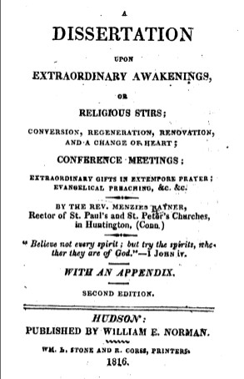
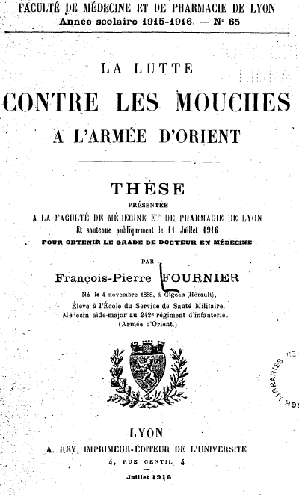
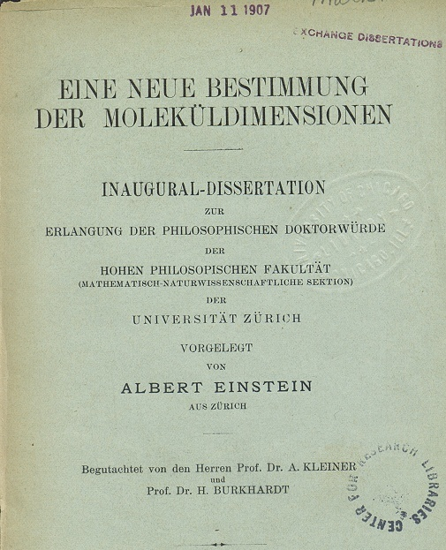
Dissertations

Slide 15
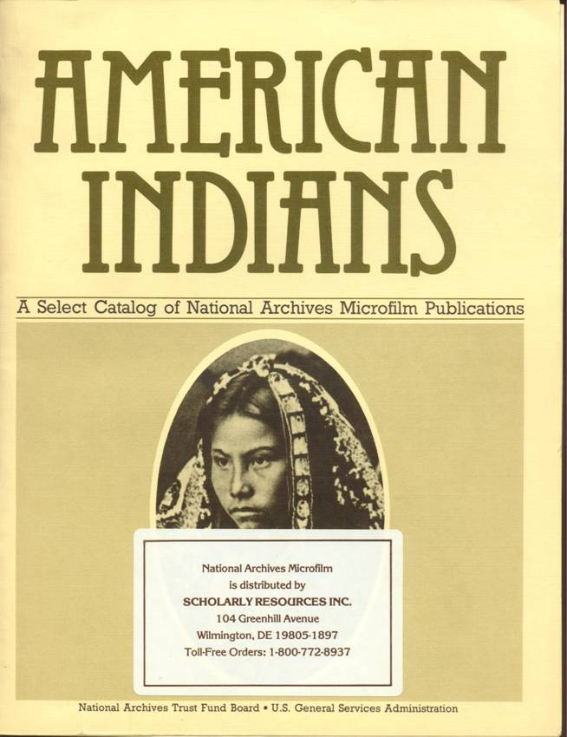
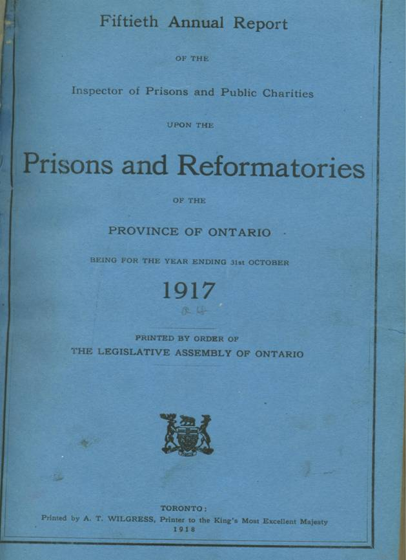
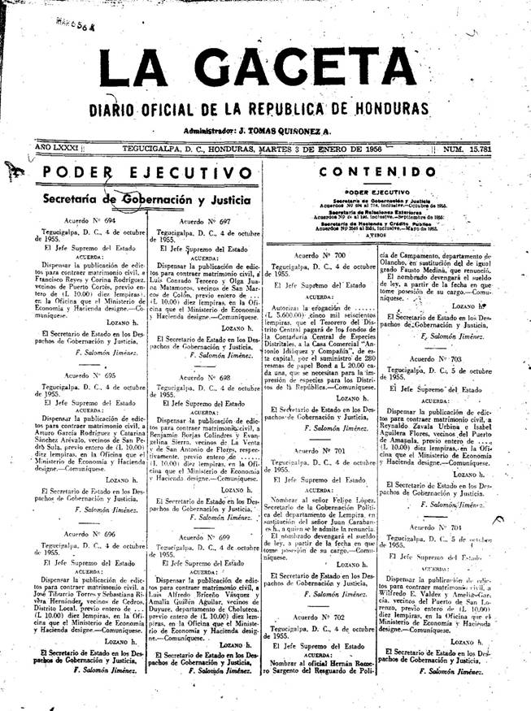
Government Documents and Archives

Slide 16

Collection Partnerships
Global Resources Partnership
Linda Hall Library
Preserve and develop research collections in STE
Access to 50,000 current, historical journals from CRL/LHL
Document delivery through
Rapid ILL
Strategic digitization of pre-1950
monographs
Print preservation
Senior Advisor, Steering Committee
to shape future development

Slide 17

Collection Partnerships
LLMC-Digital
Partnership with Law Library Microform Consortium
48 million pages converted legal and government texts
Targeted digitization from CRL, member libraries
Access open to all CRL libraries

Slide 18
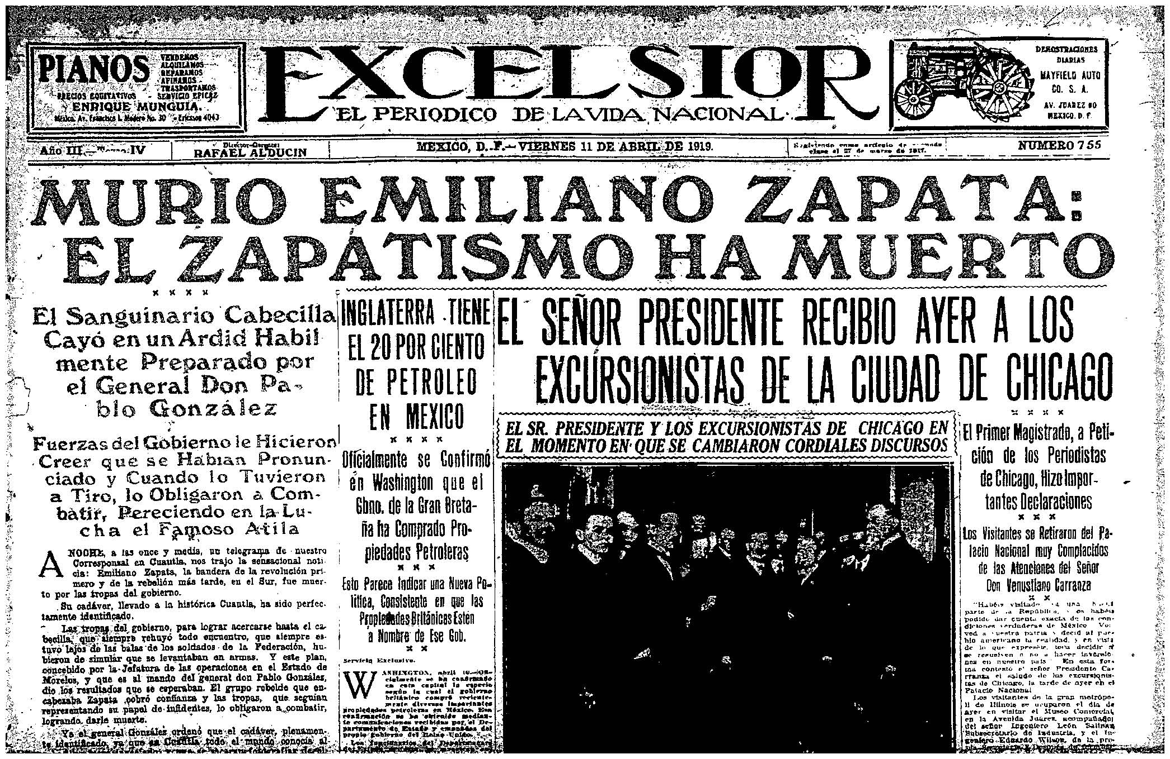
Collection Partnerships
World Newspaper Archive
Partnership between CRL member libraries and Readex
Historical content from Latin America, Africa, South Asia
(Eastern Europe upcoming)
Community sourced, community controlled
Favorable member pricing through CRL

Slide 19
CRL Records
In CRL online catalog
Also available in WorldCat and the major web-scale discovery services
Records available for local loading

Slide 20
Sending ILL Requests
CRL accepts requests via:
  - OCLC – ILLiad (symbol: CRL)
  - Fax: 773-955-9732
  - Postal Service
  - Access Services Department email: asd@crl.edu

Slide 21
CRL’s Affiliations
Partners in resource-sharing:
Linda Hall Library of Science, Engineering, and Technology
Prospector
Rapid
Connect NY
Borrow Direct
UBorrow
Others as member demand arises

Slide 22
Shipping CRL Materials: Loans
Loan period
  - 6 months with unlimited renewals
  May be recalled for another CRL member
UPS 2nd day delivery

Slide 23
Shipping CRL Materials: Copies
CRL sends copies via:
  Ariel
  Odyssey
  Email pdf
  Fax
  Postal Service

Slide 24
CRL’s Shipping and Loan Policies
24-hour response time
Possible delays:
  - citation problem
  - not on shelf
90% one-day turnaround time

Slide 25
Demand Purchase Program: Overview
“You demand, we purchase”
Archival material
Newspapers
Foreign Doctoral Dissertations

Slide 26
Demand Purchase Program:
Other Details
$2,000 limit per patron
Related CRL Programs
  - Purchase Proposal
  Shared Purchase

Slide 27
Demand Purchase Program: Archival Material
Governments, agencies, etc.
  - U.S. National Archives
  U.K. National Archives
  NGOs and institutions

Slide 28
Demand Purchase Program: Newspapers
Foreign and Domestic
If any date owned, will purchase date(s) needed

Slide 29
Demand Purchase Program:
Foreign Doctoral Dissertations
“If not owned, please purchase”
Signed Copyright Declaration
    - Oxford
    - Cambridge
    - Hong Kong
    - Leeds
    Manchester
EThOS (http://ethos.bl.uk/About.do)

Slide 30
Digital Collections and Services at CRL
CRL strategic goal: providing research and teaching resources in digital format
Annual in-house digital conversion: nearly one million pages/4,500 items
Selection for digital conversion: two sources
  Digital delivery (patron loan requests provided in digital format): majority of in-house production
  Strategic digitization: primarily through partnerships to build collections

Slide 31
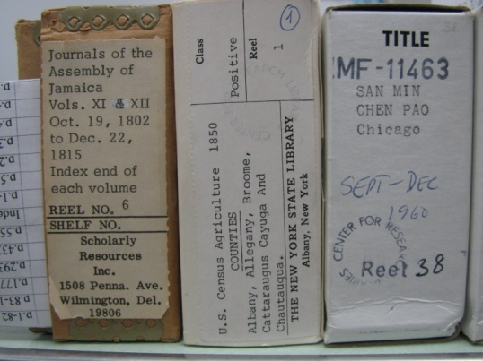
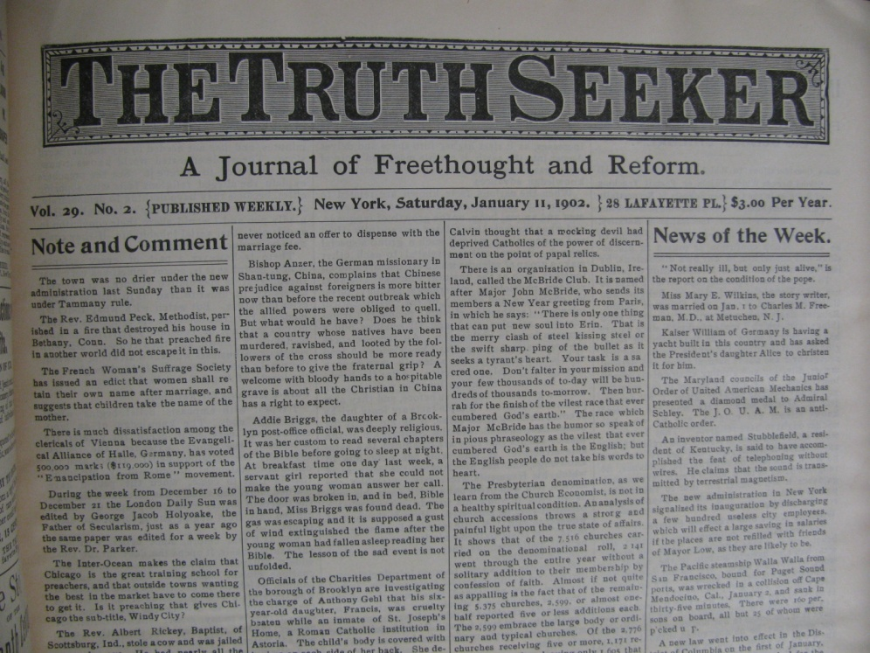
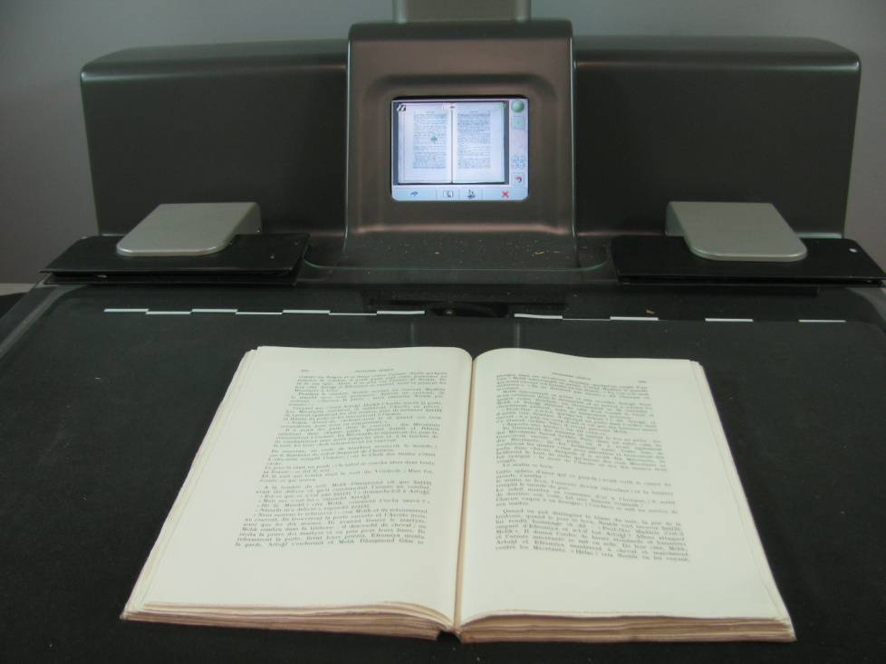
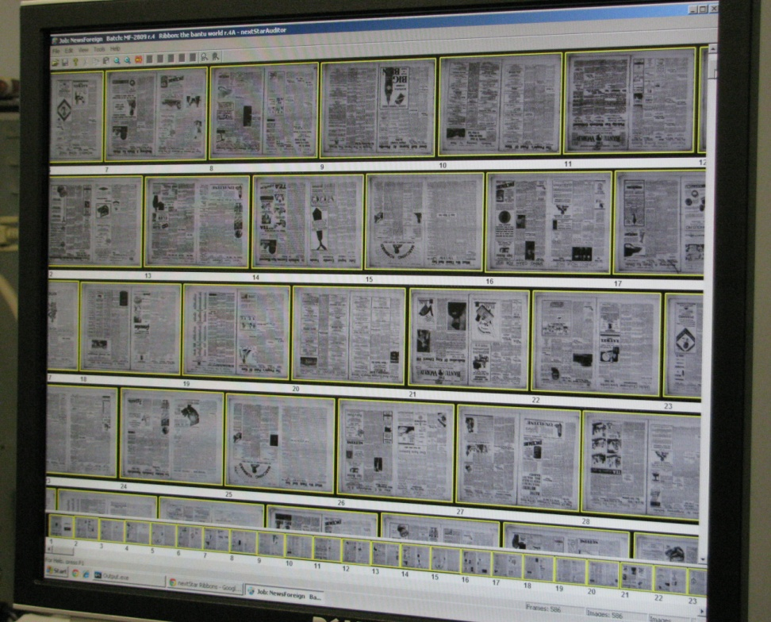
Digital Delivery for Scholars

Slide 32
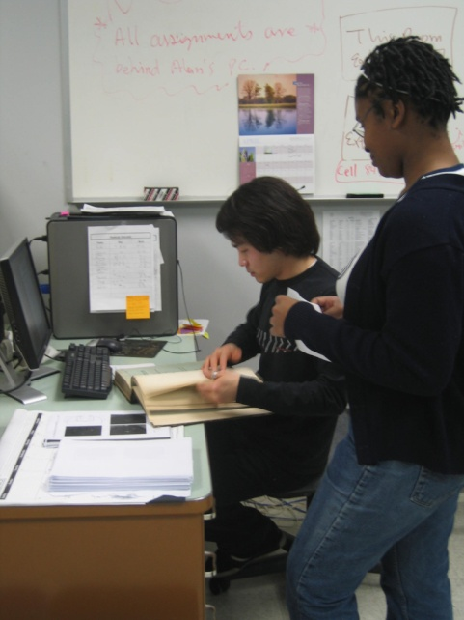
CRL Digital Delivery
Scan the
item(s)
Create OCR (searchable text), save as PDF file
Mount files on CRL’s server + link from record in OPAC
Send member email with url
Update WorldCat

Slide 33
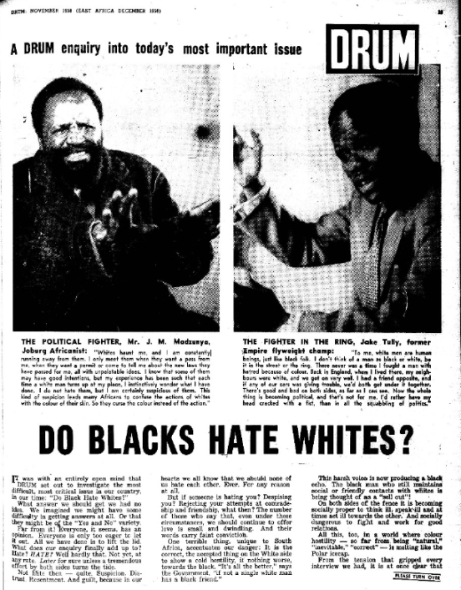
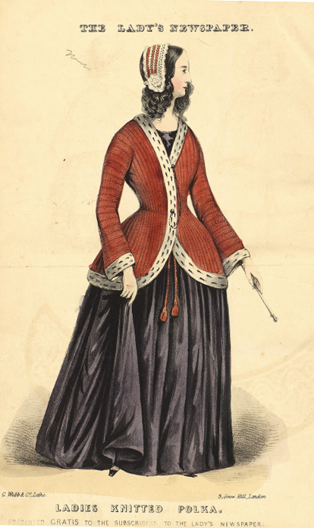
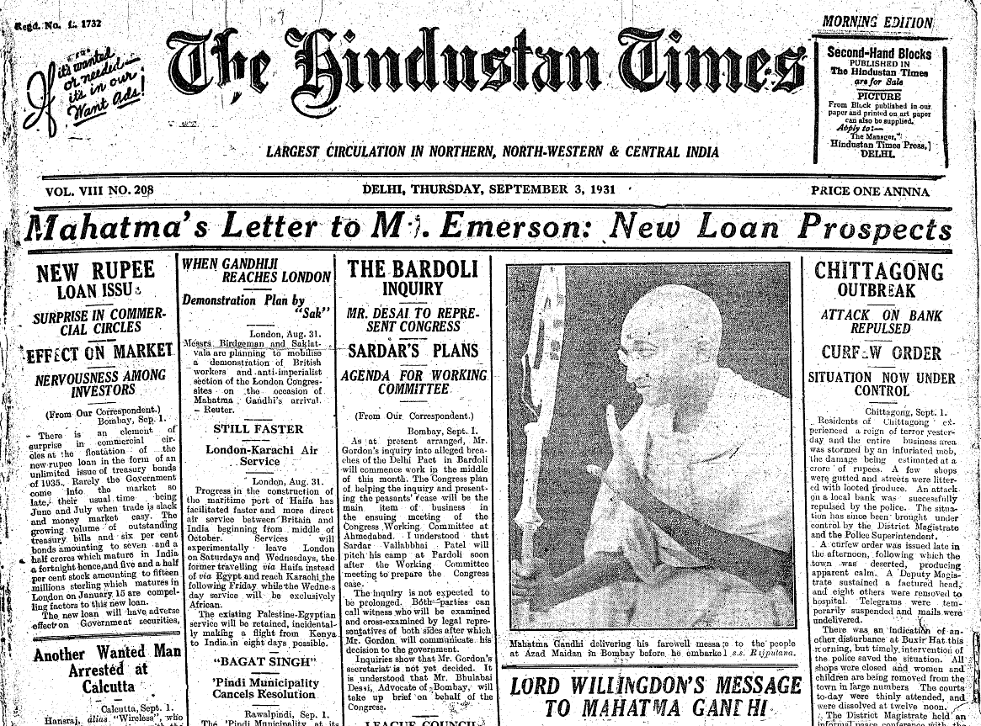
Strategic Digitization
Scanning in support of instruction or targeted research projects
      Examples
      Drum magazine (Johannesburg, South Africa)
      Civilian Conservation Corps camp newspapers
      Microform guides and finding aids

Slide 34
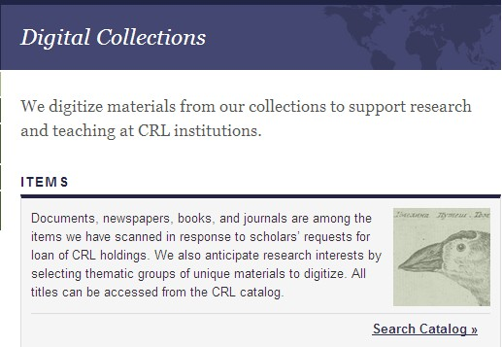
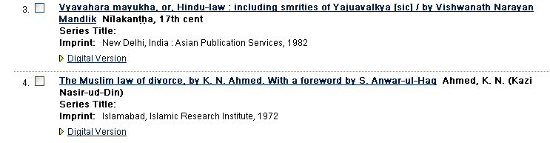
Access to CRL Digital Items
1. From CRL Digital Collections Page
2. From ‘Digital Version’ link in catalog
For off-campus access to “Members Restricted” digital items: add CRL to proxy server configuration

Slide 35
Copyright Access & Restrictions
Three categories of accessibility – based on
fair use principles
  Open access (public domain)
  Member access (“gray area”)
  Member access restricted (active copyright protection)

Slide 36
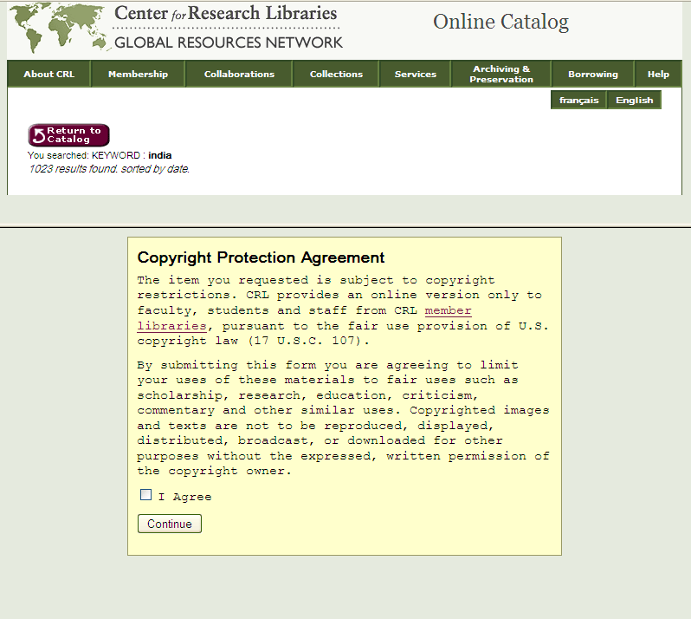
Digital Access to Copyrighted Items
For source items with active copyright protection: member agrees to use restrictions

Slide 37
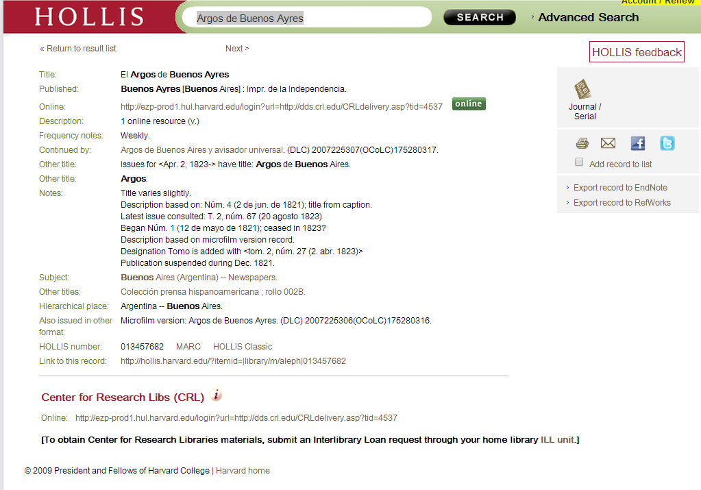
CRL Records in
Harvard’s Catalog

Slide 38
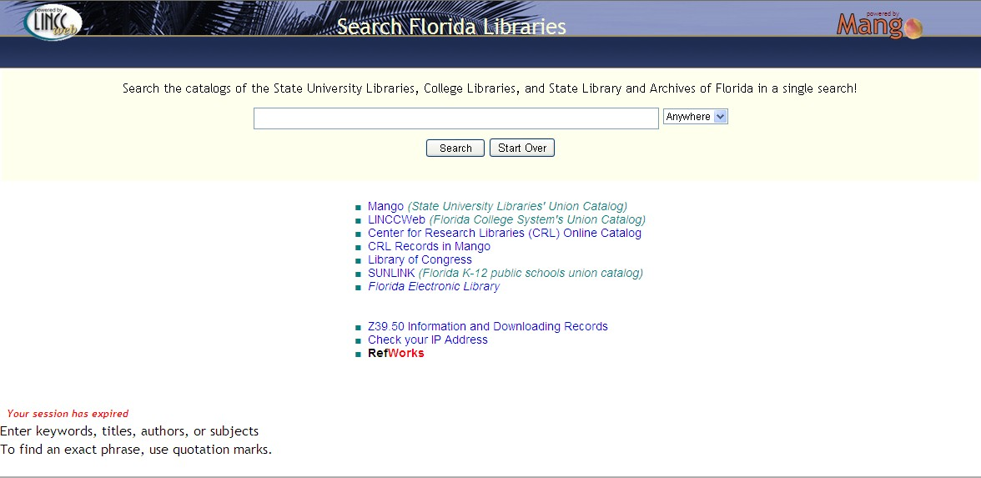
CRL Records in
Florida Libraries Catalog

Slide 39
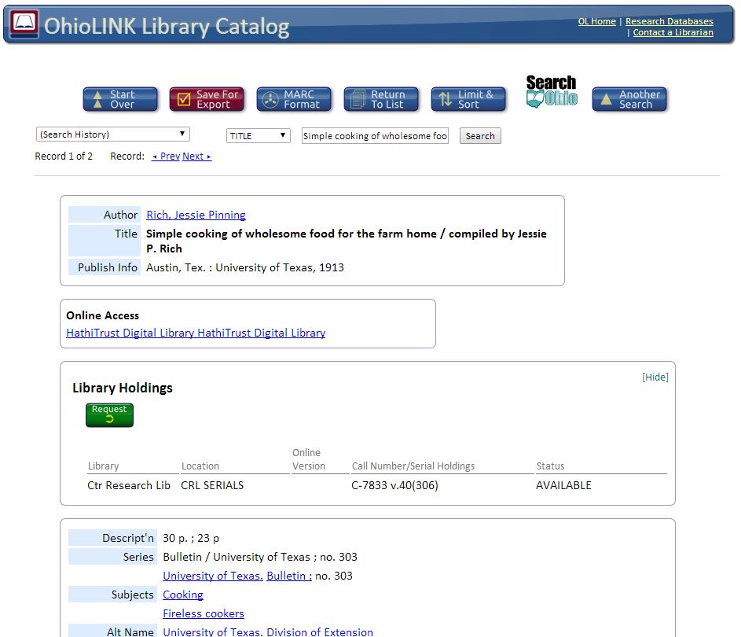
CRL Records in
OhioLINK Catalog

Slide 40
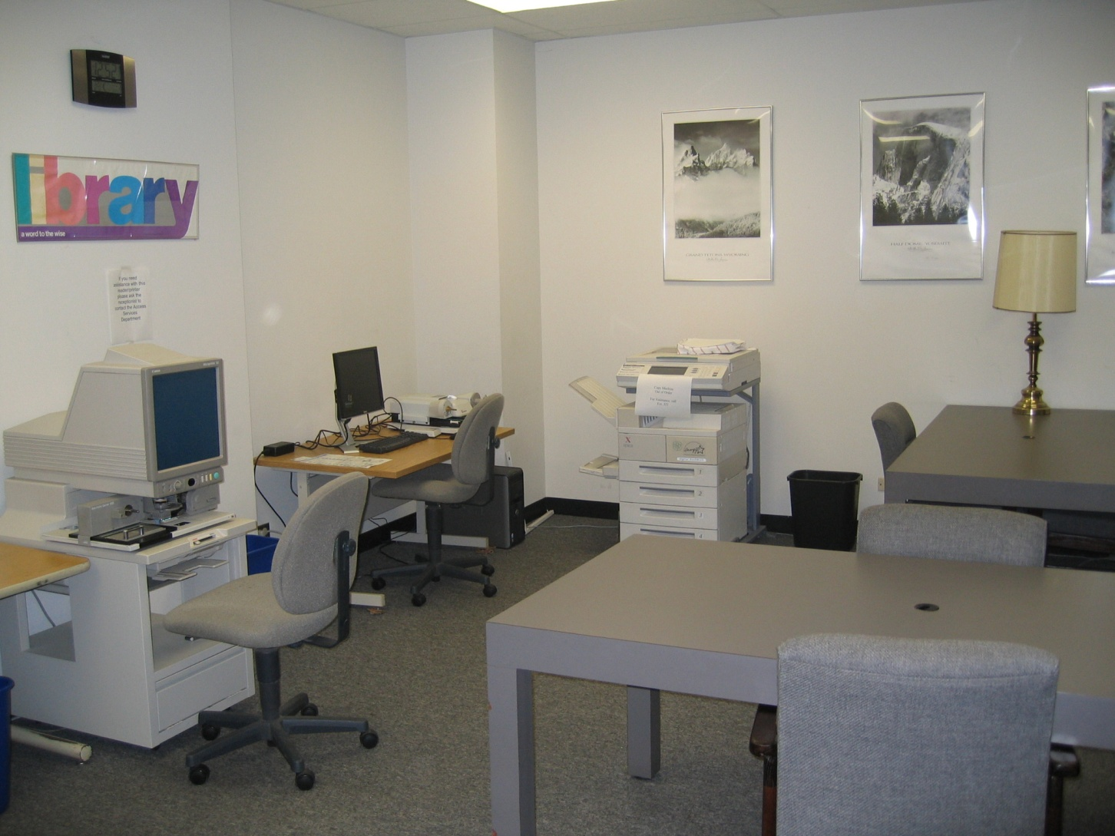
Reading Room for Visiting Scholars
3 business days advance notice
Monday-Friday
  9:00 a.m.-2:00 p.m.

Slide 41
Problems? Concerns?
Contact Us
CRL: 800-621-6044 or 773-955-4545
Kevin Wilks ext.314, wilks@crl.edu
Michelle Carver ext.321, carver@crl.edu
Access Services email, asd@crl.edu

Slide 42

Licensing and Collection Programs
  Electronic Resource Licensing
  Cooperative Collection Development Programs
  Reference Consultation
Notes:
42
42

Slide 43
Electronic Licensing @ CRL
Goals
  Expand CRL libraries’ electronic access to primary source collections
  Support informed local investment
Strategic Priorities
  Focus on CRL collection strengths (news, archives, data, international).
  Objective, critical analysis of content, platform.
  Leverage expertise and “market share” to obtain more favorable terms.

Slide 44








Recent Electronic Resources Offers
Notes:
44
44

Slide 45

eDesiderata edesiderata.crl.edu
An online platform developed by CRL to gather and organize e-resources of interest to CRL libraries, solicit member input, and track the progress of negotiations and take-up.
A place for sharing information and opinions about e-resources.
Notes:
45
45

Slide 46
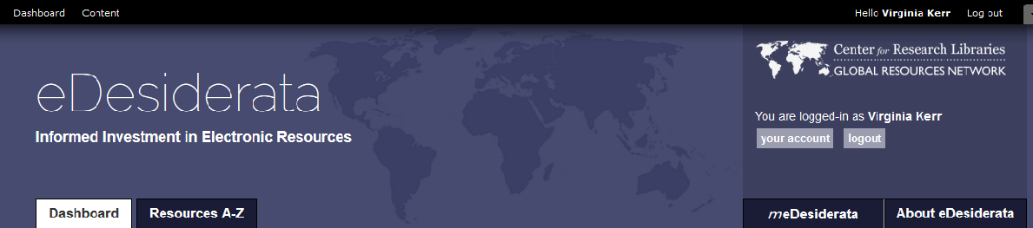
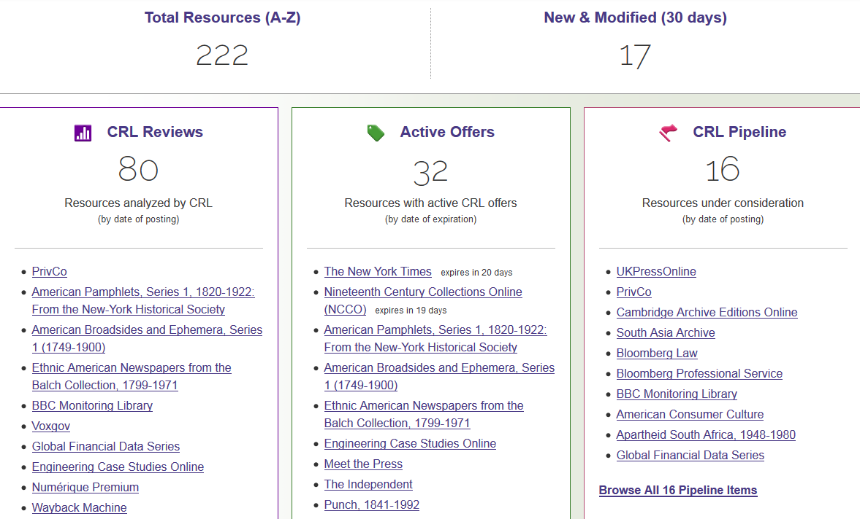
Notes:
46
46

Slide 47
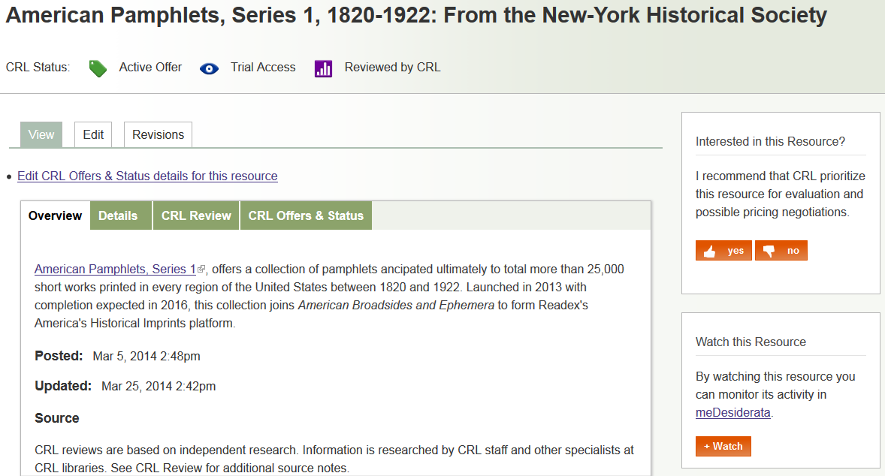
Notes:
47
47

Slide 48
Cooperative Collection Development
http://www.crl.edu/collections/collection-building/cooperative-resource-development
Notes:
48
48

Slide 49
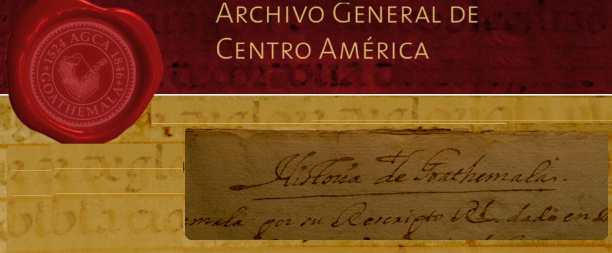

Purchase Proposal Program
Central American Archives (purchase over 3 years) $180,000
China & the West: the Maritime Customs Service Archive from the Second Historical Archives of China Nanjing. Parts 1-7 $74,400
Notes:
49
49

Slide 50
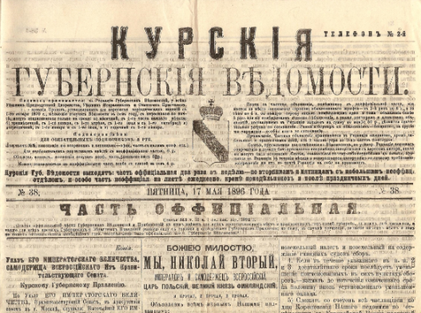
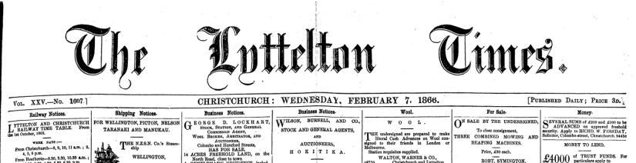

Shared Purchase Program
Gubernskie Vedomosti (Provincial Reports), 1838-1918
$14,750
Lyttelton Times. Christchurch, New Zealand. 1890–1908
$6,000
Sources on Social Welfare. Freie Wohlfahrtspflege
$13,725
Notes:
50
50

Slide 51
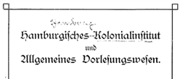
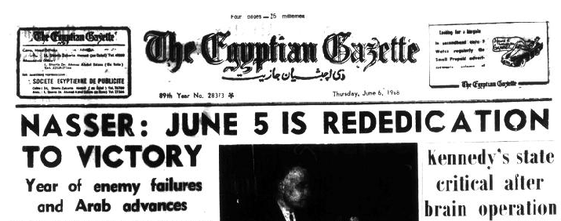
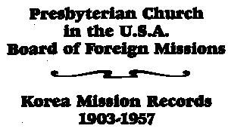
Reference Consultation
Identifying CRL materials
of particular interest
For researchers
For classroom use
Identifying specific items for
CRL to acquire
Notes:
51
51

Slide 52
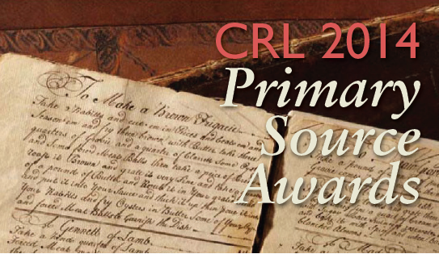
Primary Source Awards
CRL’s annual Primary Source Awards recognize the innovative use of primary source materials in three areas: access, research, and teaching. Prizes are presented to the awardees and their nominators.
Nominations due: January 31
For more information, visit
www.crl.edu/primary-source-awards

Slide 53
CRL Strategic Objectives 2015
  Strengthen key partnerships
  Expand member library access to primary source collections
  Enhance online resources for collection decision-makers (PAPR, ICON, eDesiderata)
  Ensure the long-term integrity and accessibility of critical evidence

Slide 54
Questions & Answers
Please join us for a discussion with our presenters.
Please submit your questions in the Q&A box.

Slide 55
Contact Information
James Simon Director, International Resources
jsimon@crl.edu
Kevin Wilks Head of Access Services
kwilks@crl.edu
Mary Wilke Member Liaison & Outreach Services Director mwilke@crl.edu
Virginia Kerr Digital Program Manager
vkerr@crl.edu
Gwen Ihnat Communications Specialist
gihnat@crl.edu

Slide 56
Upcoming Webinar
CRL Licensing and Acquisitions 2014–15 August 13
CRL webinars usually occur on Wednesdays
from 2 to 3 p.m. Central Time

Slide 57
Upcoming Events
Annual Meeting of the CRL Council of Voting Members
April 24, 2015

Slide 58
For More Information
Fill out our follow-up survey at http://www.surveymonkey.com/s/CRLWebinarFollowup
This presentation will soon be available on our YouTube channel: www.youtube.com/crldotedu
Visit the CRL website www.crl.edu
Sign up for CRL Connect: www.crl.edu/connect
Find CRL on Facebook and Twitter

