Slide 1
Drawing Down Print: Making the Case
Shared Print Archiving Preconference
Rick Lugg, Sustainable Collection Services
November 2, 2011

Slide 2
Electronic resources dominate

Slide 3
Electronic resources dominate

Slide 4
Print use is low and declining

Slide 5
Circulation in Academic Libraries, 2002-2008
37% Decline

Slide 6
Print use is low and declining…
30 million books, 88 libraries
6% of books accounted for 80% of circulation
http://www.oclc.org/research/publications/library/2011/2011-06r.htm

Slide 7
Cornell Task Force on Print Collection Usage
55% of Cornell’s books published since 1990 have never circulated.
“Of books in circulation on April 19, 2010, only 10.7% were charged out to undergraduates.”

Slide 8
Stacks are overcrowded

Slide 9
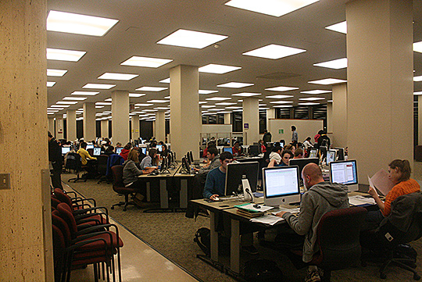
Library space is wanted for other purposes…
“The crowding out of readers by reading materials is one of the most common and disturbing ironies in library space planning.”
--Scott Bennett

Slide 10
Library space is wanted for other purposes

Slide 11
Space Requirements: Monographs
Volumes | Square Feet
100,000 | 20,000
250,000 | 45,000
500,000 | 80,000
1,000,000 | 150,000
2,700,000 | 405,000
 | Source: Stephen R. Lawrence, Lynn Silipigni Connaway, and Keith H. Brigham, “Life Cycle Costs of Library Collections” College & Research Libraries, November 2001, p. 546.

Slide 12
Keeping print books is expensive…
CLIR, June 2010
Courant & Nielsen
Estimated Annual Costs
$4.26/ volume annually in central stacks
$0.86/volume in high-density facility
Notes:
For every 10,000 monographs added (net):
2,000 square feet of space is required
2007 construction cost/square foot: $300
2,000 x $300 = $600,000
For every 10,000 monographs retained in central stacks:
Annual Maintenance cost (UCB): $25,000
Annual Cost (Courant): $42,600
Lifecycle Maintenance cost (UCB): $3,430,300
Discounted Lifecycle Maintenance cost: $1,195,600

Slide 13
Print redundancy is significant…
Potential for shared print
And local reductions

Slide 14
The scholarly record can be secured
Currently Digitized:
5,164,337 book titles

Slide 15
The scholarly record can be secured

Slide 16
Other copies can be accessed….

Slide 17
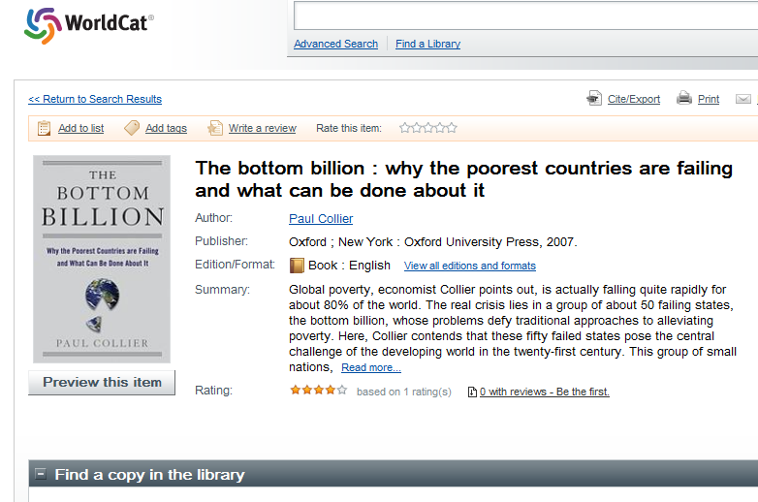
Displaying 1-6 out of 1682 for all 21 editions

Slide 18
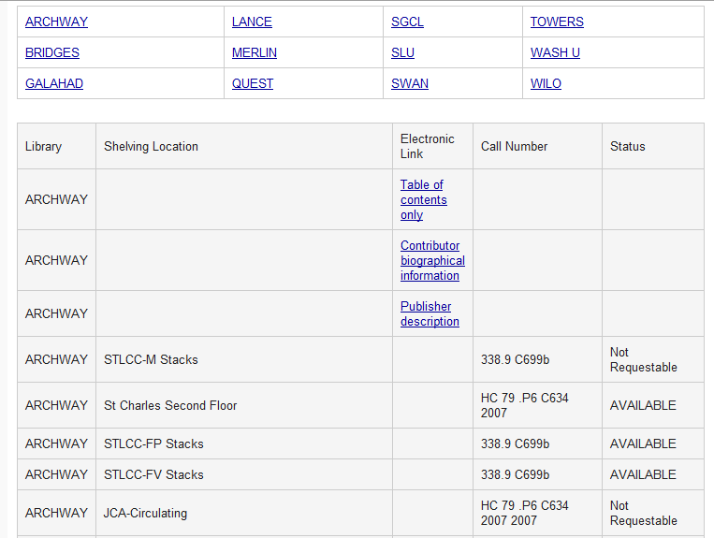
Regional Availability

Slide 19
Start here… Source: Constance Malpas, OCLC Research

Slide 20
A managed, collaborative drawdown…
Yes, ma’am, other libraries are also doing this…

Slide 21
Make progress

Slide 22
Your boss will like it…
Median ARL Space Savings: 45,000 ASF
Cost Avoidance (annual): $500,000 - $2 million

Slide 23
The Cost of Inaction
For every 10,000 monographs retained in central stacks:
2,000 square feet of space is required
Annual Cost (Courant): $42,600
Annual Maintenance cost (UCB): $25,000
Lifecycle Maintenance cost (UCB): $3,430,300
Discounted Lifecycle Maintenance cost: $1,195,600

