Slide 1
9:15 to 10:00 WorldCat Registration Workflow
10:00 to 10:45 Registration Discovery & API Development
Kristin Ewig
Senior Product Manager

Slide 2
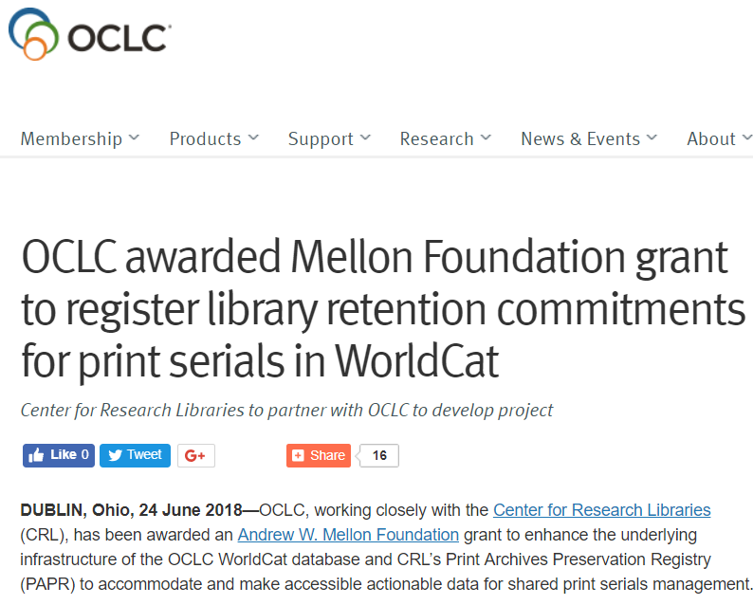
Shared Print Data Infrastructure
Thank you to the Andrew W. Mellon Foundation!
Batch registration of shared print serials
Set retention attributes in Collection Manager
Serial holdings data API
Connexion and Record Manager discovery improvements
Enhancements to CRL’s PAPR registry
Notes:
Full Text in Mellon Proposal:
Enhancement of WorldCat functionality to enable batch registration of shared print serial retention commitments,
Enhancement of OCLC’s WorldShare Collection Manager to allow programs to set the attributes of the retention commitment,
Creation of an application programming interface (API) to retrieve serial holdings data from WorldCat,
Enhancements to OCLC’s Connexion and Record Manager products to improve search functions and discovery of shared print holdings,
Enhancements of CRL’s PAPR registry data fields to include additional data used by shared print programs, and to improve import and export functionality to enable synchronization of WorldCat and PAPR holdings information for registered titles.

Slide 3
Shared Print Serials Roadmap
2018
2019
2020
Q1
Q2
Q3
Q4
H1
H2
H1
H2
Grant Proposal/Review/Awarded
Product Strategy/Requirements
Development/QA Testing/Product Release/Grant End
Grant Award
Planning Start
Begin Development
Product Release
Grant Start
Requirements Validation/Charleston
Development Complete

Slide 4
Objectives
9:15 – WorldCat Registration Workflow
  Validate high-level serials registration workflow
  Identify opportunities to improve workflow over time
10:00 – Registration Discovery & API Development
  Feedback on registration discovery options
  Identify opportunities to improve discovery over time
  Feedback on proposed API

Slide 5
WorldCat Registration Workflow
9:15 to 10:00

Slide 6
Shared Print Registration
Shared Print Registration Service for single-part monographs went live on June 1st
Pilot program has registered over 250,000 retention commitments in WorldCat
Notes:
Mary
Documentation available at www.oclc.org/shared-print.html
Email for a walkthrough of the service for your library or consortium
Service is for single-part monographs
Benefits of registration
Allows batch creation of Shared Print monograph retention commitments
Uses non-MARC data to create LHRs (via 583 Action Note)
Eliminates the need for an OCLC second symbol
Provides ability to output MARC records in multiple formats, including non-interleaved LHRs, for input into ILS
Discovery in Record Manager and Connexion
Included in a library’s OCLC cataloging subscription

Slide 7
Monograph and Serials Workflow
The planned serials registration workflow is based on the existing single-part monograph workflow
  The 583 $3 will be added to record holdings information
Walkthrough of the single-part monograph process:
  1. Do you foresee obstacles using these processes for serials?
  2. How can the process be improved overall?
Notes:
Documentation: https://help.oclc.org/Library_Management/SCS_and_GreenGlass/Shared_Print_Registration_Service/Register_shared_print_retention_commitments

Slide 8
Monograph Registration Workflow
Part 1:
Establish a collection/create profile
Part 2:
Submit shared print retention commitments
Notes:
Documentation: https://help.oclc.org/Library_Management/SCS_and_GreenGlass/Shared_Print_Registration_Service/Register_shared_print_retention_commitments
A streamlined registration process that:
Allows batch creation of Shared Print single-part monograph retention commitments via Collection Manager
Uses non-MARC data to create Shared Print LHRs (via 583 Action Note)
Eliminates the need for an OCLC second symbol
Sets the Shared Print holding type flag which enables future enhancements/improvements
Provides ability to output MARC records in multiple formats for input into ILS
Allows discovery in Record Manager and Connexion
Included in a library’s full cataloging subscription

Slide 9
Part 1: Establish Collection

Slide 10
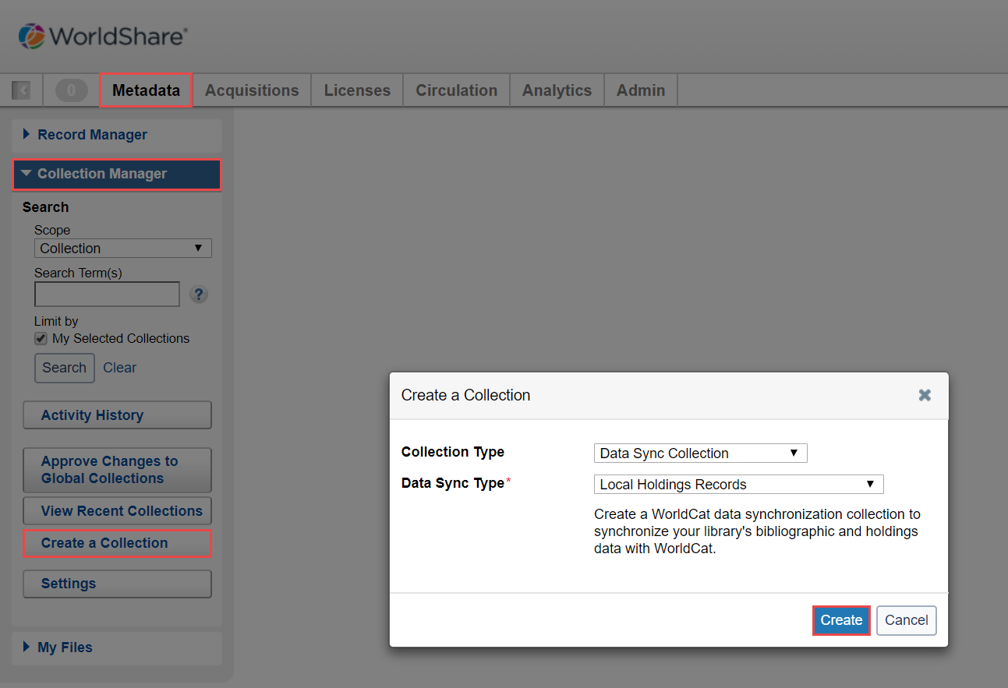
1. Create the Collection
Notes:
Start by creating a collection/profile
*How often do you do this?
*increasing efficiencies to not have to create multiple- opportunities?
In your browser, enter the WorldShare URL for your library. Your library's WorldShare URL will have the following format: https://yourlibrary.share.worldcat.org/wms. Replace yourlibrary with your library's identifier.
On the Sign in screen, enter your User Name and Password.
Click Sign In.
Navigate to Metadata tab > Collection Manager.
Click Create a Collection.
Select Data Sync Collection from the Collection Type drop-down list.
Select Local Holdings Records from the Data Sync Type drop-down list.
Click Create.

Slide 11
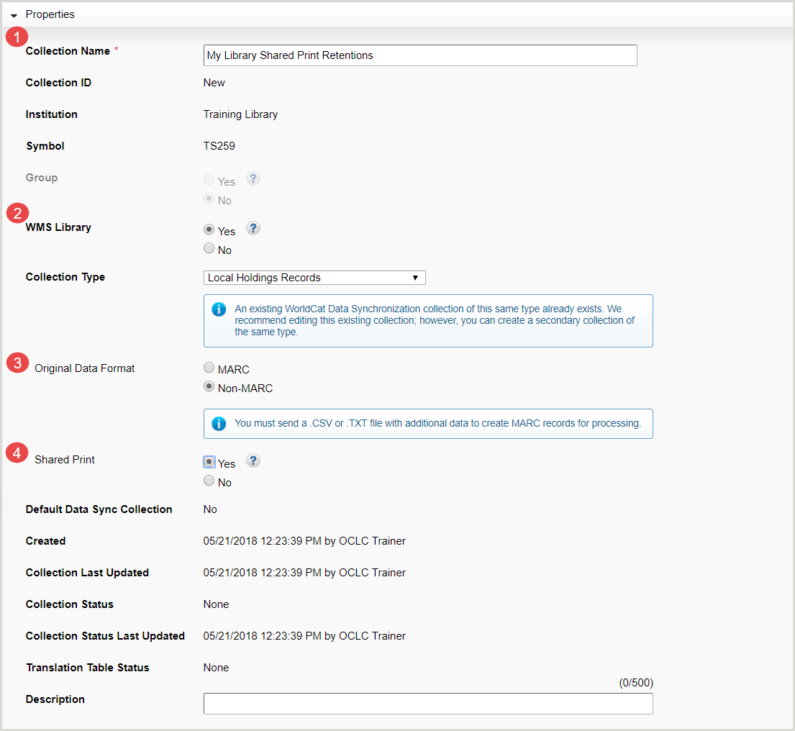
2. Complete Properties
Notes:
For Collection Name, enter a name (e.g., My Library Shared Print Retentions) for your collection.
Select whether your library is a WMS Library. WMS libraries have purchased WorldShare Acquisitions and Circulation modules.
Select Non-MARC for the Original Data Format.
Select Yes for Shared Print.
Click Save Progress at the top of the screen.

Slide 12
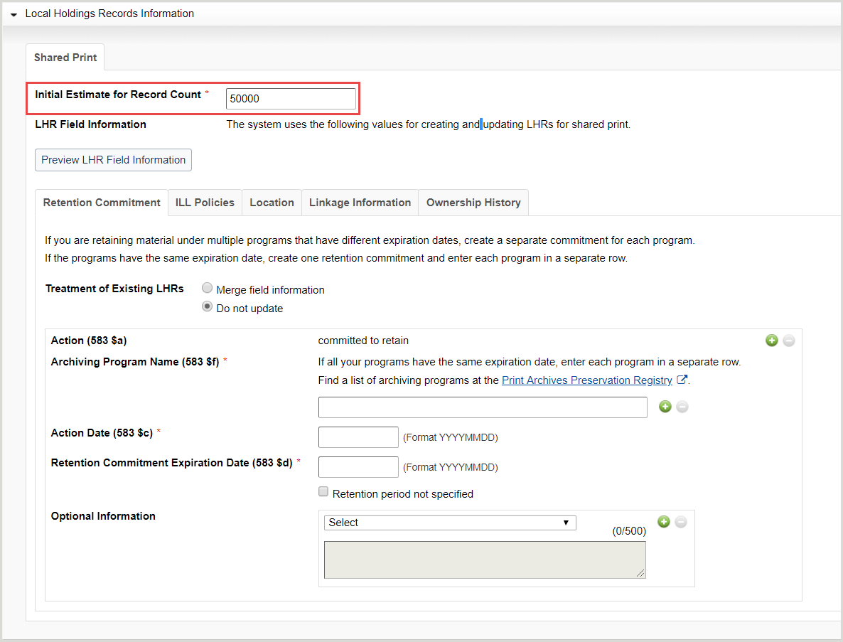
3. Complete LHR Information
Notes:
Click Local Holdings Records Information to open the accordion.
For Initial Estimate for Record Count, enter the number of retention commitments you are registering.
Complete the Retention Commitment, ILL Policies, Location, Linkage Information, and Ownership History tabs to specify what data you want in the local holdings records (LHRs) that will be created for each of the OCLC numbers in your data file.
*Are you typically setting most of your retention commitments to one date? Or do you have to create multiple collections for multiple dates?
Optional information field usage?

Slide 13
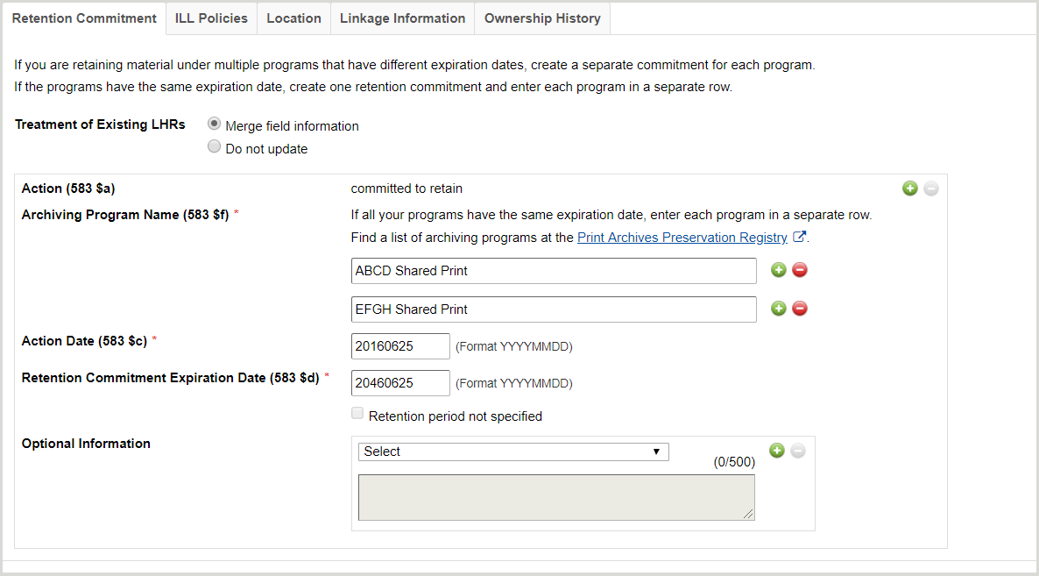
4. Complete Retention Commitment
Notes:
Select a value for Treatment of Existing LHRs.
For Archiving Program Name (583$f), enter the name of your archiving program/consortium.
(Optional) Click the Add button () to add additional archiving program names.
For Action Date (583 $c), enter the start date (format: YYYYMMDD) of your retention commitments.
For Retention Commitment Expiration Date (583 $d), enter the expiration date (format: YYYYMMDD) of your retention commitments.
Note: If you do not have an expiration date, check Retention period not specified.
(Optional) You can add additional subfields to your 583 note with Optional Information.
Select a subfield type from the drop-down list.
j - Site of Action
u - URL to Documentation for Archiving Program
z - Public Note
5 - Archiving Institution
Enter subfield details in the text box.
(Optional) Click the Add button () to add additional subfields.
Click Save Progress at the top of the screen.
If you are retaining material under multiple programs that have different expiration dates
Completed Retention Commitment tab for multiple programs that have different expiration dates - ExampleSelect a value for Treatment of Existing LHRs.
For Archiving Program Name (583$f), enter the name of your archiving program/consortium.
For Action Date (583 $c), enter the start date (format: YYYYMMDD) of your retention commitments.
For Retention Commitment Expiration Date (583 $d), enter the expiration date (format: YYYYMMDD) of your retention commitments.
Note: If you do not have an expiration date, check Retention period not specified.
(Optional) You can add additional subfields to your 583 note with Optional Information.
Select a subfield type from the drop-down list.
j - Site of Action
u - URL to Documentation for Archiving Program
z - Public Note
5 - Archiving Institution
Enter subfield details in the text box.
(Optional) Click the Add button () to add additional subfields.
Click the Action (583 $a) Add button () to add an additional program and repeat steps 1 through 5.
Click Save Progress at the top of the screen.
In a nutshell, “Treatment of Existing LHRs” indicates whether you want the registration process to create new LHRs, or update existing LHRs. (Which I suspect mostly boils down to non-WMS libraries, vs. WMS libraries, but we leave the options open for anyone)
your notes mention that $z public note can be added as “Optional Information” but the screenshot doesn’t show it. I mention that only because it looks like discovery is one of the focuses of the discussion.
Did you want to include $3 in your notes because it cannot be added in Optional Information? (Remember, we don’t support it here because $3 is by definition, item-specific information – so not appropriate for a collection “template” that will be applied to every LHR)

Slide 14
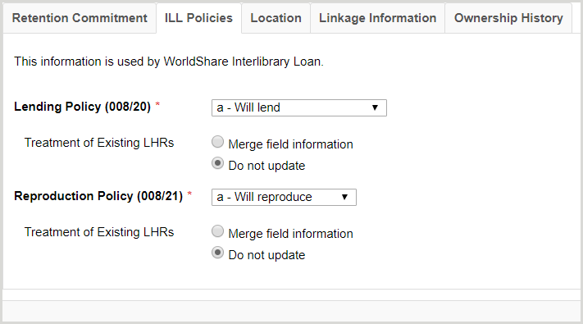
5. Complete ILL Policies
Notes:
why are you setting these values? Because OCLC’s WorldShare ILL, Tipasa and ILLiad will use that info to automatically deflect requests for items the LHR says you will not lend or copy, so your staff won’t have to respond “no” to those requests
.
The ILL Policies tab allows you to set positions 20-21 in the 008 field.
Click the ILL Policies tab.
Select a Lending Policy (008/20) from the drop-down list.
a - Will lend
b - Will not lend
c - Will lend hard-copy only
l - Limited lending policy
u - Unknown
Select a value for Treatment of Existing LHRs.
Select a Reproduction Policy (008/21) from the drop-down list.
a - Will reproduce
b - Will not reproduce
u - Unknown
Select a value for Treatment of Existing LHRs.
Click Save Progress at the top of the screen.

Slide 15
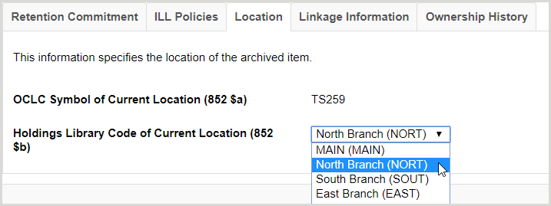
6. Complete Location
Notes:
**Current challenge
The Location tab allows you to create the required 852 field.
Click the Location tab.
For Holdings Library Code of Current Location (852 $b), select a holding library code from the drop-down list.
Note: If you do not know what the correct 4-letter holding library code is, you should find out from your cataloger, otherwise LHRs will be created with inaccurate location information. If your library does not use 4-letter holding library codes, then use the default. Every symbol has a default holding library code, which should be displayed in the drop-down list.
Click Save Progress at the top of the screen.
Note: If you have items for retention stored in different locations (e.g., a MAIN branch and an off-site facility), you will need to create and submit separate SP collections for each location where those items are stored.

Slide 16
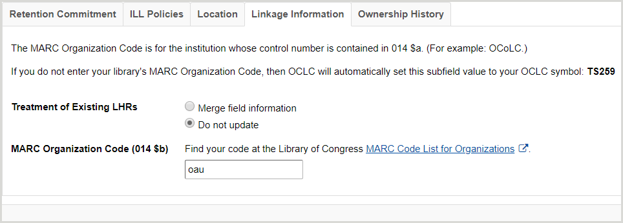
7. Complete Linkage Information
Notes:
fyi, the code “oau” = Ohio University. (Note that this is not an OCLC symbol; the MARC holdings format requires a “MARC organization code” here, not an OCLC symbol)
The Linkage Information tab allows you to create the required 014 field.
Click the Linkage Information tab.
Select a value for Treatment of Existing LHRs.
Enter your MARC Organization Code (014 $b).
Note: If you do not know your MARC Organization Code, click MARC Code List for Organizations to search for it in a new tab.
Click Save Progress at the top of the screen.

Slide 17
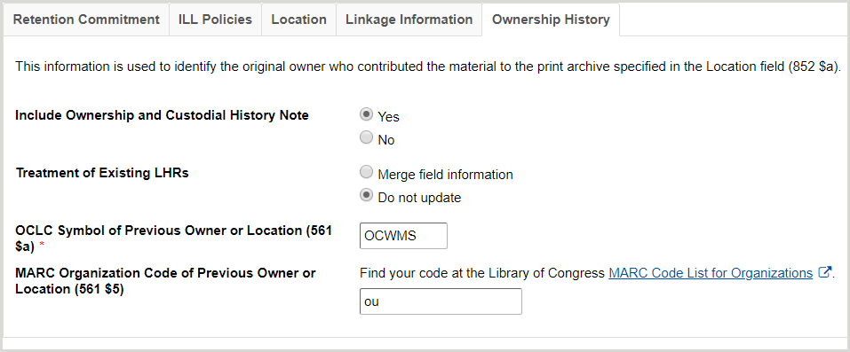
8. (Optional) Ownership History
Notes:
fyi, the code “ou” = Ohio State University. (same comment as above). Most registration projects will skip this tab, because they are retaining ownership of the items. It’s only relevant when retained items are transferred to another entity for storage, e.g. the University of California Regional Storage Facilities.
The Ownership History tab allows you to create the 561 field.
Click the Ownership History tab.
For Include Ownership and Custodial History Note, select Yes.
Select a value for Treatment of Existing LHRs.
Enter the OCLC Symbol of Previous Owner or Location (561 $a).
Enter the MARC Organization Code of Previous Owner or Location (561 $5).
Note: If you do not know the previous owner or location's MARC Organization Code, click MARC Code List for Organizations to search for it in a new tab.
Click Save Progress at the top of the screen.
fyi, the code “ou” = Ohio State University. (same comment as above). Most registration projects will skip this tab, because they are retaining ownership of the items. It’s only relevant when retained items are transferred to another entity for storage, e.g. the University of California Regional Storage Facilities.

Slide 18
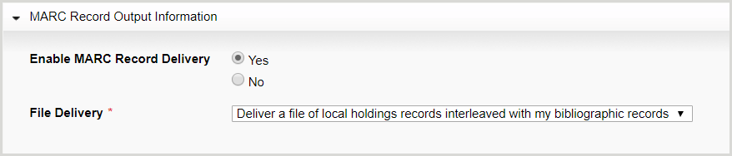
9. MARC Record Output Information
Notes:
Click MARC Record Output Information to open the accordion.
Select whether to Enable MARC Record Delivery for your retention commitments.
If Yes, select your preferred method of delivery from the File Delivery drop-down list.
Deliver a file of local holdings records only
Deliver a file of local holdings records and a file of bibliographic records
Deliver a file of local holdings records interleaved with my bibliographic records
Click Save Progress at the top of the screen.

Slide 19
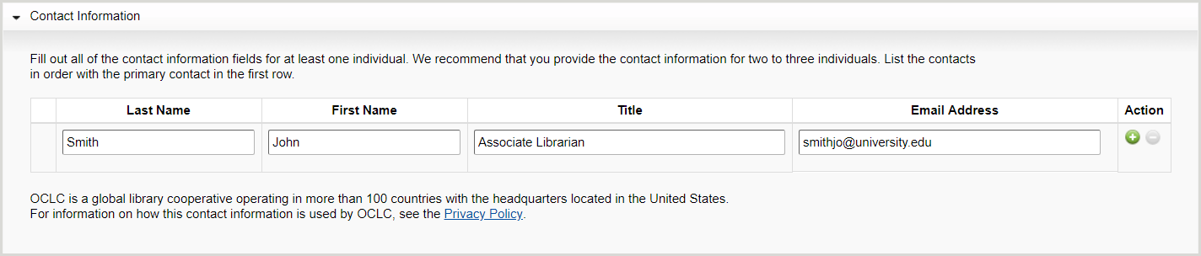
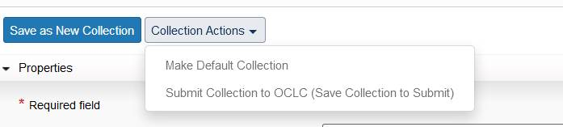
10. Complete Contact Information & Submit Collection
Notes:
this is the last step in completing the collection. Either here – or as a separate step– the user needs to submit the collection to OCLC staff. Otherwise, the data file they upload will never be processed!
Click Contact Information to open the accordion.
Enter the contact's Last Name.
Enter the contact's First Name.
Enter the contact's Title.
Enter the contact's Email Address.
Click Save Progress at the top of the screen.
Note: When adding multiple contacts, use the Add button () to create additional rows. List contacts in order of priority.

Slide 20
Establishing a collection
Current opportunities with the monograph workflow?
How does the serials workflow differ from the monograph workflow?

Slide 21
Part 2: Submit Commitments

Slide 22
Prepare Data File
1. CSV File
2. Rename Headings
3. Rename File
<collectionID>.<OCLCsymbol>.sharedprint_<optionaltext>_<YYYYMMDD>.
<optionalfile#>.csv
Example:
1028071.ndclv.shareprint_20170731.csv
Future:
Potential columns added here to support serials information
Notes:
yes, for serials (and presumably, multi-part monographs), I’d expect we will define an additional column for 583 $3.
The barcode is a requirement for WMS libraries, but if – for whatever reason – a non-WMS library already has LHRs that include barcodes, the registration process will always attempt to match on that barcode, to update an existing LHR, rather than creating an entirely new one. So it’s not only for WMS libraries, but they certainly are the most likely to use it.

Slide 23
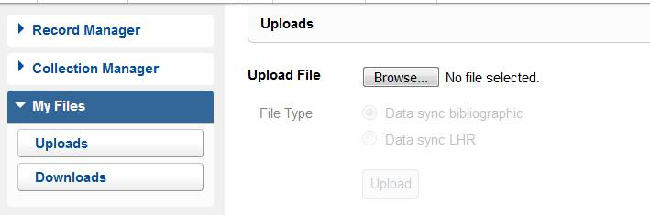
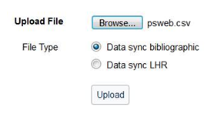
Upload Data File
Notes:
once you navigate to the file you want to upload, the radio button is active – choose LHR, and then Upload.

Slide 24
Available Reports
1. Summary Report
  Count of the number of retention commitments uploaded, LHRs created, LHRs updated, holdings symbols added, and retention commitments skipped
2. Exception Detail Report
  System processing errors
  Missing OCLC numbers in the original data file
  Incorrect record type (e.g., Multi-Part Monograph, Serials)
  Missing or incorrect barcodes (WMS libraries only)
Notes:
‘records’ mentioned in the exception detail report will potentially need to be resubmitted, or removed from the datafile (depending on the exception will be resolved) . The smaller, corrected datafile can be uploaded whenever it’s ready; the same Collection will be used to process it.

Slide 25
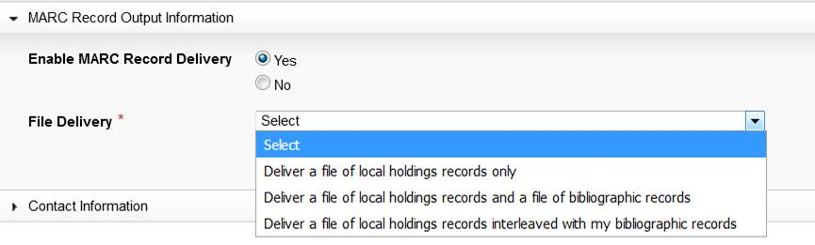
(Optional) Download MARC records
Notes:
In case anyone asks whether records can be output in a format other than MARC, I believe we now support outputting MARC XML* as well. It doesn’t appear as an option on the collection, but I suspect the library would set that as an institution-wide setting in Collection Manager, which would then be applied to all of the institution’s collections.

Slide 26
Submitting Commitments
Opportunities with existing process?
Opportunities to support serials?
Notes:
Location
Frequency
Condition

Slide 27
Registration Discovery & API Development
10:00 to 10:45

Slide 28




Registration Commitment Visibility
Metadata services
View commitments in Record Manager and Connexion
Download commitments in Collection Manager
Discovery
View commitments in Discovery
On the roadmap for First Search
Resource Sharing
Lending policies are unaffected by shared print retention commitments
API
Will include comprehensive shared print detail
Allows data to be accessible in multiple places/formats
Notes:
Mary
Currently anticipate visibility in First Search available

Slide 29
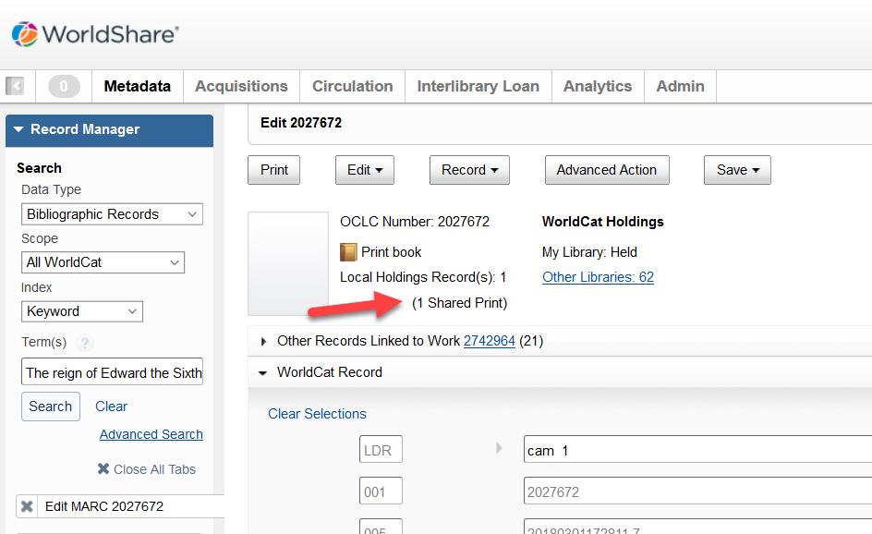
Record Manager Display

Slide 30
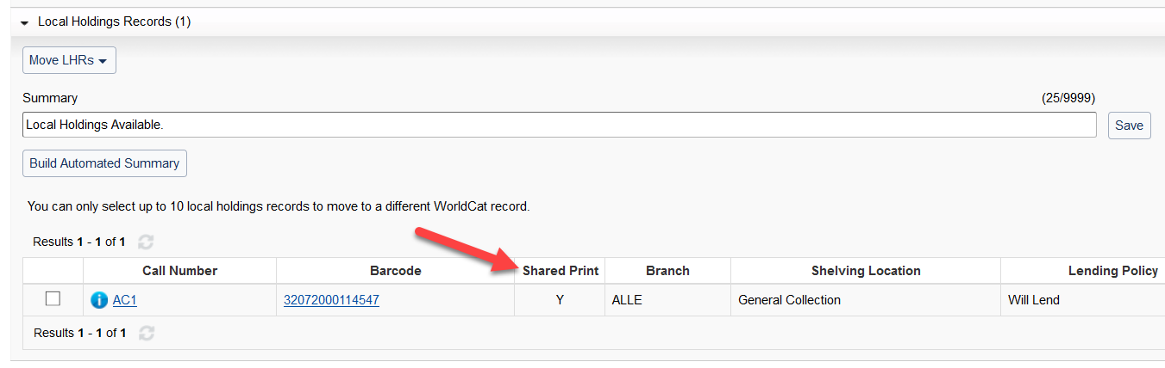
Record Manager Display

Slide 31
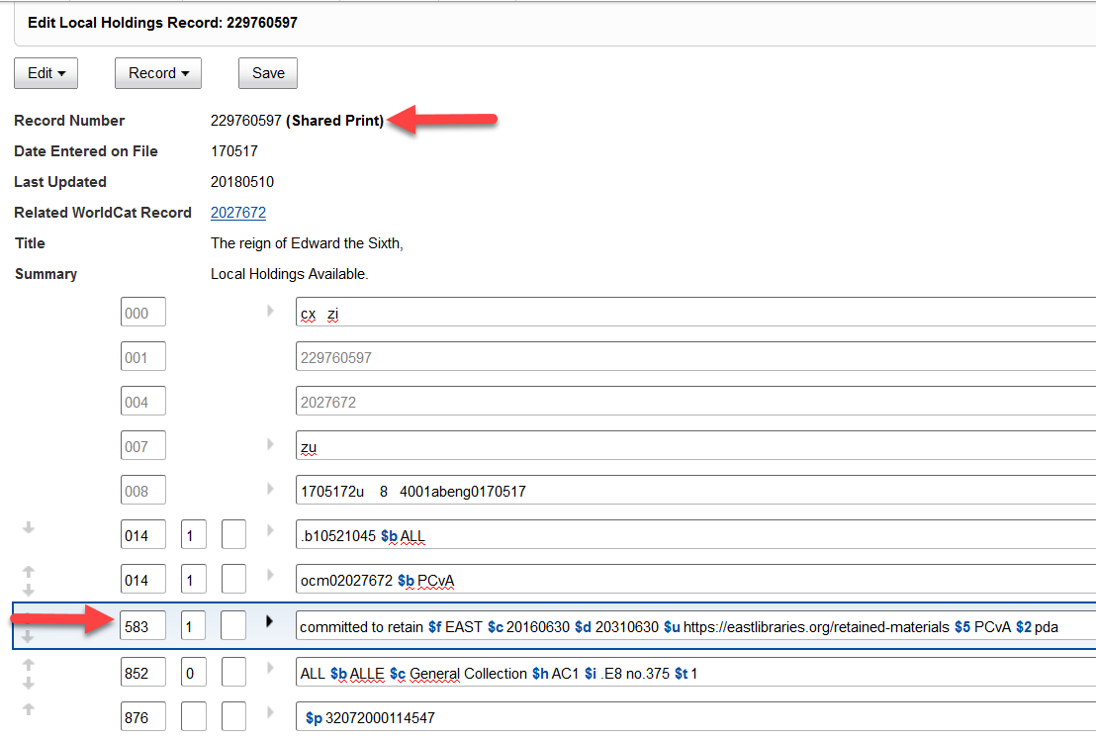
Record Manager LHR Display

Slide 32
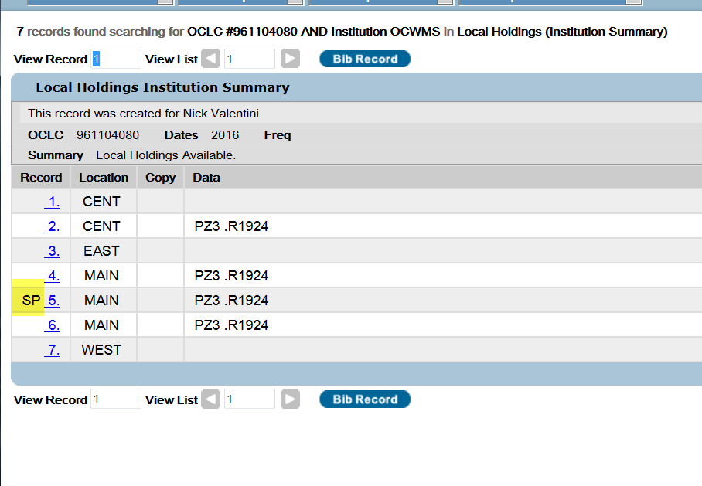
Connexion Display

Slide 33
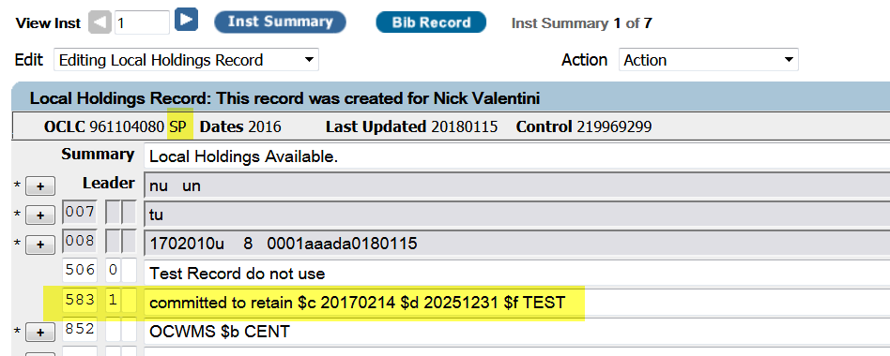
Connexion Display
Notes:
And speaking of discovery tools, I want to hand things over to Kristin Ewig, our product manager for FirstSearch to show you some enhancements we’ll be making to that product and get your feedback as well.

Slide 34
Connexion & Record Manager Discussion
Obstacles today in viewing shared print commitments?
Desired improvements in displaying serials information?
Notes:
Only being able to see my own commitments in record manager
Few layers deep

Slide 35
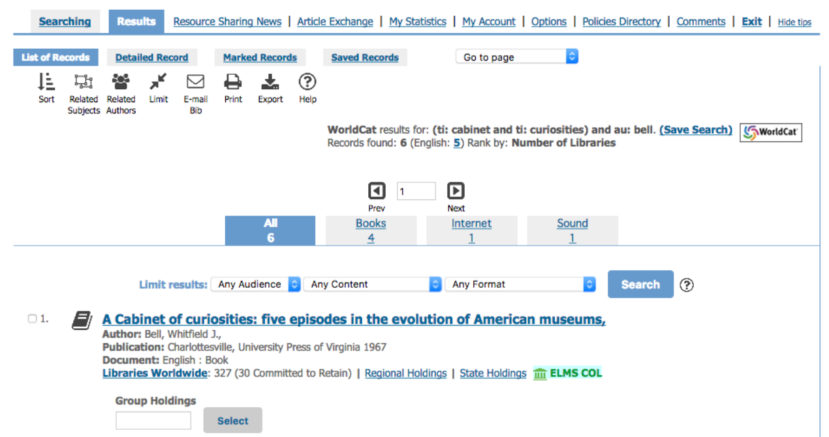
FirstSearch Mockup
Notes:
This is a view of a search results page. Every result that is returned today shows the # of libraries worldwide. How valuable do you think seeing a # of committed to retain worldwide would be to you?
Level set that this is a Worldwide #, not contextual to group or institution searching
*would it be of value to you if this # was specific to your institution? Elms college SP1 ?
Your group? BLC or EAST?
Your search parameters? Ex. Searched for symbol PBU

Slide 36
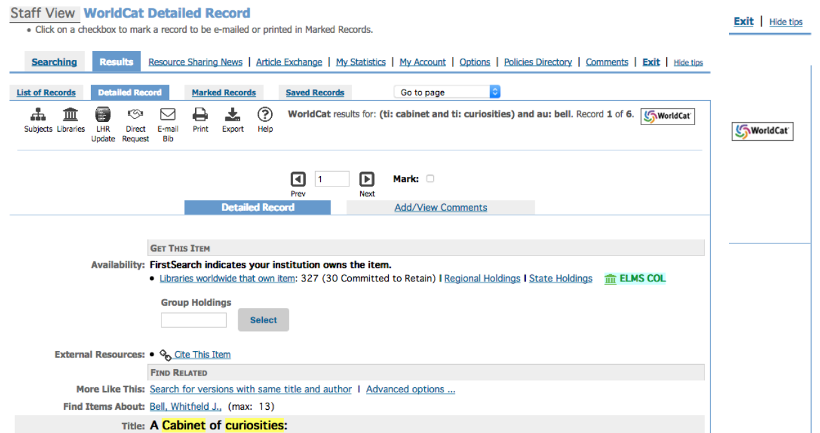
Notes:
This is the view of the detailed record page, which duplicates the same view.
Other thoughts at this level? Do you expect anything different at this level in regards to SP commitments?

Slide 37
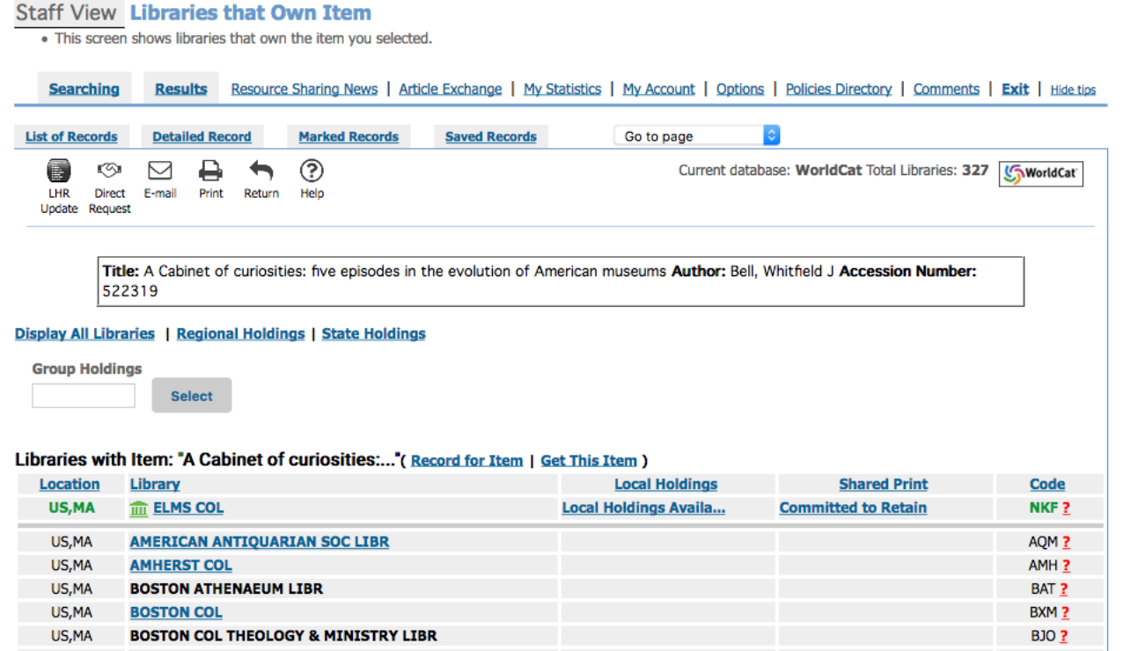
Notes:
This is a list of libraries that own the item. You might get to this screen by clicking on libraries worldwide. Of course, however you’ve configured your group settings, those institutions would display first. This example is from an autho that has Elms college setup as your institution. You can see here, right at the holding libraries screen that this record has a retention commitment.
The thought is, anywhere a shared print commitment is set against this record, in any library worldwide, it would be displayed on this screen.
Do you find this valuable?
Is this enough detail at this level?
Would it be valuable to sort on a view of all institutions who are committed to retain this item, regardless if they’re in your group or not?
What else would you find valuable to have at this level?

Slide 38
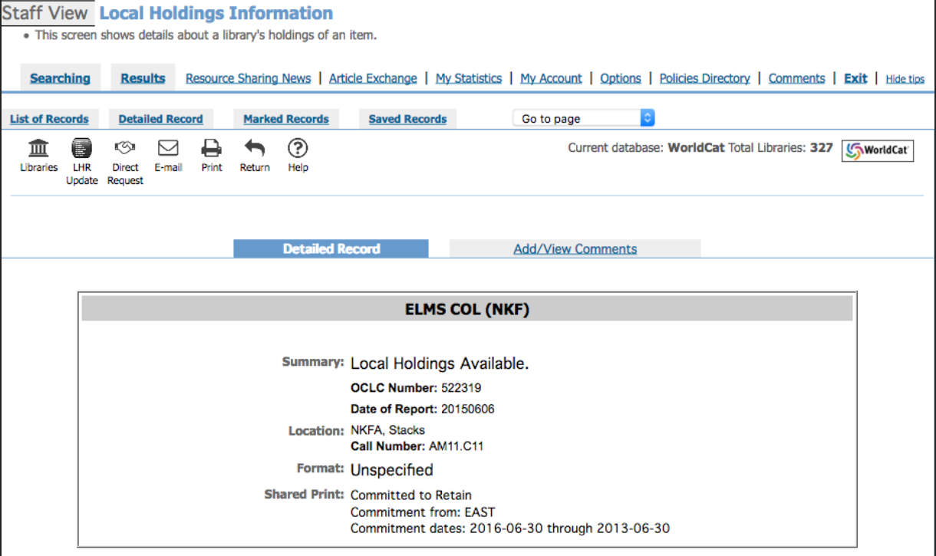
Notes:
Now we’ve drilled into the detailed record w/ the local holdings information
Notice the detail that is listed here (let’s assume this record is a single part monograph). Were showing a commitment to retain, from the 583 field, who the commitment is from (583) and what the commitment dates are (583)
Does this provide the information you need? Would you expect any other details or subfields to be displayed?
How about for different material types like serials? How would that change the information you would expect to see?
Any other materials aside from serials that might require additional detail?

Slide 39
Data API
Proposed Functionality:
Search WorldCat and retrieve bibliographic records for cataloged serials retention commitments
Retrieve records in MARC XML or Dublin Core formats
Get item information in the standard bibliographic citation formats (APA, Chicago, Harvard, MLA, and Turabian)
Find libraries that own an item and retrieve links to online catalog records when available.

Slide 40
Data API
What level of information do you expect the API to provide and in what format?
How do you anticipate groups / members using the new API?
Notes:
Once API is built and all data can be extracted, how do you envision using?
What channel do you envision using the API on - mobile, web, kiosks, offline batch, other
What other OCLC APIs are currently in use in conjunction w/ search API integration?
What other 3rd party offerings or APIs are typically used in conjunction with OCLC API to deliver end-to-end solution?
In what format would you want bib data available to you through the API? Dublin Core, Marc XML, JSON, Linked Data RDF, Other?
Which integration programming language or platform do you prefer? (i.e. Java, Python, Ruby, etc.)

Slide 41
For additional information, please contact:
Kristin Ewig
Senior Product Manager
ewigk@oclc.org

