Slide 1
Central Iowa Collaborative Collections Initiative Survey
Teri Koch
Andrew Welch

Slide 2
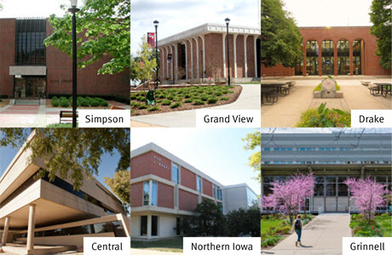
Central Iowa Collaborative Collections Initiative (CI-CCI)

Slide 3
CI-CCI key facts:
Formed in 2013. UNI joined in 2014.
Initial focus: Monograph retention
No shared catalog
Characteristics:
Small, Private Academic libraries (FTE’s: 1,388-4,400)
UNI=Regent University. FTE=11,000
Holdings (1,000,000 without UNI), with UNI = 2,000,000-ish
Hired SCS for collection analysis

Slide 4
Why Validate?
Only one retention copy among the group
Relatively small number of titles to verify (around 154k total, Drake=45k)
Important to faculty (they didn’t want to withdraw books unless guaranteed another CI-CCI school would FOR CERTAIN retain)
Web app developed to facilitate process (faculty involved in this process)

Slide 5
Purpose of Survey
Validation requirement added to MOU in 2015
Determine extent and perceived value of validation in other shared print programs
Notes:
Was CI-CCI validation unique?

Slide 6
Survey Development
Selected participants after consulting the Print Archives Preservation Registry (PAPR) list and talking with Ruth Fischer (SCS)
Targeted programs performing monograph retention (all or mixed)
Short Qualtrix survey with focused questions, emailed to program contacts
Notes:
Briefly describe the 3 main types of retention programs?

Slide 7
Level of Validation Performed
Notes:
Point out that “Other” included responses indicating that validation was still being considered, but none indicated full validation.

Slide 8
“Other” Level of validation performed:
Verification is limited to observing the book completeness and preservation (e.g., no visible mold).
We’re deciding how to handle sampling right now but nothing has been done to this point.
New members that are being asked to retain on average 58 titles are checking their shelves to ensure the title is present…But this level of validation was just not feasible during the original group analysis.
As of current planning stage, no physical verification is anticipated, but could change.
No plans at this point but do not rule out verification work.

Slide 9
Reasons for Validating
Respondents were asked to rank factors, with 1 being the most important
Loss of access and few retention copies both received the highest rankings
Survey choices could have been more clearly delineated
Notes:
Concern about loss of access to scholarly material vs. Few items retained

Slide 10
Reasons for Not Validating
Respondents were asked to rank factors, with 1 being the most important
Cost vs. benefit was the highest ranked factor (4 programs ranked it 1 or 2)
Multiple copies held within the group was the second most important factor

Slide 11
Lessons Learned - Comments
“Our statistical consultant was integral to the success of our validation sample study.”
“Use a data collection tool, such as Sara Amato’s at EAST.”
“You need to consider the ROI of validation.”

Slide 12
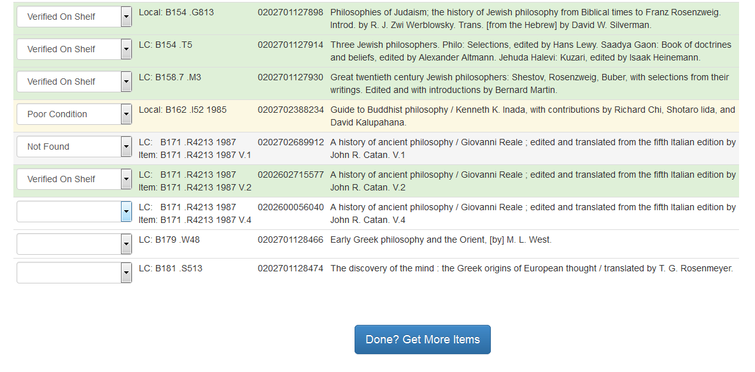
CI-CCI Web App

Slide 13
CI-CCI Sampling (6,000 volumes) vs. Full Validation Success Rates
 | Random Sampling | Random Sampling, including withdrawals | Full Validation (# of volumes) | Full Validation, including withdrawals (# of volumes)
Institution A | 98.1% | N/A | 98.1% (20,143) | N/A
Institution B | 99.4% | N/A | 99.4% (46,754) | N/A
Institution C | 97.1% | 91.9% | 97.1% (23,415) | 91.9% (24,741)
Institution D | 98.8% | N/A | 98.8% (14,511) | N/A
Institution E | 97.3% | 91.3% | 97.3% (38,471) | 91.3% (40,971)

Slide 14
Conclusions
Value of verification depends upon number of retention copies and, to a lesser extent, collection size.
8 of 13 respondents consider validation to be “Moderately to Extremely Useful”
Sampling may be sufficient for programs retaining multiple copies.
Full survey results: https://tinyurl.com/cicci-validation

