Slide 1
Gold Rush Match Key
George Machovec, Executive Director
Colorado Alliance of Research Libraries
June 24, 2022
2022 Annual PAN Forum
george@coalliance.org

Slide 2
Gold Rush Analytics Technical Overview
Developed and hosted by the Colorado Alliance of Research Libraries
Highly modified Blacklight/Solr implementation
Uses mostly open-source software with a few exceptions (e.g. charting)
Servers located at the University of Denver
Much less expensive than AWS hosting at this point
Code is backed-up in GitHub
Offered as a service by the Colorado Alliance at cost
No startup fees
Friendly contract terms

Slide 3
Matching MARC
How do we match records in the system?
No common record source
OCLC, older RLIN records, vendor supplied, other sources (e.g. Skyriver)
Decided to create a match key based on universal elements from the MARC record
Will pre-build the match key during record loading so the system works in real-time
Supporting different use cases
Shared Print programs
General library analytics for weeding, shared storage, prospective collection development, backfile ebook purchasing, single & comparative analytics, resource sharing, etc.

Slide 4
Selected Elements in Match Key
Title
245 $a $b (first 70 characters)
General Media Description
245 $h (pre-RDA)
Type
'_' Leader
Title Part
245 $p
Title Number
245 $n
Publication Year
008, 264c or 260c
Edition Statement
250 $a
Publisher Name
260 or 264 $b
NO matching is done with ISBN, ISSN or OCLC #
Match key ends with an “e” or “p” to separate electronic and print

Slide 5
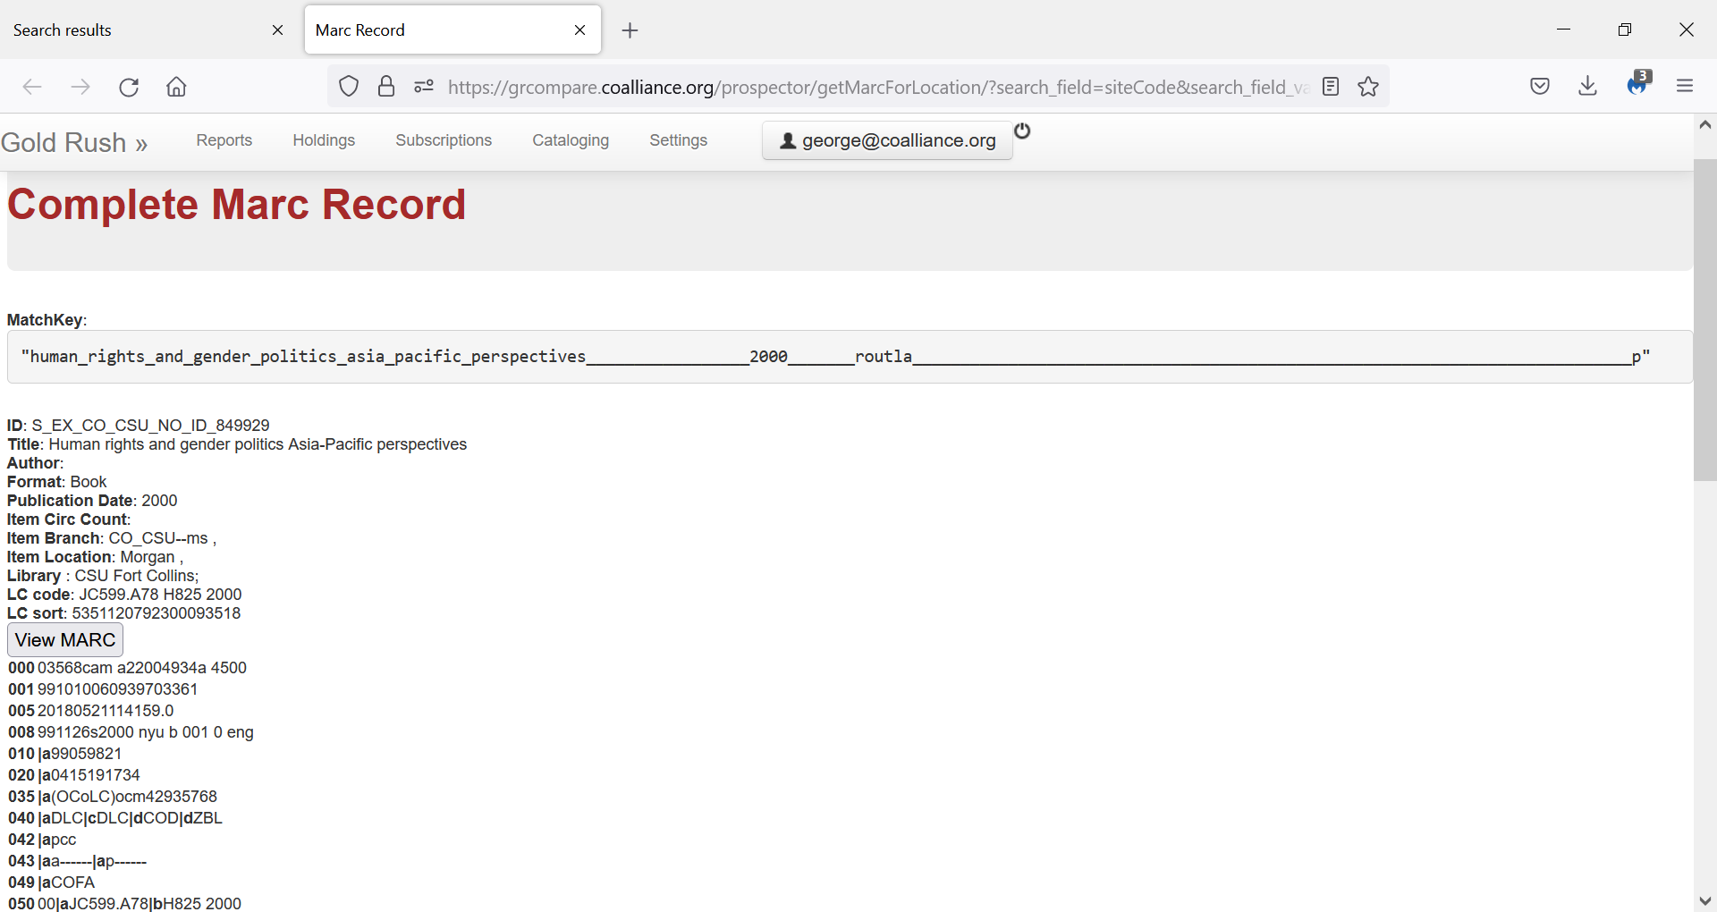
Note that the match key ends in a “p” or “e” to separate print from electronic resources

Slide 6
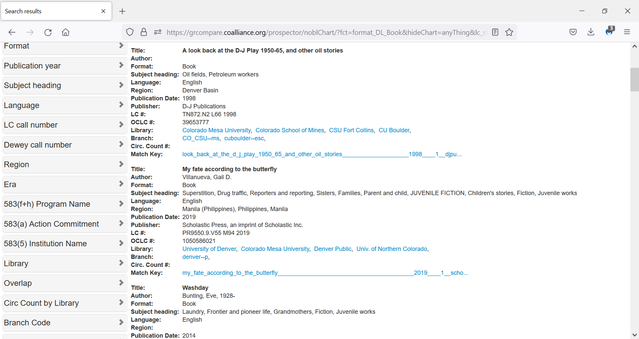
4 libraries have matched up. Select library to see their unique MARC record
A master indexing record is selected based on encoding level. MARC records from all sites are linked to the match key

Slide 7
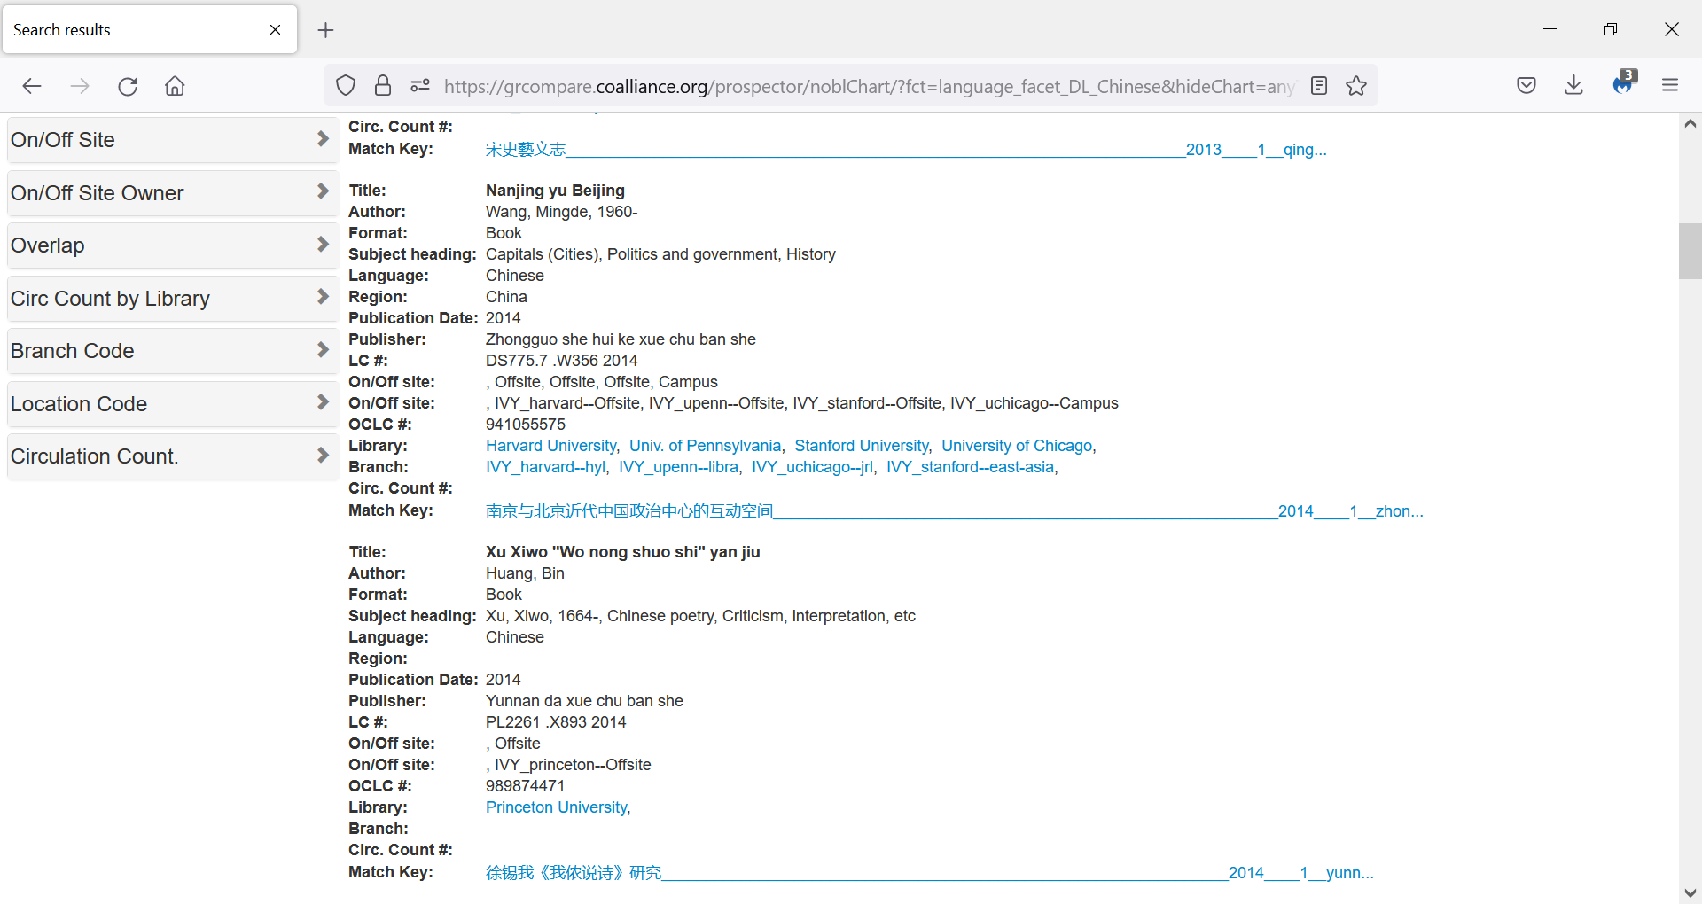
Match key is using the 880 rather than 245 due to transliteration issues

Slide 8
Challenges in Match Key Building
Speed of Indexing
Examples of normalization issues
Put all in lower case
Getting rid of unwanted spaces
Getting rid of special characters
Leading and following special characters deleted
Handling non-English vernacular (using 880 when available)
Date selection (008, 264c, 260c), handling reprint dates rather than original dates
Normalizing publisher names
Normalizing edition statements to integers (e.g. Second, 2nd, 2d)

Slide 9
Pros & Cons of Match Key Approach
Pros
Works quickly & efficiently in application when created
Creates a universal hash tag representing the record
Understandable to librarians
Works across all MARC formats
Concept could be adapted in a bibframe data model
Not dependent on OCLC #s, ISBNs, ISSNs, LCCNs or other numbers that may not exist
Can tweak and change as needed in the next indexing run
Cons
Significant computing resources needed
We run multiple simultaneous streams to speed up match key creation
Match key index must be rebuilt if there is a change in normalization or elements used
Not flexible for fuzzy matching or on-the-fly changes
Will be difficult to use across different platforms unless organizations use the exact same code due to differences in normalizing
Relying on libraries to not mess with the MARC record standard in their catalog

Slide 10
Let us know if you want more detailed documentation or code
George Machovec
Executive Director
Colorado Alliance of Research Libraries
george@coalliance.org

