Slide 1
PAN FORUM UPDATE
June 2018
Kim Armstrong, Chair, Operations Committee

Slide 2
The Rosemont Shared Print Alliance is a collaboration of regional programs interested in coordinating their efforts on a larger scale to ensure the retention of and access to print journal backfiles.
Current participants include:
Big Ten Academic Alliance Shared Print Repository (CICBTAA-SPR)
Eastern Academic Scholars' Trust (EAST)
Florida Academic Libraries Repository (FLARE)
Scholars Trust
Western Regional Storage Trust (WEST)

Slide 3
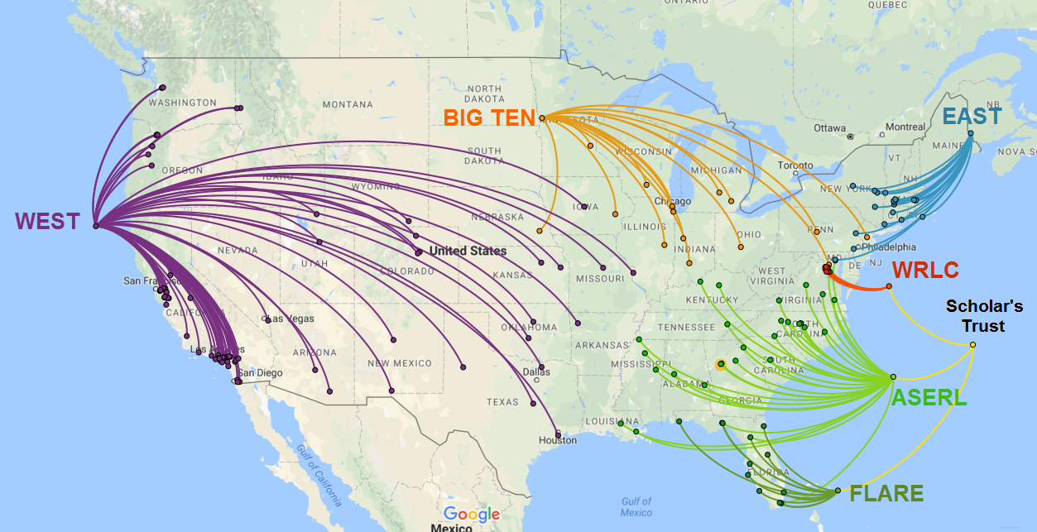
160+ U.S. Institutions
USA map: Google Maps; Network map: Rebecca Crist

Slide 4
Continuing from Midwinter Update…..
Webinar for all Rosemont Participant Libraries
Follow-up Conference Call and Survey
CRL engagement on Rosemont disclosure in PAPR
Preliminary analysis of Rosemont collection
Planning agenda for remainder of 2018

Slide 5
WEBINAR: Journal Analytics/Decision Support Systems (DSS)
Journal analytics and decision-support capability
Purpose in meeting Rosemont’s goals
Overview of Sustainable Collection Services development
Alternatives: What other options exist?
Next Steps
Questions

Slide 6
Benefits of Shared Analysis to Participating Libraries
Local record remediation to improve data quality
Tracking high overlap (multi-level: regionally, Rosemont, WorldCat) for informed local deselection
More information for intentional local decision-making
Tracking scarcity (multi-level) to actively preserve and make informed local deselection decisions
Coordinated standards facilitate cross-institutional collaboration
High-level picture of local journal holdings → highlighting areas of subject strength
A shared analysis tool would facilitate data synchronicity
With SCS/OCLC tool, WorldCat connection
Notes:
(beyond explicitly shared print efforts)

Slide 7
Decision Support System Institutional Survey
My institution would have use for a data capture and retention modeling tool around or after March 2019.
My institution would have use for a collection management tool around or after March 2020
Given the optimal scenario, my library would be able and willing to invest in these tools.
My institution would consider the following value to be a feasible three-year annual investment:
A. $7,000-$10,000
B. $5,000-$7,000
C. $3,000-$5,000
D. $1,500-$3,000
E. $1-$1,500

Slide 8
Rosemont Disclosure - PAPR
Summary of our aims:
Making the Rosemont collaboration visible to wider audience
Facilitating regional program archiving selections and local review projects through:
Title lists: A unified title list reflecting retentions for all participating programs
Explore mechanisms to disclose Rosemont holdings

Slide 9
Rosemont Title Analysis (preliminary)
Title Overlap Data
Confirmed that over the lifetime of the 4 programs we have gathered about 41,025 OCLC numbers.
Titles held by 1: 31,630
Titles held by 2: 7,726
Titles held by 3: 4,387
Titles held by 4: 1,980
Titles held by 5: 774
Titles held by 6: 94

Slide 10
Rosemont Title Analysis (preliminary)
Total Number of Titles by Program
BTAA 6,182
EAST 2,737
WEST 23,988
FLARE 23,525
Scholar’sTrust 8,700

Slide 11
Current Roadmap 2017-2021
Collection Growth:
100,000 new titles
3 copies
Last Copy Policy/Agreement
Shared Policies:
Common Metadata Standard for Disclosure
Volume Level Validation Guidelines
Access Guidelines
Gap Filling Guidelines
Participation Model and Engagement with Other SP Programs
Communications and Administration
Consideration of collection analysis tools

Slide 12
Up Next on Our Agenda!
Operations Committee – New Orleans
Executive Committee – Oct 2018
Common Access Principles
Rosemont OCLC GAC and pod with RapidILL
Review and Refresh RoadMap
Explore Decision Support Systems
Value & Benefits to Rosemont Membership

