Slide 1
CERES and Colorado State University Libraries

Slide 2
Project ceres
Begun in 2013, Project CERES is a Center for Research Libraries Global Resources Agriculture Partnership with the United States Agricultural Information Network (USAIN), the Agriculture Network Information Center (AgNIC).
Participants must be members of CRL, USAIN or AgNIC. To apply for participation, applicants submit a project proposal to the Project CERES committee, which is a subcommittee of the USAIN preservation committee. There is an annual call for proposals.
Project goals:
To preserve essential print materials on the History and Economics of Agriculture
Make the resources accessible electronically through digitization
Scope – Serial Publications:
Core Historical Literature of Agriculture
Other agriculture and related trade journals published in the U.S. and Canada
Serial publications published by the U.S. agricultural extension services and experimental stations.
Colorado State University Libraries received $3125.00 from CRL. Each of the participating libraries received the same amount of funds in the first round of Project CERES.

Slide 3
Background
Colorado State University is the land grant university for the state of Colorado
The Libraries participated in Phase 5 of the National Preservation Program for Agricultural Literature, digitizing 1064 core agricultural documents
For Project Ceres, the Libraries chose our collection of Colorado Experiment Station publications to make them accessible to all interested users
The Libraries selected 100 Colorado Experiment Station titles for the project

Slide 4
Grant requirements
Digitization - Create digital objects following NAL specifications
Metadata - Provide descriptive and condition information
Create MARC bibliographic records, contribute records and holdings to OCLC’s Worldcat database, CRL catalog, local catalog and local digital asset management system.
Provide piece-level gap and condition information using a CRL metadata worksheet
Disclose preserved print holdings in PAPR and Worldcat (in process with CRL’s help)
Accessibility - Easily accessible and harvestable
Digital Archiving – Maintain local copies; provide copy to NAL
Print Archiving – Retain holdings, make available, provide archiving information

Slide 5
Workflow
Create a title list and collect volumes
Record physical condition information on internal assessment document
Create a scanning schedule – begin digitization
Use local OCLC MARC bibliographic records, local holdings information, and PDFs to create the metadata
Organize and deposit digital and metadata files into the Digital Collections of Colorado’s Colorado State University holdings http://lib.colostate.edu/digital-collections/
Provide the Ceres Project manager with copies of all required files

Slide 7
Condition Assessment Form
Notes:
When the volumes were pulled from the shelves, each was reviewed and its general condition was entered on a spreadsheet
BND= is the volume bound
GTR= are there problems with the gutter
B/W= volume is bound with another
YLW= pages are yellowed
WTG=
DMG=
TEXT= are there problems with the text

Slide 8
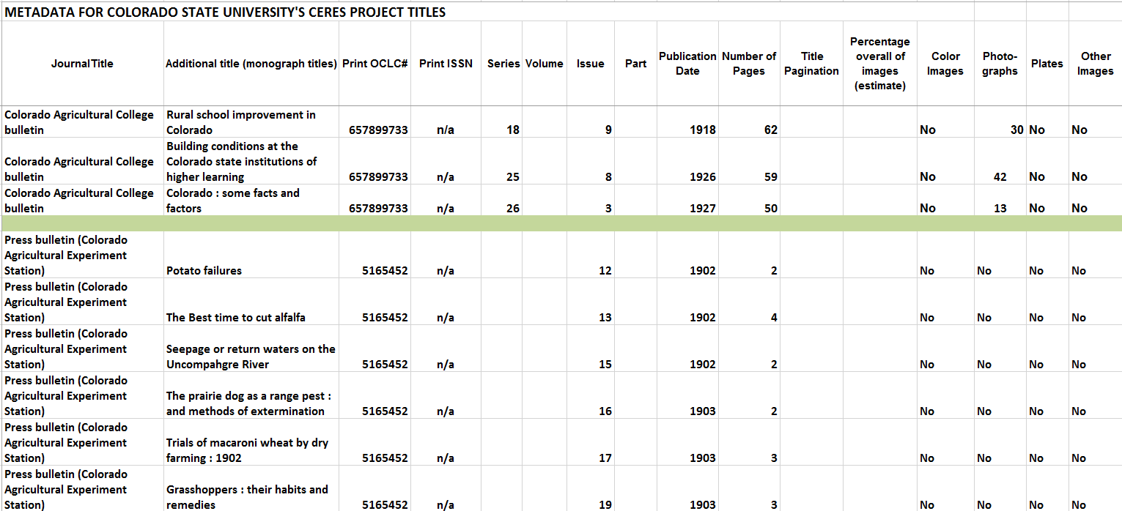

Slide 10
Project completion
The Ceres Project’s goals to digitize and preserve unique print materials was a perfect match with our Libraries’ goals
The time needed to record condition at the issue level metadata is relatively small when digitizing
The CSU Libraries has seen the use of these materials increase once they were digitized – illustrating their value in understanding the history and economics of agriculture
Preservation and access

