Slide 1
Value of Shared Print Working Group
Miranda Bennett, California Digital Library
Aaron Krebeck, Washington Research Library Consortium
Charlotte M. Johnson, University of Pittsburgh
Rebecca Lubas, California State University, San Bernardino
Marie Waltz, Center for Research Libraries
Emily Winthrop, Virginia Commonwealth University

Slide 2
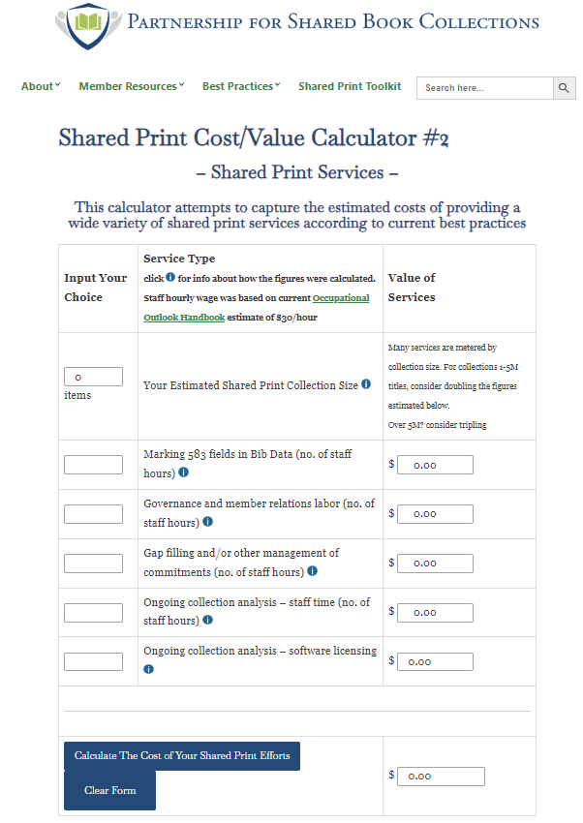
Shared Print Cost Calculators:
Cost of adding a new member
Cost of various services
Cost of shared print for participating libraries
Next steps:
Revise calculators based on feedback from shared print community (thank you!)
Use calculators to address working group requirement to “identify average costs of shared print programs nationally based on a variety of program types” and to establish benchmarks for future longitudinal analysis

