Slide 1
Shared Print Initiatives in Virginia
Summer Durrant
VIVA E-Resources Librarian
PAN Annual 2023
June 23, 2023
Notes:
Good morning, everyone. My name is Summer Durrant and I’m the E-Resources Librarian at VIVA, which is Virginia’s Academic Library Consortium. And I will be speaking about the evolution of shared print initiatives in Virginia.

Slide 2
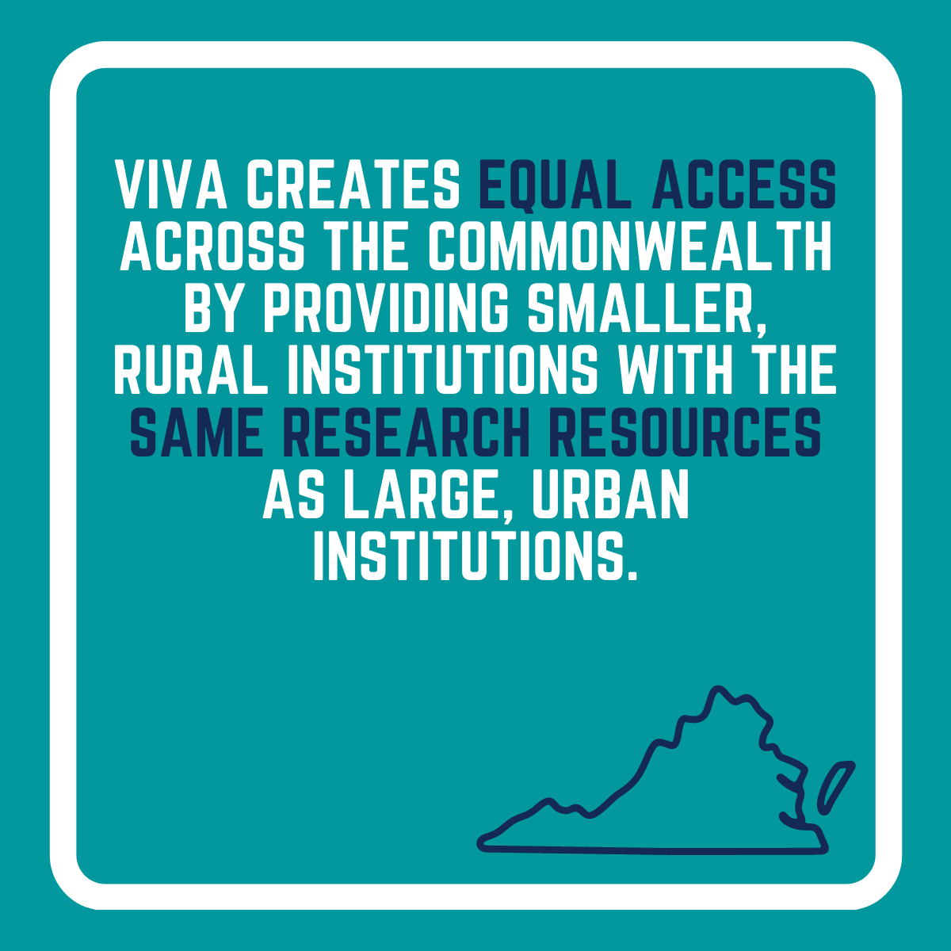
VIVA, Virginia’s Academic Library Consortium
VIVA is a consortium of 71 academic libraries in Virginia
Members include both public and private, not-for-profit, colleges and universities
Our mission is to level the academic playing field in Virginia
Notes:
Our shared print initiatives have been organized through our academic library consortium, so I wanted to start with some background information on VIVA. VIVA is a consortium of 71 academic libraries in Virginia. Our members include both public and private, non-profit, colleges and universities. For nearly 30 years, VIVA has supported the library community in shared initiatives, such as cooperative purchasing, resource sharing, and open and affordable course content. And our core mission is to level the academic playing field in Virginia, ensuring that students and faculty have access to the same core resources regardless of whether they are at a small community college or large research institution.

Slide 3
Timeline of Shared Print Initiatives
2013
2022
2023
VIVA Monographic Collection Analysis project
VIVA joins EAST
Shared Print Pilot
project with EAST
Notes:
I’m going to be talking about three projects that we’ve worked on over the past decade, starting with the VIVA Monographic Collection Analysis, which began in 2013 and then our more recently work with EAST on a Shared Print Pilot in 2022, which culminated in our decision to join the EAST network this year. My goal is really to provide some context on our goals for a shared print collection as well as some of the challenges we encountered and why we decided that joining EAST was the best decision for us.

Slide 4
VIVA Monographic Collection Analysis Project

Slide 5
Print Monographic Collections Analysis
In Fall 2013, VIVA initiated a comprehensive print monographic collections analysis project. The main circulating holdings of 12 institutions were analyzed, a total of 5.8 million bibliographic records.
Analysis focused on:
rare and unique titles
local disciplinary strengths
widely held and highly and recently circulated books
Project Goals
Pilot a coordinated, consortial approach to collection assessment
Use the data and analysis to inform future, collaborative collection development
Begin a discussion about the possibility of reducing unnecessary duplication and saving local space through strategic weeding
Provide remediated and enhanced records back to the participating schools
Notes:
About 10 years ago, we embarked on an ambitious project to analyze the main circulating print collections at 12 member institutions, which ended up being a little under 6 million records.
We had some pretty diverse goals for the project:
The first was to pilot a coordinated, consortial approach to collection assessment. This is a huge challenge for us because we don’t share an ILS or discovery layer in Virginia. And our members use different vendors system so we needed to figure out how to pull all of our holdings together and analyze them.
Second, we had a strong focus on how we could use the results to inform future collection development.
Third, a number of institutions were planning building renovations so we wanted explore the possibility of reducing unnecessary duplication and facilitate strategic weeding.
Finally, we hoped to be able to provide remediated and enhanced records back to the participating schools.
As to be expected, we encountered a lot of challenges. One is particular was the issue of ephemera. At the time we really didn’t have the tools we needed to identify and remove ephemera titles from our dataset.
But overall our analysis focused on:
Rare and unique titles
Identifying local disciplinary strengths (so for example, Virginia Tech has a strong agricultural collection and VCU has a strong collection of art monographs.
Widely held and highly and recently circulated books (obviously we wanted to retain additional copies of high use materials, but this was also important for informing future collection development)

Slide 6
Recommendations and Outcomes
MOU for Rare and Unique Materials
MOU for Widely Held Titles
Recommended threshold of four print titles
Acquisition of shared e-book collections
Notes:
Some of the recommendations and outcomes that emerged from the project include:
Memorandum of Rare and Unique Materials - so institutions agreed to retain identified rare and unique materials for an initial 10 year period. These were titles held by fewer than 10 libraries in the United States.
Memorandum of Widely Held Titles - we discovered that there was a lot of duplication in print titles across the state, so to facilitate strategic weeding, we earmarked 2 copies for retention in the state, but if a title had never circulated, then we decided that 1 copy would suffice. From this, we developed a safe to weed list that institutions could use to deaccession materials knowing that at least 1 or 2 copies were retained and available for ILL in the state.
We also developed a recommendation that libraries did not necessarily need to purchase a monograph if there were already four copies in the state. It was just a recommendation, so each institution could make their own determination if a title was needed or not. To provide this information to libraries, we worked with Gobi to create a tab that members could use when ordering to see how many other VIVA libraries had already ordered a particular title.
A final outcome was the acquisition of several new e-book collections. In particular, we used data on widely held and highly and recently used titles to determine top publishers and then looked for opportunities to purchase relevant e-book collections from those publishers.

Slide 7
VIVA EAST Pilot Project

Slide 8
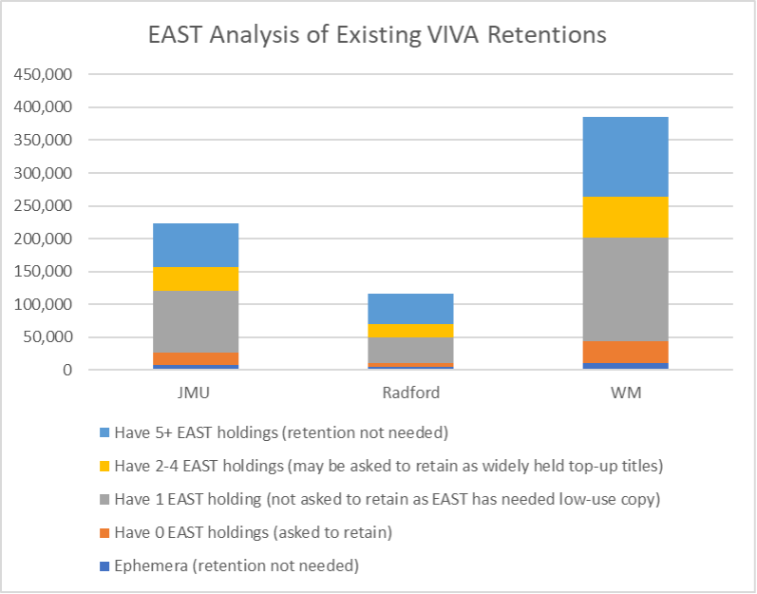
VIVA EAST Pilot Project Overview
As local retention commitments approached their end, VIVA partnered with EAST on a pilot project to explore participation in a formal shared print program.
The objective was to evaluate whether participation in a larger shared print program facilitated by EAST could alleviate the retention commitments on participating libraries while still ensuring continued access to titles through the EAST network.
Three institutions participated in the pilot: James Madison University, Radford University, and William & Mary.
Notes:
As you’ll recall, we initiated the print monograph collection analysis project in 2013 and the MOUs that resulted from it had an initial retention period of 10 years. As we neared the end of our MOUs, we decided to partner with EAST on a pilot project to explore participating in a formal shared print program.
Our primary goal for the pilot project was to see if participating in a larger shared print program facilitated by EAST could alleviate the retention commitments on participating libraries while ensuring continued access to titles through the EAST network. As I mentioned earlier, a number of our members had embarked on building renovations and so there was a lot of discussion around revising existing commitments. In particular, ephemera titles continued to be a challenge for us. We had a difficult time identifying them in our holdings and as a result far too many made their way into our retention commitments. So we were especially interested in seeing if EAST could help us do a better job eliminating ephemera from our analysis.
Three institutions participated in the pilot: James Madison University, Radford University, and William & Mary.

Slide 9
VIVA EAST Pilot Project Takeaways
Benefits of Participation
Offers degrees of freedom to focus on local collections through deeper collaboration at scale
Facilitates intelligent deaccessioning of print titles from local collections when needed
Provides reassurance to stakeholders that deaccessioned titles remain available through resource sharing
Supports preservation of the cultural record and scholarly heritage as reflected in print library collections
Considerations
Staff time to submit metadata records and update local retention commitments
Overlapping retentions
Members previously used VIVA retentions to inform local weeding. How would the transition impact them?
If titles are retained outside of Virginia, how can we ensure access for non-retention partners?
Notes:
Overall, the pilot was very useful and helped us make a decision about the best path forward for a shared print collection in Virginia. Through the pilot, we uncovered a number of benefits of participation:
Offer degrees of freedom to focus on local collections through deeper collaboration at scale
Facilitates intelligent deaccessioning of print titles from local collections when needed
Provide reassurance to stakeholders that deaccessioned titles remain available through resource sharing
Supports preservations of the cultural record and scholarly heritage as reflected in print library collections
So basically, we learned that we wouldn’t have to remain as many titles in the state but could rely more on the EAST network. But we would also be adding a number of unique titles to the EAST network as well. It really felt like a win-win for us.
However, there were a number of considerations that we had to think through. We had numerous discussions with our members about the time commitment required to pull their bibliographic records and then mark their retention commitments locally as well as in the OCLC WorldCat. We also had to resolve overlapping retentions. Our 10 year MOU had not expired, so we needed buy in from institutions to release everyone from their existing retentions and start fresh with EAST. And finally, for institutions not participating as retention partners, we needed to think through how to ensure that they would have continued access to titles through ILL if the titles were no longer retained in the state. This was a huge consideration because a number of institutions had weeded their collections using our “safe to weed” list with the understanding that the titles would be available for borrowing within the state. So we wanted to make sure we addressed that concern.

Slide 10
VIVA EAST Partnership

Slide 11
VIVA EAST Partnership
In January 2023, VIVA officially became part of the EAST shared print program
11 institutions, including all 8 research institutions, are participating as Retention Partners
Remaining public institutions and 2 private institutions are Consortia Supporting Partners and participate in resource sharing
Retention Partners
Christopher Newport University
George Mason University
James Madison University
Old Dominion University
Radford University
University of Mary Washington
University of Virginia
Virginia Commonwealth University
Virginia Tech
Washington & Lee University
William & Mary
Notes:
So this brings me to the conclusion. In January of this year, VIVA officially became part of the EAST shared print program. 11 institutions, which includes all 8 research institutions in the state, participate as retention partners. And you can see the full list of institutions on the slide. And the address the issue of borrowing, all of the remaining public institutions and 2 private institutions participating as consortial supporting partnership, which means that they don’t retain any titles but do participate in resource sharing.

Slide 12
Thank You
Summer Durrant
VIVA E-Resources Librarian
sdurrant@gmu.edu

