Slide 1
Preserving the Inputs and Outputs of Scholarship
Tim Babbitt
SVP, ProQuest Platforms

Slide 2
Our Vision
ProQuest will be
central to research
around the world

Slide 3
The changing Context

Slide 4

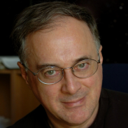
A Revolution in Research
What is at stake is nothing less than the ways in which astronomy will be done in the era of information abundance
Astronomer George Djorgovski

Slide 5
Drivers of context change
Growth of the internet
Low cost, rapid digitization of print materials
Open Source movement
Rise of Social Software, Web 2.0 tools, mobile
Publishing and scholarship ecosystem
  Changing policies
Internationalization of scholarship
Growth in primary source datasets

Slide 6
Key characteristics of the current research landscape
The products of research and the starting point of new research are increasingly digital and increasingly “born-digital”
Exploding volumes and rising demand for data use by the rapid pace of digital technology innovations
The rapid expansion of the inputs and outputs of scholarship

Slide 7
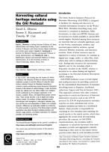
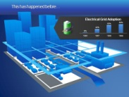
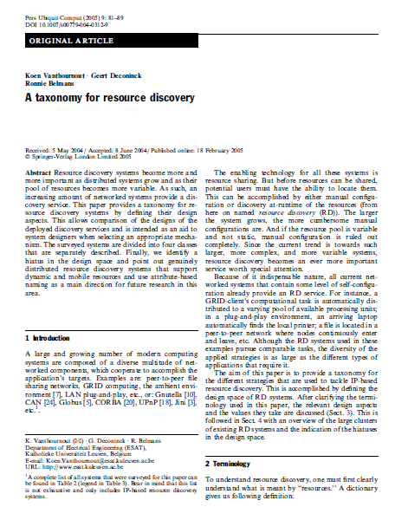
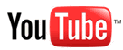
Linking the Scholarly lifecycle
Vitae
Grants
Related Articles
Comments & Reviews
Notebooks
Models
Codes
Presentations
Algorithms
Preprints
Models
Podcasts
Methods
Video
Plans
Data
Ontologies
Intermediate Results

Slide 8

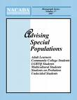


Network of Ideas (citations)

Slide 9
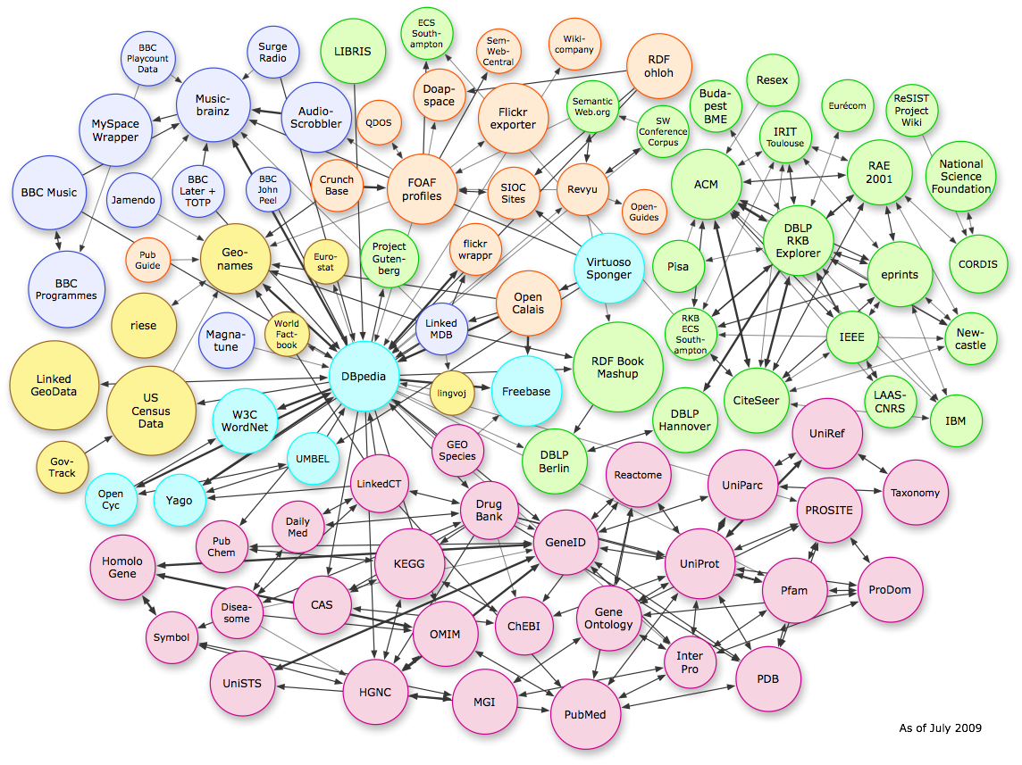
Network of datasets

Slide 10
Examples of text as data
Changes in word sense ( e.g. consumption( TB ) , moot, oratio¹ ) and spelling (e.g. 18th C. ſ to s , *re → *er )
Bibliometrics and other usage analyses
  Citation patterns
  Institution vs. discipline
  Author demographics
Pharma: Drug / Symptom correlation.
Biology: Species / date / location observations.
Social Sci: Work/life habits of undergrads based on access patterns at different institutions [ usage data based]
…
Notes:
Whilst content can be obfuscated or reduced, there are thorny issues with usage data. Early policy decisions need to be taken with respect to exposing usage data, even indirectly ( triangulation is always possible ).
--¹ Oratio has shifted from ‘speech’ to ‘prayer’ and back again in the latin literature. See Greg Crane et al.

Slide 11
Text Mining
Unstructured text to queryable data structures
WHY?
Too much text to hand analyze.
Improved discovery ( better ‘metadata’ )
Business Intelligence
  e.g. content stats -> content acquisitions
Saleable datasets
  E.g. Distribution of authors vs. disciplines vs. grants
End User research agendas
  High-End : Custom (user specified) mining as a service
  Simple : Visualization of results ( frequency / co-occurrence … )

Slide 12
Datasets: Factoids & point data
ca. 1.4M Faculty ( 50% full-time ) in US HE, ~75M people enrolled in US HE
ca. 100k Faculty in UK HE
44% of Researchers use online (other people’s) datasets for their research
48% of Researchers use datasets > 1GB
10.8% store their data outside their institution ( 50% store it in their “lab”)
1 - 5% of datasets are formally moved into the curation process.
66%of faculty have requested other people’s data ( and 49% of those got it).
[ 26.5% have the expertise to analyze their own data.
[ 80.3% do not have sufficient expertise to manage their own data
Institutional storage costs ~ $600 / TB / year
[ 58% is the annual increase in the amount of data being generated
[ 20-40% is annual growth in the amount of storage deployed (est.)
< 1% of ecological data is accessible after publication.
> 85% of all information is in text form
2.7 times more citations accrue to papers with accessible data
3 to 6 times more papers emerge if the data is accessible.
Notes:
Figures on faculty demographics from http://nces.ed.gov/programs/digest/d09
Sources in earlier paper on datasets.

Slide 13
Curation OF scholar data
Tools to ingest, add & validate schemas, publish, migrate and preserve. ( DMP¹ provision )
Tools to analyze²
Tools to discover datasets
  “Summon” for IR datasets, gov’t datasets …
Tools to merge (create composite datasets) ³
Citation management & attribution for datasets.
Generic capabilities (domain specific later).
Notes:
DMP : JISC / NSF mandated Data Management Plan
Both ‘canned’ such as histograms and user-scriptable.
E.g combining observational data over time and space to turn point measurements into a time series of distribution map.

Slide 14
Dataset provision TO scholars
Content procurement and dissemination.
  What we do already (intermediary)
  Needs discovery tools
Easy to focused on selected domains that are publicly available.
Most research does not use publicly available data

Slide 15
Towards reproducible research
Reproducible research
  means context, quality, trust
  means easy access to the sources
Science depends entirely on the knowledge and data gained in the past to further advance
Notes:
Reproducible research

Slide 16
Preserving Research Data
Growing trend of journals and publishers linking to open-access data repositories
  Elsevier and PANGAEA – Publishing Network for Geoscientific & Environmental Data
    Reciprocal linking of articles and the data behind the research
Journals and funding agencies setting policy to preserve and associate data supporting research results
  e.g. American Naturalist new policy:
    This journal requires, as a condition for publication, that data supporting the results in the paper should be archived in an appropriate public archive, such as GenBank, TreeBASE, Dryad, or the Knowledge Network for Biocomplexity. Data are important products of the scientific enterprise, and they should be preserved and usable for decades in the future. Authors may elect to have the data publicly available at time of publication, or, if the technology of the archive allows, may opt to embargo access to the data for a period up to a year after publication. Exceptions may be granted at the discretion of the editor, especially for sensitive information such as human subject data or the location of endangered species.

Slide 17
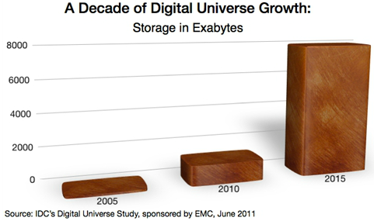
Digital Universe Growth

Slide 18
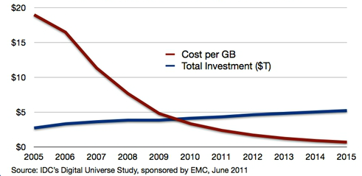
Falling Costs/Rising Investments

Slide 19
Proquest & Preservation

Slide 20
ProQuest Microfilm
PQ business original objectives: preservation and access
  New technology, microfilming
  1938 British Library – 120,000 first printed books in English
  1939 established Dissertations filming, printing program
  1940’s began microfilming newspapers
  1948 began microfilming serials
  Added 700+ Research Collections for Academic market, still actively filming several
  2.5M Dissertations and Theses, actively filming
  Newspaper Archive contains 10,700 titles, 900 titles actively filming

Slide 21
Microfilm Commitment
With the ongoing research and archival need for microfilmed content, ProQuest invested significantly to build a new filming operation in Ypsilanti, MI.
Opened May, 2010
Employing 65 staff
Utilizing eBeam Cameras: digital images to film masters
Scanning operation.
Utilizing 2 archive locations: Iron Mountain and Ypsilanti

Slide 22
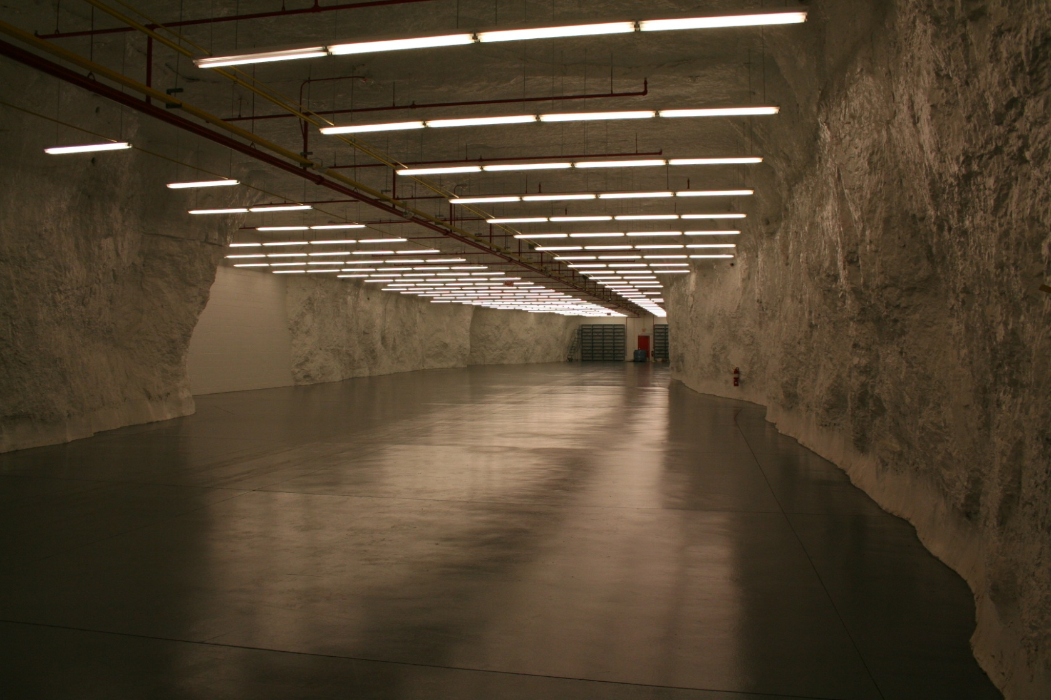
Film Archive at Iron Mountain

Slide 23
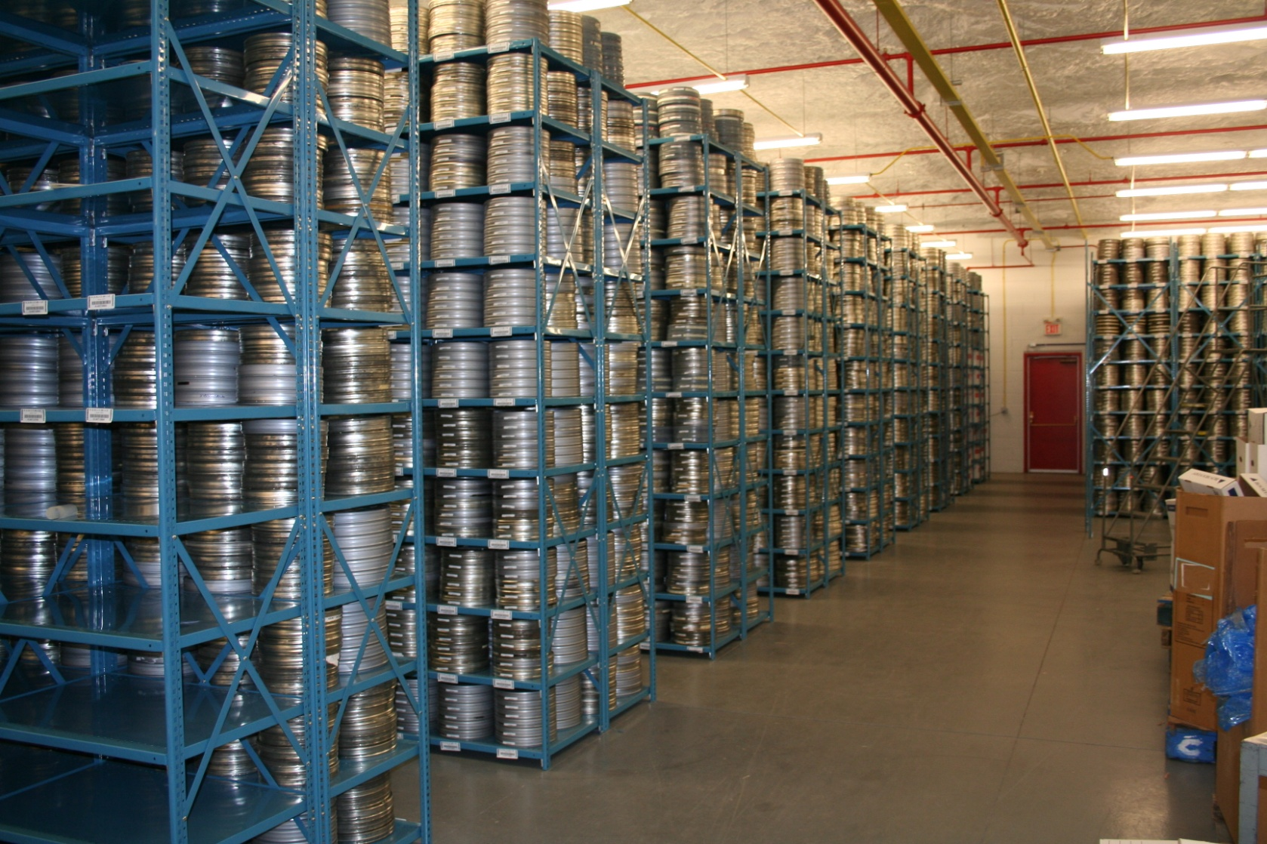
Film Archive at Iron Mountain

Slide 24
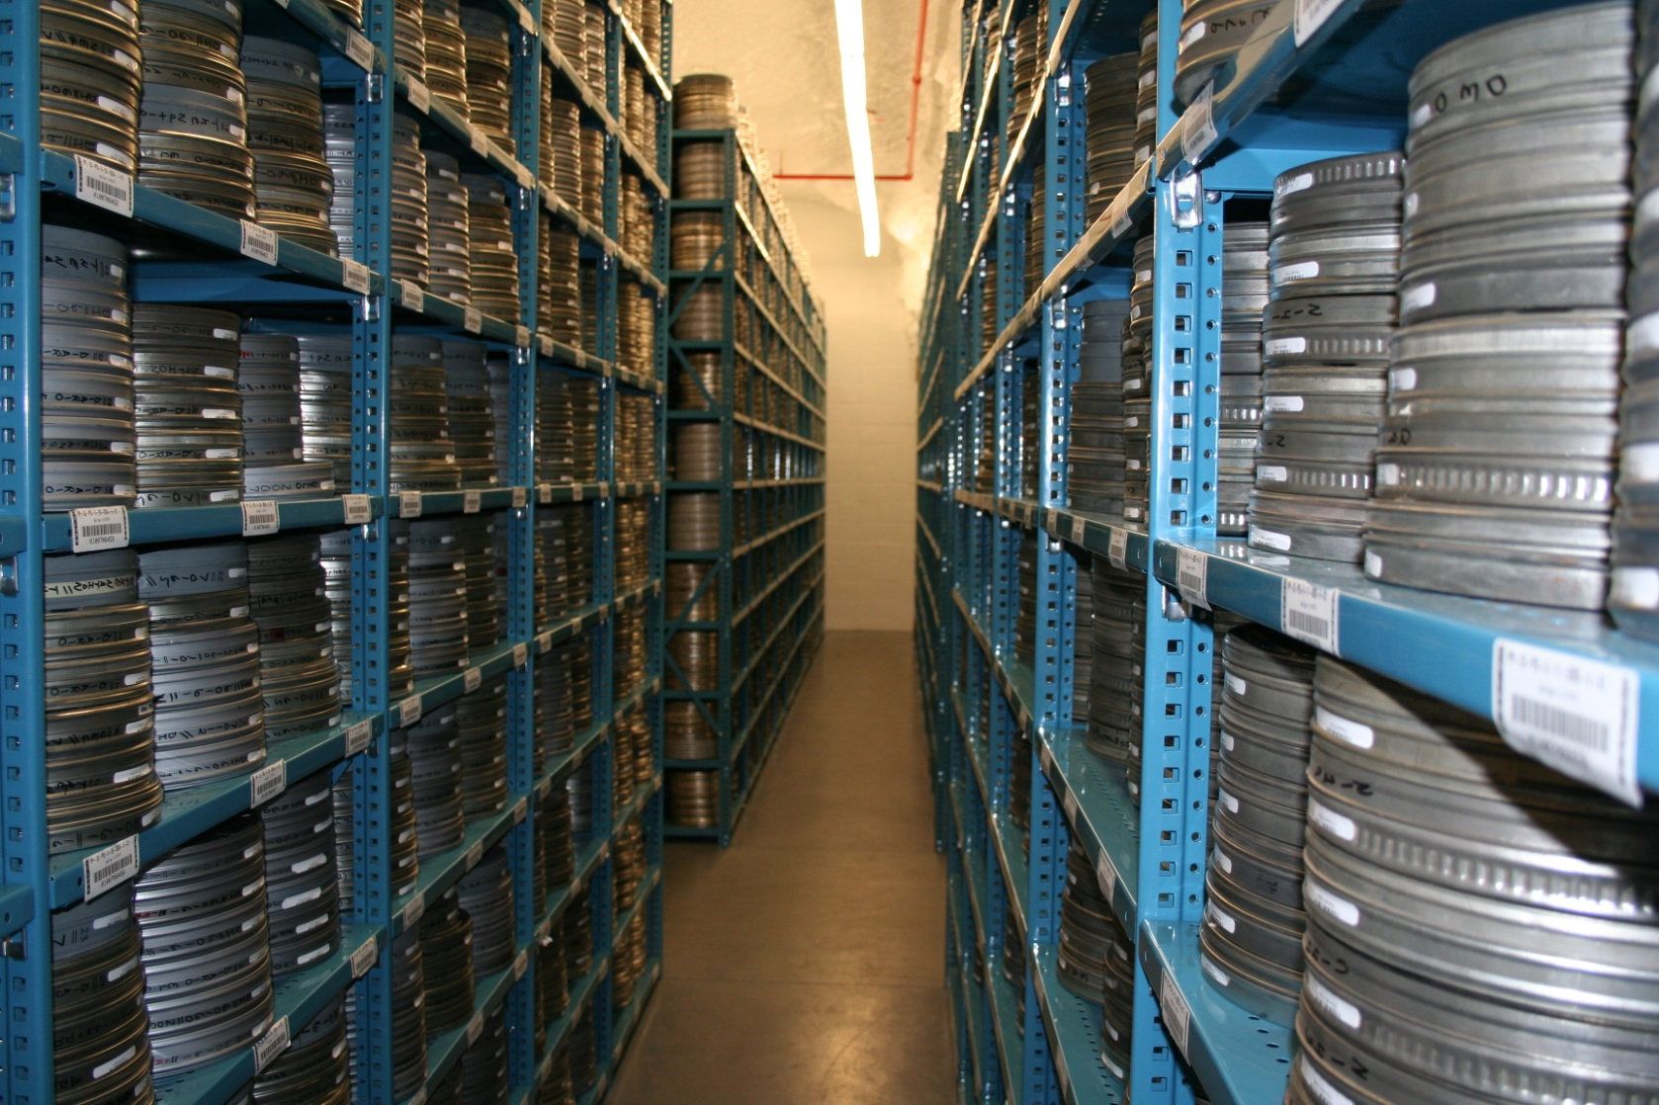
Film Archive at Iron Mountain

Slide 25
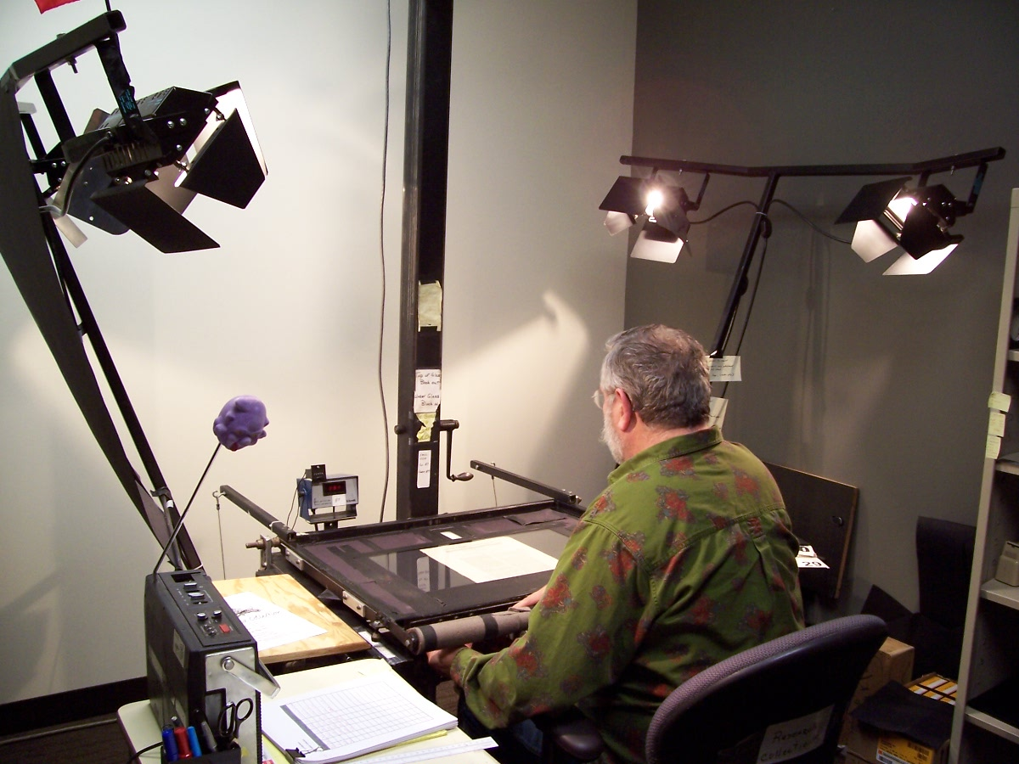
Camera Work

Slide 26
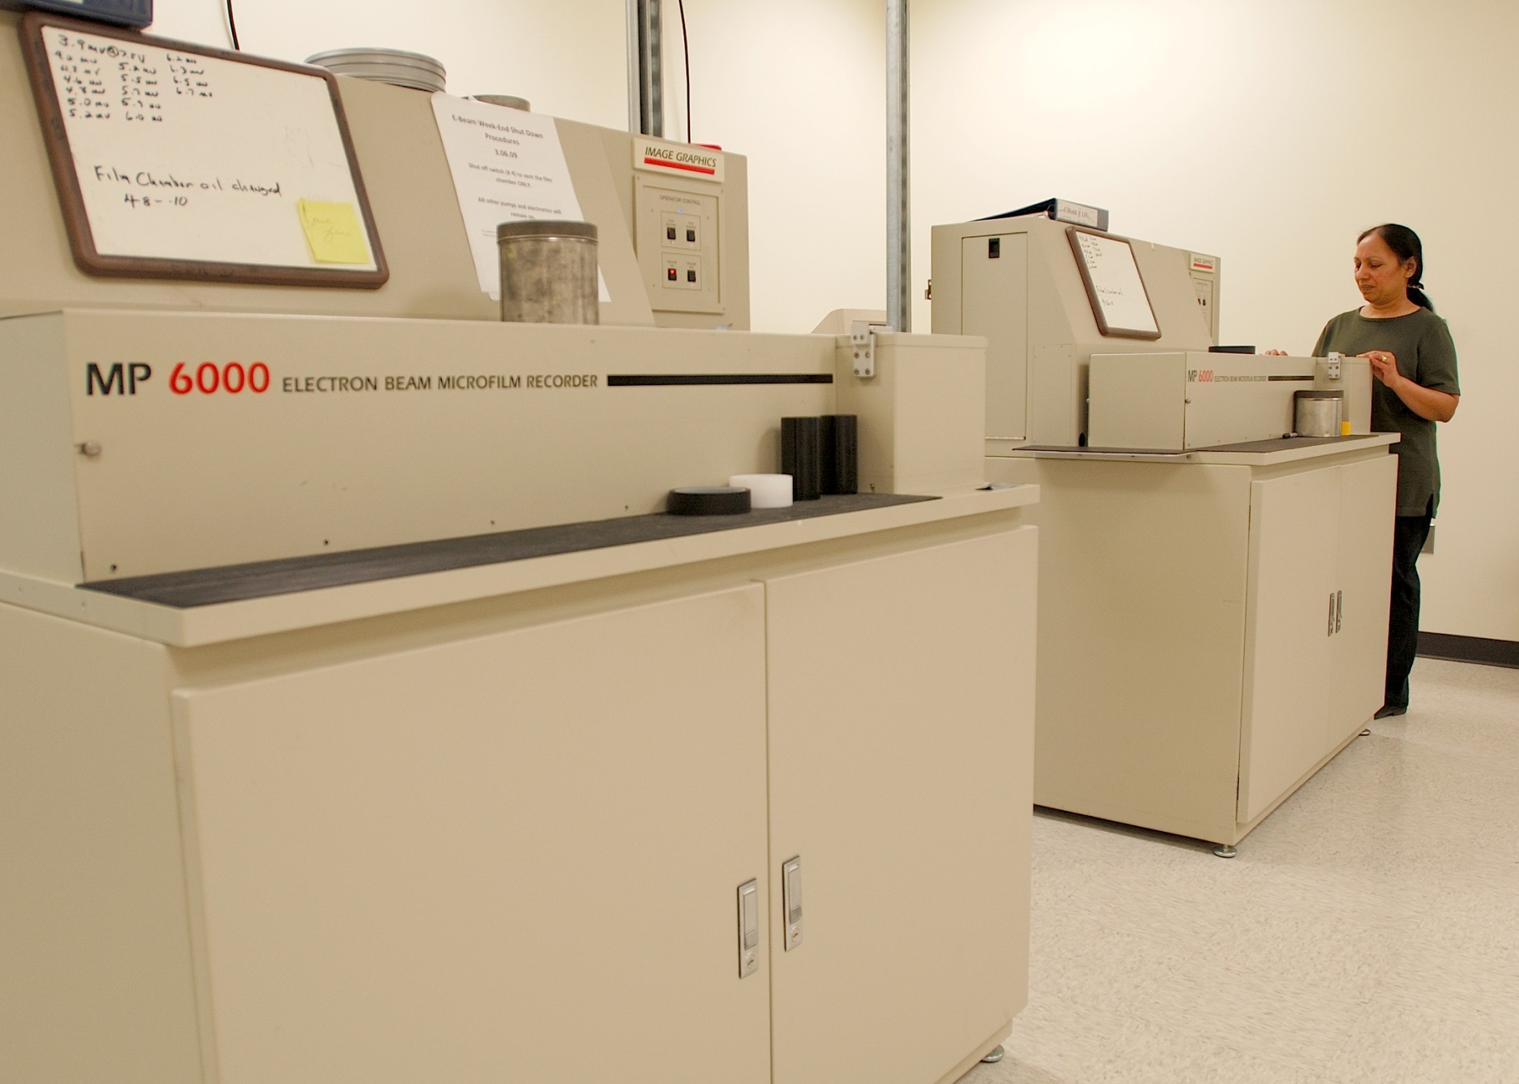
eBeam Cameras

Slide 27
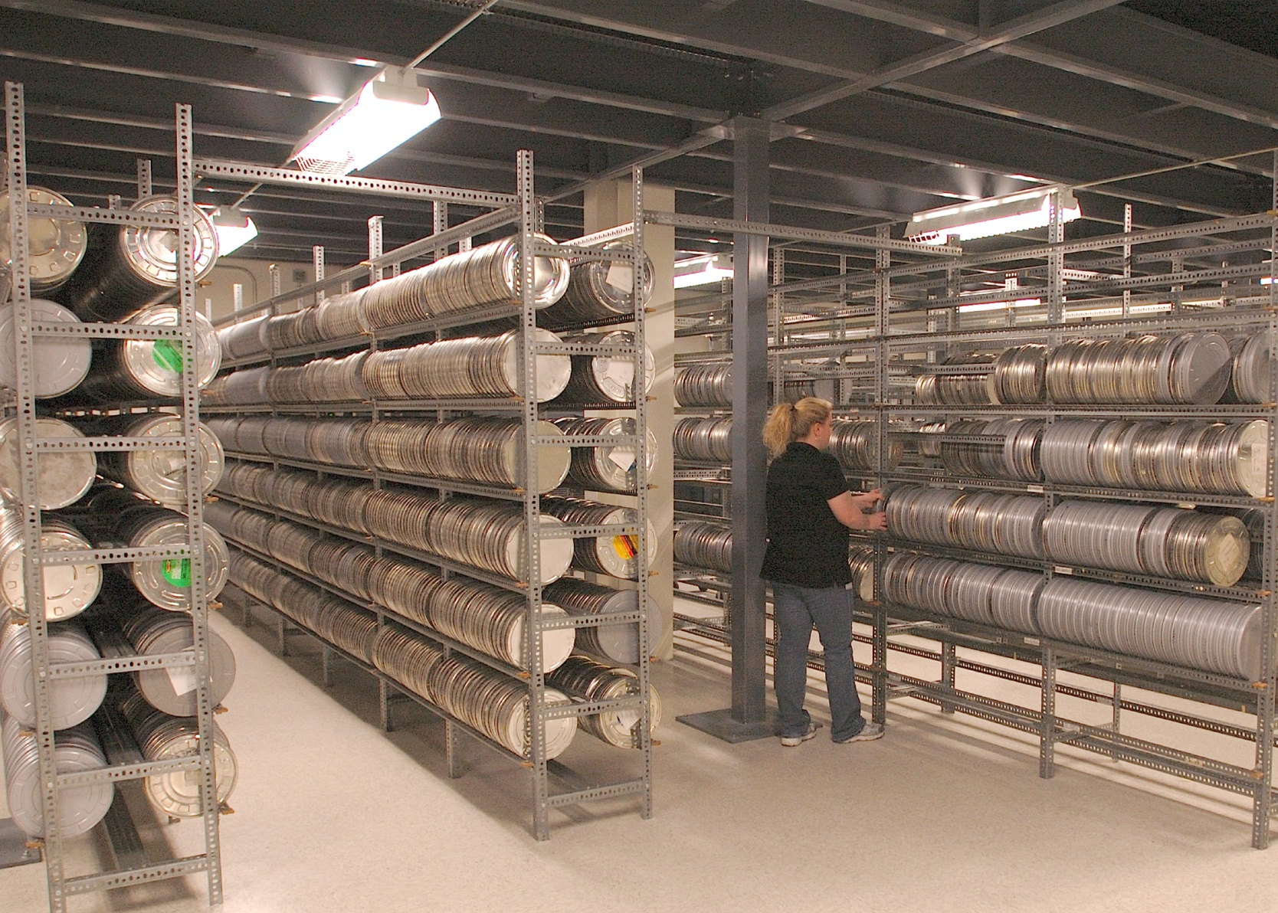
Newspaper Microfilm Archive - Ypsilanti

Slide 28
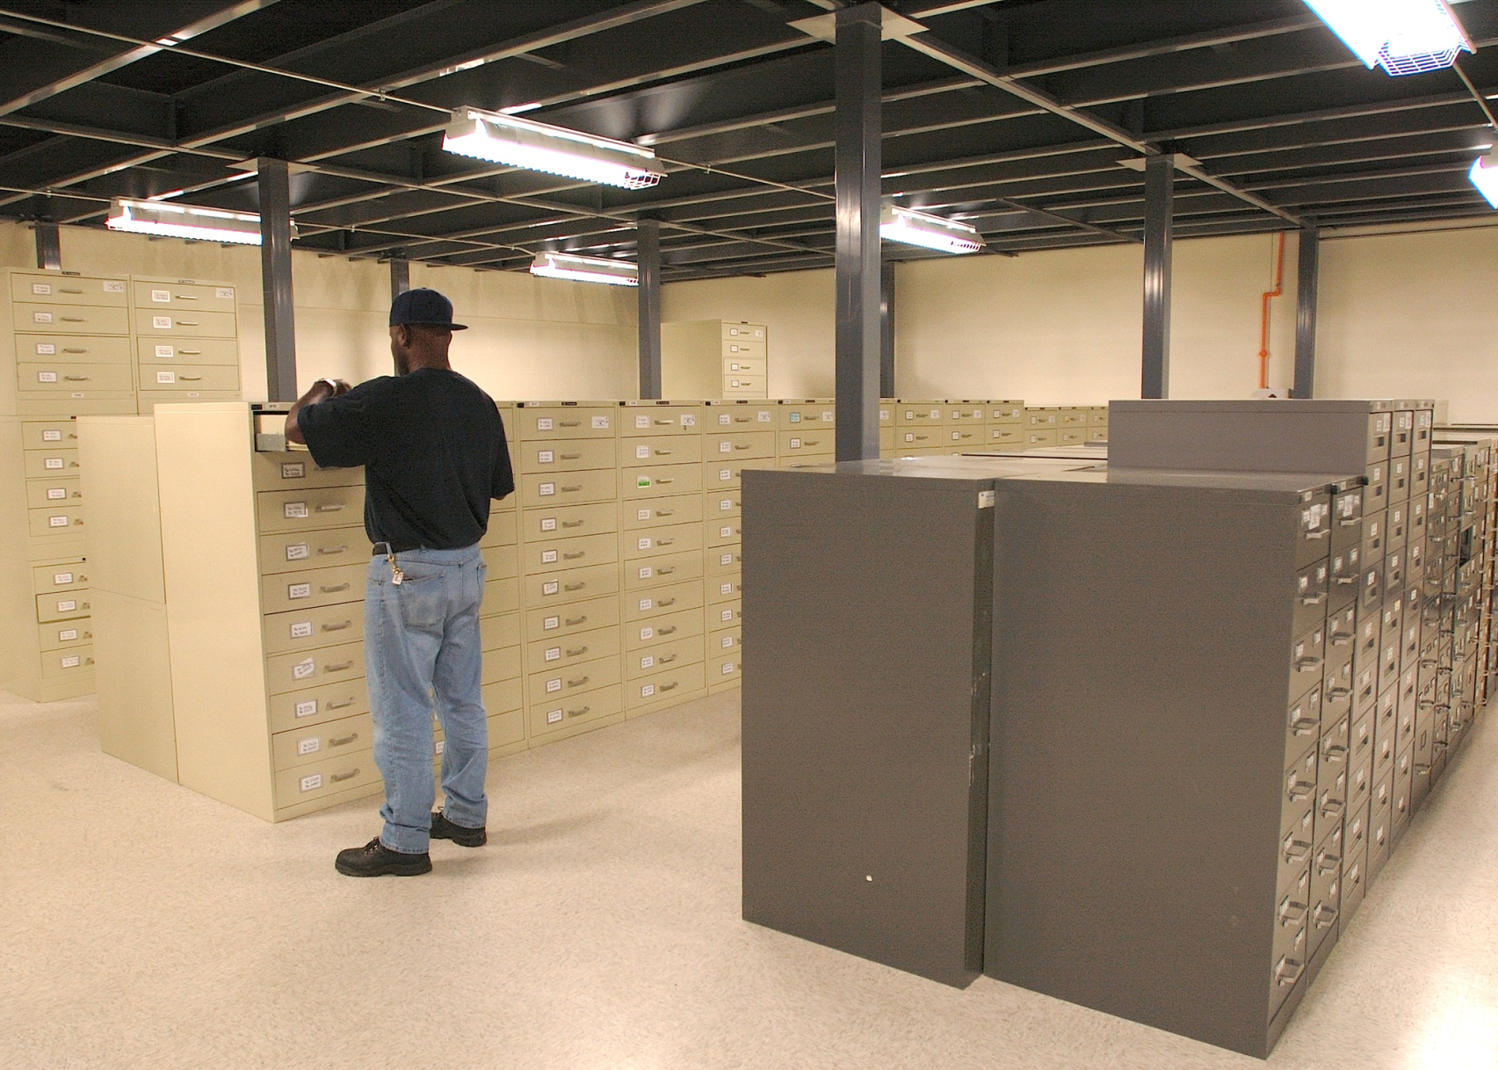
Microfiche Archive - Ypsilanti

Slide 29
Microform and Digital Interface
Microforms are the source materials for numerous historical digital products.
  Historical Newspapers
  Periodical Archive Online, Periodical Index Online
  Early English Books Online
  Parliamentary Papers
  Sanborn Maps, Geo-edition Sanborn Maps
  Gerritsen Collection of Women’s History
  700+ Research Collections……

Slide 30
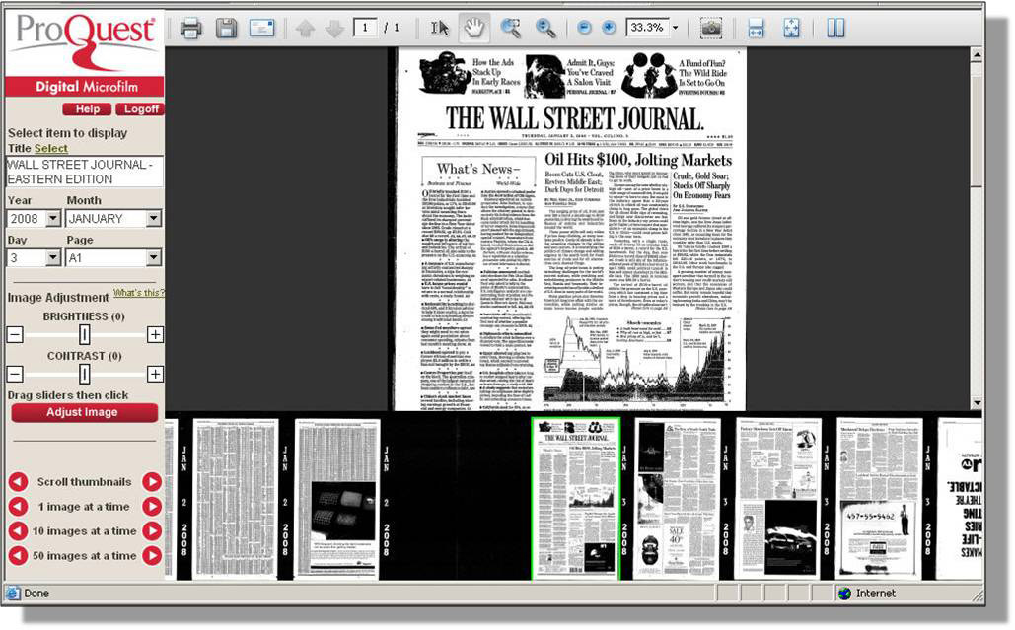
Digital Microfilm
Adobe controls for zooming, rotating, printing, saving, emailing PDFs or links
Use this area for further date selection
Notes:
A reminder - Digital Microfilm acts like an extension of microfilm – there is no searching. It does provides basic amounts of metadata – for newspapers: title, year, month, day, and page – that make it easy to skip through the reels.
Another reminder - It is web-based, so researchers can access the film content from their kitchens or their dorm rooms.

Slide 31
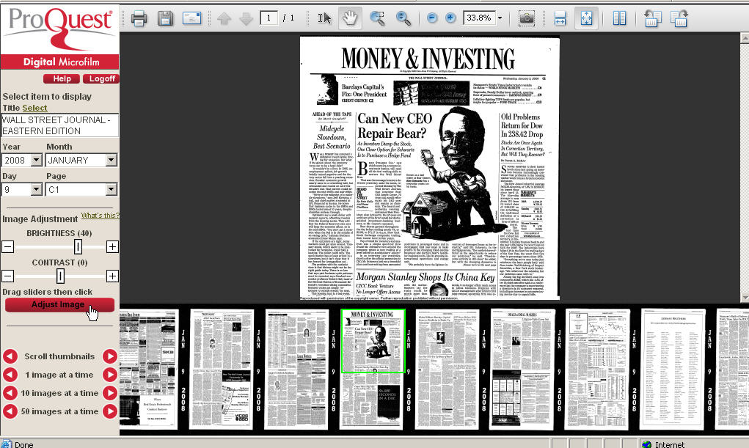
Image Adjustment
Notes:
A reminder - Digital Microfilm acts like an extension of microfilm – there is no searching. It does provides basic amounts of metadata – for newspapers: title, year, month, day, and page – that make it easy to skip through the reels.
Another reminder - It is web-based, so researchers can access the film content from their kitchens or their dorm rooms.

Slide 32
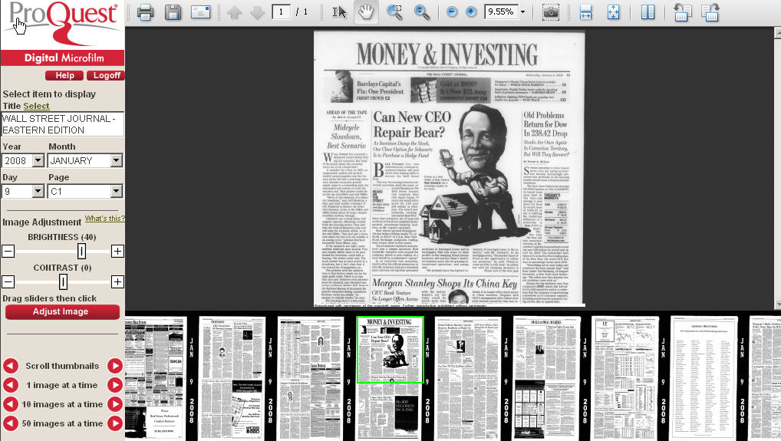
Notes:
A reminder - Digital Microfilm acts like an extension of microfilm – there is no searching. It does provides basic amounts of metadata – for newspapers: title, year, month, day, and page – that make it easy to skip through the reels.
Another reminder - It is web-based, so researchers can access the film content from their kitchens or their dorm rooms.

Slide 33
Dissertations
ProQuest “UMI” Dissertation Publishing
  Over 50 years
  Official repository of dissertations and theses for the national libraries of Canada and the United States
Archive
  Use of Microform
  Multi-location digital copies
  Tape

Slide 34
Going forward

Slide 35
Preservation of inputs and outputs of scholarship
Publication part of wider network of scholarly information:
  Original data
  Shared databases
  Multimedia expressions
  Social media
Preservation should encompass all of this

Slide 36
Our concern for scholarship
Secondary source publications are much better protected than inputs to research
Research data-explosion
  Primary sources
  Datasets
  Text as data
Focus on objects rather than linkages
We need to continue to support the preservation of scholarship inputs and outputs as they evolves

Slide 37
Our questions for us…
Can practices of preservation and sustainability become common place?
What is the right balance of new digital technology and analog methods of preservation?
  Film industry—research and practice on preservation born-digital films
How should we approach going beyond the current atomic level of preservation—the object? How should we deal with:
  Links
  Text as data
  mining

Slide 38
Towards increasing the sustainability of research output
Persistent identifiers—linkages of underlying output of scholarship
  i.e. DOI, ISBN, ISNI
Establishing network of safe/trusted repositories for for all outputs of scholars
Link/citation practices to outputs, not just official publications; focus on reliability

Slide 39
Preservation of born digital outputs
Capability to preserve objects in digital formats—addressing storage capacity; accessibility; and frequent churn in digital formats, media, and tools that turn bits into humanly-recognizable artifacts—is a core requirement of digital scholarship.
  Leverage Microfilm as superior vehicle for “born digital” preservation
Driver for movement from print to digital in library collections. See for example, 2009 Ithaka paper, “What to Withdraw: Print Collections Management in the Wake of Digitization”

Slide 40
Preservation as a practice
We have a history in the preservation of scholarship that continues today
Build preservation practices into our everyday management of scholarly inputs and outputs.
Work with the community of scholars, libraries, and publishers to evolve our thinking of needs and practices
Working with CRL towards TRAC criteria audit of our digital data and content
Partner with repositories for sustainability

Slide 41
Thank you!
Questions?
Tim Babbitt
timothy.babbitt@proquest.com
(734) 997-4593

