Slide 1
The Texas Water Digital Library
Prepared by David R. Maidment
Director, Center for Research in Water Resources
University of Texas at Austin
For Texas Conference on Digital Libraries, May 17, 2010
Presented by Ken Rainwater
Director, Texas Tech University Water Resources Center
GRN Forum: Global Water - 2010 and Beyond

Slide 2
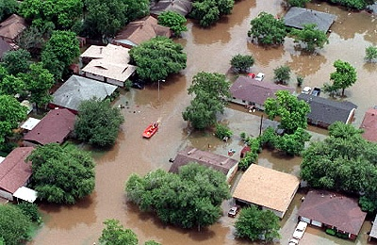
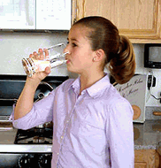
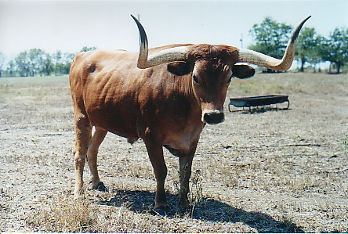
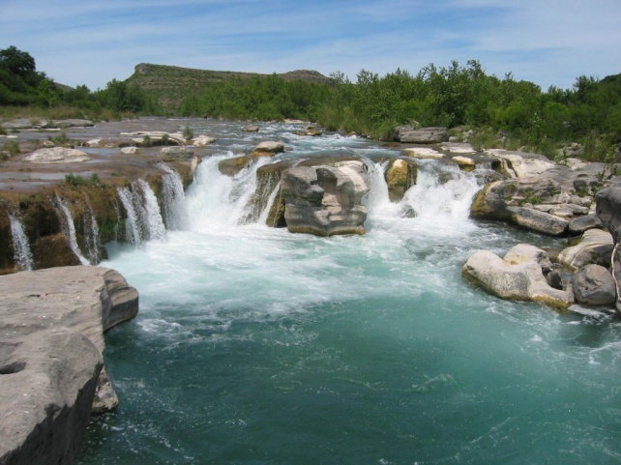
Texas Water Issues
Flooding
Water Quality
Drought
Environmental health

Slide 3
Texas Water Digital Infrastructure
Texas Water Digital Library
Texas Water Data Library
Texas Water Journal

Slide 4
Texas Water Digital Infrastructure
Texas Water Digital Library
Texas Water Data Library
Texas Water Journal

Slide 5
The Texas Water Digital Library: People
TDL: John Leggett, Mark McFarland, Ryan Steans
TAMU TWRI: BL Harris, Ralph Wurbs, Kathy Wythe, Leslie Jordan
TAMU Libraries: Holly Mercer, Scott Phillips, Sandy Tucker
TTU WRC: Ken Rainwater
TTU Libraries: Matthew McKinney
UT CRWR: David Maidment, Eric Hersh
UT Libraries: Amy Rushing, Robyn Rosenberg
Notes:
A collaborative effort of the TDL and the water research centers and libraries of these three Texas universities (so far)

Slide 6
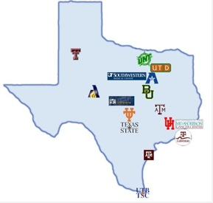
Texas Digital Library Members
Many of these universities also have a Water Research Center

Slide 7
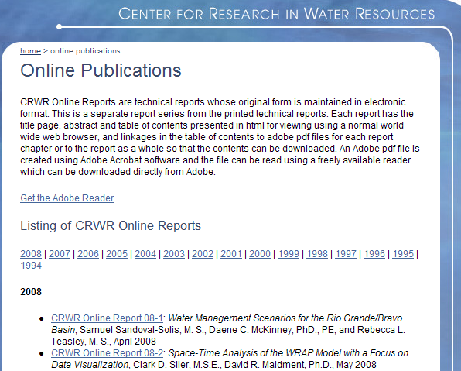
Digital Archiving of Theses, Dissertations and Reports since 1994 at CRWR
Notes:
CRWR has been individually hosting reports and Electronic Theses and Dissertations

Slide 8
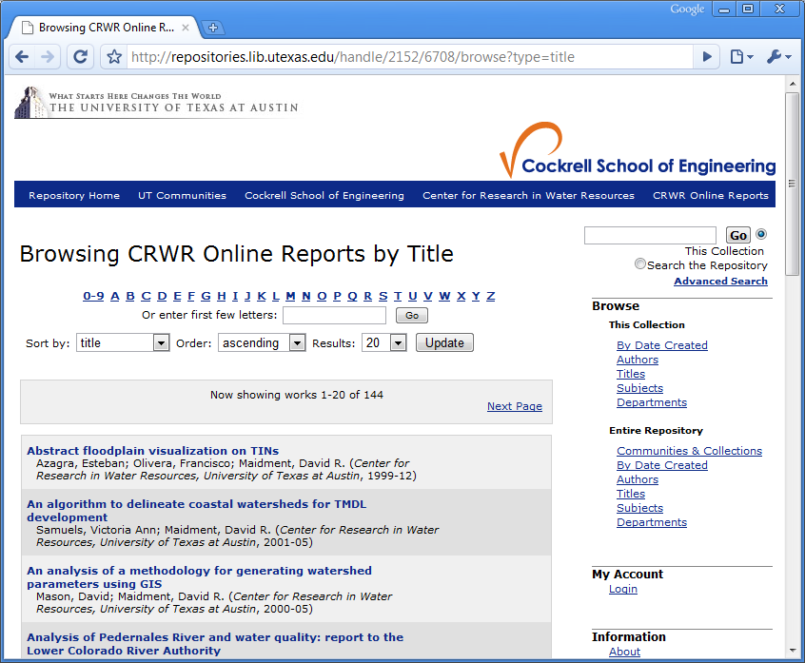
Incorporated into UT Digital Repository, 2010
UT Austin
Notes:
The CRWR collection was migrated to the UT Digital Repository in 2010

Slide 9
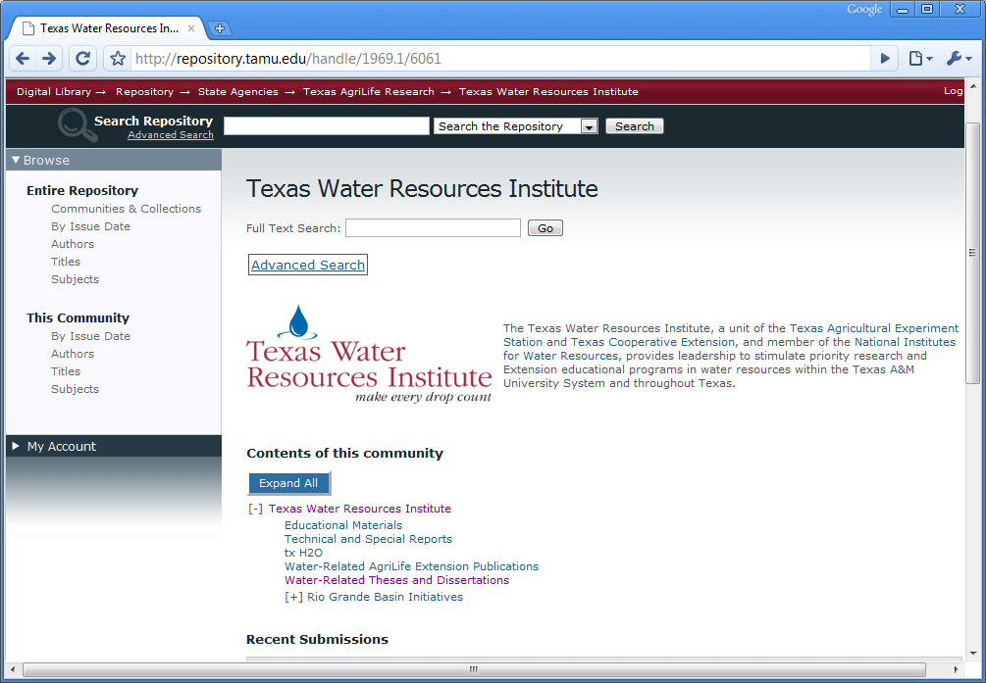
Federated with water reports from Texas A&M College Station
Notes:
The Texas Water Resources Institute at Texas A&M and the Water Resources Center at Texas Tech have both created digital repositories as well of the scholarly and research products of their respective centers

Slide 10
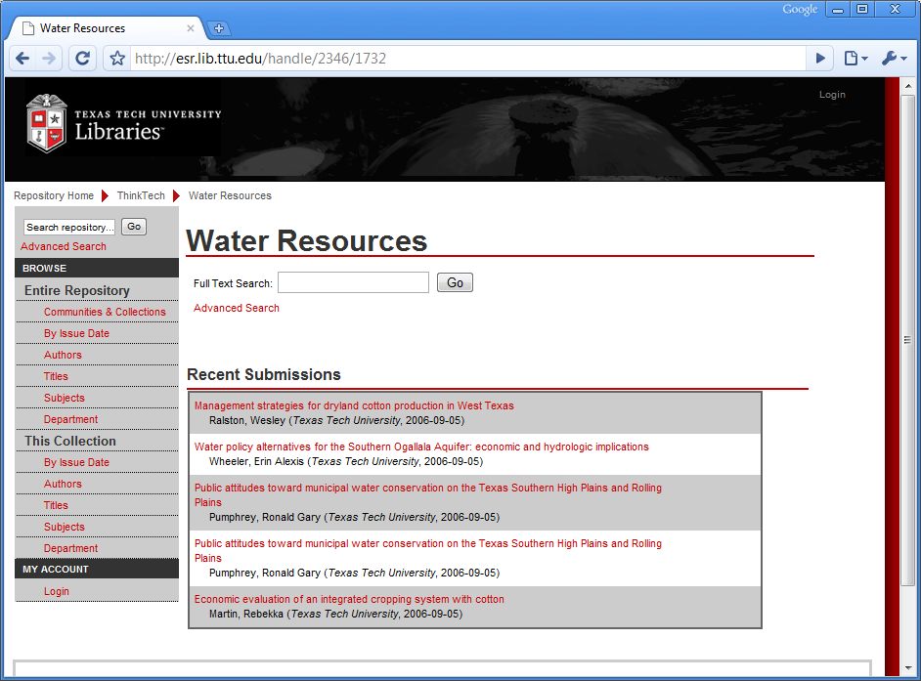
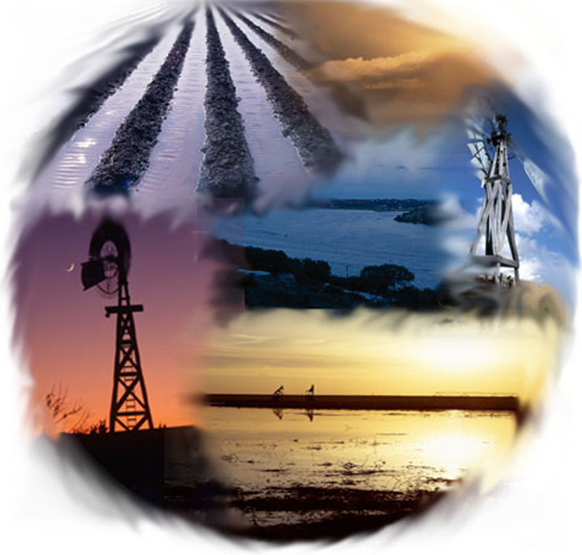
and with reports from Texas Tech University

Slide 11
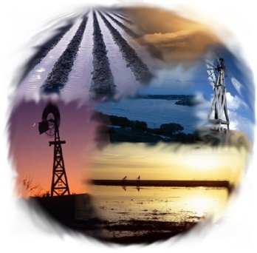
Texas water research centers are individually embracing digital libraries
BL Harris Ken Rainwater David Maidment
currently hosting technical reports, project data, outreach publications, theses and dissertations

Slide 12
Collaborating to form the Texas Water Digital Library
“A digital water library will link and make available the vast amount of information, research and data that has been and is continuing to be developed by water resource researchers in Texas. Providing information digitally is imperative for the future, and this library is definitely going to bring critical and needed information together for everyone's use.”
- B.L. Harris, acting director of TWRI

Slide 13
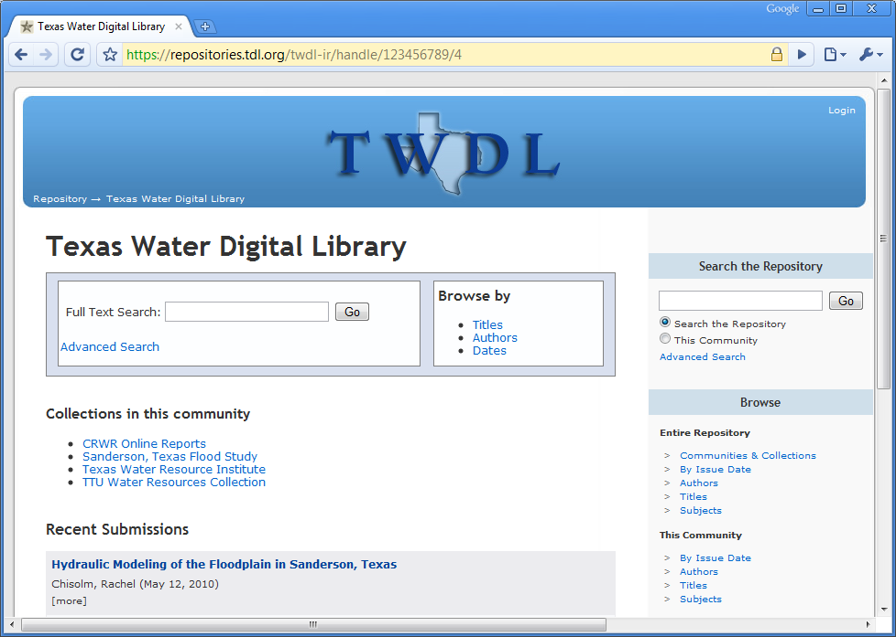
https://repositories.tdl.org/twdl-ir/

Slide 14
The Texas Water Digital Library
Mission: to be a centralized, online location for the research and works of university and other water resource entities in Texas, effectively federating water research currently housed at many universities across Texas

Slide 15
Texas Water Digital Infrastructure
Texas Water Digital Library
Texas Water Data Library
Texas Water Journal

Slide 16
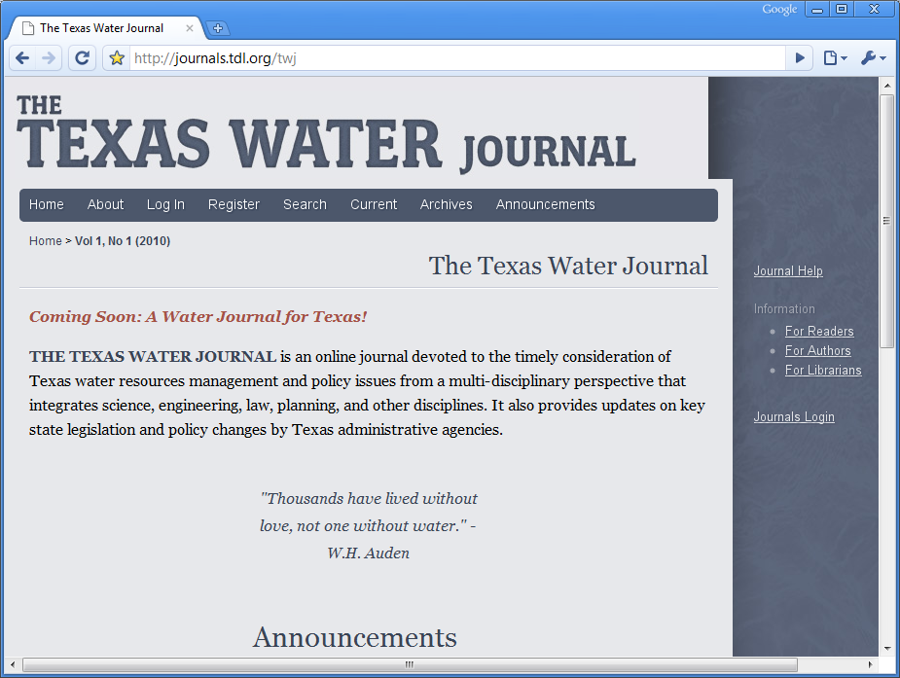
http://journals.tdl.org/twj
Notes:
Coincident with the creation of the Texas Water Journal, an online peer-reviewed forum for Texas water policy and research

Slide 17
Texas Water Digital Infrastructure
Texas Water Digital Library
Texas Water Data Library
Texas Water Journal

Slide 18
AWRA GIS in Water Resources Conference
Orlando, FL, March 29, 2010

Slide 22
Texas Water Digital Infrastructure
How do these components connect?
Texas Water Digital Library
Texas Water Data Library
Texas Water Journal

Slide 23
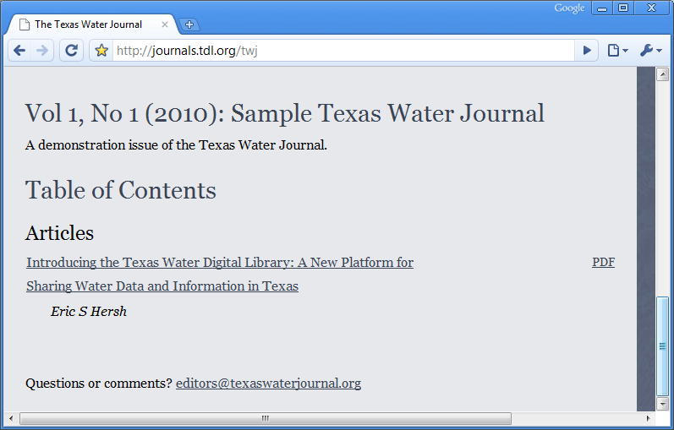
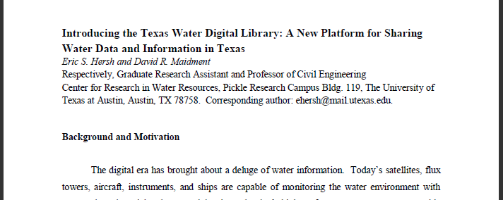
an article…
http://journals.tdl.org/twj

Slide 24
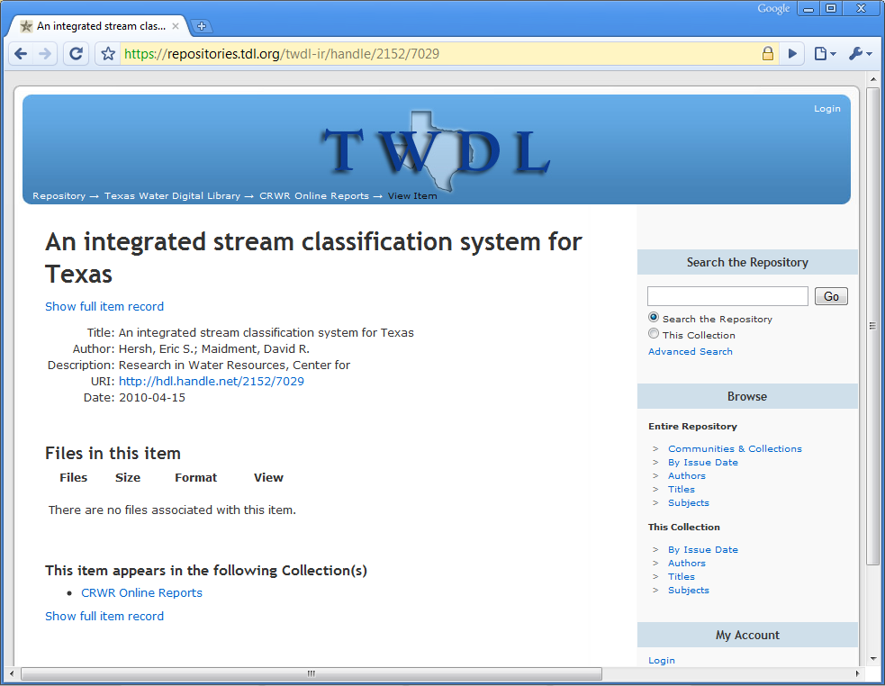
…referencing an academic study…
https://repositories.tdl.org/twdl-ir/handle/2152/7029

Slide 25
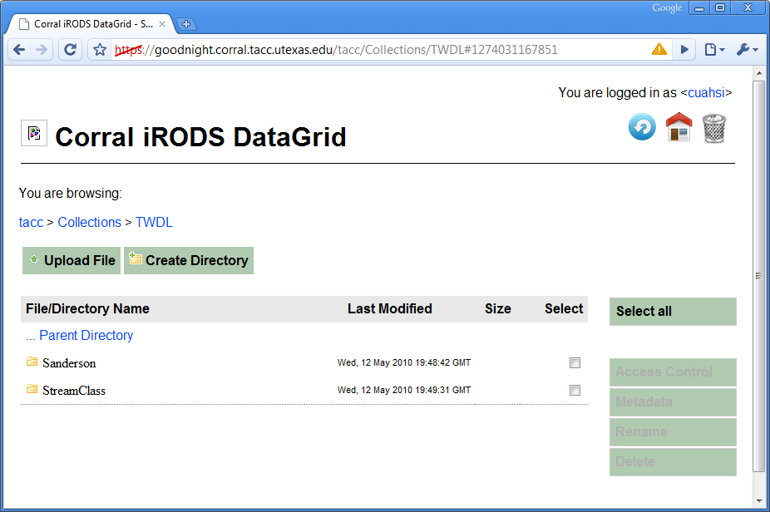
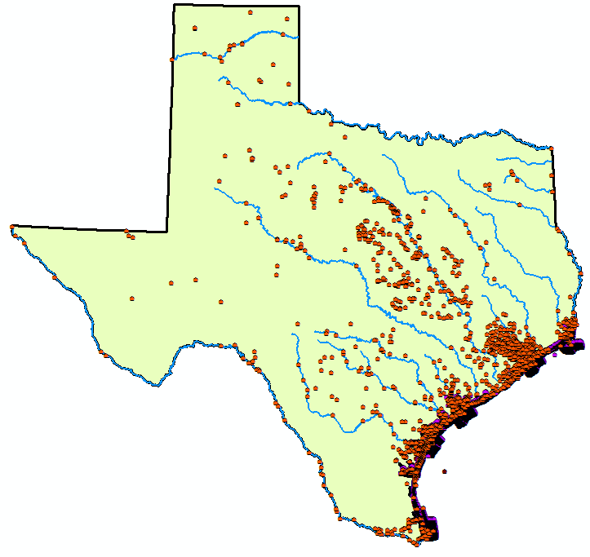
…linked to data

Slide 26
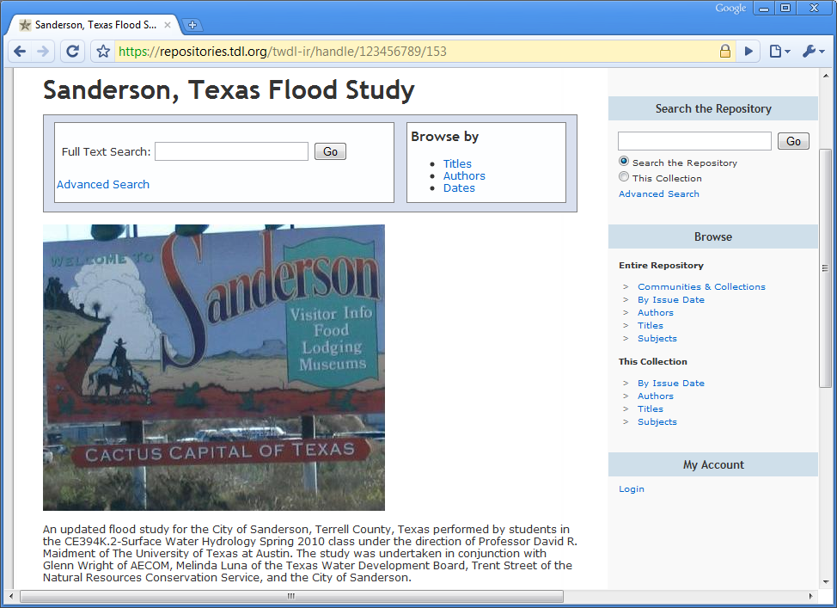
a professional study…
https://repositories.tdl.org/twdl-ir/handle/123456789/153

Slide 27
…linked to reports and presentations…
https://repositories.tdl.org/twdl-ir/handle/123456789/153

Slide 28
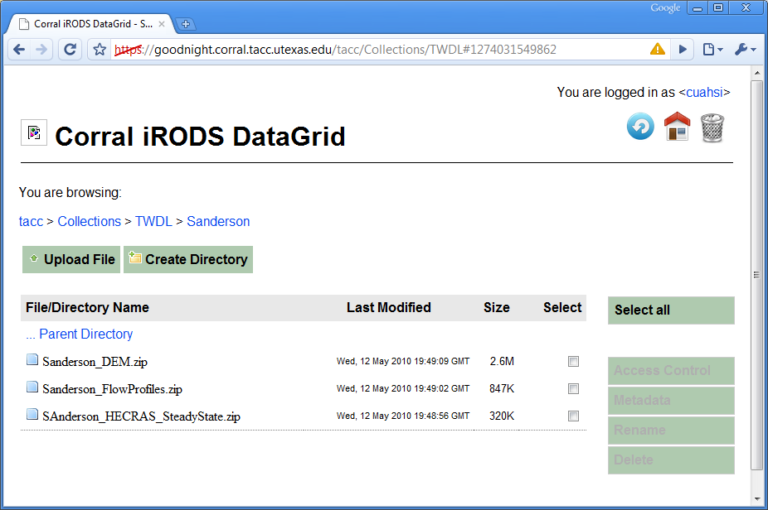
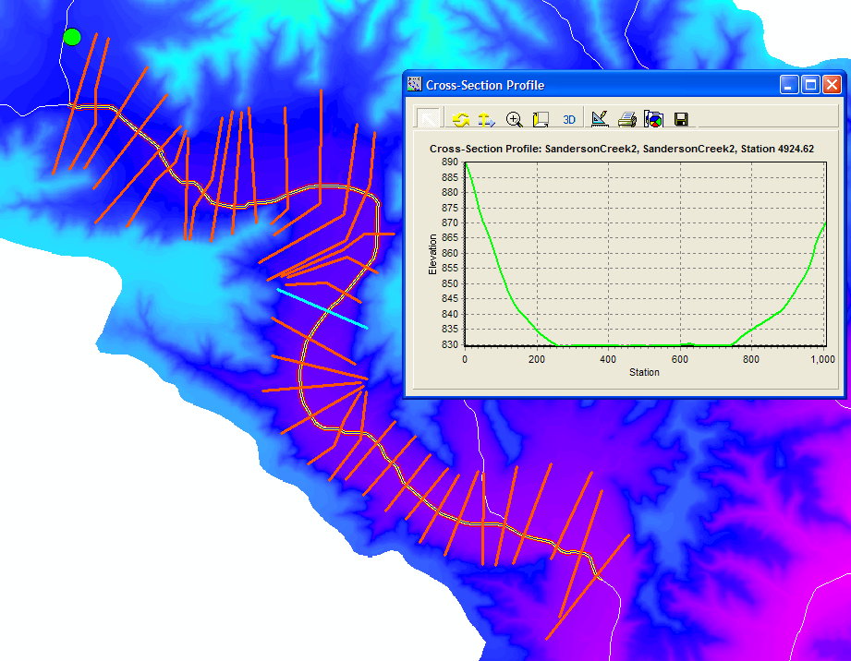
…along with models & data

Slide 29
TCDL & TWDL goals and challenges moving forward
The digital library process is more ‘formed’ than the data process
Workflow for submitting and registering data and documents
‘Versioning’ of information: temporary/living versus permanent/archived
External users and providers (e.g. consultants)
access and intellectual property issues
What is the role of informal student projects compared to formal documents?

Slide 30
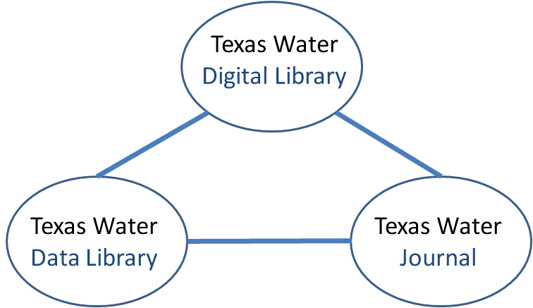
Some Questions
How do we understand the relation between a Digital Library and a Data Library?
Are they the same thing?
How do we connect digital libraries of different organizations
CUAHSI and TWDL?
What is the meaning of a repository of data services as compared to data files?

