Slide 1
Shared Print and Weeding:
Communications Lessons from Libraries
June 24, 2022
PAN Annual
Anna Striker, CDL/WEST
Notes:
Note on terminology in this presentation: throughout this presentation I refer to the activity of removing materials from library collections as “weeding,” a common and immediately understandable term for this activity. In the tools we strongly encourage librarians and project coordinators to think carefully about the language they use when communicating with their local communities (“weeding” vs “deselection” vs “pruning”, etc), but for consistency and clarity I am using the term “weeding” throughout this presentation.

Slide 2
Background
Joint Communications and Advocacy Working Group
Identifying difficult topics and areas for additional support
Wider context
Best Practices
Shared Print Toolkit
Notes:
A quick background on this group and our work:
In 2021 the Rosemont Shared Print Alliance and the Partnership for Shared Book Collections formed a joint working group to coordinate the communications and advocacy efforts of the two groups. One topic that kept coming up in early conversations in this group was how difficult it can be for libraries to talk to their local communities about weeding projects and the very strong emotions that often surface when these projects are implemented, and whether participation in shared print impacted those conversations. This small group was formed to investigate this in more depth and produce some tools to help libraries navigate this topic.
We started our work mindful of the context around us, including the Partnership’s work creating Best Practices that apply broadly to different libraries in different contexts, and the newly launched Shared Print Toolkit that gathers together tools and resources to support institutional and program operations. We wanted to model our work after these groups and develop resources that could be drawn on in a variety of different circumstances.

Slide 3
Group Members
Aaron Krebeck
Director of Library & User Services
Washington Research Library Consortium (WRLC)
Anna Striker
Shared Print Operations & Collections Analyst
California Digital Library (CDL) / WEST
Louise White
Project Manager
Keep@Downsview
Marie Waltz
Head of Access Initiatives & Collections Care
Center for Research Libraries (CRL)
Notes:
Thanks to Aaron, Louise, and Marie for dedicating so much time and thought to this!

Slide 4
Scope of work
Interviews with practitioners
4 months (March-June)
~30 minutes each
15 individuals
14 institutions
8 different shared print programs (monographs and serials)
Synthesize findings
Pain points, successes, lessons learned
Deliverables
Notes:
All of us had varying degrees of personal experience with the challenges of communicating with users about weeding projects, so we wanted to cast a wider net to gather a range of experiences. We solicited volunteers from the Rosemont and Partnership Executive Committees and reached out to institutions we knew had experience conducting these projects. We focused on academic and research libraries, as the main library type represented in Rosemont and the Partnership. Interviewees represent a range of roles in the library, including library leaders, collection managers, technical services, and project coordinators.
We did go into these interviews with some assumptions about what we would probably hear, but our main goal was to listen to these experiences and synthesize the information in a way that can help support institutions who are struggling with these conversations or who are only recently having to face them.
Before we started the interviews we had a couple of ideas for what form the final deliverables might take, but we decided to really let the interviews guide us on the final form. We’re currently working on two tools: a matrix of communication recommendations during different project phases and an FAQ that provides guidance on responding to common questions and comments. These are still drafts that we’re refining, so I don’t have final products to share but I can give a preview of their basic structure and purpose.

Slide 5
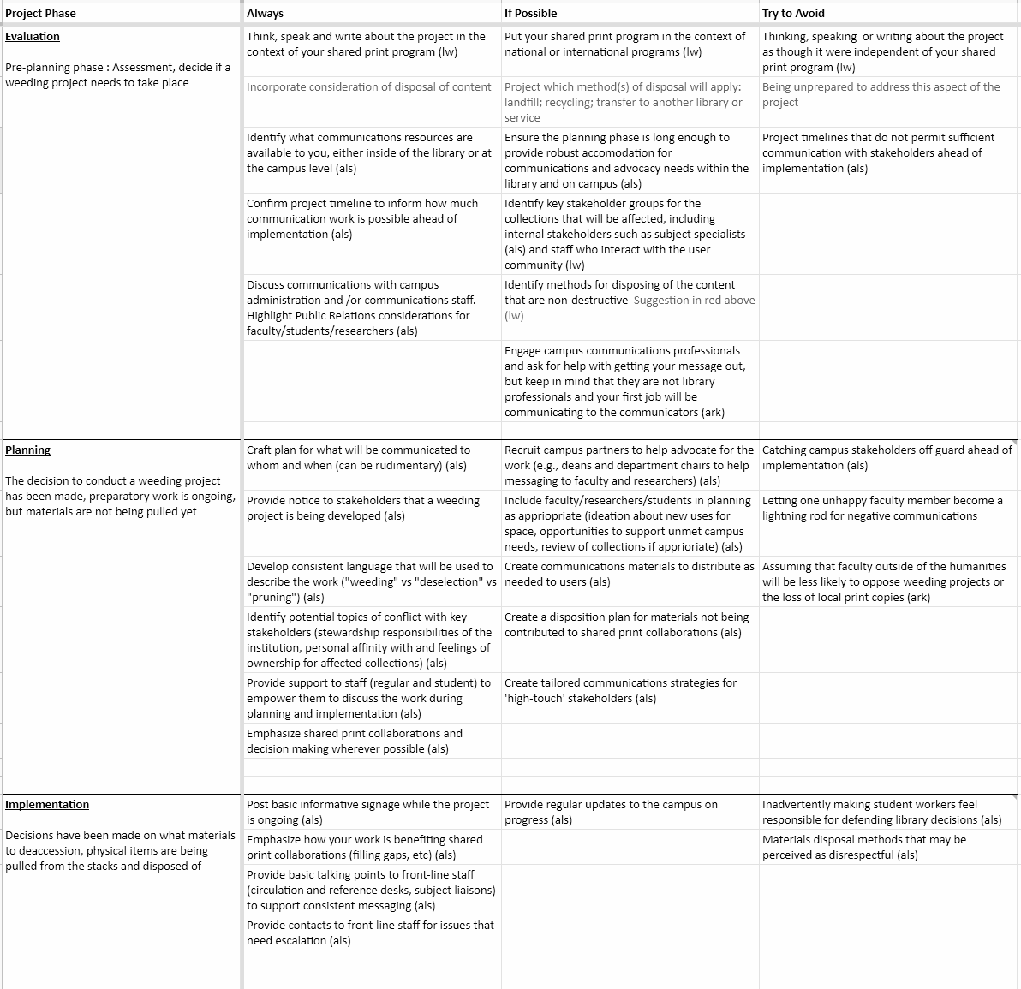
Matrix
3 project phases
Evaluation
Planning
Implementation
3 communication categories
Always
If possible
Try to avoid
Notes:
With the matrix our goal is to provide reasonable suggestions for communications activities at each major phase of a weeding project. We’ve broken these suggestions into three categories: things to always do in some form, things to do if you have the resources and time to accomplish them (the “nice to have”), and things to avoid (things that interviewees reported really set them back in these projects).

Slide 6
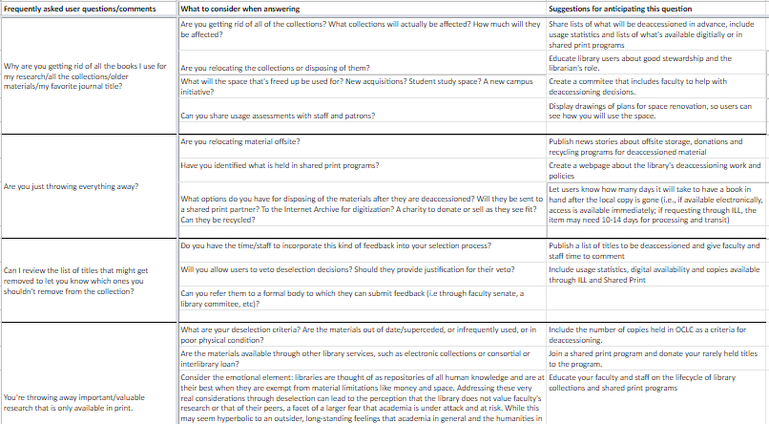
FAQ
Frequently asked user questions/comments
What to consider when answering
How to anticipate this question
Notes:
As we conducted the interviews we were hearing a lot of similar stories about questions and comments users had about the projects. The FAQ lists some of these questions and comments, along with suggestions for what to consider when answering (like, are you actually throwing the books away or are they going to another home, or do you have the staff and time available to allow faculty to review lists) and suggestions for how to anticipate these questions and incorporate them into your project planning and implementation. The goal here isn’t to ignore the question or dismiss it, but really to make it so your users don’t feel the need to ask these questions.

Slide 7
Key takeaways from interviews
Talking about weeding with stakeholders can be difficult but doesn’t have to be
Avoiding the topic does not make it easier
Shared print connections can make it easier
Communication is essential, but may look different for different libraries
Notes:
So we don’t have the final products ready, but I can share some key takeaways and major recommendations we were hearing. Starting with the key takeaways:
Talking about removing materials from the library can be really, really hard. Users have scholastic connections to the materials, of course, but also emotional ones which can make this a delicate topic. But, there are things that can make it easier to have these conversations, which we’ll talk about in a minute.
Avoiding the topic DOES NOT help. Something we heard a few times from interviewees is that they would handle communication differently if and when they do another weeding project by talking about it earlier and bringing more people into the conversations to help socialize the project and reassure users that there is a deliberate process and things aren’t just getting thrown out willy nilly.
Connecting your work to shared print efforts can help the conversation. There are two aspects to this: knowing that someone still has a copy that they can access if they need it can mitigate some concerns, but it also helps if you’re contributing some of the materials to another institution. Users want to know that the materials that mean so much to them will still be available if they need them, and that they’ll have a second life, or will help someone else. There may be local considerations that make it difficult to send materials to another institution (like rules around disposition of state property), but if you can send them to another institution, sharing this information can help turn the conversation from one of loss to one of collaboration and demonstrates your ongoing support for and value of research.
Overall, the main message we heard is that communication is essential, full stop. Different libraries have different resources available - some have trained communications professionals they can draw on, others rely on their librarians and project managers to get the word out - but any effort you make will help make this a more constructive project for you and your users.

Slide 8
Major recommendations
Practice routine weeding (lifecycle of collections)
Communicate early and often
Contribute materials to other initiatives wherever possible
Notes:
Practice routine weeding (Lifecycle of collections)
Socialize and normalize weeding as a routine collection management activity
Reduce anxiety - yours and users’ - Most interviewees that had been through several rounds of this noted that it got easier over time.
Reduce shock of larger-scale projects
Communicate early and often
Don’t hide the project, don’t look like you’re hiding it
Provide the ‘why’ up-front - be mindful of the emotional stake users have in the library, and adjust your language accordingly, but also focus on the benefits that you’ll gain by doing this work
Engage key stakeholders in the ‘how’ - make them advocates, not adversaries
Communication can be a project website and professional signage, and communication can be emails to key campus stakeholders and getting on the agenda for faculty meetings. There’s a whole range of approaches you can take within your resourcing capacity.
Contribute materials to other initiatives wherever possible
Give collections a ‘second life’
Emphasize collaborations and community in communications, that you’re part of a larger network and that you are making deliberate choices about your collections.

Slide 9
Thank you!
Questions?

