Slide 1
Platform for Open Data
PAN Midwinter Forum
January 21, 2022

Slide 2
PLATFORM FOR OPEN DATA
In 2019, the Ivy Plus Libraries Confederation (IPLC) launched a concerted effort to enhance discovery for its inter-library loan program, BorrowDirect.
The challenge: what is the best way to aggregate data from 13 institutions to meet IPLC’s consortial needs?

Slide 3
PLATFORM FOR OPEN DATA
POD is working to create a platform that positions data reuse and service integration as strategic assets. Through open, iterative development and leveraging the investment in our libraries’ internal capacities, we will meet multiple library needs and enable innovation in ways that cannot be done through a series of one-off solutions or relying on vendors and external systems.

Slide 4
IN OTHER WORDS...
Gather data from IPLC institutions
Pool the data for easy reuse
Enrich the aggregated data
Deploy to support varying needs
and do this in a way that...
Enables innovation by reducing friction
Builds capacity within IPLC
Recognizes data as a reusable asset

Slide 5
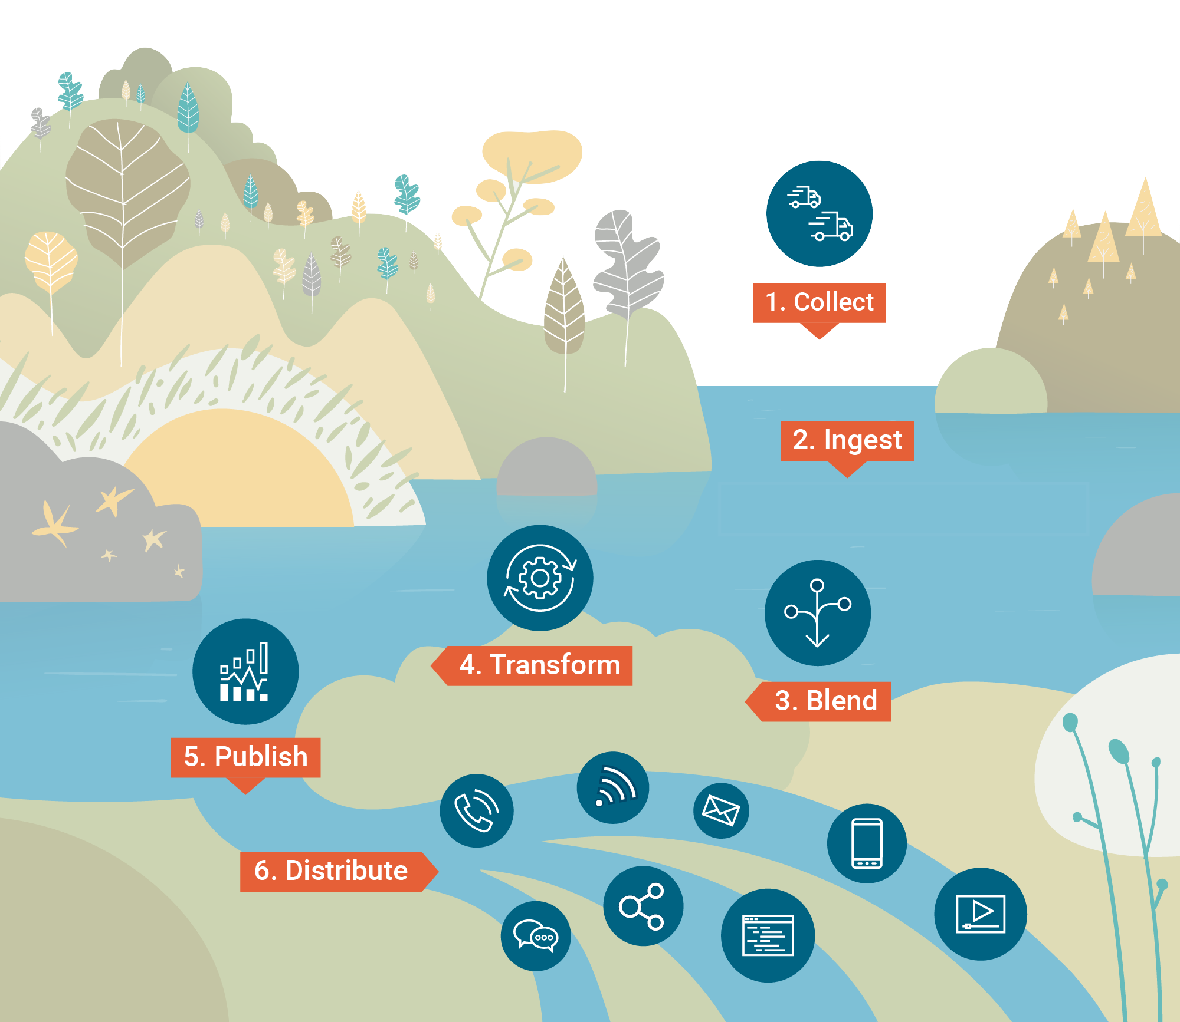
1
A DATA LAKE FOR IPLC
A data lake is a repository for structured, unstructured, and semi-structured data, allowing data to be in its rawest form without needing to be converted and analyzed first.
ONE FEED, MANY USES
Source: https://learn.g2.com/what-is-a-data-lake
Notes:
A central part of the work on POD is providing the infrastructure to aggregate data and to support normalization. Despite the convergence on MARC-based bibliographic and holdings data, there are nonetheless variations in local systems and practices. Accordingly, we have been working on developing a minimum viable product for a data lake to support the aggregation of the data, which allows participating data providers to submit data with a minimum of upfront remediation.
By providing a platform to collect, ingest, combine, transform, and publish data, our intent is to make it significantly easier for participating institutions to work with the data in whichever way they prefer. The POD Data Lake is intended to provide access both the original data as received from the data providers - in its “rawest form” - for institutions that want to index it as is - as well as provide data with a basic degree of normalization to make it easier to parse data like holdings information.

Slide 6
ONE DATA FEED, MANY POSSIBLE USES
Resource sharing: discovery
Collections analysis
Linked data & data sharing
Data mining
AI
Single feed per participating institution
Potential data feeds for collection analysis, et al. (e.g., Gold Rush)
Feeds for ILL discovery

Slide 7
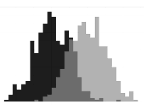
THREE DISTINCT CLUSTERS OF USE CASES
Resource Discovery, Access & Sharing
Physical and digital access across IPLC
Collections Analysis & Decision Support
View on collective holdings to inform local action
Data Innovation & Enrichment
Data mining
Linked data
AI
Notes:
Updated version of this with actual use cases.

Slide 8
USE CASES -- RESOURCE DISCOVERY, SHARING & ACCESS
BorrowDirect Discovery & Fulfillment Facilitation
Digital Resource Sharing for public domain, OA, repository content
Special Collections: IPLC-wide Virtual Reading Room
Serials Analysis for Copyright Status & Enhanced Access
Controlled Digital Lending for BorrowDirect / IPLC
Catalog Enrichment & Remediation
Catalog Matching, Deduplication, Linked Data Transformation
Potential ERM Analysis, Pooling
Notes:
Updated version of this with actual use cases.

Slide 9
USE CASES -- COLLECTIONS ANALYSIS
Collections Analysis (POD feed to Gold Rush)
Shared Print Retention Commitment Management & Analysis
Deselection, Gap filling, understand rare/unique
Data Mining to Support Research
…autosuggest URIs for publishers in cataloging UI
…art & architecture acquisitions over 20 years
DEI Analysis of IPLC Collections
IPLC Collections Intelligence:
Inform Digitization, Preservation, Replace Lost Item Decisions
E-resource Holdings Analysis to HathiTrust, Open Library, etc.
Notes:
Updated version of this with actual use cases.

Slide 10
1
GETTING DATA INTO POD
DATA PROFILING TOOLS
pod.stanford.edu
Bib, item and holdings data
Upload data by
Dashboard
API
Remote URL
Support for
Full data dump
Incremental changes
Summary information (inclusion of 001s, multilingual data, holdings)
Histogram of MARC field and subfield occurrence
Listing of non-standard field usage

Slide 11
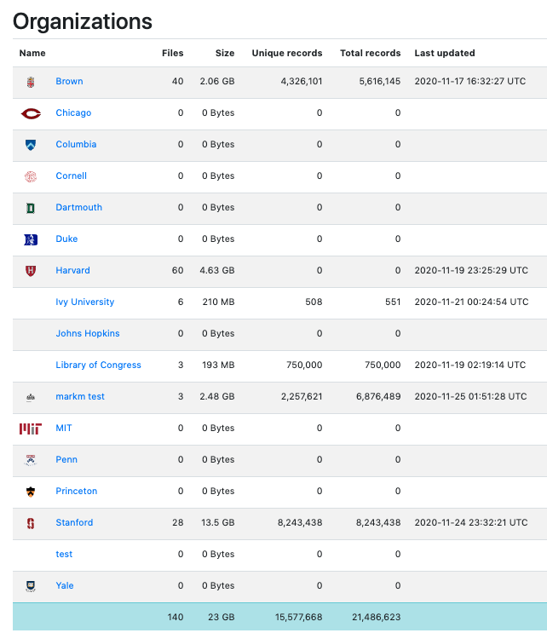
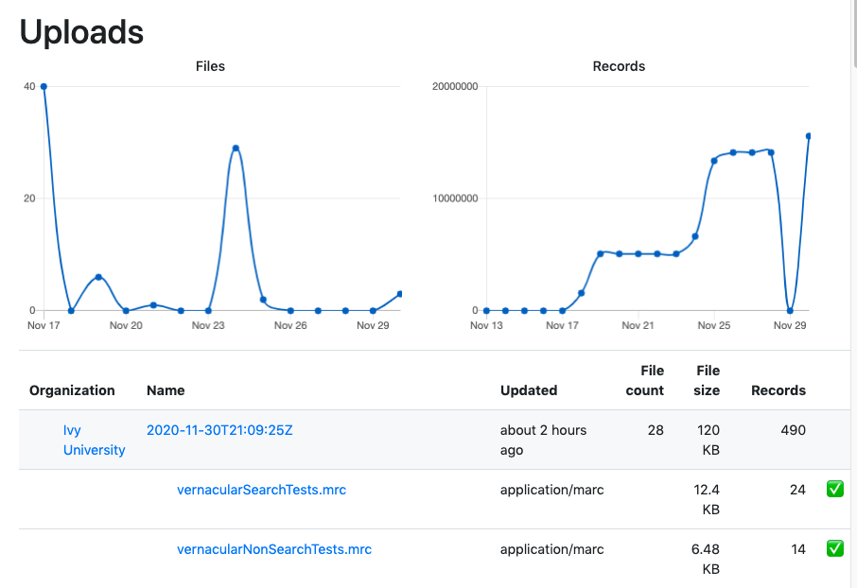
1
STATISTICS
Notes:
Overall information on org # records, uploads; download conts als otracked

Slide 12
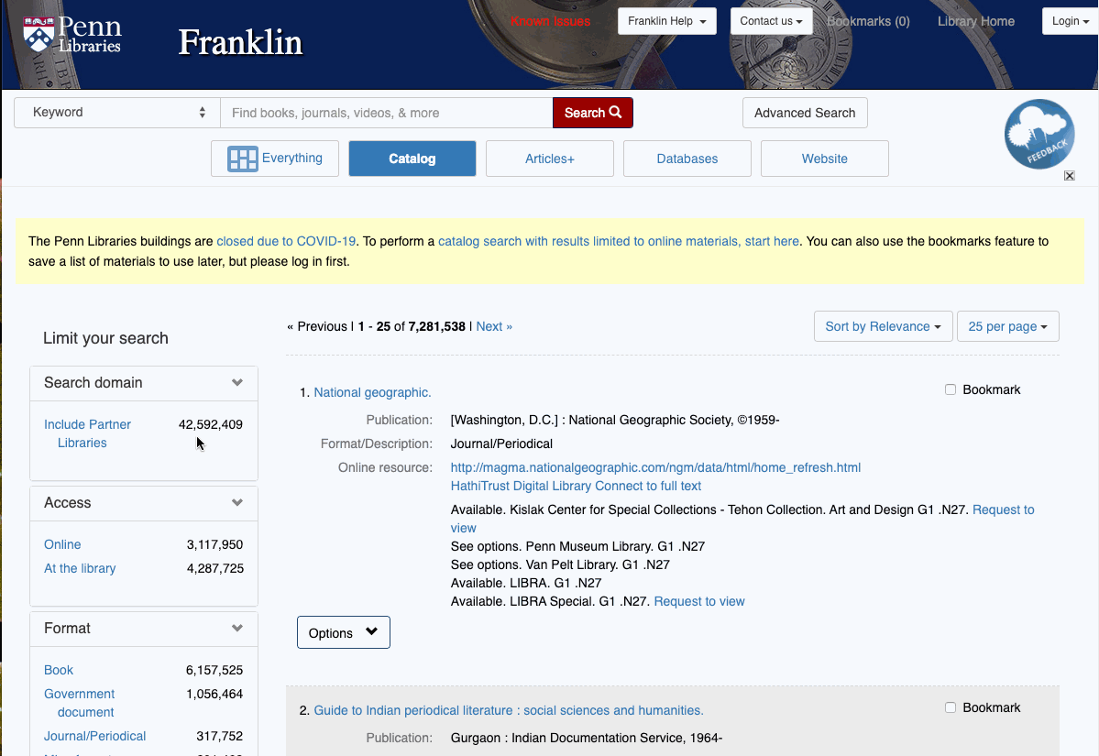
1
FRANKLIN DEMO
2020 proof of concept
7M Penn records
+43M titles from POD
Default search Penn
Expand to POD
Direct link to partner libraries
Notes:
https://franklin-preview.library.upenn.edu/#catalog
User name = pod
Pword = dolphin

Slide 13
PROJECT STATUS
Broad participation across IPLC; 2+ years of continuous work
Established ongoing team from 10+ institutions and 25+ individuals
Operational data lake running since Dec 2020
Data: 60M unique records amalgamated from 13 IPLC sites
Two proof-of-concept local discovery environments operational
2022 development workcycle planned to put POD into production
Full population of data lake with 100M records (ETA May 2022)
Production feeds to support ILL discovery & fulfillment (ETA June 2022)
Extension to additional use cases (2022-23)

Slide 14
1
pod.stanford.edu
GitHub Repository: github.com/ivplus/aggregator
Contact: LIBpod@o365lists.upenn.edu
Notes:
Active, ongoing communication is happening via multiple pathways
POD Announce & monthly reports (are sent to POD channels, ULs, and related Ivy Plus Libraries Confederation communication channels)
POD Tech calls every 2 weeks

