Slide 1
The Superseded Reference Collection June 25, 2021

Slide 2
Agenda
History
The Collection Today

Slide 3
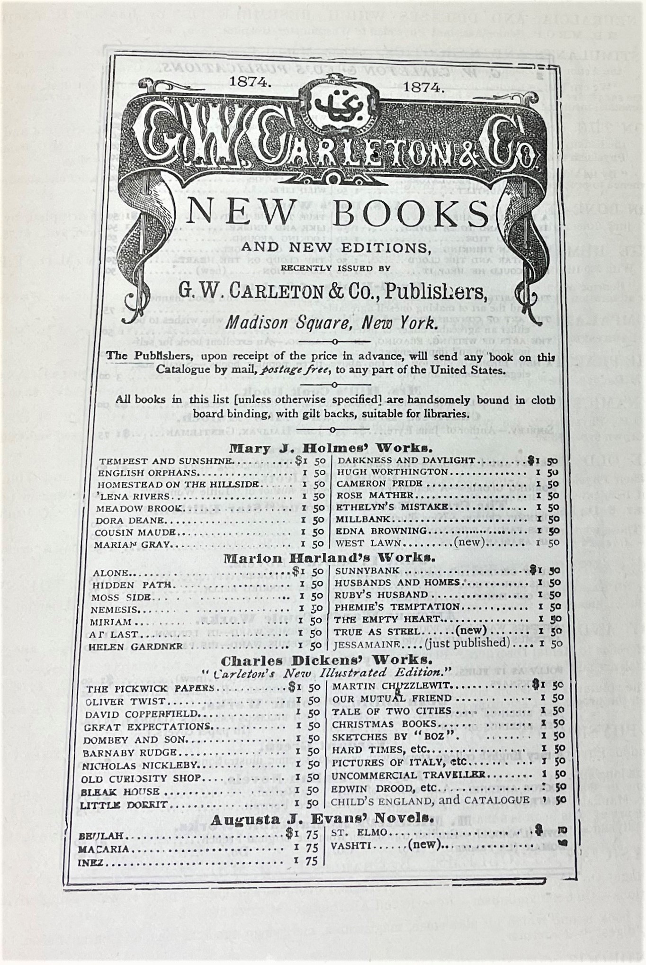
History
CRL began collecting superseded reference materials in the 1990s.
Furthers CRL's goals of collaborative collecting and preserving historical research materials.
Includes reference material starting from the late 19th century.
Image from: Publisher's Trade List Annual (1874)

Slide 4
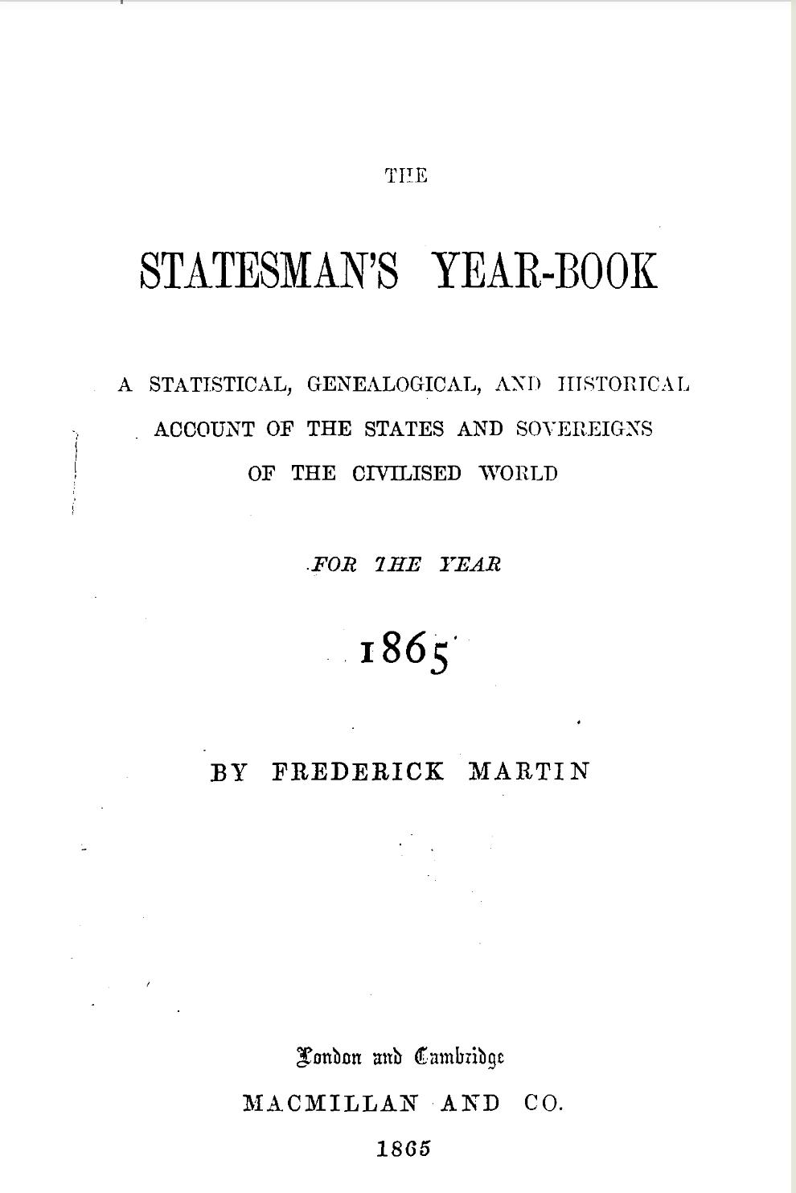
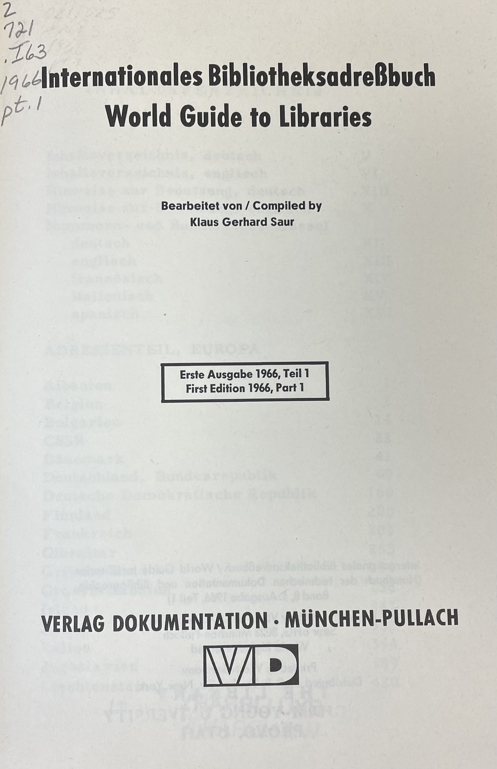
The Collection Today
27 titles
International and Domestic material
Current goal: to include the entirety of its current list of titles, except for the most recent edition.
Image from: the Statesman's Year-Book (1865)
Image from:World Guide to Libraries (1966)

Slide 5
Thank you!
Jazmyn Taylor
Jtaylor@crl.edu

