Slide 1
Building the BIG Collection
Rebecca Crist
Library Project Manager, Big Ten Academic Alliance
PAN Forum
June 25, 2021

Slide 2
Who We Are
15 research universities
University of Chicago
University of Illinois–Urbana-Champaign
Indiana University
University of Iowa
University of Maryland
University of Michigan
Michigan State University
University of Minnesota
University of Nebraska–Lincoln
Northwestern University
Ohio State University
Pennsylvania State University
Purdue University
Rutgers University–New Brunswick
University of Wisconsin–Madison

Slide 3
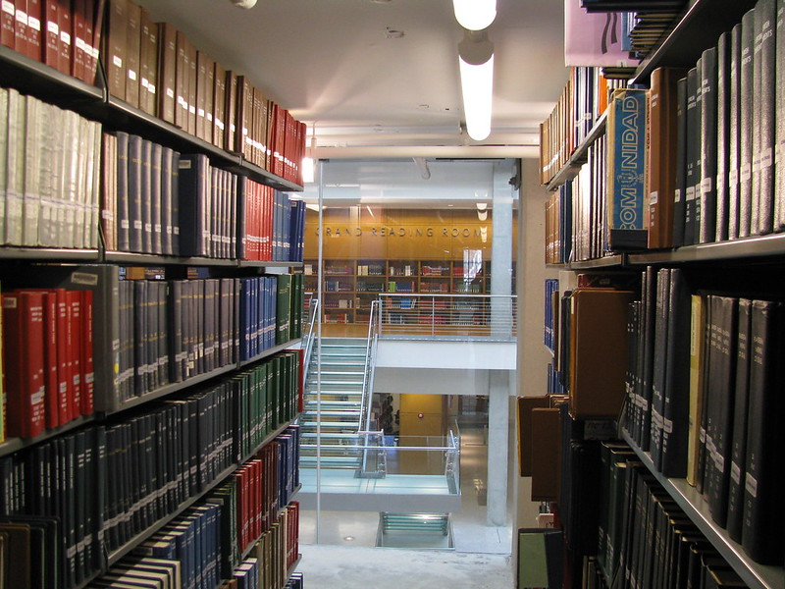
Our libraries are LARGE
About 115 million volumes
13 million discrete print book titles
630,000 students
5 library management systems
"Thompson Library 2674.JPG" by broken thoughts is licensed under CC BY-NC-SA 2.0

Slide 4
Our libraries are GEOGRAPHICALLY DISPERSED
Our collections are HOMOGENOUS and UNIQUE
Our collections are PART OF A LARGER COLLECTION
"Thompson Library 2674.JPG" by broken thoughts is licensed under CC BY-NC-SA 2.0

Slide 5
To deal with growing demands and shrinking budgets, the library directors and their librarians recognized collaboration is the way forward.
collaboration
"people working together" by isbg6 is licensed under CC BY-NC 2.0

Slide 6
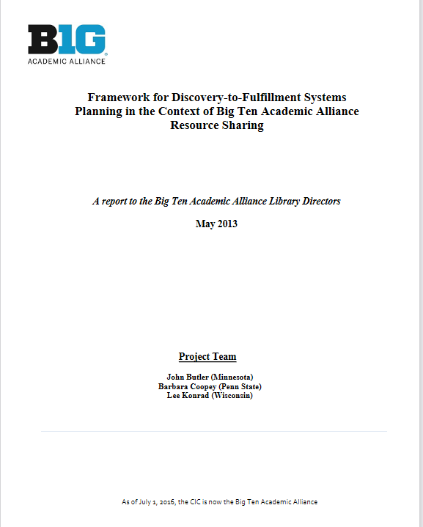
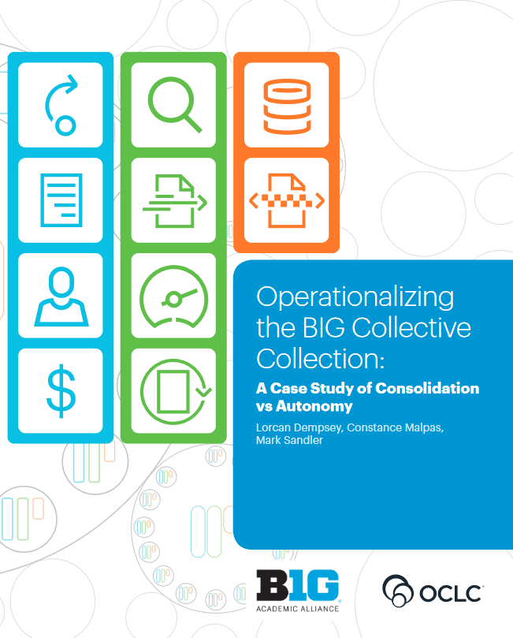
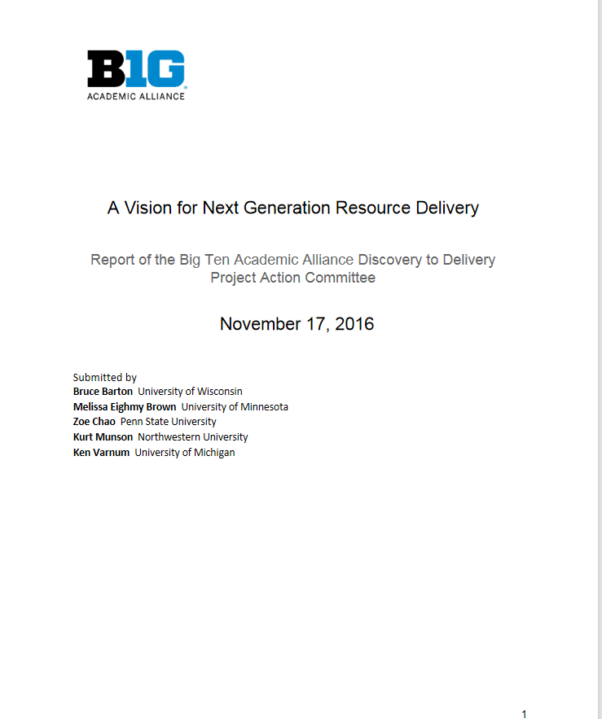
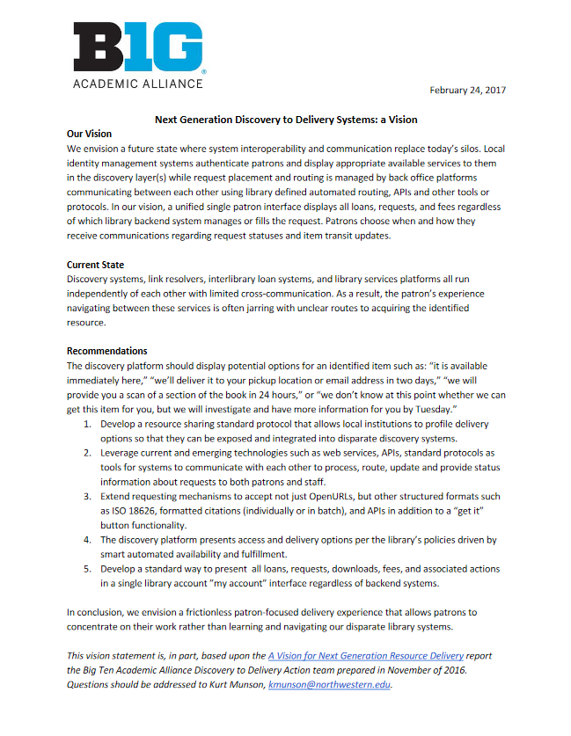
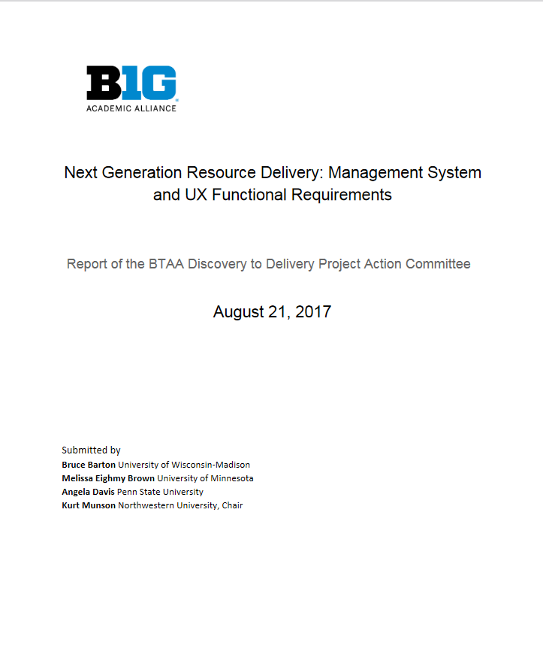
https://www.btaa.org/library/discovery-to-delivery/reports
https://www.oclc.org/content/dam/research/publications/2019/oclcresearch-operationalizing-the-BIG-collective-collection.pdf

Slide 7
The
Collection
Commitment from the library directors to:
Create a more seamless network environment for users
Expand existing programs to coordinate collections
Ensure the longevity of existing print and digital collections

Slide 8
Where Are We Now?
Governance structure established
Communications channels set up
Initial pilot projects approved
"119/365 - One old compass" by olfiika is licensed under CC BY-SA 2.0

Slide 9
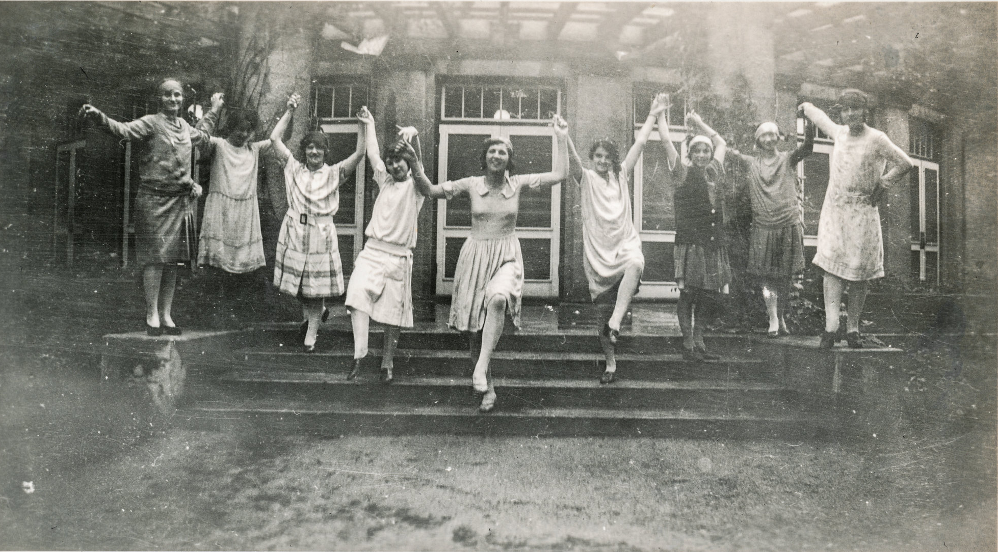
Governance Structure Established
LIBRARY DIRECTORS
establish direction
"Young women dancing on the steps" by simpleinsomnia is licensed under CC BY 2.0
STEERING COMMITTEE
guides pilots and working groups
PILOT TEAMS and PEER GROUPS
develop and execute pilots
BTAA STAFF
coordinates and supports the work

Slide 10
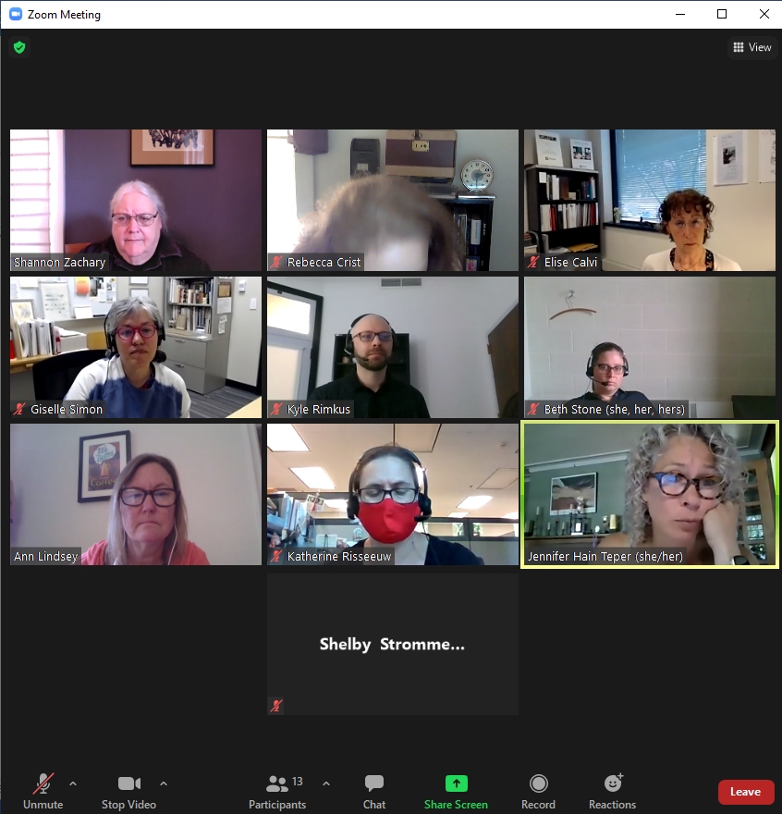
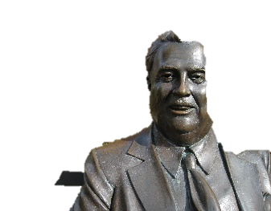
Communications Channels Established
Monthly webinars, including guest speakers
Forms and guidelines in process for establishing pilot projects
Adopting new tools

Slide 11
First round of pilot projects have been approved by the Steering Committee
Initial Pilot Projects Approved
Include
further development of consortial resource sharing,
investigating discovery infrastructure, and
adopting tools for the project
"thumbs up" by .nate is licensed under CC BY-NC-SA 2.0

Slide 12
OK, but this is PAN Forum!
What are you doing with print retentions?
"mountain of books" by ginnerobot is licensed under CC BY-SA 2.0

Slide 13
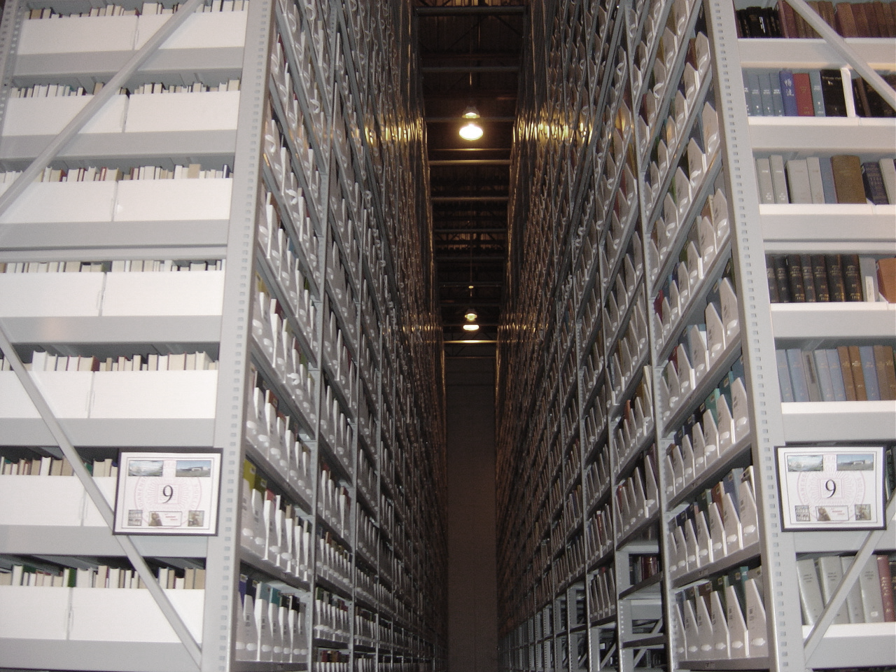
Formally Retained Shared Print
10,713 serials titles retained in the BTAA Shared Print Repository
+ 6 million monograph volumes retained through HathiTrust
+ additional commitments through state, local, and other networks
= About 15% of the collective collection committed
"Locked & Chained" by .Bala is licensed under CC BY-SA 2.0

Slide 14
Then what?
Goal of creating a fully integrated collective collection clearly includes coordinated curation of the print collection
5-year collection building phase begun in 2017 wrapping up; considering options for next area of focus now. Stay tuned!
"mountain of books" by ginnerobot is licensed under CC BY-SA 2.0

Slide 15
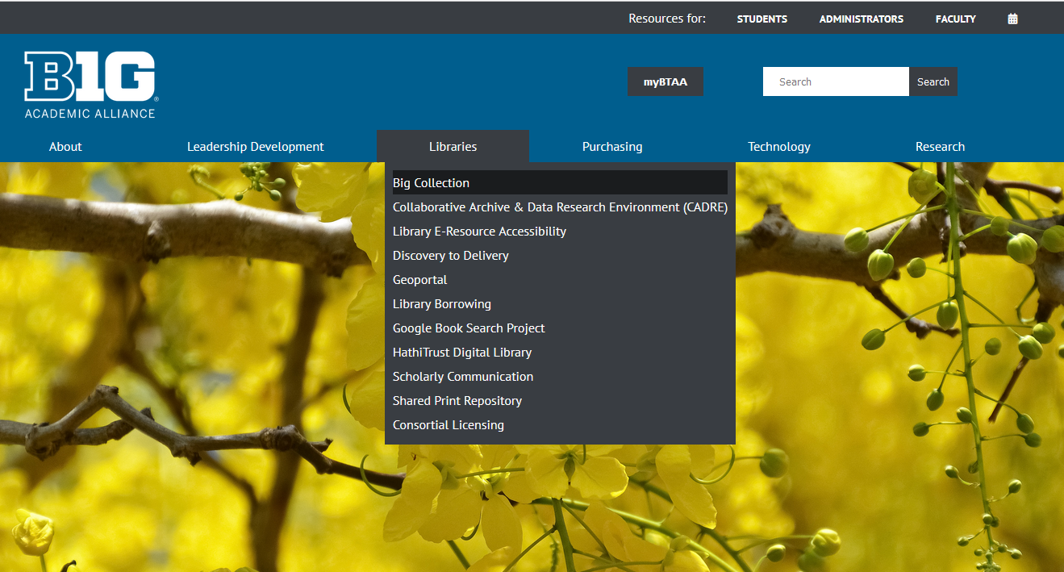
Find out more! www.btaa.org

Slide 16
Thanks!
Rebecca Crist
rebecca.crist@btaa.org

