Slide 1
Journal Retention and Needs Listing (JRNL) Update
Print Archive Network 2021 Midwinter Virtual Meeting
Ben Walker
University of Florida

Slide 2
Journal Retention and Needs Listing (JRNL) History
Purpose
Allows libraries to expose lists of print journals for which they have made retention commitments
Express needs (or gaps) in their holdings
Communicate offers to fill gaps in other participating libraries’ holdings
Development history
2013: Initial development for Scholars Trust Print Journal Retention Program; ISSN # initially the primary identifier
2015: WEST joins; shift to the OCLC # as primary identifier
2017: BTAA joins
2020: Major enhancement to allow gap statements rather than listing gaps individually by volume

Slide 3
JRNL Overview
Administration
Managed by UF for all partners
MOU signed by each program that outlines administration and governance
Governance
JRNL Oversight Committee develops outline and schedule of enhancements, policy changes, etc.
Those recommendations taken to each program executive for final decision
Funding
Each program pays equal share to offset development costs
Current funding set at $31,500

Slide 4
Participating Programs
WEST: 66 libraries (dark blue)
BTAA: 14 libraries (light blue)
Scholars Trust: 36 libraries (red)
FLARE: 12 libraries (orange)
*States with borders have representation in more than one program

Slide 5
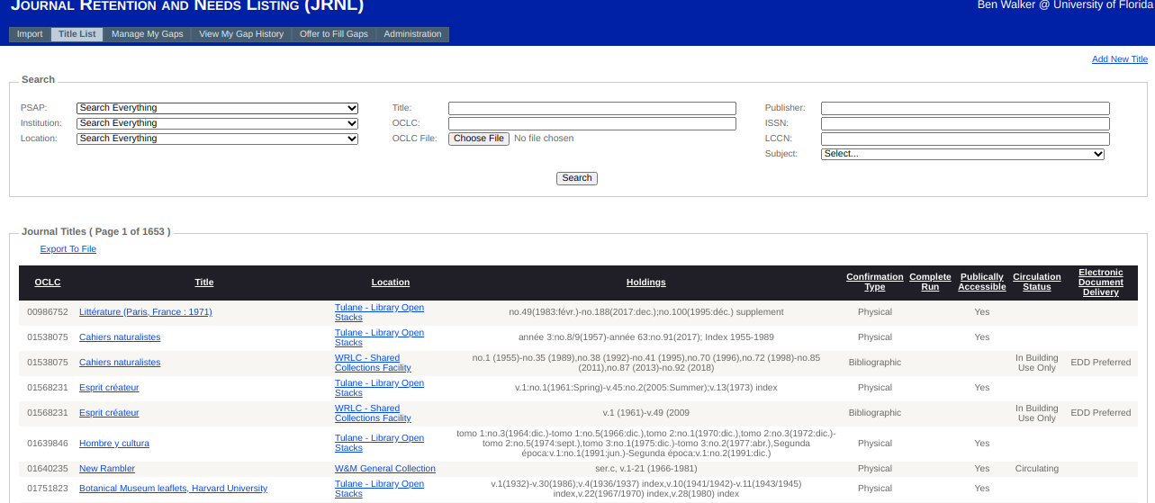
JRNL Title List allows libraries to expose lists of print journals for which they have made retention commitments. See guides.uflib.ufl.edu/JRNL

Slide 6
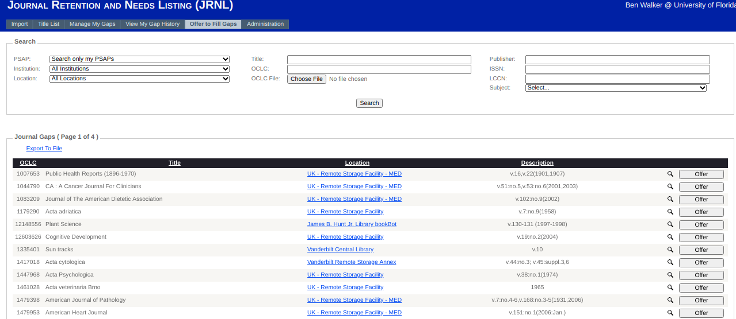
JRNL Gaps allows libraries to express needs (gaps) in holdings as well as communicate offers to fill gaps in participating libraries’ holdings. See guides.uflib.ufl.edu/JRNL

Slide 7
Thank You!
For more details see: guides.uflib.ufl.edu/JRNL
Read only access available for those considering JRNL
Or contact me at bfwalker@ufl.edu

