Slide 1
Shared Print and Resource Sharing:
ReShare
PAN
January 21, 2022

Slide 2
Presenters
Pam Jones, Executive Director, ConnectNY
Boaz Nadev-Manes, University Librarian, Lehigh University
Kristina Rose, Associate Dean for Collections & Content Strategy, New York University Libraries

Slide 3
What is ReShare?
Open source software
Inclusive, community-owned ecosystem made up of libraries, consortia, software developers, and open source advocates
No ILS/LSP limitations: system agnostic
Standards-based protocols
Returnables now; road map includes non-returnables and CDL support
Enables collective collections (rather than providing sharing of individual collections)

Slide 4
The Consortial View: ConnectNY
Why ReShare?
Why now?
How’s it going?
Notes:
Why ReShare? Agency, no extra costs for various systems, reduction in overall costs, shared index
Why now? ConnectNY was ready for a change. Looking for a more open system that can interoperate across networks, hope to attract new members
How’s it going? CNY went live on September 1, 2021 with Index Data as the service provider. So far, so good.

Slide 5
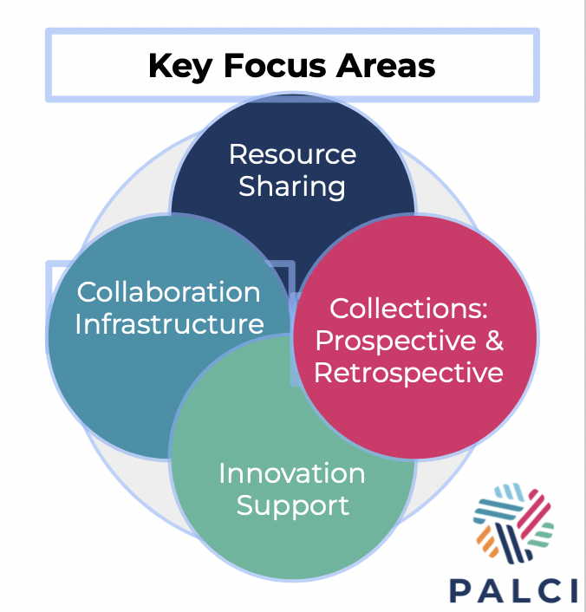
August 2021 - Partnership Wide Implementation
Vision: PALCI is the trusted and preferred partnership for academic library collaboration and innovation.
Boaz Nadav Manes
Notes:
PALCI - pARTNERSHIP FOR ACADEMIC LIBRARY COLLABORATION & INNOVATION consists of 74 academic and research libraries, private and public, in Pennsylvania, New Jersey, New York, and West Virginia. Member institutions range from small liberal arts colleges to publicly funded universities to ARL institutions and the State Library of Pennsylvania. Libraries in PALCI have holdings in excess of 36 million volumes and a combined FTE of over 550,000 students and faculty.
In October 26, 2018 The PALCI Board of Directors unanimously approved up to $100,000 in funding to Project ReShare – a new open-source, community-owned resource sharing solution.
This course of action was unanimously recommended by the PALCI Future of Resource Delivery Working Group (R&D), for PALCI Libraries to proceed with Project ReShare as our resource sharing software supporting the next generation of the E-ZBorrow Service with piloting and testing beginning in Fall 2019

Slide 6
Lehigh’s Implementation of ReShare - "tip of the spear" Mark Canney
Localization process (2018-2021)
“Move away from vendor and proprietary systems and make use of open data through the use of API development and other interoperability technologies based on library standards” Sharon Wiles-Young
Notes:
Why locally? We like it! Tradition of open source work and reliance OLE, FOLIO, VuFind, and cross industry collaborations -
Members of Hathi, EAST, CRL, GoldRush, Unsubit - Shifting of collecting priorities to more community and event support
Future is in our hands. Governance and roadmapping ++
Better user experience - better availability
Participation from the ground-up - developer working on z39.50 connections
Process:
Beginning in Fall 2020 to participate in the development and testing of the new system. PALCI hosted community meetings and we participated in Subject Matter Expert (SME) group convened by IndexData and we were able to contribute to the direction of development.
In early 2021 we were given access to a ReShare demo site and staff were able to begin to experience the new interface and workflows. Because ReShare is built upon FOLIO and VuFind, the same platform we are using for ILS and discovery, our staff were immediately comfortable. Also, in spite of the fact we were preparing to go live with a project which was still in its infancy, we were encouraged by the broad consortial participation in the project, the corporate involvement of partners like IndexData (who were already hosting our FOLIO implementation) and the opportunities on the road-map for extending the reach of resource sharing into new areas like CDL and other integrations.
Outcome:
In the first six months of "go live" our researchers have placed about 800 requests and we have fielded about 700 requests. It seems our researchers have adapted quickly to the new system and I have not encountered any negative reaction from them.

Slide 7
Present Future
Shared Print = DATA = Actionable Accountability
The Belonging Collection
Event Driven Acquisitions
Connection Driven Preservation
Inverse Collecting and Discovery
Data Driven De-selection
Reverse Acquisitions
Direct to Shared Print
Notes:
Data driven reinvestment and focus of resources and expertise
Expand on foundation of ILL service excellence
CDL - BLC joining ReShare
Collection analysis at scale
CCLP
LDP
Automated lending
“smart fulfillment”
Inverse Collecting

Slide 8
Healthy Sharing Ecosystem
Retrospective Collections Working Group, Partnership for Academic Collaboration & Innovation (PALCI)
Terese Heidenwolf, Co-Chair (Lafayette), Dan Heuer, Co-Chair (Bucknell), Rachel Newbury (Clarion), Julia Proctor (Penn State), Kristina Rose (NYU), J. Brian Schoolar (Temple), Andy Hart (Univ of Pennsylvania), Alison Bradley & Jill Morris (PALCI)
Notes:
Presenting the work PALCI’s Retrospective Collections Working Group has done to define a “healthy sharing ecosystem.” within the context of PALCI and to articulate commitments among consortial members in regards to our shared collections. We hope it will shape future projects involving retrospective collections - particularly leveraging the ReShare shared index.
Many PALCI Libraries are members of a shared print programs - EAST and HathiTrust.

Slide 9
What is a healthy sharing ecosystem?
Pillars
System is based on inclusion
Access
Stewardship of collective collection
Trust
Grounded in pragmatism
Notes:
KR Notes
System based upon inclusion
Interoperability of systems
Support for a diverse set institutions
Openness of data and ability to share it
Use of standards
Access
For current users - Access to collection is timely and effective delivery systems
Stewardship of the collective collection
Sustainable access to collections for future users. A healthy system balances needs of access now with a need to ensure materials are well-cared for and available in the future.
Trust
At all levels: our users trust the service (even if they don’t know it’s name) as a place to get materials needed for teaching, learning and research
Our staff trust the other actors in the system to do their best to fulfill requests, care for materials as if they are our own, and share the load. “Good citizenship” sometimes necessary (i.e., members do things for the good of the whole, and won’t all always benefit equally, or in the same way)
We all trust consortia leaders, technology providers, developers, and subject matter experts to effectively advocate and work for collective needs; system remains open, inclusive and continues to evolve with our libraries and users.
Grounded in pragmatism
For PALCI, we are focused on access, doable and inclusive programs that allow a diverse set of libraries to provide excellent services to their users, sustainability.
A healthy sharing ecosystem is one in which all PALCI institutional circulating collections are valued and widely-shareable, particularly in light of the non-homogenous nature of the member libraries. These print collections enhance the sharing ecosystem not only via EZBorrow but through additional projects such as the Reciprocal On-Site Borrowing Program and the PALCI Distributed Print Archive.

Slide 10
Healthy Ecosystem: E-ZBorrow
Excellent user experience
Sustainable for Libraries
Active practitioner community
Commitment to growth
Notes:
EZBorrow, PALCI’s expedited interlibrary loan service, is a keystone of our healthy sharing ecosystem. Users at PALCI institutions should see the PALCI shared collection as an easily accessible extension of their local collections. EZBorrow relies upon
Excellent User Experience:
Intuitive user interface
Reliable - High fill rate and 3-5 day turnaround time: users can count on getting materials in a reasonable timeframe.
Loan lengthen - full semester
Sustainable for Libraries
Predictable shipping costs
Unmediated processing & intuitive, efficient workflows.
Ability to integrate system with other tools for resource sharing (back to standards)
Community:
Practitioners who are invested in working together and learning from each other.
People who are willing to complain, test, and participate in making the service better.
Commitment to growth
A commitment to explore alternative delivery such as controlled digital lending or consider sharing formats other than books

