Slide 1
COPPUL Digitization and Collective Collections Services
Rebecca Dickson, Digital Stewardship Network Coordinator
Doug Brigham, Shared Print Archive Network Coordinator
CRL PAN Forum 25 June 2021

Slide 2
Land Acknowledgement

Slide 3
Outline
Background: Digitization at COPPUL
Lessons from member outreach
Next step: a new “collective collections” initiative
Parallel steps

Slide 4
Digitization at COPPUL

Slide 5
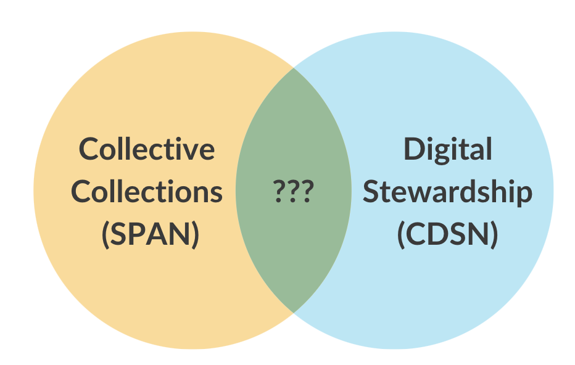
Spring 2020: CDSN/SPAN
Could collaboration between COPPUL’s Shared Print and Digital Stewardship programs support long-term access to Western Canadian documentary heritage?

Slide 6
A brief history of digitization at COPPUL
Sept. 2008
Mar. 2012
Apr. 2012
May 2012
Feb.
2019
Summer 2020
...
COPPUL's Ongoing Role in Digital Collections: Discussion Paper
COPPUL Digitization: Initiatives and Practices Survey
Digitization and Digital Preservation: Strategies for COPPUL Libraries (Workshop)
Formation of Digital Preservation Working Group
Presentation: "Integrated Preservation at COPPUL" (Brigham, Davis, Blackburn)
COPPUL Newspaper Digitization Survey
+
Member Outreach

Slide 7
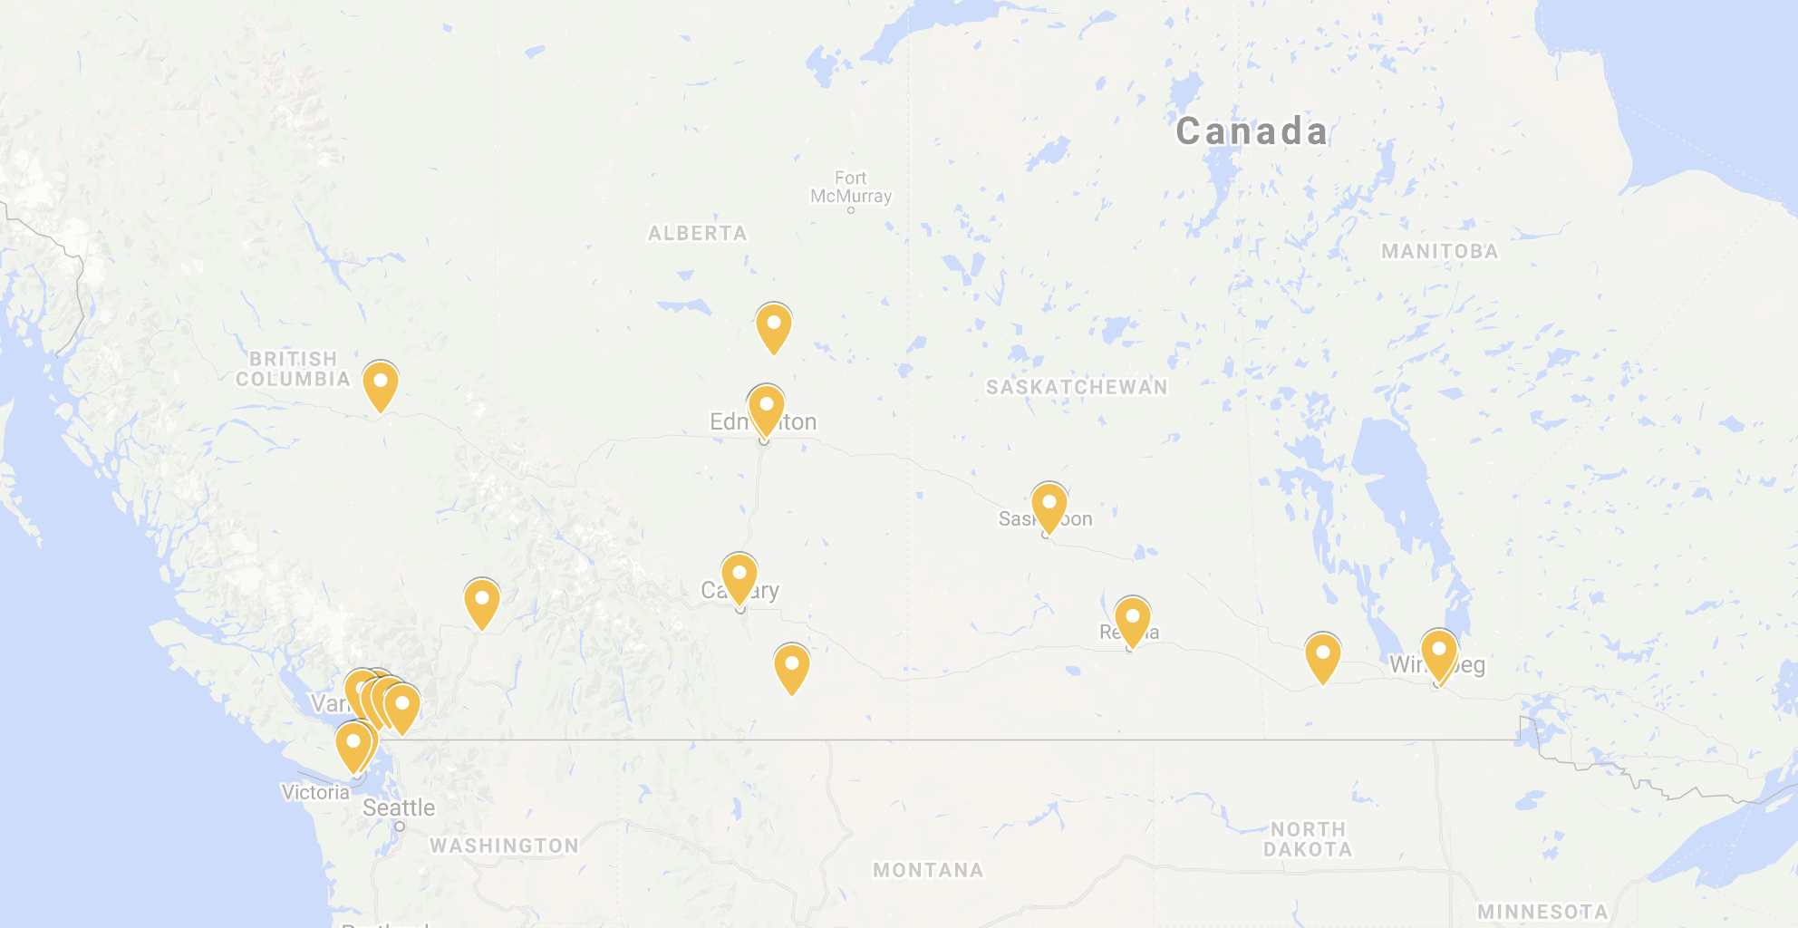
2. Summer 2020 Outreach:
Highlights and themes from our conversations with member libraries

Slide 8
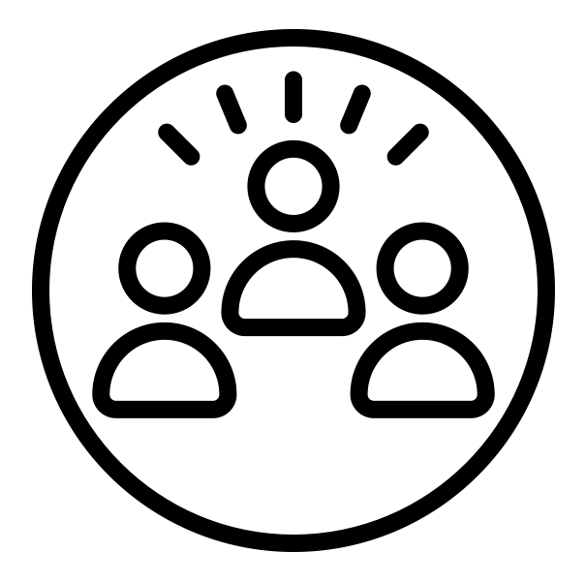
Members have common priorities for digitization
Newspapers (historical and contemporary)
Archival / unique materials
Materials related to local area
Audio-visual materials for access and preservation
Institutional research outputs
Materials related to Indigenous Knowledge
Materials to support immediate teaching & learning needs

Slide 9
Opportunities to facilitate knowledge sharing?
“We have well-documented policy and workflows, and are open to sharing our expertise.”
“We’re building local capacity to digitize fragile, at-risk special collections. Guidance on equipment selection and workflow development would help.”

Slide 10
Opportunities for collective capacity-building?
“We’d like to build up our local capacity and explore providing digitization as a service to GLAMs in the region.”
“We have a few collections we’d like to digitize, but building local capacity isn’t a high priority given the nature of our collections.”

Slide 11
How can COPPUL help advance digital collections work?
“COPPUL could provide leadership around stewardship of Indigenous materials in the digital environment.”

Slide 12
How should COPPUL aim to move that work forward?
“Work incrementally within COPPUL to advance efforts, based on understanding of existing needs and capacity.”

Slide 13
Proposed directions
Develop mechanisms for collaboration between SPAN, CDSN & IK programs
Strengthen collective understanding of digitization activities and areas of expertise within COPPUL
Explore development of collaborative (not prescriptive!) strategies for
Content selection for digitization
Pursuing funding
Amplifying existing digital collections
Build partnerships with allied organizations, locally and nationally

Slide 14
3. Next step: a new “collective collections” initiative

Slide 15
COPPUL priorities for digitization, revisited
Newspapers (historical and contemporary)
Archival / unique materials
Materials related to local area
Materials related to Indigenous Knowledge
Audio-visual materials for access and preservation
Institutional research outputs
Materials to support immediate teaching & learning needs

Slide 16
Roles of existing programs
Digital Stewardship (CDSN)
Help members build capacity to preserve, manage and provide access to digital collections.
Indigenous Knowledge (IKSC)
Facilitate communication among COPPUL institutions in area of IK; foster related opportunities for collaborative action and partnership initiatives.
Collective Collections (SPAN)
Provide expertise in identification and analysis of materials and collaborative action with library collections.

Slide 17
Indigenous heritage publications
Materials created by Indigenous communities or organizations.
Includes newspapers, newsletters and various forms of grey literature.

Slide 18
535
title families
675
individual titles

Slide 19
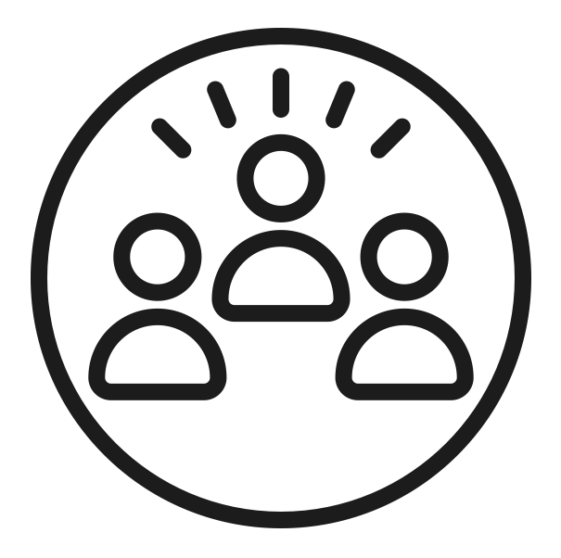
Indigenous Heritage Publications WG (IHPWG)
Six members from COPPUL libraries, with representation from all four provinces in the region
COPPUL’s three program coordinators

Slide 20
IHPWG Mandate
Guide efforts to improve discovery of, access to, and preservation of publications by and about Indigenous communities on whose lands COPPUL members live and work.
Support ethical stewardship of these collections, including defining access to materials based on community protocols.
Identify publications held by member academic libraries and archives, expanding to include born-digital publications and those held by allied organizations across the national cultural heritage sector as applicable.

Slide 21
Prioritizing “relationships, not records”
“If we take the general ‘get it, curate it, share it’ model and expand it to include cultural, ethical, and historical checks at each step, then we get a workflow that encourages collaboration, relies on historical specificity, and has ethical considerations embedded at every step.”
(Christen, 2018, p. 406)

Slide 22
4. Parallel steps
Strengthen partnerships with allied national organizations in the heritage publications & digitization spaces
Build relationships with stakeholders and partners at local and provincial levels
Explore opportunities to collaboratively pursue funding
Connect digital collections peers within COPPUL, exploring mechanisms for building & leveraging collective capacity

Slide 23
Thank you!
Rebecca Dickson
cdsn@coppul.ca
Doug Brigham
span@coppul.ca
Created by Maxim Kulikov from Noun Project

Slide 24
References
Brigham, D. & Dickson R. (2020, Oct. 15). Connecting Shared Print and Digitization at COPPUL. In Making the Connection Between Digitization Strategies and Collective Print Initiatives [Panel session]. 2020 CRKN Virtual Conference. https://www.crkn-rcdr.ca/en/conference/crkn-virtual-conference/program/making-connection-between-digitization-strategies-and
Christen, K. (2018). Relationships, Not Records. In J. Sayers (Ed.), The Routledge Companion to Media Studies and Digital Humanities (1st ed., pp. 403–412). https://doi.org/10.4324/9781315730479-42
Lee, D. & Dickson, R. (2020, Oct. 13). Indigenous Perspectives on Library and Archival Digital Preservation Practices [Conference session]. 2020 CRKN Virtual Conference. https://www.crkn-rcdr.ca/en/conference/crkn-virtual-conference/program/indigenous-perspectives-library-and-archival-digital

