Slide 1
Shared Print Program Assessment
Moderated Panel Discussion
PAN Forum
January 22, 2021

Slide 2
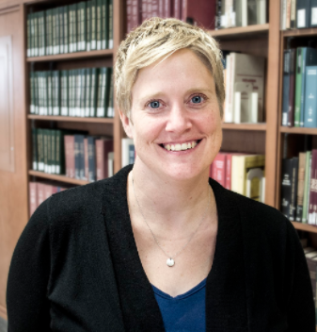
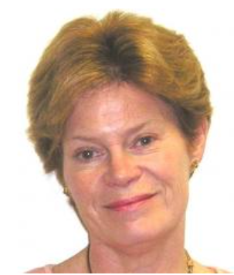
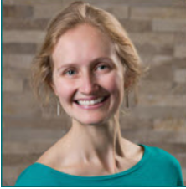
Moderator: Amy Wood, CRL
Panelists:
Heather Weltin, HathiTrust
Susan Stearns, EAST
Alison Wohlers, WEST

Slide 3
Panel Questions
Notes:
Stop share - focus on panelist faces!

Slide 4
Q&A
Notes:
Start share again.

Slide 5
Thank you!
More questions?
Amy Wood, wood@crl.edu
Heather Weltin, weltin@hathitrust.org
Susan Stearns, sstearns@blc.org
Alison Wohlers, alison.wohlers@ucop.edu

Slide 6
WEST

Slide 7
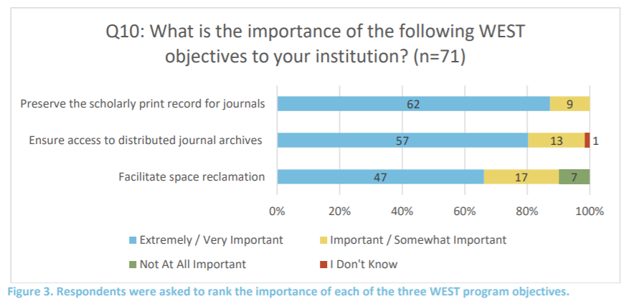
Notes:
In 2016, preservation surpassed access. Non-archive holders place a higher importance on access and space reclamation than archivers. Builders - who manage high density facilities, place less importance overall on space reclamation.

Slide 8
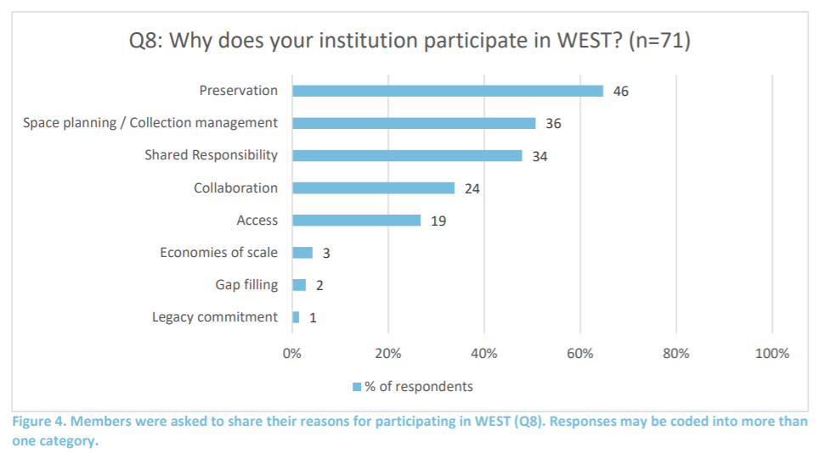

Slide 10
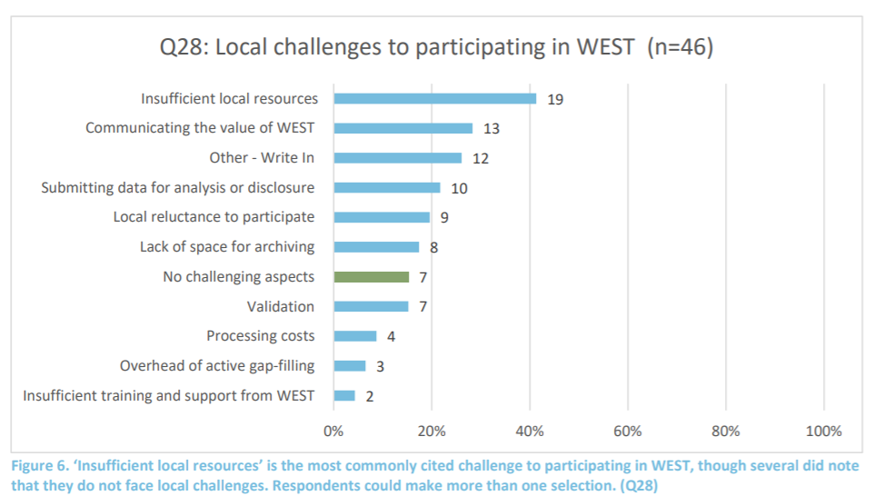

Slide 11
EAST

Slide 13
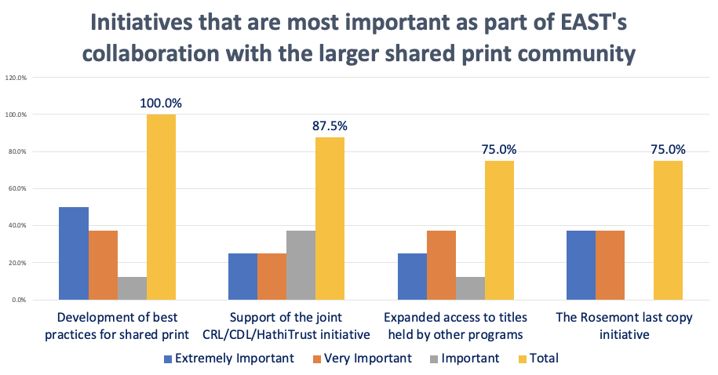

Slide 17
HathiTrust

Slide 18
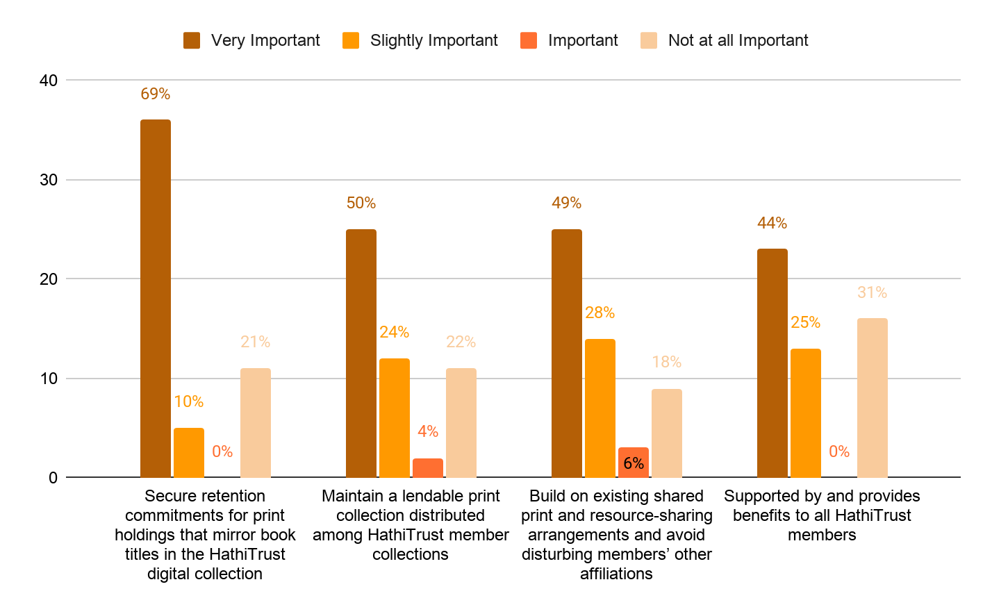
The primary goals of the HathiTrust Shared Print Program are to ensure preservation of print and digital collections by linking the two, to reduce overall costs of collection management for HathiTrust members, and to catalyze national/continental collective management of collections. Key attributes of the program are listed below. What is the importance of the HathiTrust Shared Print Program Objectives to your institution?

Slide 19
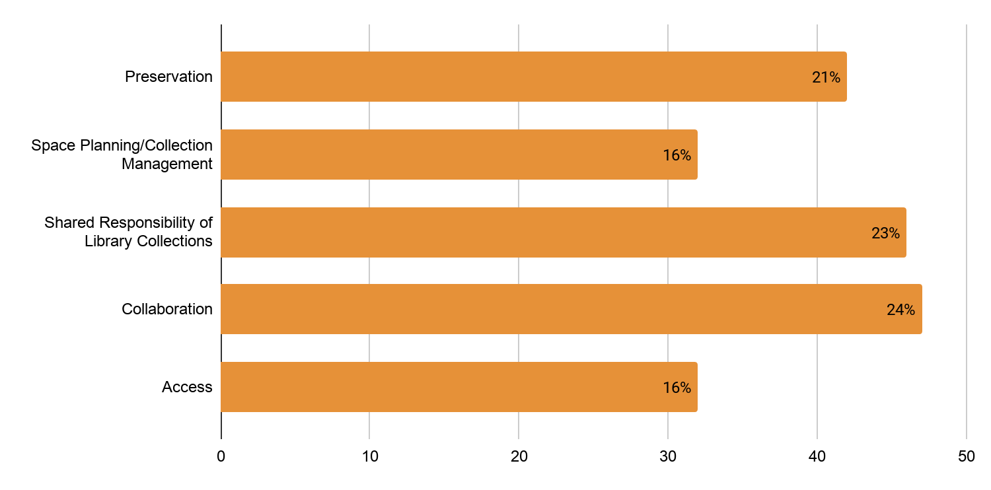
Why does your institution participate in HathiTrust's Shared Print Program? Please select all that apply.

Slide 20
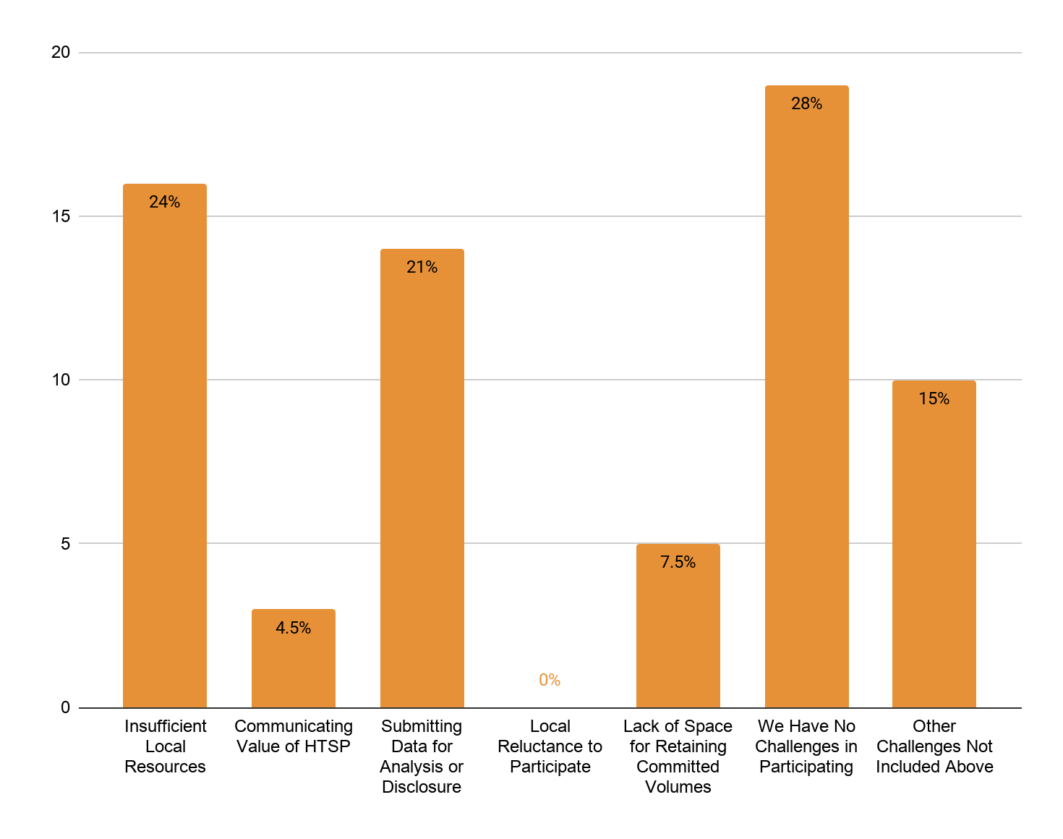
What barriers has your library encountered regarding participation or potential participation in the HathiTrust's Shared Print Program? Please select all that apply.

