Slide 1
Shared Print Collection Analysis at
Washington Research Library Consortium
Aaron Krebeck
Director of Library and User Services

Slide 2
Greenglass (2015)
Gold Rush (2022)
2 million retention commitments
Monograph only
OCLC check for rarity
Provide user with pre-selected retention copies
Minimal local work required
Expensive
Additional 570,000 commitments
Monograph only
No automatic OCLC check
Can compare to all prior users of Gold Rush
Must identify own retention commitments
More local work required
Small fraction of the price
Notes:
Identified 2 million retention items from a total extract of ~9 million
This project was only monographs and at the time Greenglass could only do monographs, but they can now handle serials as well
Because Greenglass is an OCLC product, they have unlimited access to the OCLC API and can therefore not only check your items for internal/local rarity but also compare them to all records in world cat. We found out that nearly a quarter of a million of our items had 10 or fewer copies in all of WorldCat.
Capable of providing a randomized list of the retention copies from your list.
Minimal local work required. Just an extract and regular check-ins with the Greenglass team.
Expensive. Easily 6 figures

Slide 3
Alma Analytics
Alma Analytics

Slide 4
National Library of Medicine’s SQL formula for identifying unique titles

Slide 5
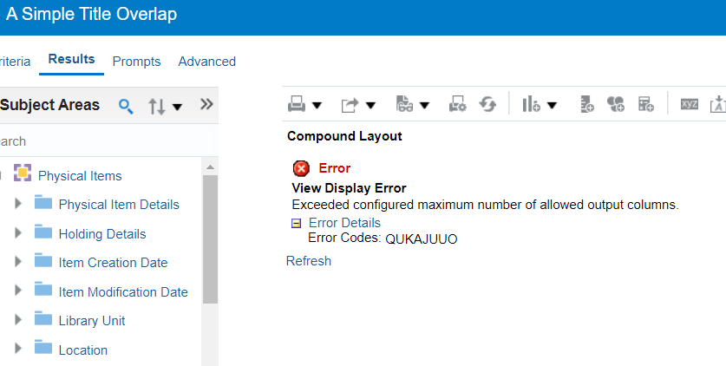
But most of the time…

Slide 6
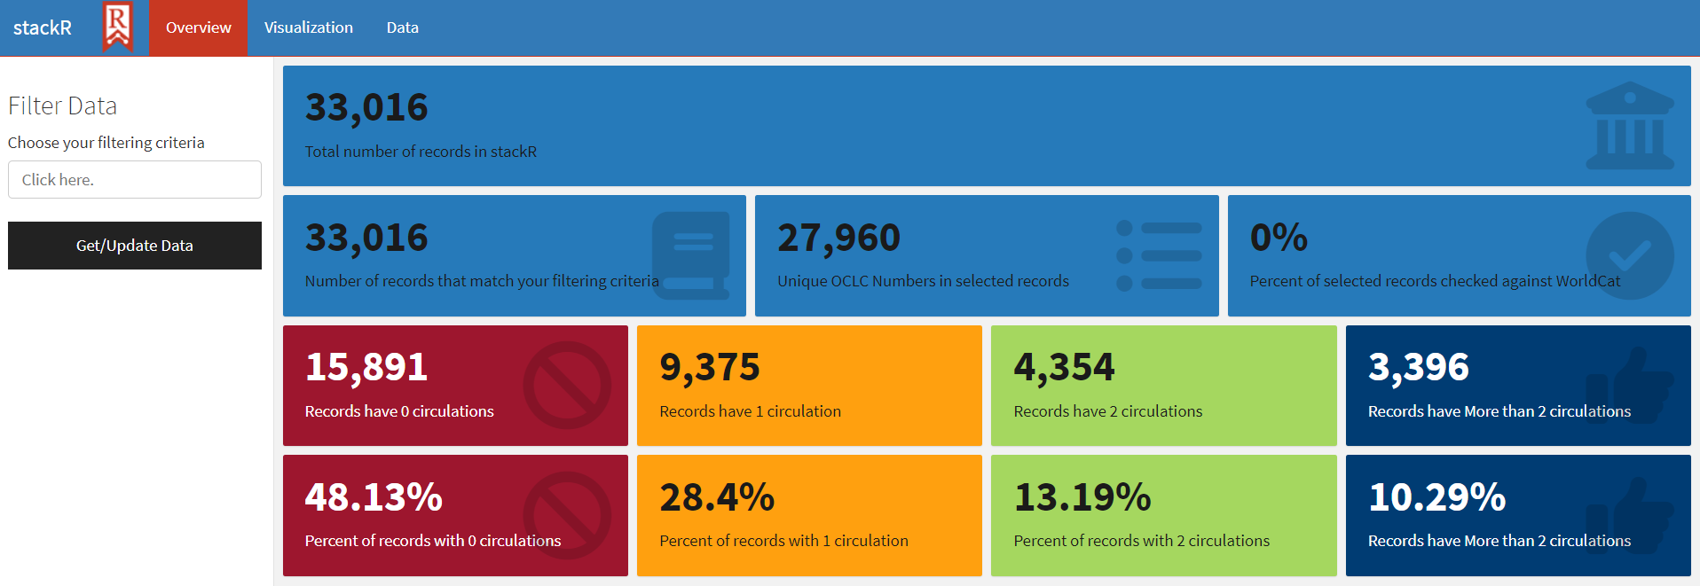
Open Source Options?
stackR - A web-based Shiny application build with R programming language by Dartmouth University

Slide 7
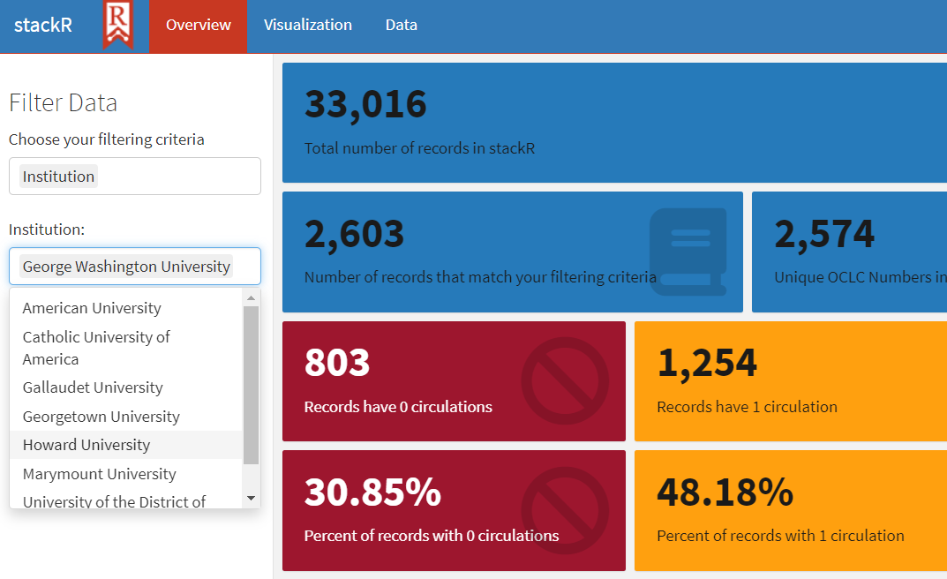
Open Source cont.

Slide 8
What the future holds for collection assessment…
Choice
Continued effort
More open source options
Hybrid approaches
Notes:
Choice - None of the options i’ve listed above are going away. For those with the means to use Greenglass, you have my admiration and a twinge of jealousy
Continued effort

