Slide 1
Print Archiving Network (PAN)
Judith C. Russell
Dean of University Libraries
Orlando, Florida
June 24, 2016

Slide 2
Federal Documents at UF
The University of Florida (UF) is the Regional Federal Depository Library for Florida, Puerto Rico and the U.S. Virgin Islands
It is also an active participant in the ASERL Collaborative Federal Depository Program with over 35 Centers of Excellence (mostly small, defunct agencies), including:
21 USDA agencies
Congressional Hearings
CFR and Federal Register (Law Library)
Panama Canal Commission and predecessor agencies and all other Federal documents and maps about Panama and the Canal

Slide 3
Federal Documents at UF
UF began cataloging ~300,000 documents already in offsite storage in 2008
UF moved the remainder of its Federal Documents collection to offsite storage in 2014 and committed to cataloging the entire collection
Since 2008, over 555,000 volumes have been cataloged
Most are enhanced copy cataloging records, but over 13,880 original cataloging records have been created and contributed to OCLC/WorldCat

Slide 4
Federal Documents at UF
Process for Cataloging and Traying Federal Documents:
A bookcart of untrayed documents is pulled
Catalog is checked to locate a record for each item, confirm its accuracy, and verify bar code and OCLC number; record is corrected and upgraded if necessary
If no record is found, an original cataloging record is created
Condition is assessed (minimally) and, if brittle or otherwise damaged, condition is noted in the MARC 583 field and in the item record
Damaged and brittle volumes are often shrink wrapped to stabilize and prevent further deterioration

Slide 5
Federal Documents at UF
Process for Cataloging and Traying Federal Documents, continued
Retention commitment is recorded in the MARC 583 field, identifying the document for permanent retention as required by law for the holdings of a Regional Federal Depository Library
> 583 1 $5 flgafar $a committed to retain $c [date FLARE holding created] $d committed to retain permanently $f FLARE $f FDLP $j FSTO
> 583 1 $5 flgafar $a condition reviewed $c [date FLARE holding created] $f FLARE $f FDLP $j FSTO
Each document is vacuumed to remove dust
Bar code is reproduced and placed on the outside of the back cover

Slide 6
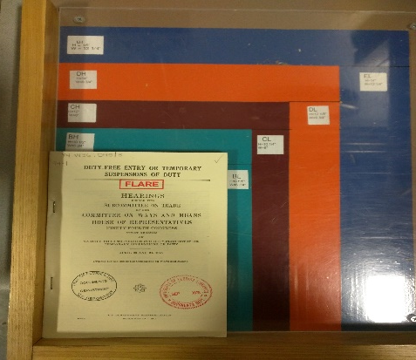
Federal Documents at UF
Process for Cataloging and Traying Federal Documents, continued
Each document is assessed for size and trayed with items of like dimensions

Slide 7
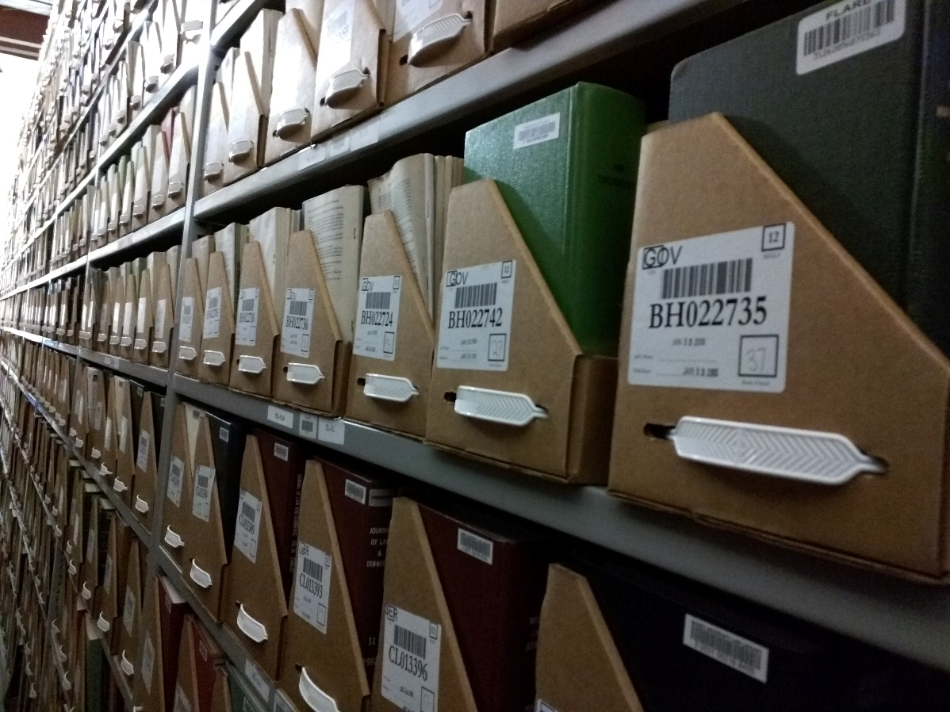
Federal Documents at UF
Process for Cataloging and Traying Federal Documents, continued
Inventory for each tray is double verified before shelving
Record/holdings statement is uploaded into OCLC and made available in WorldCat
NOTE: New documents are processed and trayed as they are received.

Slide 8
Federal Documents at UF
Additional Process for Center of Excellence (COE) Collections
COE Collections are treated as special collections
If necessary, documents are sent to the Conservation Unit for repair or treatment
Documents are digitized after page by page verification
Documents receive higher level, image by image, QC
Access copies are loaded into the UF Digital Collections (http://UFDC.ufl.edu)
Preservation copies are sent to the Florida Digital Archives (http://fclaweb.fcla.edu/fda)

Slide 9
Federal Documents at UF
Additional Process for Center of Excellence (COE) Collections, continued
UF committed to digitization of its COE Collections, with the exception of CFR, Federal Register and Congressional Hearings
UF will harvest and host born digital or digtized documents for its COE Collections, with the exception of CFR, Federal Register and Congressional Hearings for which UF relies Fdsys, HathiTrust, and Internet Archive
UF does not otherwise harvest or host digital documents locally

Slide 10
Federal Documents at UF
Centers of Excellence:
US Department of Agriculture:
A 11: Office of Fiber Investigations
A 12: Division of Foreign Markets
A 18: Division of Microscopy
A 20: Division of Pomology
A 24: Division of Seeds
A 25: Silk Section
A 27: Bureau of Crop Estimates
A 3: Agrostology Division
A 38: Fixed Nitrogen Research Laboratory
A 39: Packers and Stockyards Administration

Slide 11
Federal Documents at UF
US Department of Agriculture, continued:
A 4: Bureau of Animal Industry
A 40: Exhibits Office
A 41: Grain Futures Administration
A 42: Bureau of Home Economics
A 48: Bureau of Plant Quarantine
A 5: Bureau of Biological Survey
A 56: Bureau of Entomology and Plant Quarantine
A 6: Division of Botany
A 7: Bureau of Chemistry
A 8: Entomological Commission
A 9: Bureau of Entomology

Slide 12
Federal Documents at UF
Other Executive Branch Agencies:
AE 2: Federal Register (Law Library)
AE 2.106/3: Code of Federal Regulations (Law Library)
CZ 1: Panama Canal Zone Company, 1950-1979
D113: Panama Canal (DoD), 1949-1950
M 115: (National Military Establishment), 1947-1949
MuS 1: Institute of Museum and Library Services 1976-1981
NF 4: Institute of Museum and Library Services (1981 - )
PaC: (Apparently not used), 1950-1952
W 73: Canal Zone, 1902-1905
W 79: Canal Zone, 1912-1945

Slide 13
Federal Documents at UF
Congress and Legislative Branch Agencies:
Y 3.Is7: US Involvement with the Panama Canal
Y 3.L61: National Commission on Libraries and Information
Science
Y 3.N21/8: National Recovery Administration 1933-1935
Y 4: Hearings (All House and Senate Committee Hearings)
Y 3.P19/2: Panama Canal Commission, 1979 -
Y 3.T22/2: Office of Technology Assessment 1972-1995
Subjects: Documents and Maps about the Panama and the
Canal, regardless of agency
All UF holdings for these COE agencies are cataloged, digitized and available for public access through UFDC, except CFR, Federal Register and Congressional Hearings, which are available, but not yet fully cataloged and will not be digitized

Slide 14
Federal Documents in FLARE
Libraries in the State University System (SUS) of Florida and the University of Miami are building a shared collection called FLARE: FLorida Academic REpository
Offsite storage in Gainesville managed by UF
Journals, monographs and government documents included
Shared policy development and funding
Information at: http://cms.uflib.ufl.edu/flare/Index.aspx

Slide 15
Federal Documents in FLARE
There is a “Last Copy” policy specific to Federal Documents:
Supports the preservation of unique government documents from Florida academic libraries and selective depositories libraries in Florida, Puerto Rico and the US Virgin Islands
Acknowledges the value of retaining at least one copy of each unique government document in the state/region as part of a preservation program
"Therefore, all academic libraries in Florida and all selective depositories in Florida, Puerto Rico and the US Virgin Islands are granted the right to deposit last copies of government documents being withdrawn from their collections in FLARE for preservation and access."

Slide 16
Federal Documents in FLARE
Transfers of Federal Documents from Other Institutions:
Auburn University: ~45,000 volumes (Congressional Hearings)
Barry University Law Library: 2,640 volumes (Code of Federal Regulations, Federal Register, Treaties in Force, United States Treaties)
Embry-Riddle: 673 volumes (Civil Aeronautics Board Origin Destination Collection)
San Francisco Law Library: ~1,400 volumes (Federal Register)

Slide 17
FIPNET Opportunities
UF is already voluntarily performing many of the tasks identified by GPO as "FIPNET Opportunities," some exclusively or primarily for Centers of Excellence (COE) collections:
Cataloging and metadata creation
Digitization and content conversion (COE)
Harvesting Web content (COE)
Hosting digital content (COE)
Storing physical copies
Condition assessment
Conservation (COE)
? Other innovative activities that support preservation

Slide 18
Substitution of Digital Copies
in Regional Collections
UF has offered to serve as a Preservation Collection for print versions of digital or digitized documents in FDsys
When at least 4 preservation copies are identified, other Regional Depository Libraries will be able to request authorization from GPO to substitute the electronic version from FDsys and discard the print copies
Requires minimal changes in standard procedures at UF:
The Preservation Collection will be a non-circulating collection (Access will be provided by the official digital copy in FDsys)

Slide 19
Please feel free to contact us for more information:
Judy Russell: jcrussell@ufl.edu; 352-273-2505
Ben Walker: bfwalker@ufl.edu; 352-273-2545

