Slide 1
Citation Analysis for Shared Print Programs
Extracting citations from digitized doctoral dissertations (a first attempt)

Slide 2
Citation Analysis
Definition:
“bibliometric method used to identify patterns in scholars’ publication habits”
Philip White, Using Data Mining for Citation Analysis, pre-print 2018
Questions to Answer:
Are we preserving the right titles?
Are we preserving enough copies?
Can we make strategic collaborative decisions and develop core lists of titles across institutions that benefit all?
Will the change from a local collection to an off-site collection affect what scholar’s use?
Source of Citations:
Doctoral dissertations and master’s theses digitized or born digital.
Method of Citation Gathering:
Python script and lots of regular expression extract the journal titles.
Author’s name, Institution, Department, Publication Year obtained from metadata.

Slide 3
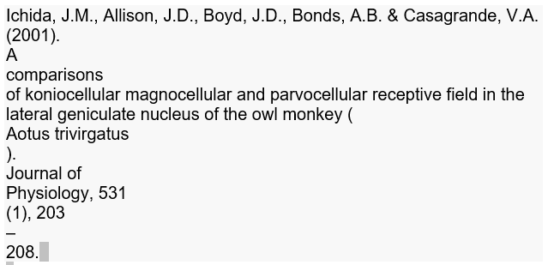
Sample Citation
Same Citation Extracted
From embedded/ocr text

Slide 4
Results
Extracted 4,874 citations from 84 dissertations.
Success rate for extracting citations ranged from 14% to 71%.
78% of the results from one dissertation were not journals, but other types of serial or multipart publications.
 | Number of Dissertations in the Sample by Year and Department
Department | 1970 | 2004 | 2009 | 2015 | 2016 | 2017 | Total
History | 83 |  | 6 |  |  |  | 89
Political Science |  | 1 |  |  |  |  | 1
Social Sciences |  |  |  | 335 | 3,005 | 1,354 | 4,694
Total | 83 | 1 | 6 | 335 | 3,005 | 1,354 | 4,784

Slide 5
Questions
Amy Wood
awood@crl.edu

