Slide 1
An Update on EAST
PAN Forum
Friday, January 21, 2022
Susan Stearns, EAST Project Director

Slide 2
EAST Today
82 libraries from Maine to Florida
Most are Retention Partners
Mission: to protect and provide access to the print scholarly record
Collective collection includes @10 million retained monographs and 29K serials/journals titles
Notes:
Thank you Matthew.
Just as a reminder for those of you who may not be familiar with the Eastern Academic Scholars’ Trust.
We are a shared print program with 82 members, primarily academic and research libraries, in 13 states in the eastern US.
Today the EAST collective collection numbers almost 10 million monographs and over 29 thousand serials and journals titles.

Slide 3
Does this resonate?
Are there areas of overlap with other shared print programs where further collaboration is needed?
How do we see this feeding into the work being undertaken following the CCH Summit?
What else would you like to see in these areas: collection analysis, special collections, and access?
Notes:
Before I begin, I want to plant the seeds of a few questions for you to consider during my presentation. I hope there will be time at the end to revisit these.
First, do these EAST initiatives overlap with or compliment work currently being undertaken and, if so, how can we best collaborate?
For those of you engaged in the work of the CCH Collaborative, how might we best feed into that work in the future?
And, what else would you like to see programs such as EAST do in the 3 areas I will be speaking about today: collection analysis, special collections, and access?

Slide 4
Our Program Assessment
Formal survey of all EAST members in late 2020
Focus on understanding benefits to member libraries, challenges to participation, and future directions for EAST and the EAST collective collection
Results reported to PAN in January, 2021 as part of the program assessment panel
Decision to focus on 3 main areas for follow up:
Future group collection analysis work
Opportunity to expand to include special collection content
Ways to expand access
Notes:
A bit of background: in late 2020 EAST undertook its first formal program assessment of our members. We reported on the details of that assessment as part of a panel discussion at PAN last January and the slides from that presentation are available on the CRL site.
Following the assessment, the EAST Executive Committee agreed to form working groups to follow up on 3 mains areas of focus from the assessment: proposals for future group collection analysis, the potential for expanding EAST to include special collection content and ways EAST could facilitate expanding access to the collective collection.
I’ll be focusing today’s update on discussing these 3 working groups in more detail.

Slide 5
The Collection Analysis Working Group (CAWG)
Willingness from our members to make future commitments
Broad collection analysis seen as the best approach, some interest in focusing on subject areas or newly acquired titles
How collection analysis can impact EAST outreach and expand access to a diverse and inclusive collective collection
What should be included in the analysis?
An agreed upon group retention model vs. more local flexibility
Factors to consider in agreeing commitments:
Retentions from other programs
Geographic distribution
Digital availability
DEI issues
Notes:
As part of the program assessment, the majority of EAST members expressed some level of commitment to making further commitments to retain monograph titles.
A broad collection analysis was deemed the best approach, but there was also interest in focusing on subject areas of interest to a library or only on materials acquired since the original cut off date for the first round, as our retention model included only those titles published prior to 2011.
Collection analysis was also deemed a way to better understand ways to expand access to a diverse and inclusive collection..
This Working Group has focused on addressing 3 major issues.
First, what content should be included in the analysis – circulating print monographs only vs. including special collections (which I’ll talk about next), the entire corpus of that content or only selected portions and, if the latter, how selected?
Second: how shall we shape the retention model: will we follow our earlier work’s model and develop a single set of criteria for retention across the group? Or, do we provide latitude for more local flexibility and decision making? And, in either case, do the tools exist to support the work?
Finally: what other factors should be considered in agreeing to retention commitments: do we want to take into consideration retention commitments from other shared print programs for example? As EAST continues to grow beyond the northeast, should we consider geographic distribution? What about digital availability of titles? And, are there ways we can bring a DEI lens to this work?
And, as with the retention model, do the tools we will be using for the analysis support including these factors or are there ways outside of the tools we can bring some of these to bear on the retention commitment decisions?

Slide 6
CAWG: Current Status
How best to consider DEI issues in subsequent analyses? Including special collections may help. Consider using tools outside of traditional collection analysis.
What tool(s) are best suited for subsequent analyses?
General view is that an updated analysis of the entire collections is best.
Consider options for libraries to volunteer retention commitments
How can tools facilitate this?
Next Steps
Survey full EAST membership to gauge interest in participating
Engage with the service providers to estimate pricing and timing
Notes:
As this Working Group winds down its initial work, we are ready to begin engagement more closely with both the full EAST membership and with the service providers.
We still have work to do to determine how best to consider issues relating to diversity of the collection, particularly as relates to tools we might use to supplement the standard analysis offerings. We may find we wish to use different tools for different components of the analysis.
The group recommends that at least some component of the analysis include the full collections of the participating libraries, although offering the option for libraries to volunteer commitments is likely.
Over the coming months we expect to survey the full EAST membership to gauge their interest in being a part of the analysis as well as undertake more detailed discussions with the service providers to estimate costs.

Slide 7
The Special Collections Working Group (SCWG)
Should EAST expand its scope to include special collections titles?
What criteria should be used to determine special collections to be in-scope?
What policies and guidelines will guide access to these titles?
Are there other operating policies that need to be addressed?
Two subgroups formed
Collection analysis pilot project
Policy and procedure development
Pilot collection analysis of 4 EAST special collections using Gold Rush library comparator tool
Results of analysis loaded into Tableau to facilitate analysis
Notes:
The second ad hoc working group established by EAST in 2021 was the Special Collections Working Group.
This group was tasked with making recommendations to the EAST Executive Committee regarding expanding the scope of the EAST collection to include materials held in special collection locations.
These recommendations will be focused on developing criteria for special collections material in-scope for EAST retention, as well as updating the appropriate access and other policies relating to management of special collection titles.
Following initial meetings, we divided the working group into two subgroups: one focused on undertaking a collection analysis pilot project, and the other focused on EAST policies and procedures.
The first subgroup included 4 EAST libraries who provided extracts of their special collection titles to be loaded into Gold Rush to compare their collections to the current EAST retention commitments, which are from circulating print monograph collections.
The data from this analysis was subsequently loaded into Tableau, a data visualization tool, to further facilitate analysis and discussion.

Slide 8
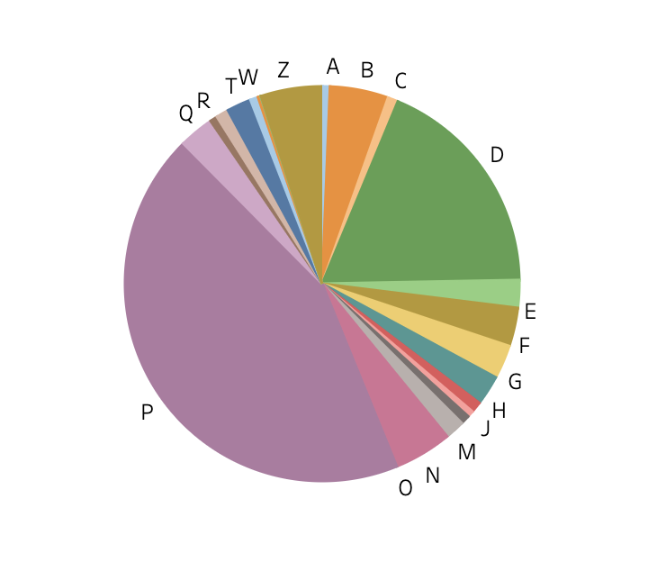
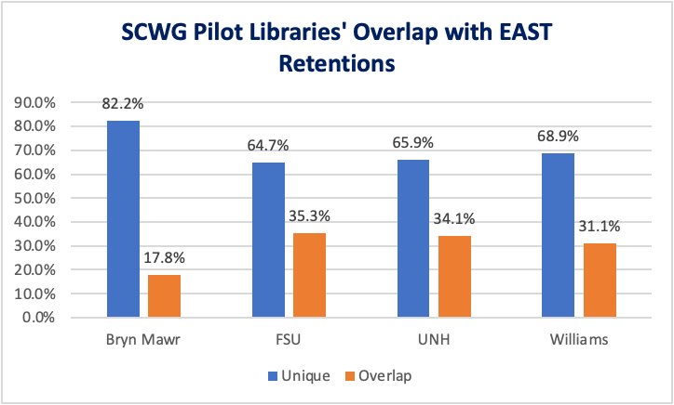
The 4 Pilot Special Collections Libraries’ Data
Distribution by LC Class
Overlap/Uniqueness with EAST
Notes:
Between the data in Gold Rush - which allowed us to determine the uniqueness and overlap between the special collections of these 4 pilot libraries and EAST, and the visualization data that was available Tableau, we were able to drill down into various characteristics of the individual collections and better understand their relationship to the current EAST retention commitments in circulating collections. As you see from the above, the overlap varies from just under 18% to over 35%. The LC class profile is, in fact, quite similar to that of the full EAST collection with literature and history at well over 50%.

Slide 9
SCWG: Current Status
Reviewed both GreenGlass and Gold Rush functional capabilities and general costs
Finalized updates to the access policy for EAST to include special collections
Reconvening ILL Working Group to update best practices for ILL
EC recommendations (draft):
An opt-in program
Include special collections in subsequent collection analyses
May consider only titles published post-1900*
Adopt the new access policy which incorporates special collections
Update ILL best practices to reflect special collections
* If libraries include only titles published since 1900, the benefits to the local libraries are increased as a higher percentage of their titles in special collections are already retained by 1 or more other EAST libraries (ranging from just over 33% to almost 42.5%)
Notes:
The analysis subgroup reviewed the capabilities and general costs of both GreenGlass and Gold Rush in addition to completing the pilot project. The policy group completed an updated EAST access policy which was subsequently approved by the Executive Committee.
Based on an initial review of the EAST ILL best practices, we will be reconvening the ILL Working Group to update this document with consideration to the revised access policy.
This working group is in the process of finalizing recommendations for the EAST Executive Committee.
Although still in draft form and not yet formally approved, we expect the recommendations will include:
Development of an opt-in program for EAST libraries to include some or all of their special collections in EAST
Ensure any future collection analyses include special collections
As a result of our pilot, which showed that titles published since 1900 have a fairly high overlap with titles in circulating collections, some libraries may wish to include only post-1900 titles
We would ask EAST members to vote on the new access policy
And, we would work with the reconvened ILL Working Group to update the current best practices.

Slide 10
EAST and Access Today
MOU: EAST is a light archive with volumes available for circulation
MOU: EAST strongly supports free lending across the libraries; members use their own institutional policies
EAST Major Operating Policies: Re-iterates MOU and adds digital delivery option to physical lending
Best Practices for ILL: Developed by ILL Working Group; Operational details including availability of Rapid Pod and OCLC GAC (Group Access Capability) to support ILL
Rosemont Alliance for Shared Print Access Principles: Focus on fulfillment of requests for retained serials and journals titles
Notes:
The third working group established last year was one focused on access, a critical component of the EAST mission. In the program assessment, members encouraged EAST to consider facilitating digitization of retained collections and to consider further opportunities for shared print content to be more easily discoverable and accessible across member libraries.
Before I talk about the work of the group, let me quickly summarize access within EAST today.
EAST is a light archives with titles held in circulating collections. The MOU strongly encourages members to provide no-charge lending to other EAST members
Our operating policies re-iterate this as well as make clear that digital delivery is a growing option to physical lending
Our current Best Practices for ILL were developed by a working group of experts and we have in place both a Rapid Pod and an OCLC Group Access Capability or GAC for EAST, which will facilitate any usage analysis we undertake.

Slide 11
The Access Working Group
Began work in Sept, 2021
Includes 3 from Exec Comm and 7 library staff from access services, ILL and cataloging
Initial areas of focus:
Analysis of ILL usage
Resources and support for digitization – local digitization, CDL initiatives
Anticipate recommendations to EC by summer
Pilot ILL data analysis project
Data from OCLC (Group Access Capability) from 2016 forward
Data from Rapid from 2019 forward
First: Compare retained and non-retained ILL, look at digital surrogates
Next: What data is practical to obtain and to use, and what questions are reasonable to answer from the data available.
Notes:
The access working group was formed in the fall of last year and includes 10 participants, 3 of whom are from the EAST Executive Committee.
After discussing a number of potential areas of focus, the working group determined to concentrate on two:
The first is on usage data: What usage data should EAST collect relating to access to the retained monographs and serials? How can this data be collected and analyzed usefully for the program and the member libraries?
The second area of focus is on digitization: Should EAST work with member libraries to digitize EAST retention commitments in support of access to this print content? If so, how might titles be selected? What is the relationship to existing digital collections? And, how might EAST support the growing initiatives relating to controlled digital lending across its member libraries?
We are just this month convening the subgroup that will be looking at the ILL data we have available. We hope to answer questions such as:
Does retention change the ILL pattern? Do retained items circulate more than non-retained titles? Does circulation increase the risk of loss or damage to retained titles? How many requests could have been fulfilled by a digital surrogate? Would seeing the percentage of retained items lent via ILL, both to EAST members, and outside of East be useful? Is speed of delivery, or turnaround time, important? Not just “can we access,” but “can we access quickly”?
We also hope this initial pilot will help inform longer term longitudinal analyses of usage data, possibly done in partnership with other shared print programs, as we know this is a topic members of both Rosemont and the Partnership are considering

Slide 12
Access WG: Digitization
What kind of reports can EAST provide on demand to member libraries in support of local digitization?
Can/should EAST play a greater role?
Can the ILL data analyses inform digitization?
Role of CDL?
What is mechanism for discoverability?
Reports:
Public domain
Not available digitally
Widely used
Scarcely held
Publication data
Diversity of voices
Rollout to EAST member libraries – multiple avenues needed. Pilot with the WG.
Notes:
In looking at ways EAST can support digitization, we began by determining the kinds of reports EAST could make available to its member libraries in support of local digitization.
Since we have the full set of EAST retention commitments loaded into Gold Rush, we know that there are more than 827,300 titles in the EAST collective collection that are in the public domain. We hope to be able to work with both the Internet Archive and HathiTrust to understand the current status of digitization of these titles and then being to engage with EAST member libraries on ways we can support local digitization efforts.
As part of our analysis of ILL usage data, we also hope to understand ways in which this data could help inform digitization priorities at the local level.
And, if, as part of our work on the collection analysis side, we can better understand ways to effectively identify the diversity of voices within the collective collection, we would hope that could contribute to efforts to make that content more readily available through digitization.
In all of these efforts, we want to stay in contact with our members who are undertaking controlled digital lending initiatives to discuss how best to support their work.
As we complete these first areas of focus for the Access Working Group, we will be looking at multiple avenues to inform our members and hope to undertake a pilot program for digitization with one or more of the Working Group members.

Slide 13
Implications for collaboration
For resource sharing data:
With service providers: to recognize retained titles
With other shared print programs: to develop collection & analysis methodologies
With other libraries and shared print programs: to share data and results of analysis
To support digitization:
With Internet Archive and HathiTrust: to reflect digital surrogates in shared print databases
With service providers: to collaborate on digitization efforts across libraries
Support access to digital surrogates for retained titles
Notes:
We recognize that these three EAST initiatives should not be considered in a vacuum and hope to work with the larger shared print community, through Rosemont, the Partnership, the CCH Collaborative and others to collaborate on both our resource sharing usage analysis and our digitization efforts.
On the resource sharing side, EAST sees opportunities to work with service providers and libraries to ensure that Interlibrary Loan usage data can be collected, shared, and analyzed. We will be sharing the results of our pilot project and have already begun discussions with others working in the shared print community on infrastructure and other issues to do our best to not duplicate efforts.
While we are not yet sure of specific plans, we hope to engage both HathiTrust and the Internet Archive in our digitization efforts and look to ways EAST can support local digitization initiatives more directly.
Your ideas in both of these areas would be gratefully received.

Slide 14
Does this resonate?
Are there areas of overlap with other shared print programs where further collaboration is needed?
How do we see this feeding into the work being undertaken following the CCH Summit?
What else would you like to see in these areas: collection analysis, special collections, and access?
Notes:
Finally, back to my first slide. Although we may not have time here, please feel free to follow up with me via email if any of this work resonates with you and may overlap or compliment initiatives in your library or with your shared print program.

Slide 15
. sstearns@blc.org

