Slide 1
Matching Algorithms
and the Impact on Shared Print
Notes:
I’m here today representing the Partnership for Shared Book Collections Matching Algorithms Task Force, which is looking into the differences between various algorithms for record matching, and how they impact shared print program decision making.

Slide 2
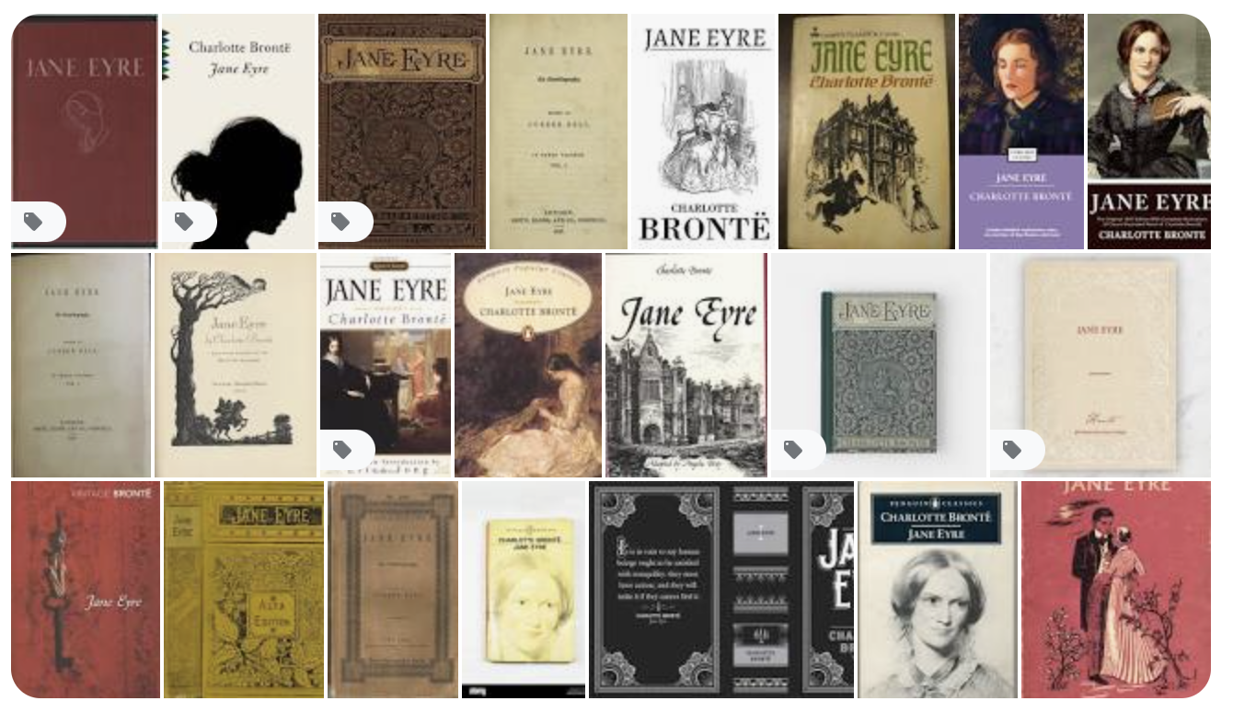
Why Matching?
Notes:
So why matching algorithms? Many algorithms are used in libraries, for example when a patron searches a database, what gets returned and how are similar items grouped? There’s an algorithm determining that. Or determining a loan period at checkout. Today we are focusing on record matching algorithms as they are integral to the shared print endeavor. Most programs have a minimum number of copies to keep, and want to give extra attention to preserve scarce or rare copies. Following up on the risk work we just heard about, how do we know how many copies we have? How do you count? Different matching algorithms may, and do, give you different answers.

Slide 3
Partnership Group
Following up on determining distinct vs. overlapping copies
Their charge includes:
Documenting the different levels of matching needs (use cases)
Gathering additional input on the original matching document.
Investigating and documenting current algorithms being used and gauging their accuracy rates vis à vis the definition provided in the document. Provide a test data set.
Documenting the discussions and findings for the community
Notes:
As a bit of background, the Partnership for Shared Book Collections Infrastructure Working Group talked to several vendors last year on how they identify rare or scarce material, which, of course, prompted the question back to the group of ‘how do you define or identify scarcity’? A group formed around this question and came up with a detailed report on considerations in identifying distinct vs. overlapping copies. That report is now being used as a basis for a group looking at matching algorithms and use cases for matching. The group is charged with
-Documenting the different levels of matching needs, and developing use cases
-Gathering additional input on the original matching document from different constituencies.
-Investigating and documenting current algorithms being used with the intent to gauge their accuracy rates vis à vis the definition provided in the document and use cases.
– and to document the discussions and findings for the community
We know that there are some other groups also looking at matching algorithms, for example ReCAP, and plan to work closely with them.

Slide 4
Areas of Concern
Varying editions may be difficult to identify, or may not technically constitute "uniqueness". Edition statement may be lacking, expressed differently (1st vs. first), or may refer to binding (pbk vs. hdc.)
Descriptive cataloging language (not material language) or the absence/presence of script parallel fields may confuse duplicate identification.
No authority records for publishers! Are these the same publisher?
Hamilton vs. H. Hamilton vs. Hamis Hamilton vs.
Hamish Hamilton vs. Hamilton Pub. vs. Hamilton Press.
The treatment of dates other than publication
(reprint/copyright/printing), is can be problematic
Miscoding of reprints and other dirty data issues.
Gradations of matching confidence levels are probably desirable
Notes:
The group has outlined some areas of concern in matching algorithms.
For example, Varying editions may be difficult to identify, or may not technically constitute "uniqueness". An edition statement may be lacking, expressed differently (1st vs. first), or may refer to binding (pbk vs. hdc.)
The Descriptive cataloging language (not material language) or the absence/presence of script parallel fields may confuse duplicate identification.
Publisher is often a primary match point, but there are no authority records for publishers! Are these the same publisher?
Hamilton vs. H. Hamilton vs. Hamis Hamilton vs.
Hamish Hamilton vs. Hamilton Pub. vs. Hamilton Press.
The treatment of dates other than publication (reprint/copyright/printing date), is of interest and can be problematic
depending upon the needs of the program. We’ve also seen miscoding of reprints to the point where it is impossible to tell from the record if it is really a reprint or a coding issue. Some gradations of matching confidence levels are probably desirable.
==================================================
Snippet from John on pub/copyright dates:
One of the most notable of these distinctions, and this arises quite frequently in late 19th century English language publications, concerns an edition date vs a printing date. Of course, depending on the evidence in the book and the inclinations of a given cataloger, divergences in practice may arise. But generally, provided that the format and content of a run of books with the same copyright date are the same, they are treated as being bibliographically the same.

Slide 5
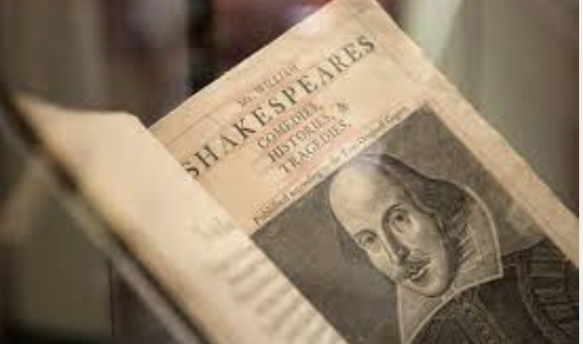
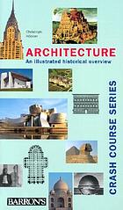
Areas of Concern - Cont.
Is it really rare or is it rare cataloging? Catalogs are filled with pre-RDA, pre-AACR, or local practice cataloging
Is it really a duplicate (aside from marginalia, etc.)? How does your program define a duplicate? Does binding (deluxe hardcover vs. paperback), unique cover art, provenance matter? Should there be any sort of common guidelines or recommendations?
Multipart monographs and monographic series may present unique issues when trying to match up analytics with sets and/or series.
How strict is the matching algorithm? Is looser vs. stricter matching dependent on the needs of the program? Should programs agree on matching criteria and acceptable levels of error?
Notes:
Another area of concern is determining if material is really rare or is it rare cataloging? Catalogs are filled with pre-RDA, pre-AACR, or local practice cataloging rules, which may confuse automated matching solutions from finding duplicates.
Is it really a duplicate (setting aside marginalia, etc.)? How does your program define a duplicate? Does binding (deluxe hardcover vs. paperback), unique cover art, or provenance matter? Should there be any sort of common guidelines or recommendations on what constitutes a duplicate copy?
Multipart monographs and monographic series may present unique issues when trying to match up analytics with sets and/or series records.
And how strict is the matching algorithm? Is looser vs. stricter matching dependent on the needs of the program? Should programs agree on matching criteria and acceptable levels of error for false positives and false negatives? This might be important in cross program collaborations.
With all that in mind, we are so pleased to see this panel at PAN today opening the topic the community.

Slide 6
Dirty Data? Reprint?
https://www.worldcat.org/title/reminiscences-of-the-life-and-character-of-count-cavour/oclc/1261343093
https://www.worldcat.org/title/reminiscences-of-the-life-and-character-of-count-cavour/oclc/5213744
Notes:
And of course the devil is always in the details.
For example, is this record for the same or different title? The are on different OCLC records.
The first is possibly a reprint according to the coding in the 006 position 6 (008/23) “form of item = r” , but there is no reprint date in the 008, so… is it a reprint? Is it a ‘print on demand’ copy. Or a coding error? You'd probably need to pull this title from the shelf to investigate to be sure. Just FYI, The second record is clearly coded as the original
Between dirty data and the nuances of cataloging reproductions, it can be tricky (to say the least) to confidently determine matches. Some gradations of matching confidence levels are probably desirable.
With all that in mind, we are so pleased to see this panel at PAN today opening the topic the community.

Slide 7
Questions asked to Panelists
Describe their current algorithm and use cases for them (what problem are they solving)
What issues/challenges they are finding, and what are their plans for improvement and/or new technologies
How they deal with various quality of records, and records from non OCLC sources, e.g. RLIN, European libraries that don't use OCLC, low quality records
Do they handle journals, journal families and monographic series? How?
Notes:
So today We’ve asked our panel to respond to the following prompts:
–to describe their current algorithms and use cases for them - what problem are they solving.
–What issues and challenges are they finding, and what are their plans for improvement and/or new technologies to address those problems
–How do they deal with various quality of records, and records from non OCLC sources, e.g. RLIN or European libraries that don't use OCLC or just low quality records in general
–and finally do they handle journals, journal families and monographic series, and if so, how?
They’ve been asked limit their responses to 5 minutes (I know, it’s hard with a complex subject) and after that we will open the floor for 10 minutes of questions.
And with that let’s get started, our first speaker is Andy Breeding from OCLC.
{did we ask this —
-The Partnership Matching Algorithms Task Force is compiling a set of test records, perhaps around 100,000 as a test set. Would you / could you use your system/algorithm to analyze this set and report what you see as # of distinct titles and overlap within the set? They are hoping to understand the variations in results and implications for shared print.
}

Slide 8
Who we will hear from today
OCLC Sustainable Collection Services
Andy Breeding, Senior Product Manager
California Digital Library
Judy Dobry, Technical Team Manager
Colorado Alliance of Research Libraries George Machovec, Executive Director
IndexData
Sebastian Hammer, President
ExLibris
Jamie Kutzuba, Product Manager
Center for Research Libraries
Amy Wood, Head of Metadata & Discovery Enhancement
Notes:
(I think Matthew is covering this in his intro)
Today we will be hearing from a representative sample of service providers who do record matching.
Andy Breeding, Senior Product Manager, OCLC Sustainable Collection Services
Judy Dobry, Technical Team Manager, California Digital Library
Sebastian Hammer, President, IndexData
George Machovec, Executive Director, Colorado Alliance of Research Libraries
Amy Wood, Head of Technical Services, Center for Research Libraries
Due to scheduling and time constraints we were unable to have presentations by ExLibris (whose metador product is of particular interest) and Sirsidynix, both of whom expressed interest in this panel. And of course there are other vendors such as AutoGraphics doing work in the shared print space. The Partnership group will be following up with them and they will be included in any output from that group.

