Slide 1
Collaborative Collection Management for Monographs: the White Rose Libraries’ Experience
Sarah Thompson - University of York
Jane Saunders - University of Leeds
Print Archive Network Forum, January 2021
Notes:
As White Rose Libraries we have been working collaboratively on collection management issues for many years, sharing experiences and approaches and helping to shape national tools such as Jisc's Copac Collections Management Tool, and its replacement Jisc Compare which is part of the UK union catalogue, Jisc Library Hub. At the end of 2015 we embarked on a shared project with OCLC using their GreenGlass tool. We shall share the outcomes of this project with you, and at the end of this give an update on the overall picture with collaborative collection management in the UK.

Slide 2
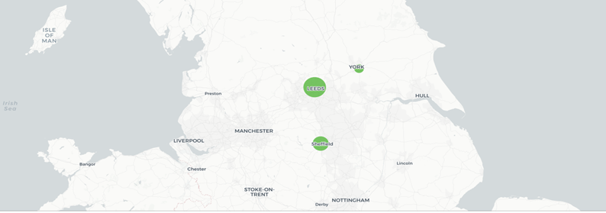
Notes:
So. iust to introduce the WR libraries we are ... The image is from GG. Blobs indicate size of collections, but we are similar in our research ambitions, regarding ourselves as research intensive, whilst also have a strong ug and taught pg offer. Our collaboration began in 2004 with the creation of the repository White Rose Research Online and we have continued to work together on a number of initiatives - including collaborative collection management.

Slide 3
The White Rose Collaboration
Staff Development
Collaborative Collection Management
Institutional Repository
White Rose Research Online
White Rose Etheses Online
White Rose Universities Press
Inter-Library Lending
Notes:
On this slide you can see the areas in which we collaborate, we don’t however operate as an interlibrary lending consortium. We all contribute our holdings to a national union catalogue – which used to be called COPAC, and is now the Jisc Library Hub. Sheffield and Leeds have also participated in the UKRR, UK Research Reserve which focuses on the collaborative management of print journals – which Andy Appleyard will be talking about shortly – so the focus of the White Rose Collaborative Collection management work has been around the printed monographs.

Slide 4
Collection Collaboration Drivers
Collection space and preservation
Understanding strengths and weaknesses - Copac Collection Management Tool / Jisc Library Hub
Understanding collection overlap - GreenGlass
Notes:
Our aims in wishing to collaborate around the management of print monographs are rooted in the desire to share the burden of print stewardship. We initially set about working with Jisc – Jisc is the body that manages the UK’s higher education digital infrastructure – to develop a tool based on the UK union catalogue Copac, now the Jisc Library Hub, to enable libraries to compare their collections. We worked together to test and use what were then the Copac Collection management tools. What these allowed us to do was to assess the relative strengths of our own collections (we could run sections of our own holdings against collections held across the UK to assess collection breadth, and also rarity of the individual items within a section) – and based on this work we developed categorisations for our collections – at Leeds and York and Sheffield we have categories – for example does the collection have a high proportion of unique or rare items which would indicate we would want to retain it. The category of a collection determines our approach to developing or editing that collection. However, we were keen to take this a step further and explore the areas of overlap across our 3 library holdings to see if there was scope for a formal deduplication and development arrangement across our three libraries. For this we made use of what is now OCLC’s GreenGlass tool as GreenGlass takes in the bibliographic and item records for each Library, and from that produces an overview of holdings, both at institution level, and also at consortium level. As circulation data is also included, it is possible to see what is being used or not used in the wider context of the consortium. We were keen to experiment with the retention modelling offered by GreenGlass.

Slide 5
What did we find?
1,971,001 title sets, with surprisingly little overlap
83% held by 1 library 13% held by 2 libraries 4% held by 3
Notes:
So, our assumptions about finding high levels of overlap were challenged. GreenGlass noted that this was a usual response - it chimed with their experience working with consortia in the US. They were confident in their data. We, as White Rose libraries, were keen to explore the findings further - we didn’t (yet!) trust the data. GreenGlass were very supportive of this. Jisc also, they provided support for our work to explore the findings.

Slide 6
What did we find?
Less surprisingly overlap was in high use titles
Notes:
Once we were confident in the data, it was clear to us that 3 libraries was insufficient to work on any kind of deduplication. Most overlap concentrated on the highest use titles which would be mainly from our teaching collections (we all routinely acquire textbooks to support teaching).

Slide 7
2018 GreenGlass UK users
8 UK & Ireland libraries currently have data in GG
Across these 8:
10% of titles have fewer than 2 UK holdings
42% of titles have 3 or more recorded uses
22% of titles held in more than 20 UK libraries
40% of titles have zero recorded uses
Notes:
So we had established that locally working together on collaborative collection management of monographs was not feasible, but we know that others in the UK were also interested in looking at collaborative collection management, and had been using GG, but focussing on what it could tell them about their own collections. We joined with these other UK users to form the UK GG usergroup, and SCS did some initial analysis, at the group's request, of the holdings across all 8 libraries in the UK are Ireland who were using GG at the time. This is what they found.
In 2018 GG held data from 8 libraries in the UK. Within these 8, 22% of the titles are held in more than 20 UK libraries; titles with fewer than 2 UK holdings – 10%; titles with zero recorded uses 40% (consistent with US); titles with 3 or more recorded uses – 42%.
[Supplementary note in case it comes up: of these they have been able to assign an OCLC number to between 94-99% of holdings (av. 96%). Percentage of titles in these libraries with holdings set in Worldcat 77%.]

Slide 8
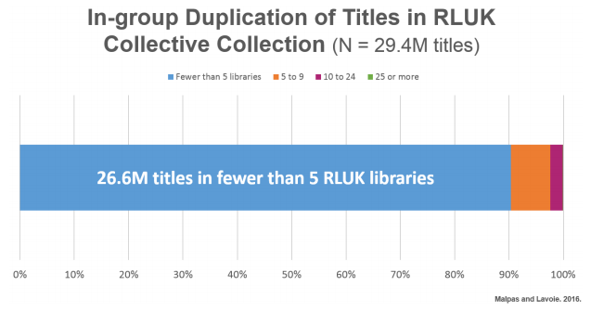
The RLUK Collective Collection
Strength in Numbers: The Research Libraries UK (RLUK) Collective Collection - OCLC 2016 report
Notes:
These findings do tie in with the findings published in the OCLC 2016 report (Strength in Numbers: The Research Libraries UK Collective Collection). RLUK, who had commissioned the report initially interpreted this as meaning that it would not be feasible to consider a national approach to print monograph management. However the report doesn’t show what the distribution across the RLUK libraries of those 26.6 million in fewer than 5 RLUK libraries is, and therefore the impact on those libraries. We presented our White Rose Library findings to the RLUK group to see if there was interest in understanding more about the distribution of these titles across the RLUK libraries, potentially using GG.

Slide 9
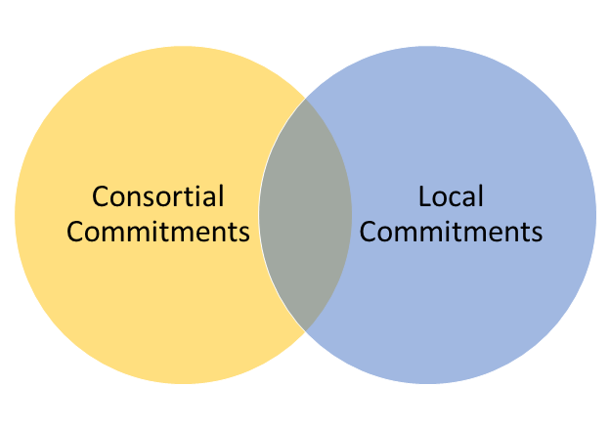
Where Next?
Notes:
At present in the UK at individual library level we have libraries making decisions using collection management tools (some GG, others using the Jisc tools) about what they will retain. However, we don’t have yet a joined up national approach – or indeed consortial approach at any level in England (colleagues in Scotland and Wales are exploring options – but I don’t think have yet drawn up an agreement). There is interest at national level in the UK around shared collection management of monographs. At present there are 2 strands, which aren’t necessarily mutually exclusive, the one is around shared storage, the other is around a distributed national collection. Both approaches require agreements and commitments.
Jisc, which provides the UK’s higher education digital infrastructure, is very interested in this work as it provides the UK union catalogue, Jisc Library Hub, and as part of this makes available a collection management tool. Where we have got to so far in the UK is to agree on an approach to flagging retention commitments within the Jisc Library Hub – this was agreed in June 2020.

Slide 10
Retention Commitments
Notes:
This means that at least where individual libraries have made decisions about what they are going to retain, these decisions can be flagged. In order to arrive at this point Jisc ran survey across libraries contributing to the Library Hub, and there was broad agreement that commitments should be signalled. What is not yet clear is how many libraries have uploaded their commitments. Leeds has commitments ready to upload, but has not yet done so – partly because of the additional work elsewhere occasioned by Covid, York is already uploading its commitments.

Slide 11
Retention Commitments
As a minimum, the following should be used:
583
$a retention statement
$c review date, in yyyymm, or yyyy
$5 library’s international MARC code
Example: 583 $aNBK-R $c202104 $5UkShU Would describe an item designated for retention by the University of Sheffield, with a review date of April 2021.
To indicate an item held in perpetuity libraries may use a yyyy date of 9999.
Notes:
And this is the data that we are uploading ...
[Optionally, libraries may wish to use other allowed subfields within the 583 to provide more retention information. We would suggest the following may be of most relevance:
$j site of action: may be useful for recording remote storage
$l status: the condition of the retained item
$x non-public note: may be useful for recording which of multiple copies are to be retained.
$z public note: may be useful for recording the date on which the retention statement was applied to the item, how many of multiple copies are to be retained, or which part of the item is referred to in the $l $3 material specified: where the retention statement only applies to a part of eg a multi-part item Examples 583 $aNBK-R $c2030 $ldamaged $zlast four pages partially unreadable $5UkYoU ]

Slide 12
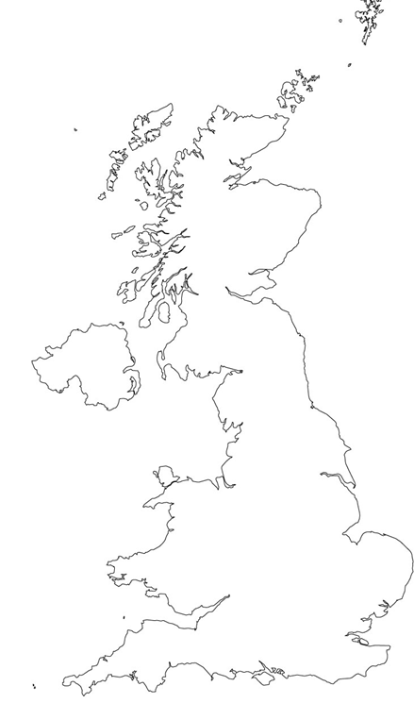
Final Thoughts
A national distributed collection - worth exploring?
Different options and models possible
Notes:
We think that the work that the White Rose Collaboration has done on GreenGlass shows that a national distributed collection is viable in terms of numbers, if the aim is to enable rare copies to be retained and curated in the UK, whilst allowing libraries to free up space. There are however a number of different ways of achieving this – and we certainly feel that Jisc’s work on brokering an agreement about retention statements is a very good step. The national union catalogue, Jisc Library Hub, is an essential piece of infrastructure that should enable us to take a national approach to monographs; it is a cataloguing and collection management tool as well as a discovery system.
Equally, regional approaches are also a possibility. For example, there have been initial discussions in some UK regions about the feasibility of setting up regional storage facilities for low use material.
We are still hopeful that a joined-up UK-wide approach will emerge in time...

