Slide 1
A Model to Determine Optimal Numbers of Monograph
Copies for Preservation in Shared Print Collections
Ian Bogus, Executive Director, Research Collections and Preservation Consortium (ReCAP)
Candace Arai Yano, Distinguished Professor, IEOR Department and Haas School of Business,
University of California - Berkeley
Shannon Zachary, Head, Department of Preservation and Conservation, University of Michigan Library
Jacob Nadal, Director for Preservation, Library of Congress
Mary Miller, Director of Collection Management and Preservation,
University of Minnesota Libraries - Twin Cities
Helen N. Levenson, Associate Professor, Collection Development Librarian, Oakland University
Fern Brody, Associate University Librarian for Collections and Technical Services, University Library System,
University of Pittsburgh
Sara Amato, Data Librarian, Eastern Academic Scholars’ Trust
PAN, June 2022

Slide 2
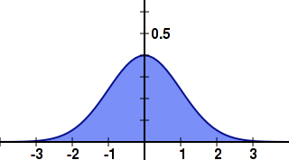
Signs of success
Recommendation
too low
Recommendation
too high
Why is Ian a Bad Librarian?

Slide 3
Pub. Date | % Present
<1800 | 91.30%
1800-1810 | 94.74%
1811-1820 | 92.59%
1821-1830 | 98.13%
1831-1840 | 96.67%
1841-1850 | 95.75%
1851-1860 | 97.09%
1861-1870 | 97.35%
1871-1880 | 97.97%
1881-1890 | 97.34%
1891-1900 | 97.61%
1901-1910 | 96.94%
Variable 1: On-shelf probability
1911-1920 | 97.45%
1921-1930 | 97.70%
1931-1940 | 96.97%
1941-1950 | 96.92%
1951-1960 | 97.01%
1961-1970 | 97.07%
1971-1980 | 97.21%
1981-1990 | 97.40%
1991-2000 | 97.64%
2001-2010 | 97.90%
Draft value: 97% Stacks
100% Storage

Slide 4
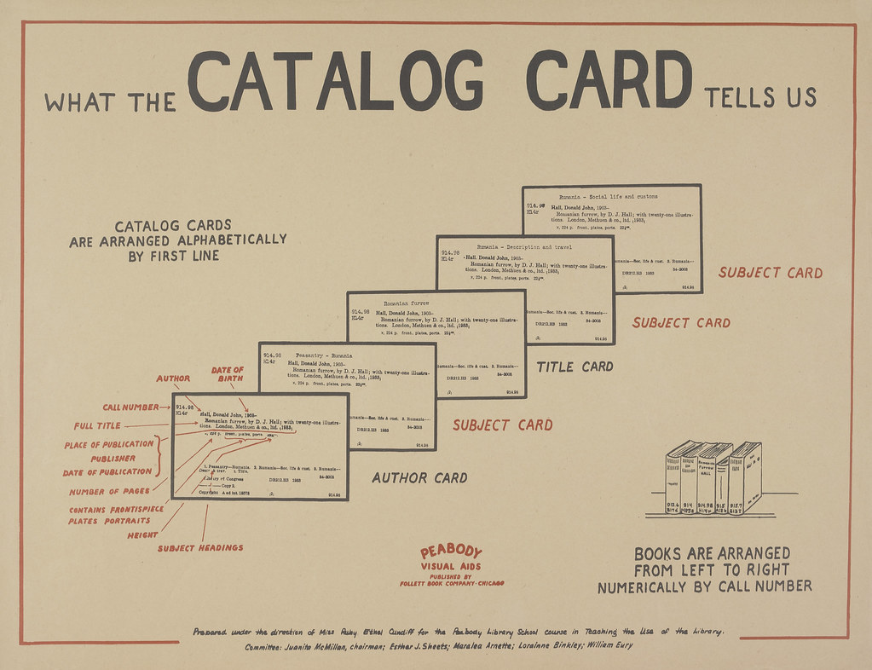
Variable 2: Bibliographic inaccuracy
Draft value: 0.1% Stacks
0% Storage
https://www.flickr.com/photos/68103485@N05/6197933357

Slide 5
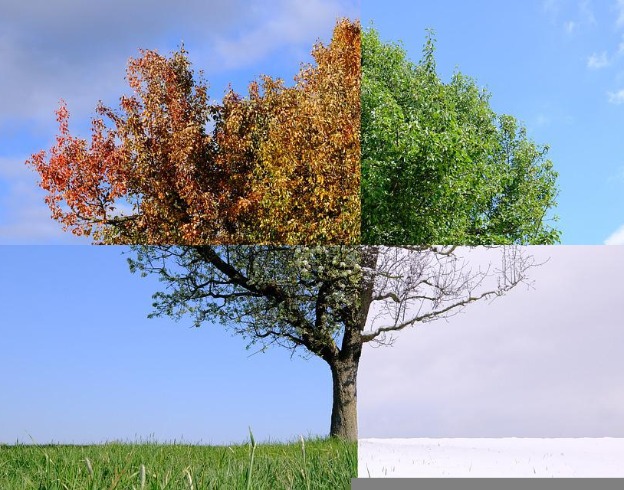
Variable 3: Annual loss rate
Draft value: 0.01% Stacks
0% Storage
https://pixabay.com/photos/seasons-4-seasons-four-seasons-5880236/

Slide 6
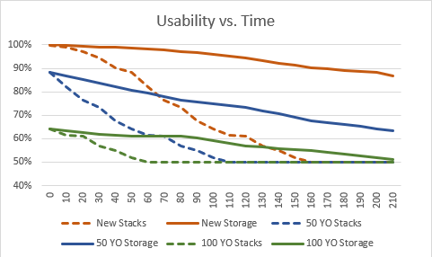
Variable 4: Physical Deterioration Over Time
https://www.needpix.com/photo/1530668/book-old-grunge-literacy-literate-illiterate-read-trash-garbage

Slide 7
Combining Variables
ME!
(probably of neither being 6’
nor having blue eyes)
P = P1 * P2
1.5% = 15% * 10 %
76.5% = (1 – 15%) * (1 - 10%)
P = Probability affected both
P1 = Probability affected by #1
P2 = Probability affected by #2
P = Probability both 6’ and blue eyes
P1 = Probability of someone being 6’ (15%)
P2 = Probability of someone having blue eyes (10%)

Slide 8
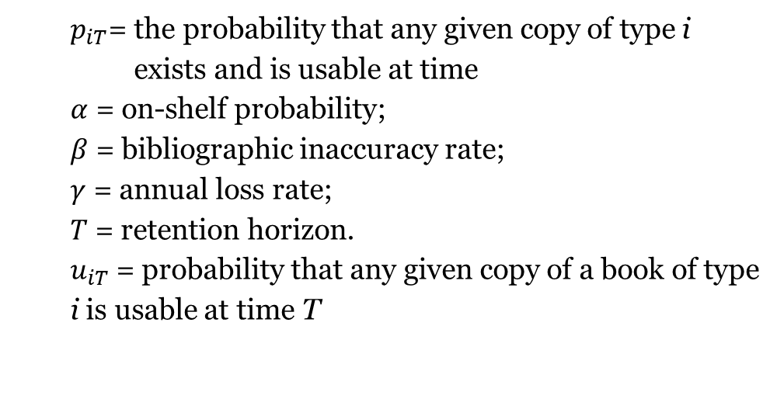
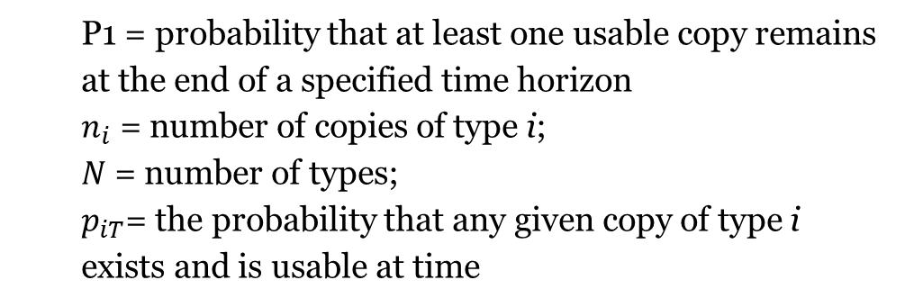
Probability one item is usable Probability that at least one item in group is usable
$$p_{iT}= α⋅(1−β)⋅[{\left(1−γ\right)}^{T}]{ u}_{iT}$$
P1 = ($1 − \left[{\left(1−p_{1T}\right)}^{n_{1}}\right]⋅$
$[{(1−p_{2T})}^{n_{2}}] ⋅⋅⋅⋅⋅$ $[{(1−p_{NT})}^{n_{N}}]$)
$p_{iT}$= the probability that any given copy of type i
exists and is usable at time
$α$ = on-shelf probability;
$β$ = bibliographic inaccuracy rate;
$γ$ = annual loss rate;
$T$ = retention horizon.
$u_{iT}$= probability that any given copy of a book of type i is usable at time T
P1 = probability that at least one usable copy remains at the end of a specified time horizon
$n_{i}$ = number of copies of type i;
$N$ = number of types;
$p_{iT}$= the probability that any given copy of type i exists and is usable at time

Slide 9
Draft values
99.8% survive at horizon (1 in 500 titles lost)
On-shelf probability: 97% for books in the stacks and 100% for books in storage
Bibliographic inaccuracy: 0.1% for books in the stacks and 0% for books in storage
Annual loss rate: 0.01% for books in the stacks and 0% for books in storage
Usability trajectories as described in the subsection on Physical Deterioration over Time.

Slide 10
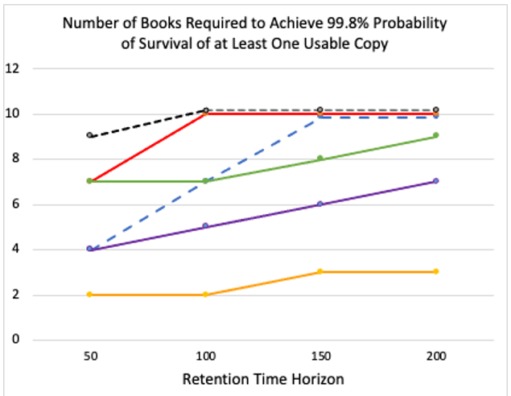
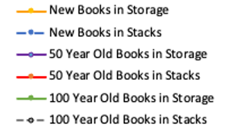
Number of copies needed

Slide 11
Thank you
Ian Bogus
ibogus@Princeton.edu

