Slide 1
European shared print initiatives and the Epico network
Andy Appleyard, British Library
Karin Byström, Uppsala University Library
Brigitte Krompf, Vienna University Library
PAN Midwinter, January 2023

Slide 2
Agenda
The Epico network and overview of current projects
Austrian shared archiving
The Swedish shared print initiative
Collaboration on high density storage
Future for Epico

Slide 3
The Epico network
Started in 2016
Austria, United Kingdom, France, Spain, Finland, Norway and Switzerland
Print repositories and shared print initiatives
Focus on networking and knowledge sharing
Kuopio conference (biannual) → Barcelona 2024

Slide 4
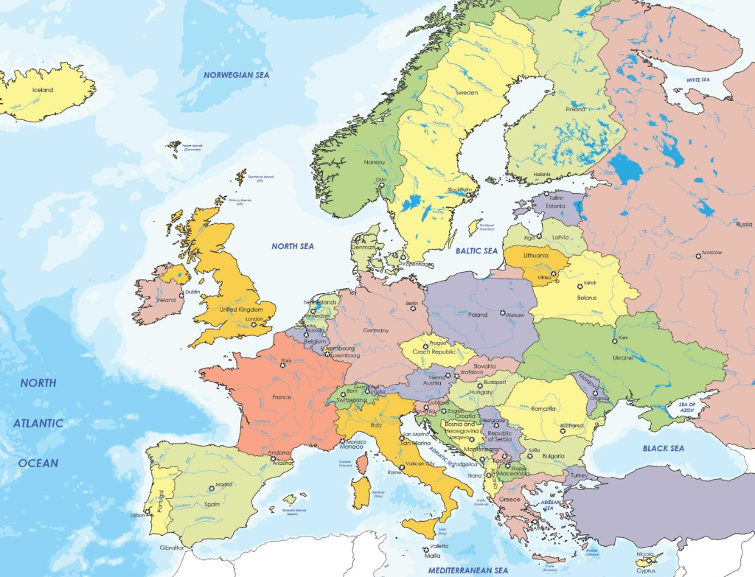

Slide 5
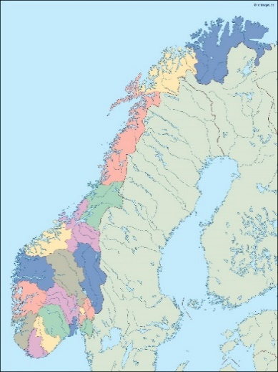
Norway
The Norwegian Repository Library by the National Library of Norway
Huge storage in Mo i Rana, in the north of Norway
Main point for digitization of Norwegian books
Storage of low use publications
1,5M monographs and 600K journal issues
Central storage in an automated storage facility
Holds up to five copies and secures the "last copy"

Slide 6
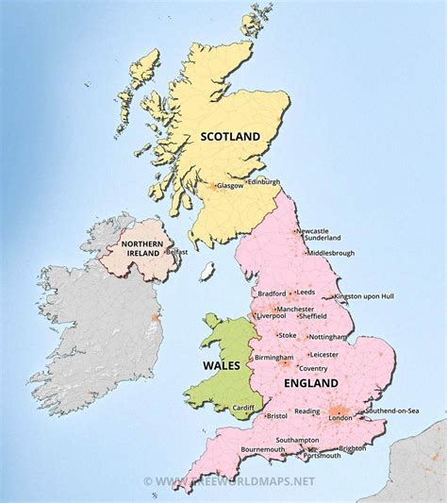
United Kingdom
UK Research Reserve (UKRR)
Project 2007, British Library and the large research libraries (since 2019 a BL program)
Goal: de-duplication and safeguarding printed research materials
Creating complete holdings as a part of the national collection
Perpetual preservation of two copies of print journals (BL at Boston Spa and Oxford/Cambridge)
Access onsite in the Reading Rooms or remotely via British Library On Demand

Slide 7
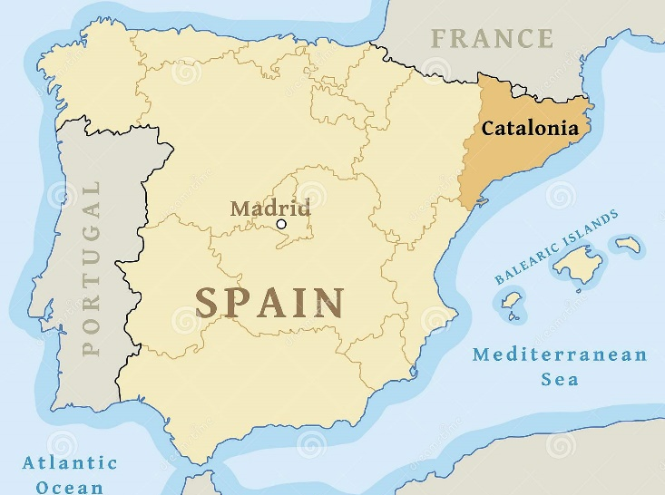
Spain / Catalonia
GEPA – shared storage facility outside Barcelona
Consortium of Academic Services of Catalonia, CSUC.
Cooperative deposit service
Preservation and accessibility
Request copies
Consultation room on site

Slide 8
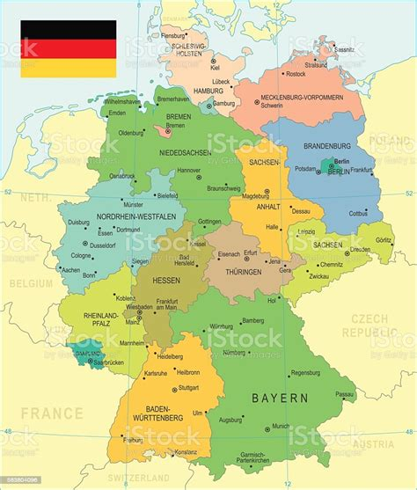
Germany
Northern Storage Network (Speicherverbund Nord)
Regional Print Archiving Cooperative
Seven libraries in five federal states
A pragmatic “keep it simple“ approach
De-centralized storage
Archiving commitments visible in national/regional union catalogues

Slide 9
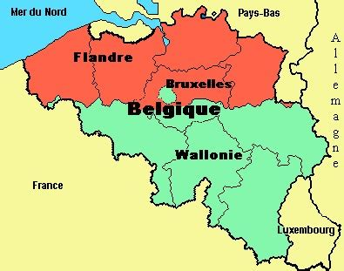
Belgium /Wallonia
Shared archiving of print journals - CPP "Conservation partagée des périodiques”
5 libraries in the French-speaking part
4 subject areas (so far)
Archiving responsability to the library with the most complete holdings – saves one copy for the group
De-centralised storage
Free inter-library loans for the shared journals

Slide 10
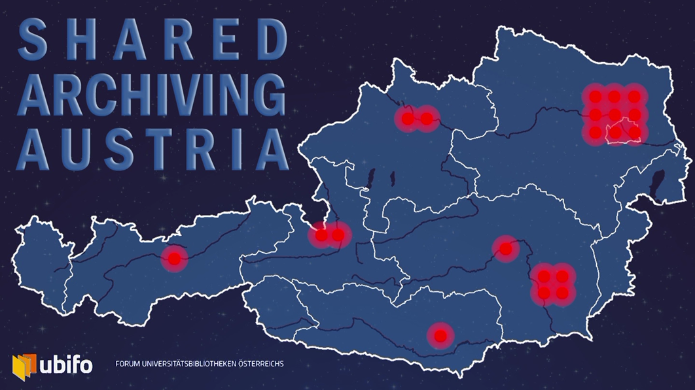
Shared Archiving Austria – The Beginnings
Prime motivator: to save space and thus money
2011: the Forum of the Austrian University Libraries (ubifo) decides to initiate joint and countrywide archiving services
No central funding for storage buildings or human resources

Slide 11
Shared Archiving Austria - Characteristics
Academic journals available electronically will only be archived once
Print duplicates may be weeded
Most complete print run assigned to one of the member libraries, responsible for:
the permanent archival and proper storage of the print run
the complete and regularly updated documentation in a central catalogue
delivering articles to participating libraries upon request
informing partners if holdings are discarded
No liability in the event of force majeure

Slide 12
Shared Archiving Austria – Legal Framework
Framework Agreement signed by all rectorates (22), defining:
shared goals and commitments
the duties of the archiving library
the university management’s consent to both handing over holdings to other institutions (acting as supplying library) and to receiving holdings from others (as archiving library)
Addenda to the Framework agreement are signed by the subset of libraries participating in the archival of a given product (collections, individual publishers, etc.), to document:
holdings
archiving libraries
supplying libraries

Slide 13
Shared Archiving Austria - Facilitators
initiators and political responsibility
joint acquisition via consortia as foundation of similar access rights
maintenance of union catalogue, metadata expertise and interface management

Slide 14
Shared Archiving Austria – pros and cons
Savings example: Pilot Project: ACS publications
860 running meters saved = 116 m² floor space
Monthly rent = 13.91 €/m²
Annual savings = 116 x 13.91 x 12 = € 19,363 !
Dependence
on voluntary engagement
Quality Metadata: massive improvements made to cataloguing records and discoverability: metadata checked and completed for all archived journals
Quality
metadata
Interdependence: at the same time, progress depends on voluntary engagement of involved partners

Slide 15
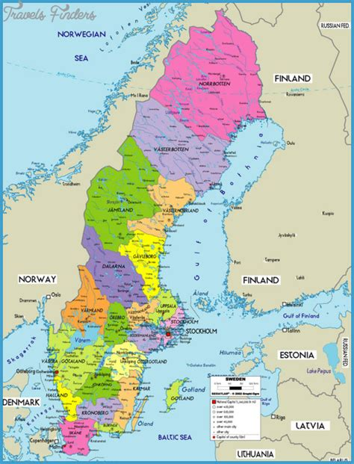
Swedish shared print initiative
National collaboration
Research libraries
Special libraries
The National Library
Began in 2021
Steering committee and working group

Slide 16
Letter of intent
“With this letter of intent, libraries want to clarify their shared responsibility and the need for national coordination to ensure the long-term access to print material.”
“for the benefit of researchers, today and tomorrow, and in support of the democratic society”

Slide 17
National collection analysis
Questions
How many records have few or only one holding?
How many records have many holdings?
How are collections distributed between library types? (national/research/special libraries)
How is the regional distribution?
Data from the national catalog Libris
Many metadata problems
Large un-cataloged library collections
Different cataloging rules over time and different local practice

Slide 18
Shared archiving project for technichal journals
Started in 2005
Six technichal libraries , almost 4000 journals
Note in the national catalog (MARC 599)
- No continuos collaboration
- No completing of journal holdings or effective coordinated weeding
case – what worked well and not so well?
possible model for more subject area collaborations

Slide 19
Next steps
Shared ambition and strategy – what is sufficient supply for the future?
Scenarios for shared archiving and coordinated weeding
Retention committments in the catalog
Forms for collaboration
International networking and collaboration

Slide 20
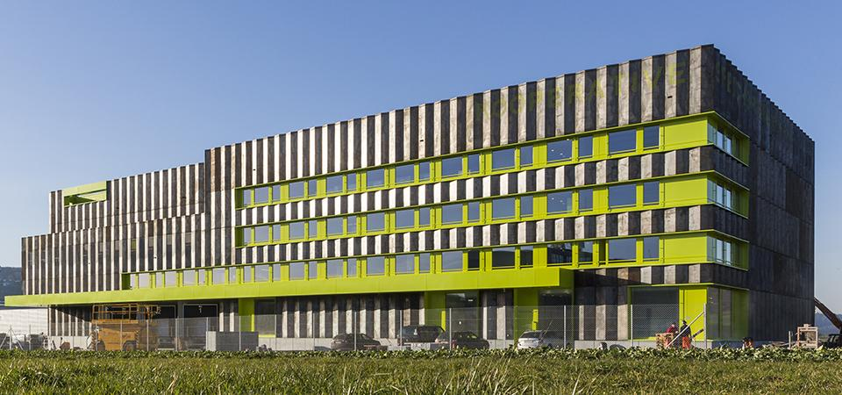
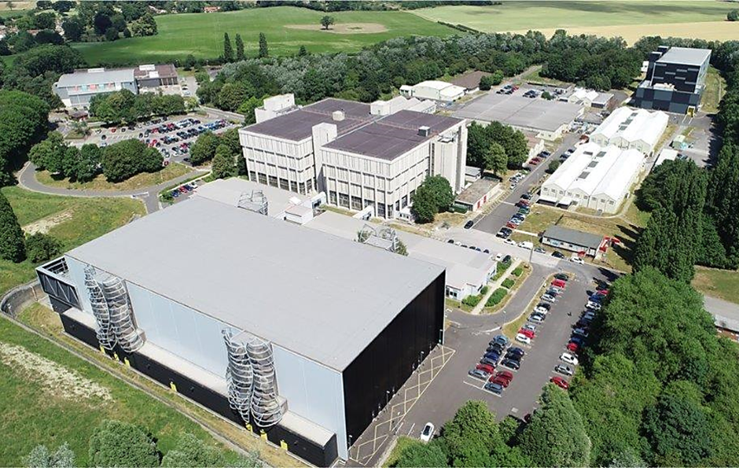
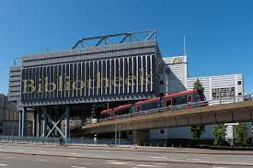
Epico collaboration on high density storage
Cooperative Storage Library Switzerland, Büron
The British Library, Boston Spa (Leeds)
Bibliothèque nationale de France, Paris
KB, Nationale Bibliotheek, The Hague

Slide 21
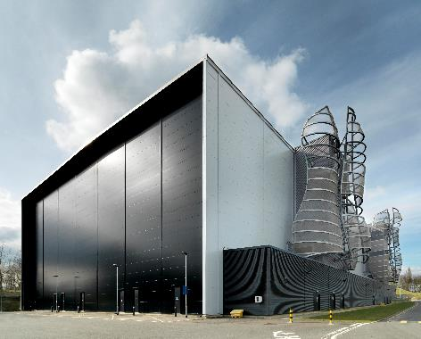
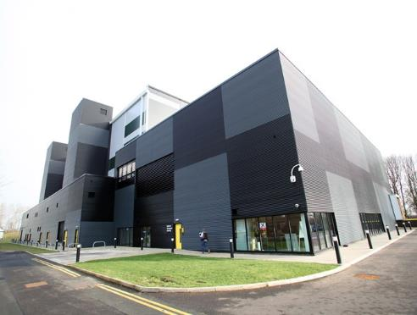
New Generation Storage and Preservation
High density, low oxygen, automated and lightweight (airtight) construction
2010
2015
Additional Storage Building (ASB) opens with the equivalent of 262 linear km of shelf space.
National Newspaper Building with equivalent of 33 kilometres of newspapers (60m issues / 750m pages).

Slide 22
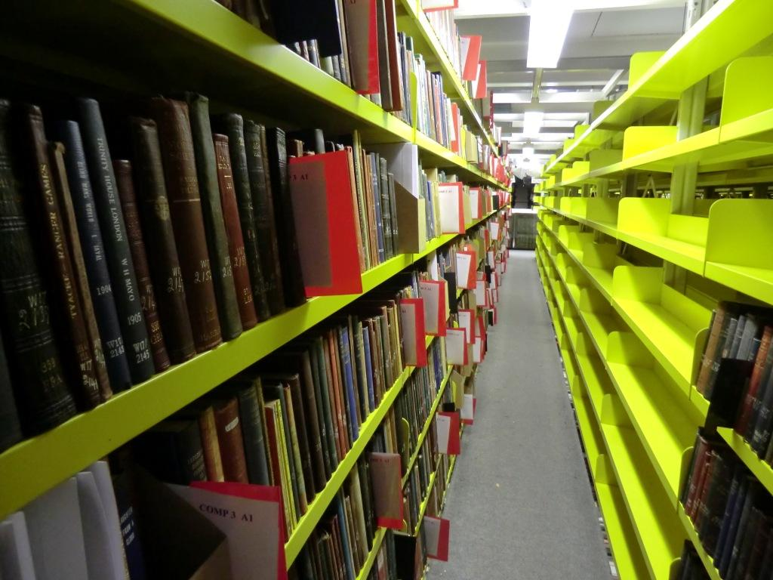
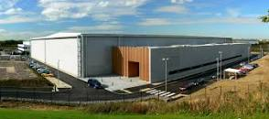
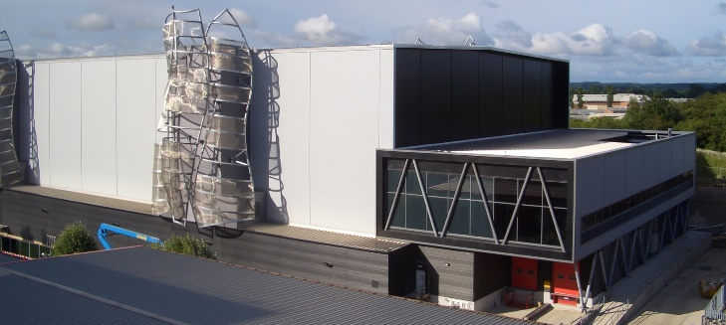
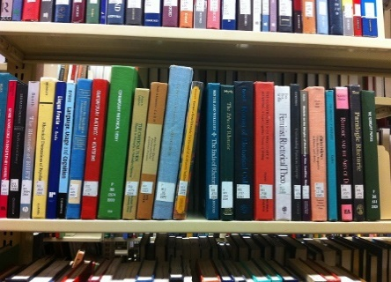
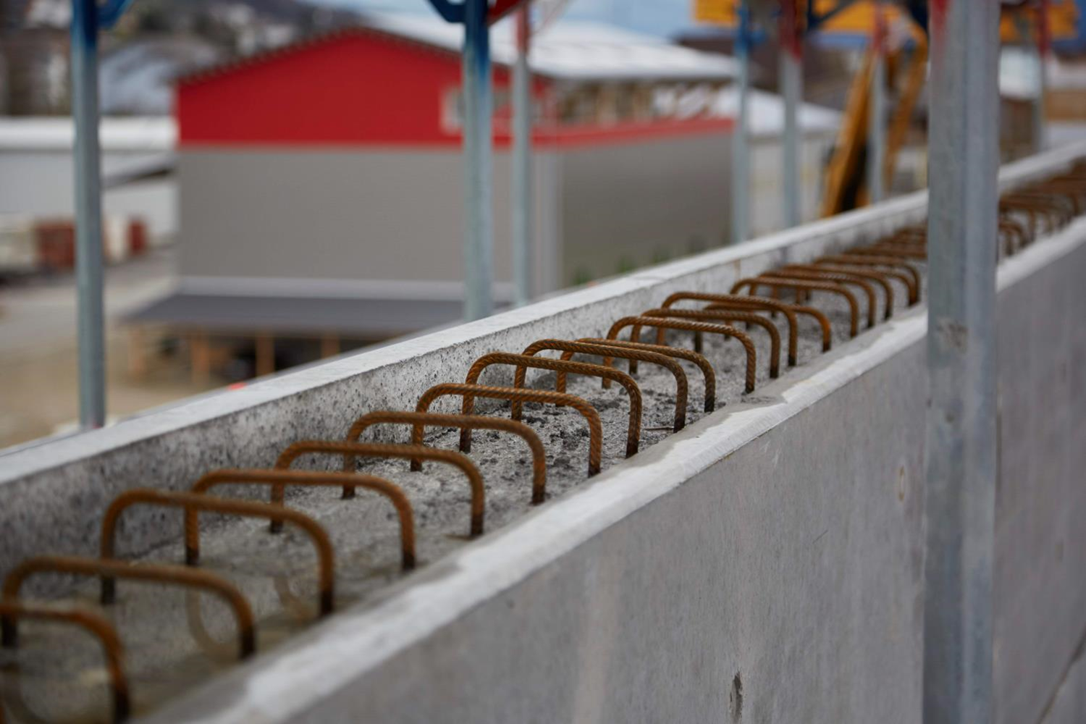
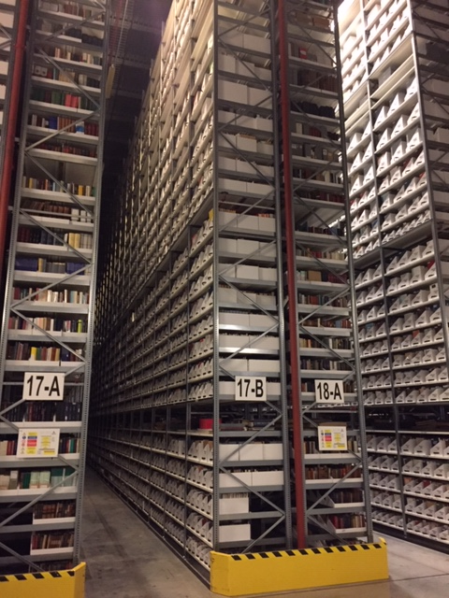
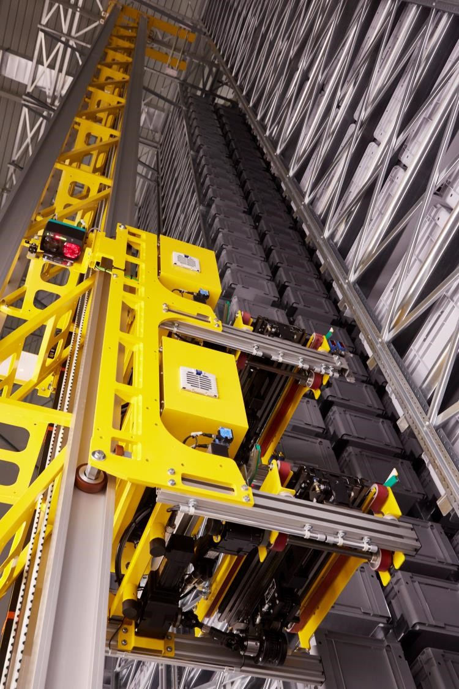
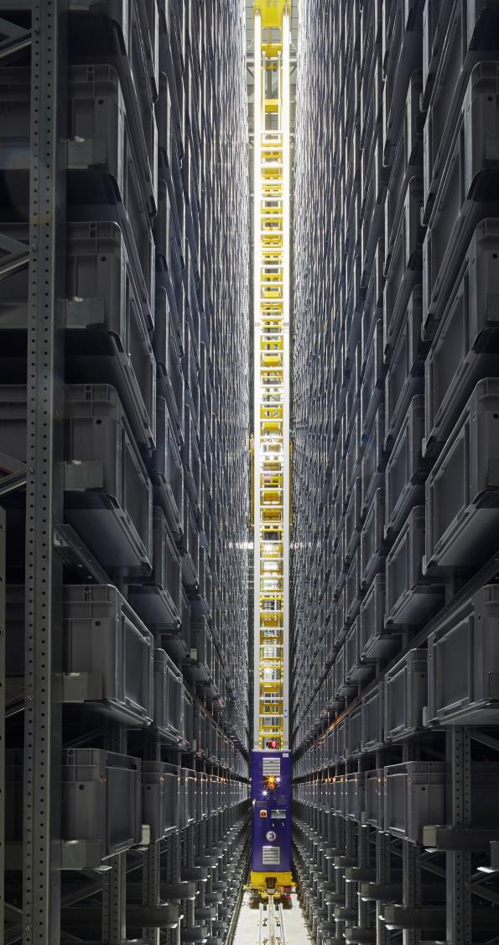
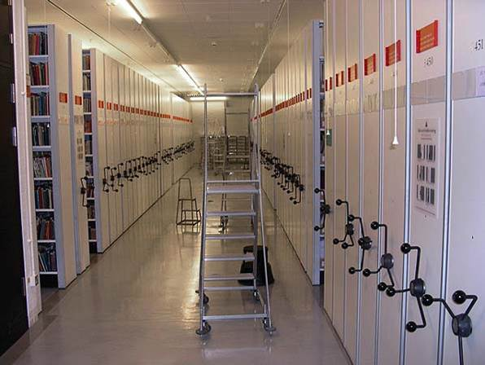
Different Print Storage Methods
Open Shelf
Harvard (Oxford) Model
The British Library Model
The Buron Model
Roller Shelving

Slide 23
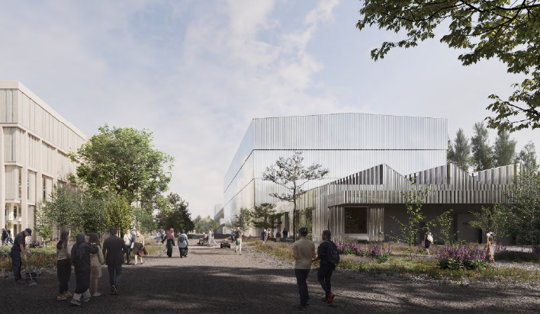
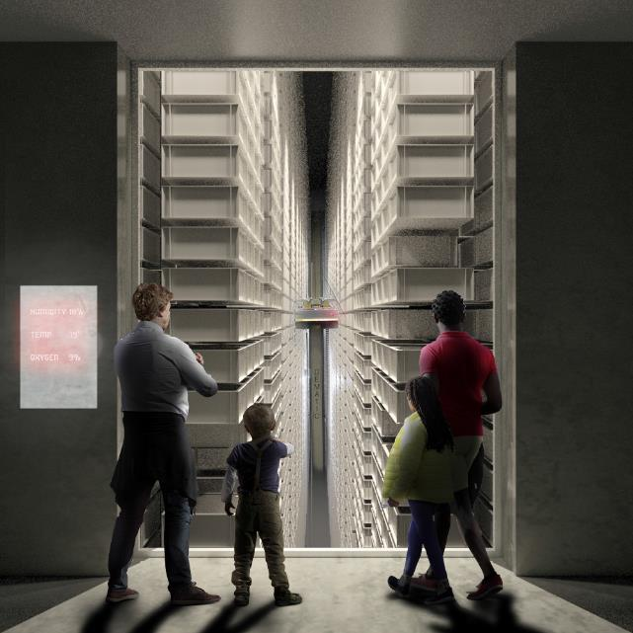
The British Library New Repository
225 lin km – lightweight construction, automated retrieval, low oxygen and passive
Visitor experience
New Storage Building
225km automated storage
Logistics Hub
Urquhart Building
Upper floors – storage
Lower floors – staff and public spaces

Slide 24
Print Storage considerations
Storage Option | Judgement factors
 | Capital Expenditure | Operating Cost (Staff) | Fire Suppression | Demand Throughput | Environment (collections) | Environment (C02 footprint)
High Density Automated (lightweight)
High Density Automated (concrete)
Harvard / Oxford Model
Roller Shelving
Traditional Open Stacks
Factors to consider before deciding the best type of print storage building to suit the organisations circumstance. Consider from capital and operating cost point of view.
Creating a storage strategy is a good place to start.
Consider too according to the physical location - seasonal temperature and weather systems for that region.
Also need to consider how link to requesting systems – local or enterprise Warehouse Management System (WMS)?
Ideally every ‘item’ recorded on WMS – consider cost and time if collections are not catalogued. Can a compromise be found (1st and last in the box)?
Consider cleaning items before moving into the new store and potentially conservation / preservation work. Consider cleanliness spec for the racking once installed.
Customer demand over time (as the store fills up) – capacity predicated on – number of workstations, cycles/hour, working times, box sizes.
Consider media type and suitability e.g. magnetic.

Slide 25
Future collaboration areas for Epico
Networking and knowledge exchange
Sharing best practices
High density facilities
Metadata and retention commitments
Document delivery and resource sharing
Increased collaboration
Comparing archived material in the different countries (MARC 583)
International collaboration

Slide 26
Thank you! → epico-libraries.eu Contact: Andy Appleyard, British Library andy.appleyard@bl.uk Karin Byström, Uppsala University Library karin.bystrom@ub.uu.se Brigitte Krompf, Vienna University Library brigitte.kromp@univie.ac.at

