Slide 1
Keep@Downsview
Western, McMaster, Toronto, Queen’s, uOttawa
www.downsviewkeep.org
Caitlin Tillman
University of Toronto

Slide 2
Who is Keep@Downsview?
Five university libraries in Ontario: Western, McMaster, Toronto, Queen’s, Ottawa
Discussions began in Feb. 2014; MOA signed in May 2017
What do we think we add to the print preservation conversation?
Humanities and Social Science titles
Through OCUL and the Scholar’s Portal TDR we combine a well developed digital preservation plan with a print preservation plan
Room to expand

Slide 3
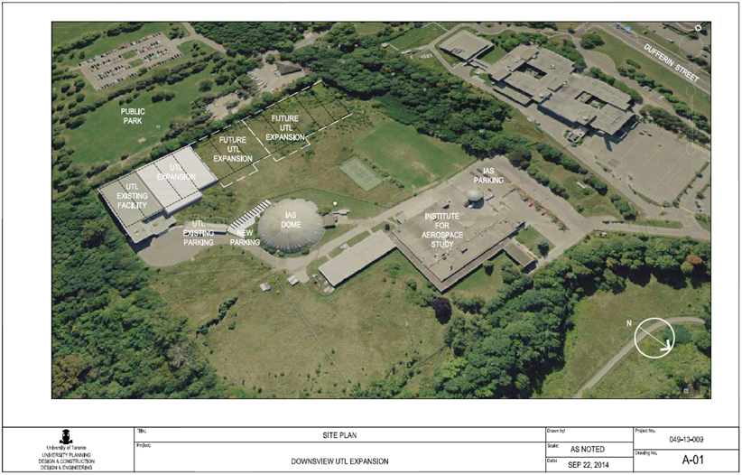

Slide 4
What’s New?
Tested ingest and delivery with all partners
Investigating middleware
Expressions of interest from other institutions
Some members participating in shared catalogue project
Some members joined HathiTrust
Conclusions from annual meeting (June 15th)
Prioritize service improvements (better delivery infrastructure)
Prioritize shared collecting programs

Slide 5
What’s Still To Do & What’s Next?
Add holdings to PAPR
Visit shared collection projects
Start preparations to expand the facility
Determine how best to report retention commitments
This could be a national effort

Slide 6
Shared Print Archive Network
Doug Brigham | COPPUL SPAN Coordinator

Slide 7
What is COPPUL?
Formed in 1991
Consortium of 22 university libraries in Western Canada
Plus 15 affiliated members across the country
Over 408,000 FTE
Shared print, resource sharing, e-resource licensing and digital preservation

Slide 8
COPPUL SPAN
Shared Print Archive Network
Formed in 2012
20 institutions participate
Most phases have focused on serials
We have also done one monographs project

Slide 9
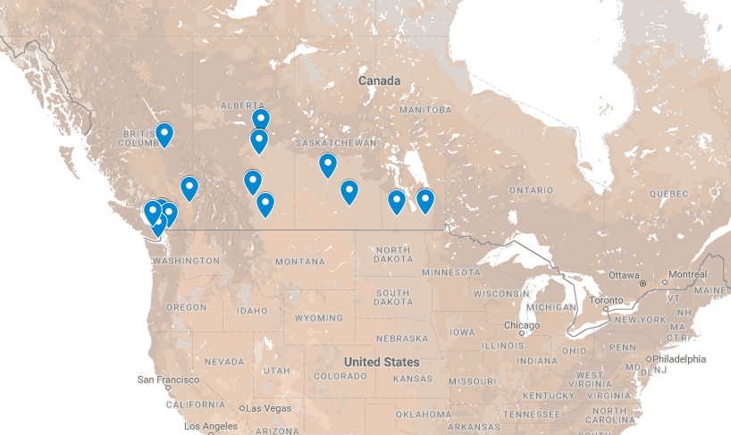

Slide 10
Goals
Provide access to shared print archives
Create opportunities for the reallocation of library space
Preserve the print record in a cost-effective manner

Slide 11
Phase One (2012 – 2013)
Widely held, low-risk print journals
Digital equivalents with post-cancellation access rights
1,630 titles retained for 10 years
10 Archive Holders

Slide 12
Phase Two (2013 – 2014)
Additional journals, including some Canadian materials
Some without post-cancellation access rights
1,155 titles retained through 2023 or 2038
9 Archive Holders

Slide 13
Phase Three (2014 – 2015)
Earlier and later titles from Phase Two
High-risk print serials
Some Statistics Canada publications with digital equivalents
379 titles retained through 2039

Slide 14
Phase Four (2016 – )
Statistics Canada monograph and serial publications
Approximately 9,000 publications in total
Retention through 2028

Slide 15
Monographs Project #1 (2015 – 2018)
10 participating institutions
Over 1,000,000 titles retained
Particular strengths: Canadian titles, less widely-held titles
Materials retained for 15 years with review ever 5 years
MOU nearly complete

Slide 16
What’s Next for SPAN?
Complete Phase Four
Develop Phase Five: Rare Canadian Serials
Connect with other shared print initiatives in North America

