Slide 1
Rosemont Shared Print Alliance Print Archive Network meeting June 25, 2021

Slide 2
Last Known Copy Initiative
Rosemont Alliance formed in 2015
Notes:
Founded 2015. Now six partners with CRL in 2020.

Slide 3
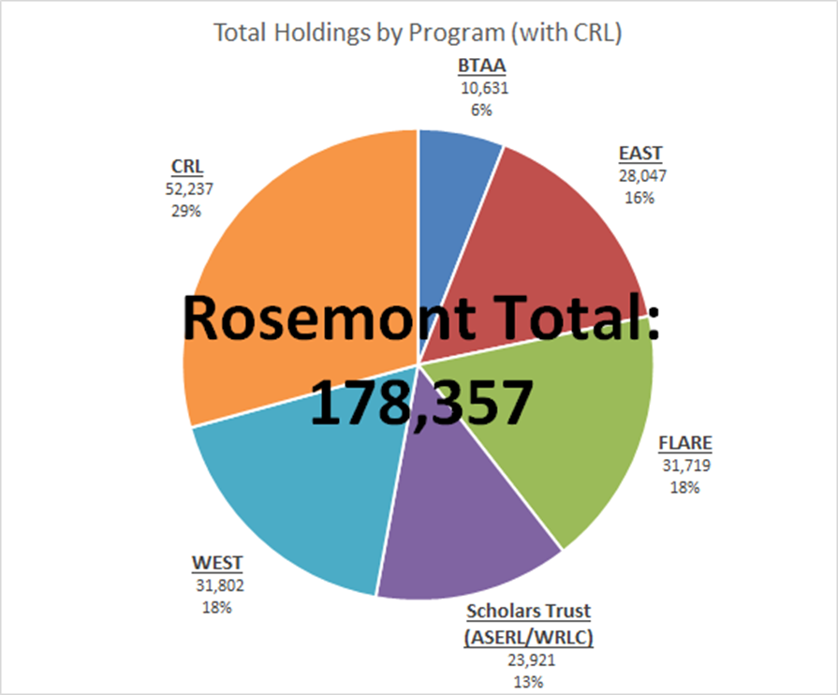
Last Known Copy Initiative
December 2020
Notes:
Set aspirational goal of 100,000 in five years. We did it!

Slide 4
Last Known Copy Initiative
Rosemont Alliance Vision: “To ensure the preservation and availability of print journal literature.”
Last Copy Principles and Guidelines - 2020
Participants in the Rosemont Shared Print Alliance seek to ensure that last or scarcely held print journal titles (i.e., titles with three copies or fewer held by libraries in the Rosemont Alliance) are preserved and accessible for future scholars.
Notes:
Most of us began shared print as a way of reducing space consumed by journals. Now shifting to ensure last copies are not discarded.

Slide 5
Last Known Copy Initiative
Last Known Copy Working Group
Matthew Revitt, EAST
Tabatha Pursley, FLARE
Mark Jacobs, Scholars Trust
Alison Wohlers, WEST
Mary Miller, University of Minnesota (BTAA)
Steve Smith, UMass Boston (EAST)
Jay Forrest, Georgia Tech (Scholars Trust)
Jesse Silva, UC Berkeley (WEST)
Notes:
Set up working group. Soon realized that we need collections expertise.

Slide 6
Last Known Copy Initiative
Data from CRL and WEST print journal collection analyses for BTAA, EAST, Scholars Trust (ASERL), WEST
Excludes FLARE and Scholars Trust (WRLC)
Over 300,000 titles are held by one library in the Rosemont Alliance
61,538 titles for which only one copy was reported in OCLC (U.S. holdings)
Data ingested into Tableau
Notes:
Data from CRL and WEST. Initial set had over 300k. Reduced to 61,538 likely candidates.

Slide 7
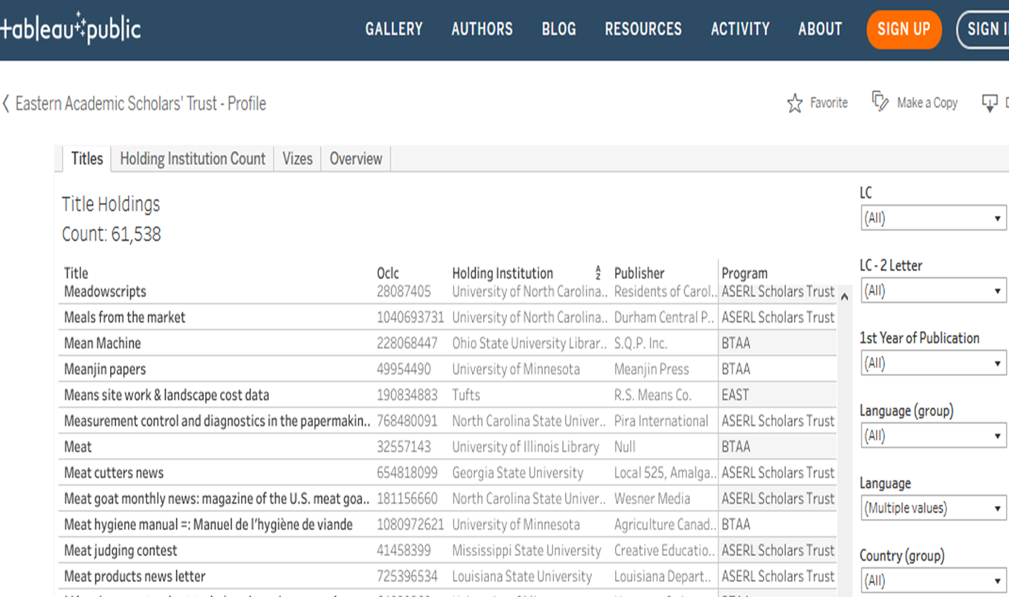
Last Known Copy Initiative - Tableau
Notes:
Explore data by various facets.

Slide 8
Last Known Copy Initiative - Program Distribution
Libraries with last known copies ranged from holding one to over 10,000 titles
Notes:
Why are EAST and WEST low?

Slide 9
Last Known Copy Initiative - Pilot Project Plan
Identify small group of Rosemont Alliance libraries representing various programs and projected participation levels
Update records with retention commitment
Disclose commitment in PAPR & WorldCat
Pilot participants record information on factors that influenced their decision-making to develop best-practices
Notes:
Project plan

Slide 10
Last Known Copy Initiative
- Pilot Recommendations
All 61,538 last known copies should be considered for retention by the library holding the title.
“Completeness” should not be considered as these appear to be the only extant copies.
Libraries are encouraged to retain first and opt out of commitments later.
Notes:
LKC WG recommended approach to pilot

Slide 11
Last Known Copy Initiative
- Pilot Project
14 libraries selected
Tier 1: Four libraries (two each from BTAA & ASERL) with 1000+ titles
Tier 2: Six libraries (two each from BTAA, ASERL, EAST) with 100-999 titles
Tier 3: Four libraries (one each from BTAA, ASERL, EAST, WEST) with < 100 titles
Notes:
Pilot libraries

Slide 12
Last Known Copy Initiative
- Results
Libraries appreciated learning that they may have a last known journal copy
Pilot participants agreed that last known journal copies should be retained
Some libraries chose to retain titles now without further analysis or investigation
Notes:
Results

Slide 13
Last Known Copy Initiative
- Results
Data quality varied widely
Library staff know their collections and were able to identify titles that were not candidates
‘Errant’ titles included monographic series, brief records, cataloging errors, reprints, withdrawn titles, titles in Special Collections and one title widely held in Europe but not in the US
Actual last known copies ranged from all the titles identified for one library to about half the titles identified
Notes:
Data quality

Slide 14
Last Known Copy Initiative
- Next Steps
Executive Committee approved expanding the project to all Rosemont Alliance libraries
LKC Working Group will:
Provide a more specific description of what is in and out of scope for this project
Determine whether to include Special Collections
Investigate whether monographic series can be excluded from the dataset
Provide guidance on what information should be included about the retention commitment in the MARC 583 field
Notes:
Next steps

